Slide 1
Computer Graphics
Lecture 02
Fasih ur Rehman

Slide 2
Last Class
Introduction to Computer Graphics
Areas
Application

Slide 3
Today’s Agenda
Introduction to Computer Graphics (Cont.)
Visualization
Image Processing
Graphical User Interfaces (GUI)
Overview of Graphics Systems
Display Devices

Slide 4
Visualization
Representing data with graphical illustrations is called visualization
Producing graphical representations for scientific, engineering, and medical data sets and processes is generally referred to as scientific visualization
The business visualization is used in connection with data sets related to commerce, industry, and other nonscientific areas.

Slide 5
Image Processing
Image processing applies techniques to modify or interpret existing pictures
Improving pictures
Machine vision
i. e., machine perception of the visual information (robotics)

Slide 6
Graphical User Interfaces (GUI)
Graphical User Interfaces display menus and icons for fast selection of any processing required.
The user does not have to memorize commands or capabilities of a computer software. All options provided by the software can be explored just by navigating using mouse clicks.
A windows manager allows user to display multiple windows. Each window can process different data (weather graphical or text). A window can be made active just by clicking mouse on it.

Slide 7
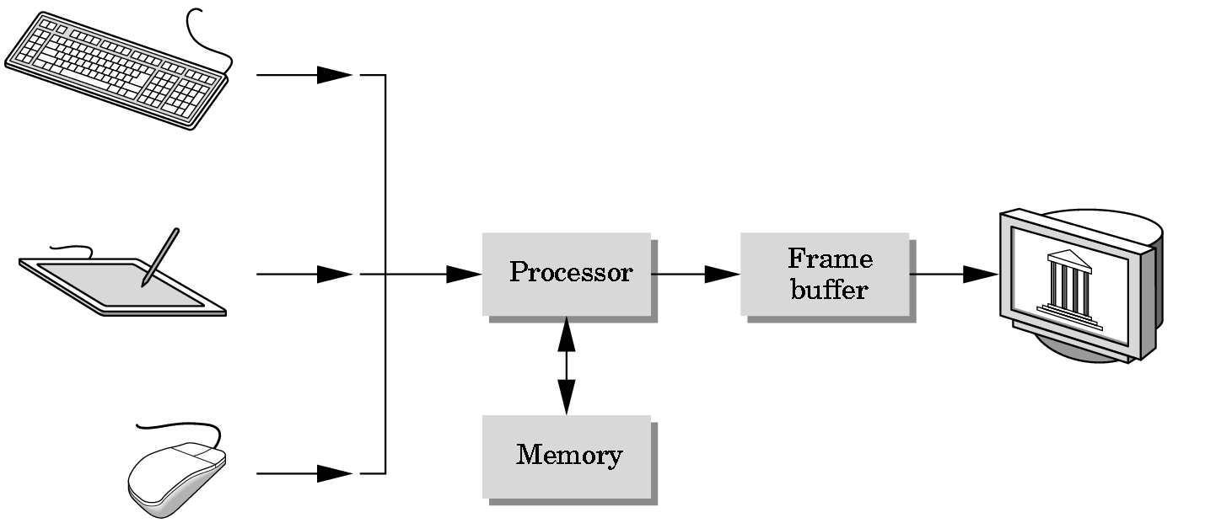
Graphics Systems

Slide 8
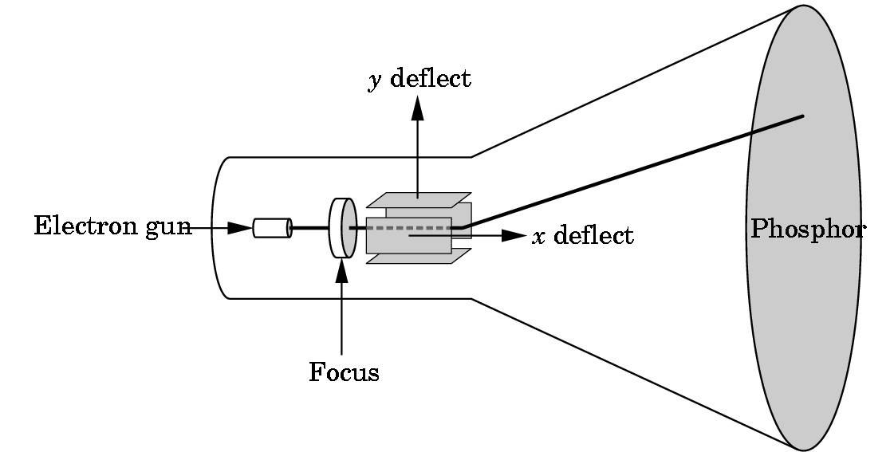
Output Devices
Cathode Ray Tube (CRT)
Calligraphic Mode
Raster Mode

Slide 9
Summary
Introduction to Computer Graphics (Cont.)
Visualization
Image Processing
Graphical User Interfaces (GUI)
Overview of Graphics Systems
Display Devices

Slide 10
References
Fundamentals of Computer Graphics Third Edition by Peter Shirley and Steve Marschner
Interactive Computer Graphics, A Top-down Approach with OpenGL (Third Edition) by Edward Angel.

