Slide 1
Computer Graphics
Lecture 03
Fasih ur Rehman

Slide 2
Last Class
Introduction to Computer Graphics (Cont.)
Visualization
Image Processing
Graphical User Interfaces (GUI)
Overview of Graphics Systems
Display Devices

Slide 3
Today’s Agenda
Overview of Graphics Systems
Display Devices
Colors and colored displays
Raster displays and frame buffer

Slide 4
CRT
Filament (acts as heating element, electrons emit from it in the form of beam)
Electrons move towards positive plate (Anode) focusing cylinder (Electric field)
Vertical and horizontal deflection plates have magnetic field in between them and control the position of the electron beam.
Beam strikes phosphor coating on front of tube producing illumination.
Stronger the beam, brighter is the screen
Longer the beam stays on a point brighter is the screen

Slide 5
Characteristics of CRT
It’s massive evacuated glass tube
Capabilities of CRT are measured by
Size of tube
Brightness of the phosphors vs. darkness of the tube
Speed of electron gun
Diameter of the beam
Pixels
Disadvantages are
Size of the tube
High power consumption
Flicker
Costly to refresh

Slide 6
Characteristics of CRT (Phosphors)
Florescence is Light emitted while the phosphor is being struck by electrons
Phosphorescence is Light emitted once the electron beam is removed
Persistence: The time from the removal of the excitation to the moment when phosphorescence has decayed to 10% of the initial light output

Slide 7
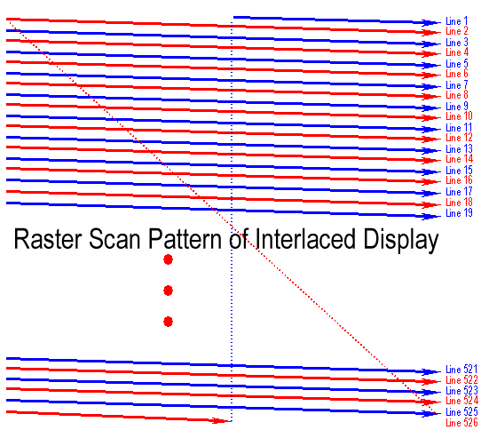
Interlacing
http://escience.anu.edu.au/lecture/cg/Display/raster.en.html

Slide 8
Video Formats
NTSC - 525x480, 30f/s, interlaced
PAL - 625x480, 25f/s, interlaced
VGA - 640x480, 60f/s, non-interlaced
SVGA – 800x600, 60f/s non-interlaced
RGB - 3 independent video signals and synchronization signal, vary in resolution and refresh rate
Time-multiplexed color - R,G,B one after another on a single signal, vary in resolution and refresh rate

Slide 9
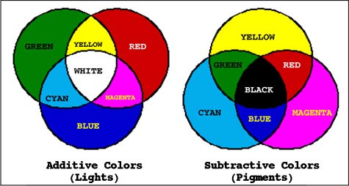
Colors
Additive Colors
Red Green and Blue (sometimes White)
Subtractive Colors
Yellow Cyan Magenta and Black
http://www.d.umn.edu/~mharvey/th1501color.html

Slide 10
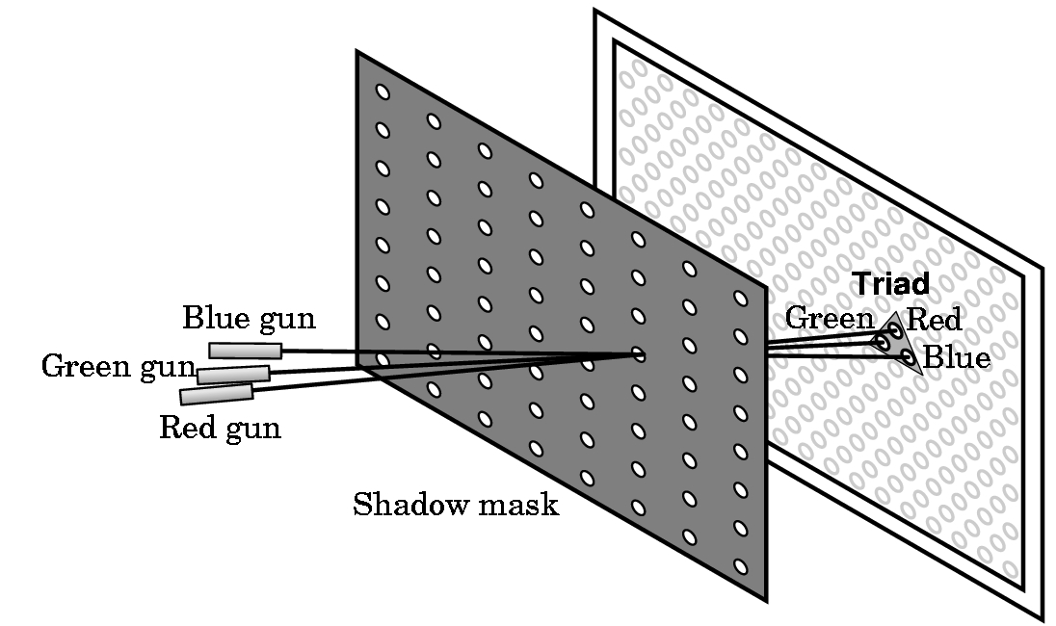
Color Display

Slide 11
Raster Displays
Use sequential access
Raster Displays (early 70s)
like television, scan all pixels in regular pattern
use frame buffer (video RAM) to eliminate sync problems
RAM
¼ MB (256 KB) cost $2 million in 1971

Slide 12
Frame Buffer
Raster images require frame buffers
Frame buffer - A block of memory, dedicated to graphics output, that holds the contents of what will be displayed.
If we want a frame buffer of 640 pixels by 480 pixels, we should allocate:
frame buffer = 640*480 bits
How many colors does 1 bit get you?
How many colors do 8 bits get you?
Monochrome systems use this (green/gray scale)
What bit depth would you want for your frame buffer?

Slide 13
Frame Buffer
No. of bytes in a frame buffer = 640*480*3
This way we can calculate memory of graphics card

Slide 14
Summary
Overview of Graphics Systems
Display Devices
Colors and colored displays
Raster displays and frame buffer

Slide 15
References
Fundamentals of Computer Graphics Third Edition by Peter Shirley and Steve Marschner
Interactive Computer Graphics, A Top-down Approach with OpenGL (Third Edition) by Edward Angel.

