Slide 1
Computer Graphics
Lecture 04
Fasih ur Rehman

Slide 2
Last Class
Overview of Graphics Systems
Display Devices
Colors and colored displays
Raster displays and frame buffer

Slide 3
Today’s Agenda
Overview of Graphic Systems
Vector Displays
Movie Standards
LCD’s

Slide 4
Some Definitions
A rectangular array of points or dots is called Raster.
A Pixel is picture element of raster.
A row of pixels is known as Scan Line.
Picture elements stored in memory are called Frame Buffer.
Pixel
Scan Line

Slide 5
Resolution
The Resolution is defined as the number of dot per inch or centimeter that can be plotted horizontally & vertically.
Higher the resolution, smaller the spot size.
Resolution is related with quality of the graphics system.
Higher the resolution, better the graphics system
High quality resolution is 1280x1024
The intensity distribution of spots on the screen has Gaussian distribution.
Adjacent points will appear distinct as long as their separation is greater than the diameter at which each spot has intensity of about 60% of that at the center of the spot.

Slide 6
Aspect Ratio
The Aspect Ratio is the ratio between number of scan lines in a rater and the number of pixels in a scan line necessary to produce equal length lines in both directions on the screen.
For example 1280 x 768 has an aspect ratio of 5:3.

Slide 7
Vector Display
The electron beam illuminates only the parts of the screen where a picture is to be drawn.
Works like plotters i.e. draws a one picture line at a time
Used in line drawing and wireframe displays
Picture definition is stored as a set of line-drawing commands stored in a refresh display file.
Number of lines derive Refresh rate and refresh cycle is between 30 and 60 per second
Can draw 100,000 short lines at this refresh rate

Slide 8
Vector Displays
Advantages
Resolution is higher than raster
Line drawings are smooth
Vector displays are not suitable for realistic shaded scens

Slide 9
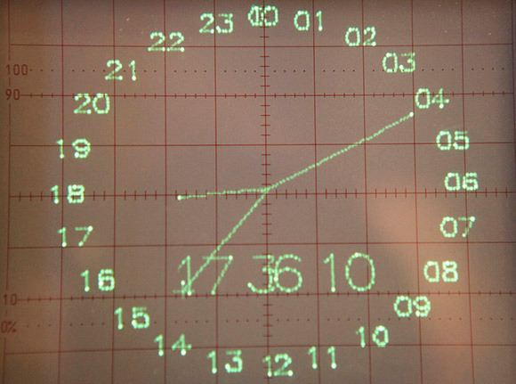
Vector Display
http://hackaday.com/2012/12/05/vector-thingy/

Slide 10
Movie Theaters
Films play at 24 fps by U.S. film projectors
Projectors have a shutter to block light during frame advance
To reduce flicker, shutter opens twice for each frame – resulting in 48 fps flashing
48 fps is perceptually acceptable
European film projectors play film at 25 fps
American films are played ‘as is’ in Europe, resulting in everything moving 4% faster
Faster movements and increased audio pitch are considered perceptually acceptable

Slide 11
Movie at Home
Film to DVD transfer
Problem: 24 film fps must be converted to
NTSC U.S. television interlaced 29.97 fps 768x494
PAL Europe television 25 fps 752x582
Use 3:2 Pulldown
First frame of movie is broken into first three fields (odd, even, odd)
Next frame of movie is broken into next two fields (even, odd)
Next frame of movie is broken into next three fields (even, odd, even)…

Slide 12
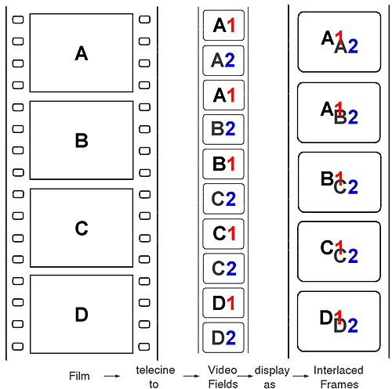
Movie at Home

Slide 13
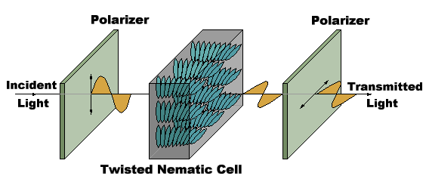
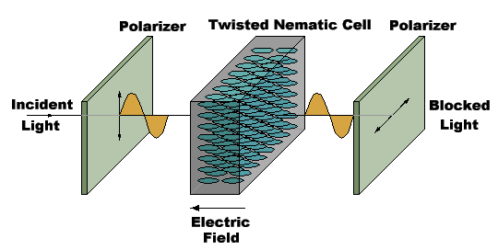
Liquid Crystal Display
Liquid crystal displays use small flat chips which change their transparency properties when a voltage is applied.
LCD elements are arranged in an n x m array call the LCD matrix
Level of voltage controls gray levels.
LCDs elements do not emit light, use backlights behind the LCD matrix

Slide 14
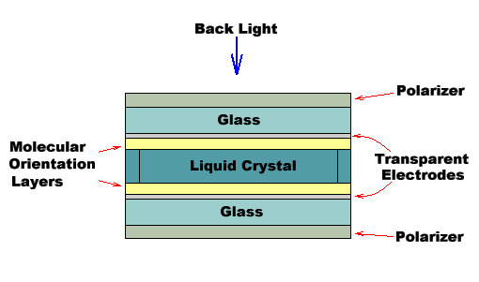
LCD
Color is obtained by placing filters in front of each LCD element
Usually black space between pixels to separate the filters.
Because of the physical nature of the LCD matrix, it is difficult to make the individual LCD pixels very small.
Image quality dependent on viewing angle.

Slide 15
Advantages of LCD
Flat
Lightweight
Low power consumption

Slide 16
Summary
Overview of Graphics Systems
Movie Standards
LCD’s

Slide 17
References
Fundamentals of Computer Graphics Third Edition by Peter Shirley and Steve Marschner
Interactive Computer Graphics, A Top-down Approach with OpenGL (Third Edition) by Edward Angel.

