Slide 1
Computer Graphics
Lecture 05
Fasih ur Rehman

Slide 2
Last Class
Overview of Graphic Systems
Vector Displays
Movie Standards
LCD’s

Slide 3
Today’s Agenda
Overview of Graphic Systems
LED Display
Plasma TV
Hardcopy Devices
Input Devices
Human Visual System
Ray Tracing

Slide 4
LED Display
LED actually stands for Light Emitting Diode.
LED displays use the same technology for display but it uses LED’s for back light while LCD displays generally use Cold Cathode Fluorescent technology

Slide 5
Comparison (Wikipedia)
Produce images with greater dynamic contrast
Can be extremely slim (some screens are less than 0.5 inch (0.92 cm) thin in edge-lit panels
Offer a wider color gamut (when RGB-LED backlighting is used)
Produce less environmental pollution on disposal
Are more expensive
Have longer lifespans and are more reliable
Have (typically) 20- to 30-percent lower power consumption
Run significantly cooler
Allow a wider dimming range
Are significantly lighter

Slide 6
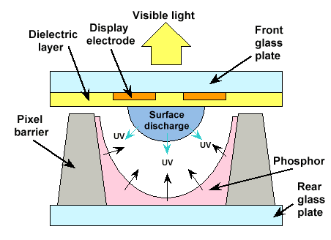
Plasma Panel
Plasma display panels
Similar in principle to fluorescent light tubes
Small gas-filled capsules are excited by electric field, emits UV light
UV excites phosphor
Phosphor relaxes, emits some other color

Slide 7
Plasma Panel (Pros and cons)
Plasma panels are fairly bright and offer large viewing angle.
Good for Large format display
Plasma panels, however, are expansive, have large pixel size (~1mm as compared to ~0.2mm). Phosphor depletes with time and are less bright than CRT

Slide 8
Hardcopy Devices
Inkjet Printer
Laser Printer
Film Recorder
Electrostatic Printer and
Pen Plotter

Slide 9
Input Devices
Locator Devices:
to indicate a position and/or orientation
to select a displayed entity
Tablet, Mouse, Trackball, Joystick, Touch Panel, Light Pen
Keyboard devices:
to input a character string
Alphanumeric keyboard (coded - get single ASCII character)
Valuator Devices:
to input a single value in the space of real numbers
Rotary dials (Bounded or Unbounded), Linear sliders
Choice Devices:
to select from a set of possible actions or choices
Function keys

Slide 10
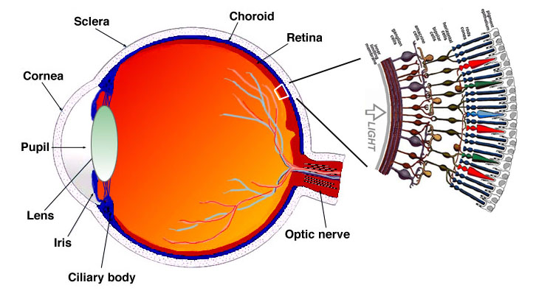
Human Visual System (HVS)

Slide 11
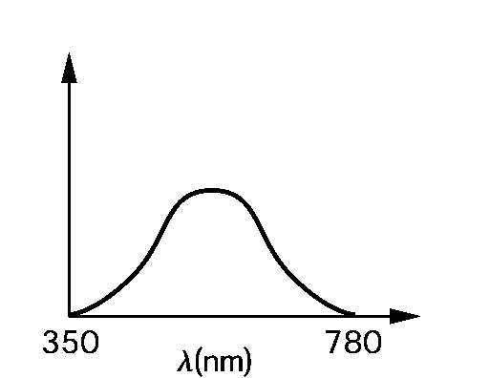
Human Visual System (HVS)
Rods and cones are energized by electromagnetic energy in the range 350-780 nm
Sizes of rods and cones determines the resolution of HVS – our visual acuity
The sensors in the human eye do not react uniformly to the light energy at different wavelengths
Different HVS response for single frequency light – red/green/blue
Relative brightness response at different frequencies
The shown curve is known as Commision Internationale de L’Eclairage (CIE) standard
The curve matches the sensitivity of the monochromatic sensors used in black & white films and video camera
Most sensitive to GREEN colors

Slide 12
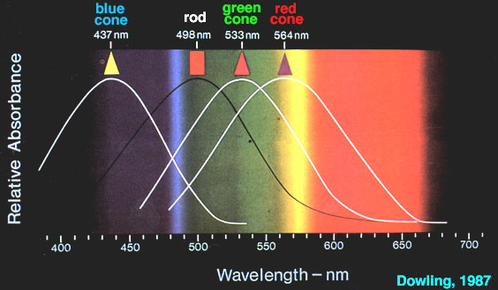
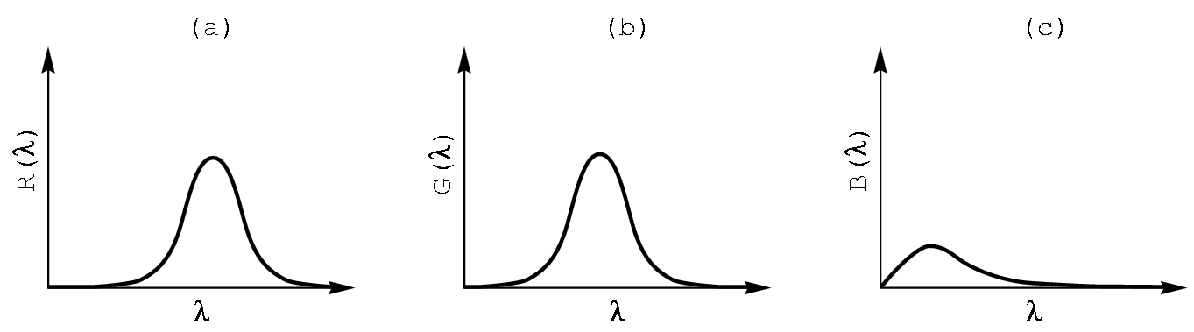
Human Visual System (HVS)
HVS has three types of cones
Blue
Green
Yellow

Slide 13
Summary
Overview of Graphic Systems
LED Display
Plasma TV
Hardcopy Devices
Input Devices
Human Visual System

Slide 14
References
Fundamentals of Computer Graphics Third Edition by Peter Shirley and Steve Marschner
Interactive Computer Graphics, A Top-down Approach with OpenGL (Third Edition) by Edward Angel.

