Slide 1
Computer Graphics
Lecture 06
Fasih ur Rehman

Slide 2
Last Class
Overview of Graphic Systems
LED Display
Plasma TV
Hardcopy Devices
Input Devices
Human Visual System

Slide 3
Today’s Agenda
Human Visual System
Illusions
Ray Tracing

Slide 4
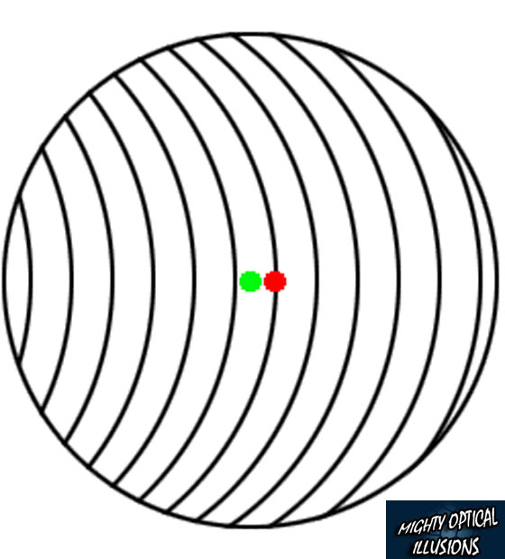
Illusions

Slide 5
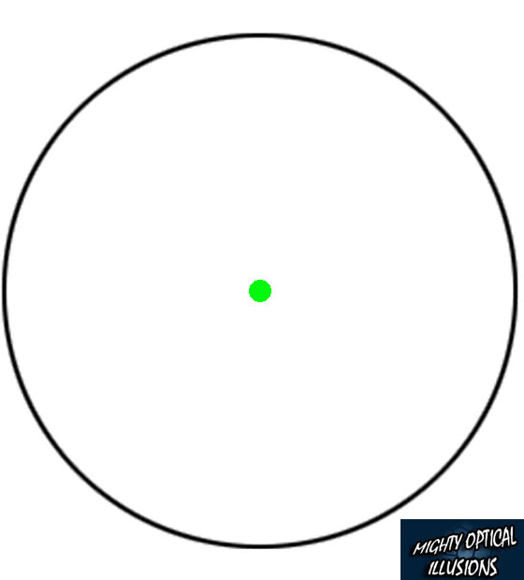
Illusions

Slide 6
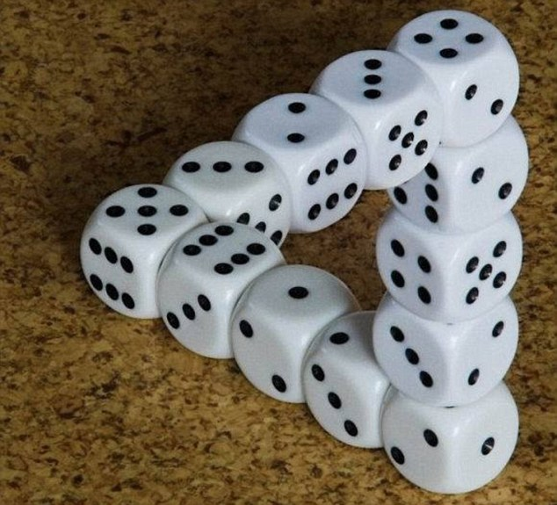
Illusions

Slide 7
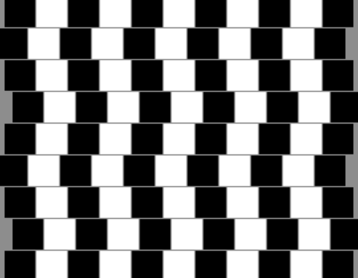
Illusions

Slide 8
Illusions

Slide 9
Pixel Formats
1-bit gray scale—text and other images where intermediate grays are not desired (high resolution required)
8-bit RGB fixed-range color (24 bits total per pixel)—web and email applications, consumer photographs
8- or 10-bit fixed-range RGB (24–30 bits/pixel)—digital interfaces to computer displays;
12- to 14-bit fixed-range RGB (36–42 bits/pixel)—raw camera images for professional photography
16-bit fixed-range RGB (48 bits/pixel)—professional photography and printing, intermediate format for image processing of fixed-range images;
16-bit fixed-range gray scale (16 bits/pixel)—radiology and medical imaging;
16-bit “half-precision” floating-point RGB—HDR images; intermediate format for real-time rendering;
32-bit floating-point RGB—general-purpose intermediate format for software rendering and processing of HDR images.

Slide 10
Image Storage
RGB images result in almost 3MB for 1 million pixel image
To reduce storage space, various compression techniques are employed and used in image compression.
Generally compression is categorized as
Lossless Compression
Lossy Compression

Slide 11
Storage Formats
jpeg. This lossy format compresses image blocks based on thresholds in the human visual system. This format works well for natural images.
tiff. This format is most commonly used to hold binary images or losslessly compressed 8- or 16-bit RGB although many other options exist.
ppm. (Portable Pixel Map)This very simple lossless, uncompressed format is most often used for 8-bit RGB images although many options exist.
png. (Portable Network Graphics) This is a set of lossless formats with a good set of open source management tools.

Slide 12
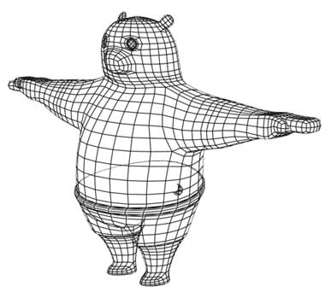
Rendering

Slide 13
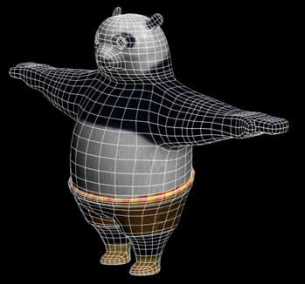
Rendering

Slide 14
Rendering
Most basic task in graphics.
Two types
Object Oder Rendering: each object is taken into account and for each object all the pixels that it influences are found and updated.
Image Oder Rendering: each pixel is considered in turn, and for each pixel all the objects that influence it are found and the pixel value is computed.

Slide 15
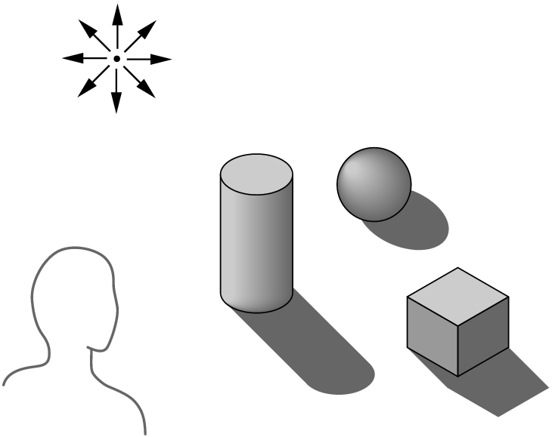
Ray Tracing
Building an imaging model by following light from a source is known as Ray Tracing
A Ray is a semi infinite line that emerges from s source and continues to infinity in one direction
Part of ray contributes
in making image.
Surfaces
Diffusing
Reflecting
Refracting

Slide 16
Summary
Human Visual System
Illusions
Ray Tracing

Slide 17
References
Fundamentals of Computer Graphics Third Edition by Peter Shirley and Steve Marschner
Interactive Computer Graphics, A Top-down Approach with OpenGL (Third Edition) by Edward Angel.

