Slide 1
Computer Graphics
Lecture 07
Fasih ur Rehman

Slide 2
Last Class
Human Visual System
Illusions
Ray Tracing

Slide 3
Today’s Agenda
Human Visual System
Illusions
Ray Tracing

Slide 4
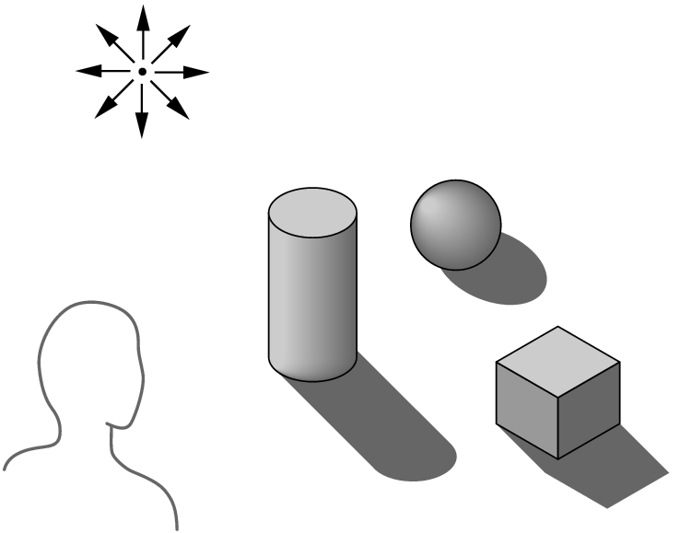
Ray Tracing
Building an imaging model by following light from a source is known as Ray Tracing
A Ray is a semi infinite line that emerges from s source and continues to infinity in one direction
Part of ray contributes
in making image.
Surfaces
Diffusing
Reflecting
Refracting

Slide 5
Ray Tracing
For each pixel intensity must be computed
Contributions of all rays must be taken into account
A ray when intercepted by a surface splits into two rays
Absorbed
Reflected

Slide 6
Ray Intersections
Tracing a single ray requires determining if that ray intersects any one of potentially millions of primitives
This is the basic problem of ray intersection
Many algorithms exist to make this not only feasible, but remarkably efficient
Tracing one ray is a complex problem and requires serious work to make it run at an acceptable speed
Of course, the big problem is the fact that one needs to trace lots of rays to generate a high quality image

Slide 7
Lighting
Once we have the key intersection information (position, normal, color, texture coordinates, etc.) we can apply any lighting model we want
This can include procedural shaders, lighting computations, texture lookups, texture combining, bump mapping, and more
Many of the most interesting forms of lighting involve spawning off additional rays and tracing them recursively
The result of the lighting equation is a color, which is used to color the pixel

Slide 8
Ray Tracing Algorithm
Ray generation, which computes the origin and direction of each pixel’s viewing ray based on the camera geometry
Ray intersection, which finds the closest object intersecting the viewing ray
Shading, which computes the pixel color based on the results of ray intersection.

Slide 9
Ray Tracing Algorithm
Structure of a ray tracing algorithm is
For each pixel do
compute viewing ray
find first object hit by ray and its surface normal ‘n’
set pixel color to value computed from hit point, light, and n
End

Slide 10
Summary

Slide 11
References
Fundamentals of Computer Graphics Third Edition by Peter Shirley and Steve Marschner
Interactive Computer Graphics, A Top-down Approach with OpenGL (Third Edition) by Edward Angel.

