Slide 1
Computer Graphics
Lecture 08
Fasih ur Rehman

Slide 2
Last Class
Ray Tracing

Slide 3
Today’s Agenda
Viewing
Perspectives
Projections

Slide 4
Viewing
Process of seeing a scene is regarded as viewing.
The world or scenes are in three dimensions (3D)
A 3D Scene has to be “projected” in 2D
A Synthetic camera has to be modeled

Slide 5
Viewing Problems
Where a viewer is located (Location)
Viewing Plane
The visible portion of the scene
i. e., what can be seen (clipping)
Maintaining relation between objects
Parallel lines
Angles
Distances
Relation to the viewer

Slide 6
Scenes and Objects
Viewing a scene or object
Some viewing techniques perform better in viewing objects than a whole scene.
External Viewing: Viewing an object from outside e. g. a building
Internal Viewing: viewing from inside. e.g. internal of a building specially in games.

Slide 7
Projections
Project N-Dimensions Coordinates onto <N Dimensions Coordinates

Slide 8
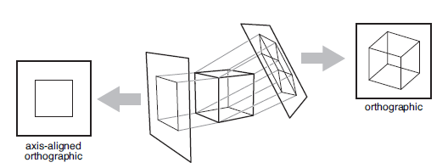
Projections
When projection lines are parallel and perpendicular to the image plane, the resulting views are called orthographic.

Slide 9
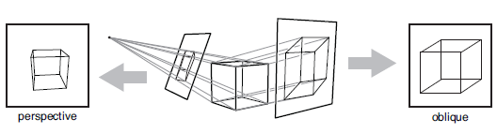
Projections
The image plane is perpendicular to the view direction, the projection is called orthographic otherwise it is called oblique

Slide 10
Perspective
The process of creating 2D images of 3D objects/scenes
In linear perspective, 3D objects are projected onto an image plane in such a way that straight lines in the scene become straight lines in the image.
Parallel Projection: 3D points are mapped to 2D by moving them along a projection direction until they hit the image plane

Slide 11
View Classification
Parallel
Orthographic
Top (Plan)
Front
Side
Axiometric
Oblique
Cabinet
Cavalier
Other
Perspective
One-Point
Two-Point
Three-Point

Slide 12
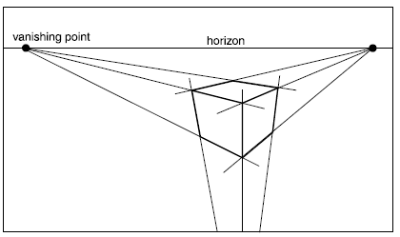
Creating View
In three-point perspective, an artist picks “vanishing points” where parallel lines meet. Parallel horizontal lines will meet at a point on the horizon. Every set of parallel lines has its own vanishing points. These rules are followed automatically if we implement perspective based on the correct geometric principles.

Slide 13
Computing Viewing Rays
We start by ‘shooting’ rays from the camera out into the scene
We can render the pixels in any order we choose (even in random order!), but we will keep it simple and go from top to bottom, and left to right
We loop over all of the pixels and generate an initial primary ray (also called a camera ray or eye ray)
The ray origin is simply the camera’s position in world space
The direction is computed by first finding the 4 corners of a virtual image in world space, then interpolating to the correct spot, and finally computing a normalized direction from the camera position to the virtual pixel

Slide 14
Shadow Rays
Shadow rays behave slightly differently from primary (and secondary) rays
Normal rays (primary & secondary) need to know the first surface hit and then compute the color reflected off of the surface
Shadow rays, however, simply need to know if something is hit or not
In other words, we don’t need to compute any additional shading for the ray and we don’t need to find the closest surface hit
This makes them a little faster than normal rays

Slide 15
Summary
Perspectives
Projections

Slide 16
References
Fundamentals of Computer Graphics Third Edition by Peter Shirley and Steve Marschner
Interactive Computer Graphics, A Top-down Approach with OpenGL (Third Edition) by Edward Angel.

