Slide 1
Computer Graphics
Lecture 09
Fasih ur Rehman

Slide 2
Last Class
Viewing
Perspectives
Projections

Slide 3
Today’s Agenda
Perspectives
Projections

Slide 4
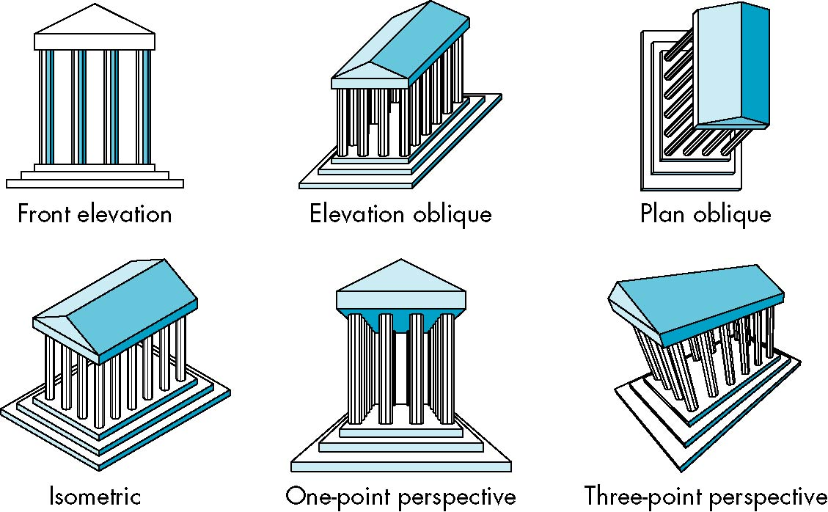
Perspectives and Projections

Slide 5
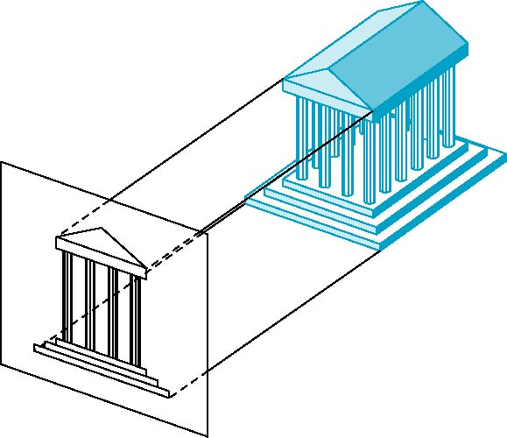
Orthographic Projections
The projectors are orthogonal to the projection surfaces

Slide 6
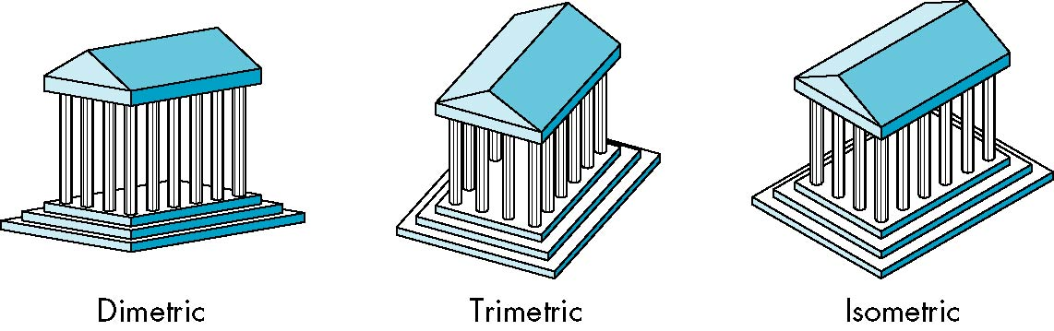
Axonometric Projections
Projection planes can move relative to the object
Axonometric projections are classified by how many angles of a corner of a projected cube are the same
Trimetric (none of the angles is same)
Dimetric (two angles are same)
Isometric (all three angles are same)

Slide 7
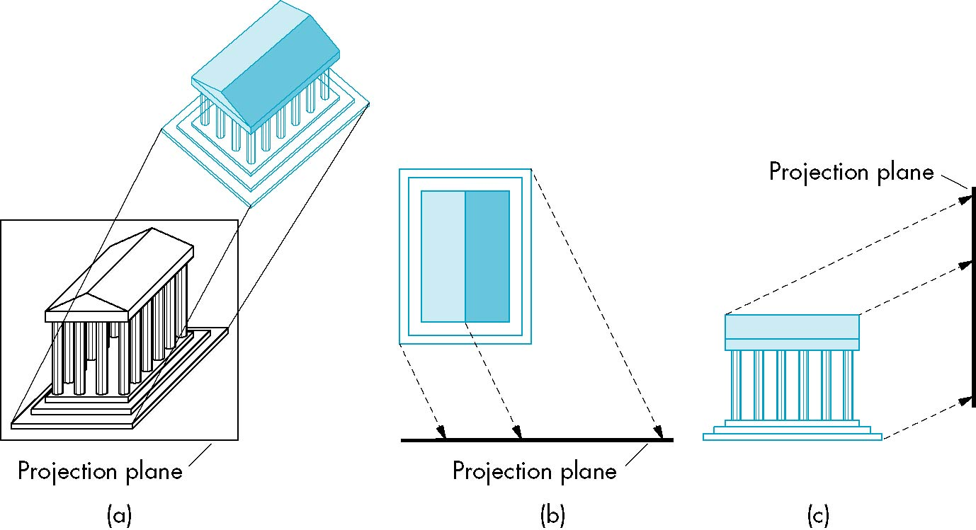
Oblique Projections
Relationship between projectors and projection plane is arbitrary

Slide 8
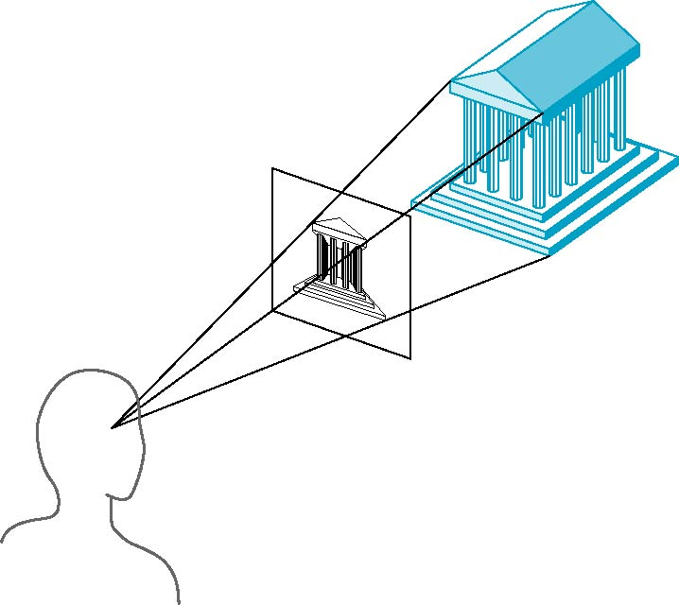
Perspective Projections
Perspective views are characterized by diminution of size.
When objects are moved farther from the viewer, their images become smaller

Slide 9
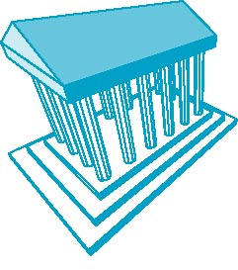
Three Point Perspective
None of the principal face is parallel to projection plane.
No. of vanishing points is three in a cube

Slide 10

Two Point Perspective
One of the principal directions is parallel to projection plane.
No. of vanishing points is two in a cube

Slide 11

One Point Perspective
One of the principal face is parallel to projection plane.
No. of vanishing points is one in a cube

Slide 12
Computer Viewing
Computer viewing comprises following aspects
Positioning of the camera
Selecting a lens (Projections and Perspectives)
Clipping
Can be accomplished with transformations.

Slide 13
Coordinate Systems

Slide 14
Coordinate Systems

Slide 15
Coordinate Systems

Slide 16
Summary
Perspectives
Projections

Slide 17
References
Fundamentals of Computer Graphics Third Edition by Peter Shirley and Steve Marschner
Interactive Computer Graphics, A Top-down Approach with OpenGL (Sixth Edition) by Edward Angel.

