Slide 1
Computer Graphics
Lecture 13
Fasih ur Rehman

Slide 2
Last Class
Cross Product
Plane
Sphere
Transformations

Slide 3
Today’s Agenda
Transformations
Translation

Slide 4
Example (Scaling)
Find the transformed point, P’, subject to scaling P= (6, 2) through a vector v = (a, b) where i) a = b = 3; ii) a = 3, b = 4; iii) a = 1; b = -4

Slide 5
Example (Rotation)
Find the transformed point, P’, caused by rotating P= (6, 2) about the origin through an angle of 90°

Slide 6

Translation
In translation all points in an object move to new position along the same straight-line path.
The path is called translation vector or shift vector
$$x^{′ }=x+ α$$
$$y^{′ }=y+ β$$

Slide 7
Example (Translation)
Find the transformed point, P’, caused by translating P= (6, 2) through a vector v = (2, 4)

Slide 8

Shear
$$x^{′}=x+h_{x}∗y$$
$$y^{′}=y+h_{y}∗x$$

Slide 9
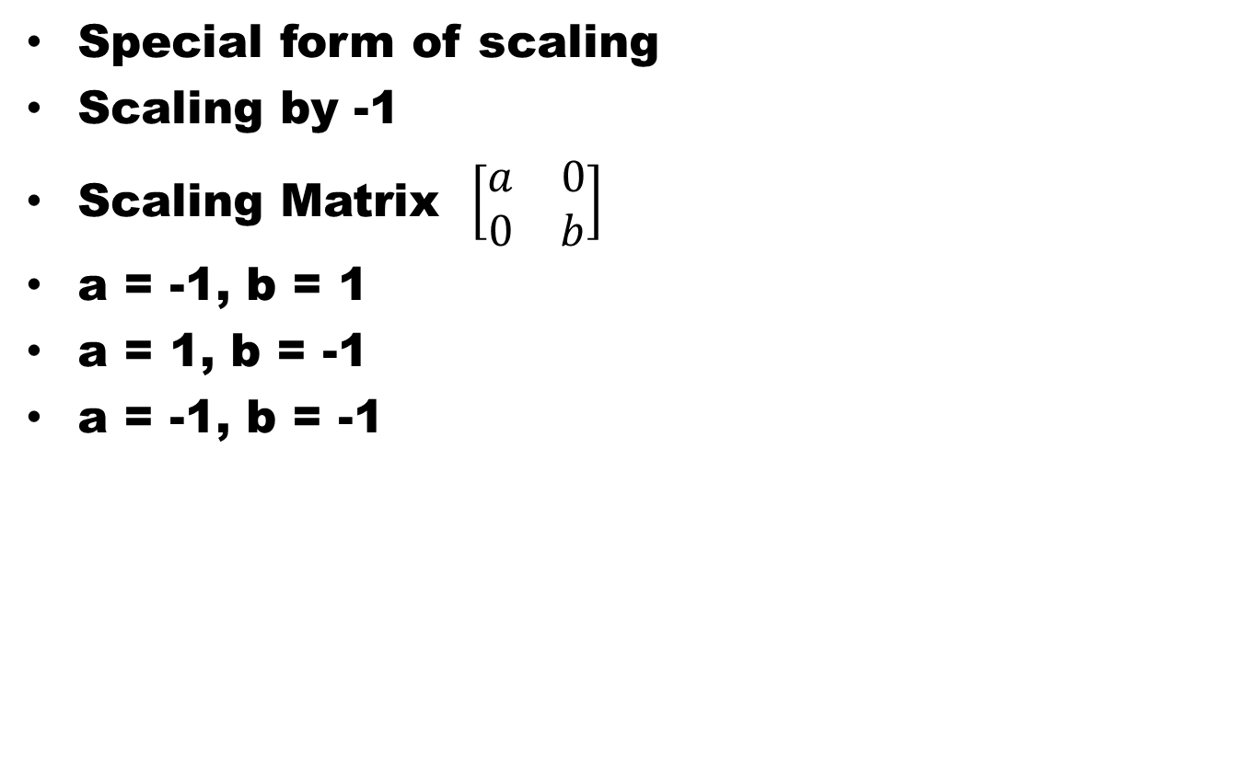
Reflection
Special form of scaling
Scaling by -1
Scaling Matrix $\left[\begin{matrix}a & 0 \\ 0 & b\end{matrix}\right]$
a = -1, b = 1
a = 1, b = -1
a = -1, b = -1

Slide 10
Reflection

Slide 11
Combining Transforms
General transformation of a point:
P' = N • P + A
Scaling or rotation,
Translate, we set A, and N is the multiplicative identity.

Slide 12
Summary
Translation
Shear
Reflection
Combining Transforms

Slide 13
References
Fundamentals of Computer Graphics Third Edition by Peter Shirley and Steve Marschner
Interactive Computer Graphics, A Top-down Approach with OpenGL (Sixth Edition) by Edward Angel.

