Slide 1
Computer Graphics
Lecture 17
Fasih ur Rehman

Slide 2
Last Class
3D Transforms
Inverse Rotation

Slide 3
Examples

Slide 4
Today’s Agenda
Graphical Processes

Slide 5

Graphical Process
High level graphical process

Slide 6
Implementation Tasks
Four Major Tasks
Modeling
Geometry Processing
Rasterization
Frame Processing

Slide 7
Modeling
The usual results of the modeling process are sets of vertices that specify a group of geometric objects supported by the rest of the system.

Slide 8
Geometry Processing
Geometry processing means to determine which geometric objects can appear on the display and to assign shades or colors to the vertices of these objects.
Four Tasks
Projection
Primitive assembly
Clipping
Shading
Hidden surface removal and visible surface determination are required

Slide 9
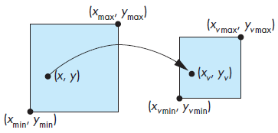
Rasterization
Calculation of pixel values based upon the previous steps i. e. Projection, Primitive assembly, Clipping and Shading
The rasterizer starts with vertices in normalized device coordinates but outputs fragments whose locations are in units of the display—window coordinates.
Viewport transformation

Slide 10
Summary
Graphical Processes

Slide 11
References
Fundamentals of Computer Graphics Third Edition by Peter Shirley and Steve Marschner
Interactive Computer Graphics, A Top-down Approach with OpenGL (Sixth Edition) by Edward Angel.

