Slide 1
Computer Graphics
Lecture 18
Fasih ur Rehman

Slide 2
Last Class
Clipping
Modeling
Geometry Processing

Slide 3
Today’s Agenda
Clipping

Slide 4
Graphical Process
Graphical Process is

Slide 5
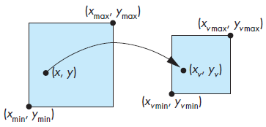
Rasterization
Calculation of pixel values based upon the previous steps i. e. Projection, Primitive assembly, Clipping and Shading
The rasterizer starts with vertices in normalized device coordinates but outputs fragments whose locations are in units of the display—window coordinates.
Viewport transformation

Slide 6
Normalized Coordinates

Slide 7
Example

Slide 8
Rasterization
Calculation of pixel values based upon the previous steps i. e. Projection, Primitive assembly, Clipping and Shading
The rasterizer starts with vertices in normalized device coordinates but outputs fragments whose locations are in units of the display—window coordinates.
Viewport transformation

Slide 9
Fragment Processing
Each fragment is assigned a color by the rasterizer and this color is placed in the frame buffer at the locations corresponding to the fragment’s location.
Various possibilities are
merging with the results of the geometric pipeline at the rasterization stage.
for example shaded and texture-mapped polygon is processed
hidden-surface removal process is typically carried out on a fragment-by-fragment basis.
Fragment colors may have to be blended with the colors of pixels already in the color buffer due to some translucent object

Slide 10
Display Problems
Generally, displaying framebuffer content on the monitor is not of concern of the application program but
Jaggedness (rough quality)
Aliasing

Slide 11
Clipping
Identification of the portions of geometric primitives by analytical calculations within the view windows

Slide 12
Summary
Clipping

Slide 13
References
Fundamentals of Computer Graphics Third Edition by Peter Shirley and Steve Marschner
Interactive Computer Graphics, A Top-down Approach with OpenGL (Sixth Edition) by Edward Angel.

