Slide 1
Computer Graphics
Lecture 23
Fasih ur Rehman

Slide 2
Last Class
Clipping Algorithms

Slide 3
Today’s Agenda
Polygon Clipping

Slide 4
Polygon Clipping
Difficult task
Polygon clipping may result in
Original Polygon
New polygon
Nothing
Trivial Accept
Trivial Reject

Slide 5
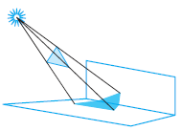
Polygon Clipping

Slide 6
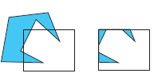
Polygon Clipping

Slide 7
Original Polygon

Slide 8
No Polygon

Slide 9
New Polygon

Slide 10
Sutherland-Hodgman Clipping
Consider each edge of the view window individually
Clip the polygon against the view window edge’s equation
After doing all edges, the polygon is fully clipped

Slide 11
Polygon Clipping

Slide 12
Polygon Clipping

Slide 13
Polygon Clipping

Slide 14
Polygon Clipping

Slide 15
Summary
Clipping

Slide 16
References
Fundamentals of Computer Graphics Third Edition by Peter Shirley and Steve Marschner
Interactive Computer Graphics, A Top-down Approach with OpenGL (Sixth Edition) by Edward Angel.

