Slide 1
Computer Graphics
Lecture 24
Fasih ur Rehman

Slide 2
Last Class
Polygon Clipping Algorithms

Slide 3
Today’s Agenda
Shading

Slide 4
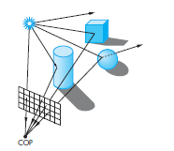
Light, Surface and Imaging
Illumination has strong impact on appearance of the surface

Slide 5
Surfaces
Shading

Slide 6

Specular Surfaces
Specular surfaces appear shiny because most of the light that is reflected or scattered is in a narrow range of angles close to the angle of reflection.
Mirrors are perfectly specular surfaces

Slide 7
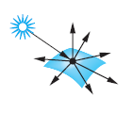
Diffusive Surfaces
Diffuse surfaces are characterized by reflected light being scattered in all directions. Walls painted with matte or flat paint are diffuse reflectors.
Perfectly diffuse surfaces scatter light equally in all directions,
Flat perfectly diffuse surface appears the same to all viewers.

Slide 8
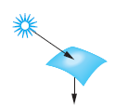
Translucent Surfaces
Translucent surfaces allow some light to penetrate the surface and to emerge from another location on the object.
This process of refraction characterizes glass and water.
Some incident light may also be reflected at the surface.

Slide 9
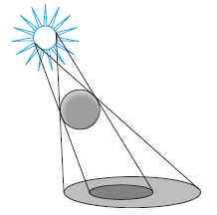
Shadows
Shadows created by finite-size light source.
Umbra – full shadow
Penumbra – partial shadow

Slide 10

Light Sources
Color Sources
Ambient Light (uniform lighting)
Point Source (emits light equally in all directions)
Spot Lights (Restrict light from ideal point source)

Slide 11

What Shading can do?
Let us suppose we draw a circle

Slide 12
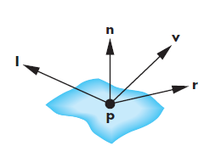
Phong Reflection Model
A simple model supports three models of light – matter interactions
Diffuse
Specular
Ambient
and uses four vectors
normal
to source
to viewer
perfect reflector

Slide 13
Summary
Shading

Slide 14
References
Fundamentals of Computer Graphics Third Edition by Peter Shirley and Steve Marschner
Interactive Computer Graphics, A Top-down Approach with OpenGL (Sixth Edition) by Edward Angel.

