Slide 1
Computer Graphics
Lecture 25
Fasih ur Rehman

Slide 2
Last Class
Shading

Slide 3
Today’s Agenda
Shading

Slide 4

What Shading can do?
Let us suppose we draw a circle

Slide 5
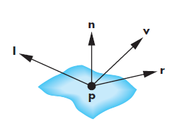
Phong Reflection Model
A simple model supports three models of light – matter interactions
Diffuse
Specular
Ambient
and uses four vectors
normal
to source
to viewer
perfect reflector

Slide 6

Ideal Reflector
Local orientation of the surface determines the normal vector
Law of reflection is obeyed
The three vectors must lie in same plane
$$r=2\left(l.n\right)n−l$$

Slide 7
Lambertian Surface
Perfectly diffuse reflector
Light scattered equally in all directions
Amount of light reflected is proportional to the vertical component of incoming light
reflected light ~cos θ_{i}
cos θ_{i} = l · n if vectors normalized
There are also three coefficients, k_{r}, k_{b}, k_{g} that show how much of each color component is reflected

Slide 8

Specular Surfaces
Most surfaces are neither ideal diffusers nor perfectly specular (ideal reflectors)
Specular highlights appear on smooth surfaces due to incoming light being reflected in directions close to the direction of a perfect reflection

Slide 9
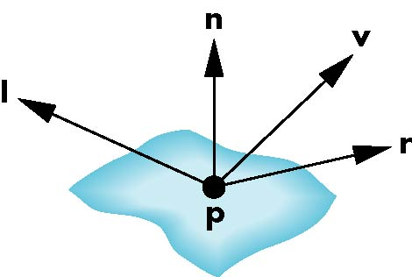
Specular Reflections Model
According to Phong, Reflected intensity I_{r} goes as absorption coeff. k_{s} and projection of incoming intensity along viewer (α is shinness coeff)
I_{r} ~ k_{s} I cos^{α}φ

Slide 10
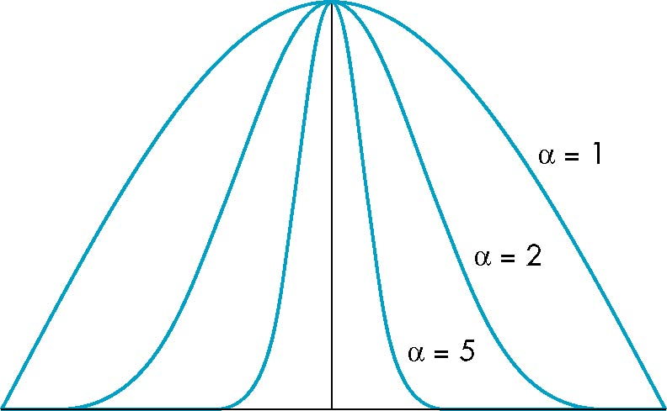
The Shininess Coefficient
Values of α vary between 100 and 200 for metals
Values vary between 5 and 10 for surfaces that look like plastics

Slide 11
Ambient Light
Ambient light is the result of multiple interactions between (large) light sources and the objects in the environment
Amount and color depend on both the color of the light(s) and the material properties of the object
Add k_{a} I_{a} (reflection coef * intensity of ambient light) to diffuse and specular terms

Slide 12
Distance Terms
The light from a point source that reaches a surface is inversely proportional to the square of the distance between them
We can add a factor of the form 1/(ad + bd +cd²) to the diffuse and specular terms
The constant and linear terms soften the effect of the point source

Slide 13
Light Sources
In the Phong Model, we add the results from each light source
Each light source has separate diffuse, specular, and ambient terms to allow for maximum flexibility even though this form does not have a physical justification
Separate red, green and blue components
Hence, 9 coefficients for each point source
I_{dr}, I_{dg}, I_{db}, I_{sr}, I_{sg}, I_{sb}, I_{ar}, I_{ag}, I_{ab}

Slide 14
Material Properties
Material properties match light source properties
Nine absorbtion coefficients
k_{dr}, k_{dg}, k_{db}, k_{sr}, k_{sg}, k_{sb}, k_{ar}, k_{ag}, k_{ab}
Shininess coefficient α

Slide 15
Summing up
For each light source and each color component, the Phong model can be written (without the distance terms) as
I =k_{d} I_{d} l · n + k_{s} I_{s} (v · r )^{α} + k_{a} I_{a}
For each color component we add contributions from all sources

Slide 16
Summary
Shading
Phong Reflection Model

Slide 17
References
Fundamentals of Computer Graphics Third Edition by Peter Shirley and Steve Marschner
Interactive Computer Graphics, A Top-down Approach with OpenGL (Sixth Edition) by Edward Angel.

