Slide 1
Computer Graphics
Lecture 30
Fasih ur Rehman

Slide 2
Last Class
Information presentation
direct or transformed
Model view approach
Static or dynamic

Slide 3
Today’s Agenda
Graphical User Interfaces
Animation

Slide 4
Display Factors (Information)
User requirement
Precise information
Data relationships
Information values change frequency
Should user know immediately about the change?
Response on change required or not from user
Direct or transformed?
Textual or numeric?
Multiple information presentation

Slide 5
Analog and Digital Presentation
Digital presentation is compact so takes less screen space and can present precise value
Analog presentation give good information by just getting an overview and present information of outliers etc.

Slide 6
Dynamic Display
Time
Temperature
Pressure

Slide 7
Displaying Relative Values
Progress bar etc.

Slide 8
Data Visualization
Used to display large amount of information
Reveals trends
Examples
Weather information from a number of sources
Traffic information at toll plazas

Slide 9
Use of Colors
Extra dimension can be added
Can be used for warning
Guideline
Too many colors should not be used
Color code should also be provided and the user may be provided flexibility to change color code.
Designing must be done for monochrome and colors should be added afterwards
Color codes should be consistent
Keep lower resolutions in mind

Slide 10
User Facilitation
The user guidance system (like on – line help, error messages and manuals) should be integrated with the user interface

Slide 11
Animation
Walt Disney created Animated objects
Mickey Mouse
Donald Duck
Animate mean bring to life

Slide 12
Animation
How we perceive motion
Persistence of vision (1/25 seconds)

Slide 13
Kinematics
Study of movement and motion of the structure that have joints (without consideration of cause of motion)
Human
Robots / Robotic manipulators

Slide 14
Animation Types
Cel Animation: based on changes that occur from one frame to another.
Path Animation
Created using Key frames by tweening

Slide 15
Frame Rate
24 FPS (US film standard)
25
30

Slide 16
3D Animation
Modeling
Animation
Rendering

Slide 17
Morphing
Process of mixing image

Slide 18
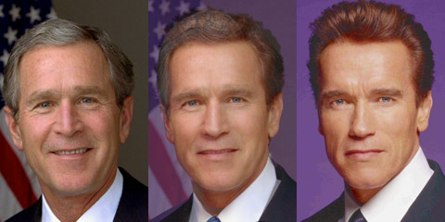
Morphing Images

Slide 19
Summary
Display Factors
Animation

Slide 20
References
Fundamentals of Computer Graphics Third Edition by Peter Shirley and Steve Marschner
Interactive Computer Graphics, A Top-down Approach with OpenGL (Sixth Edition) by Edward Angel.

