Slide 1
Computer Graphics
Lecture 31
Fasih ur Rehman

Slide 2
What are Computer Graphics
The study of using computers to create and manipulate images is called Computer Graphics
In true sense the subject requires rigorous background in Linear Algebra especially Matrices.

Slide 3
Graphics Areas
The area of Computer graphics that deals with the mathematical specification of shape and appearance properties in a way that can be stored on the computer is called Modeling.
The creation of shaded images from 3D computer models is called Rendering.
Modeling of interaction of light with matter is called Illumination.
The technique to create an illusion of motion through sequences of images is referred to as Animation.

Slide 4
Entertainment
Video Games
Cartoons
Animated Films

Slide 5
Industry
CAD/CAM: These fields use computer technology to design parts and products on the computer and then, using these virtual designs, to guide the manufacturing process.
AutoCAD from AutoDesk
Microsoft Visio
Adobe’s Photoshop etc.

Slide 6
Visualization
Representing data with graphical illustrations is called visualization
Producing graphical representations for scientific, engineering, and medical data sets and processes is generally referred to as scientific visualization
The business visualization is used in connection with data sets related to commerce, industry, and other nonscientific areas.

Slide 7
Image Processing
Image processing applies techniques to modify or interpret existing pictures
Improving pictures
Machine vision
i. e., machine perception of the visual information (robotics)

Slide 8
Graphical User Interfaces (GUI)
Graphical User Interfaces display menus and icons for fast selection of any processing required.
The user does not have to memorize commands or capabilities of a computer software. All options provided by the software can be explored just by navigating using mouse clicks.
A windows manager allows user to display multiple windows. Each window can process different data (weather graphical or text). A window can be made active just by clicking mouse on it.

Slide 9
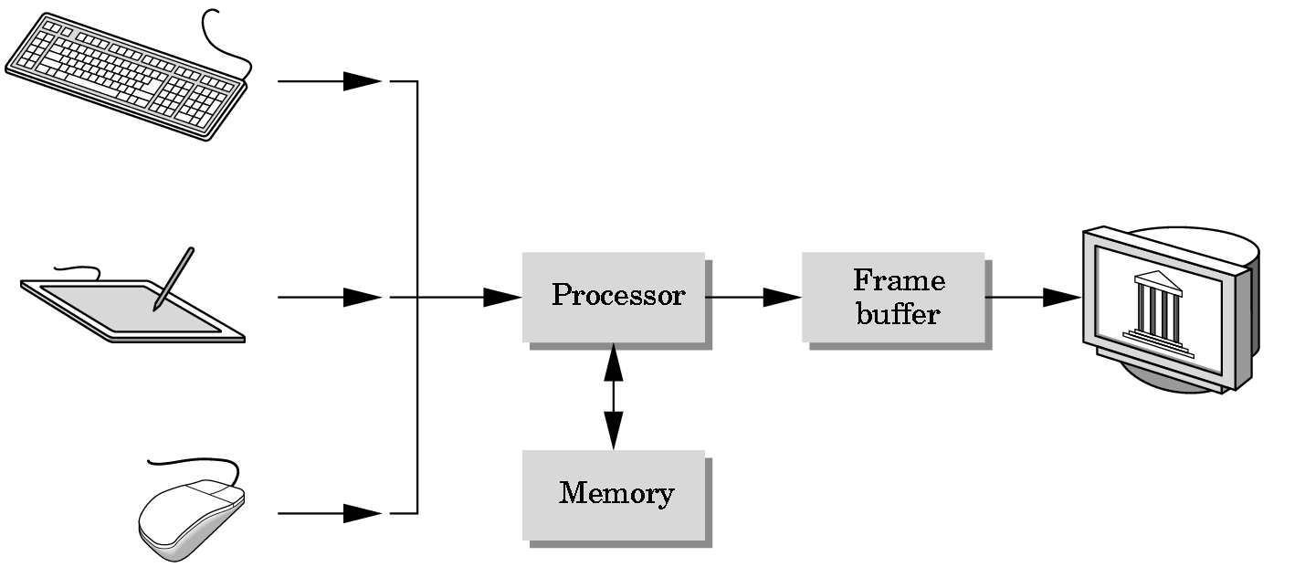
Graphics Systems

Slide 10
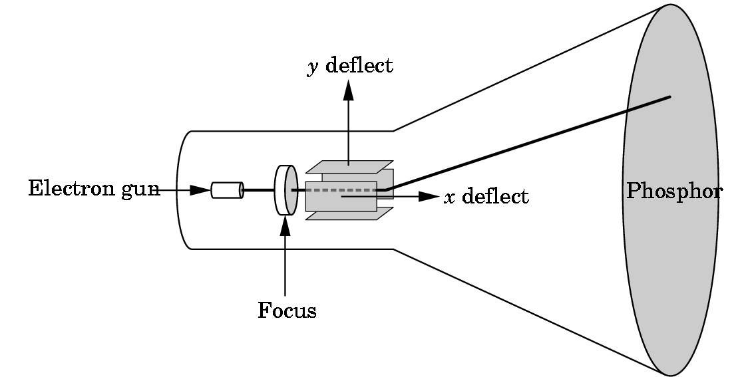
Output Devices
Cathode Ray Tube (CRT)
Calligraphic Mode
Raster Mode

Slide 11
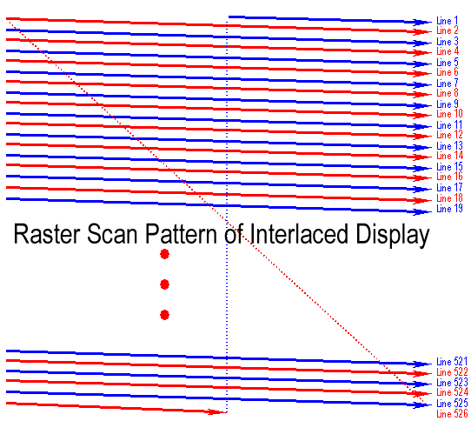
Interlacing
http://escience.anu.edu.au/lecture/cg/Display/raster.en.html

Slide 12
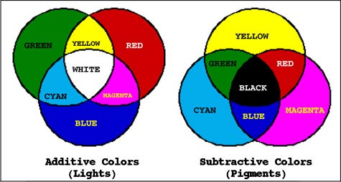
Colors
Additive Colors
Red Green and Blue (sometimes White)
Subtractive Colors
Yellow Cyan Magenta and Black
http://www.d.umn.edu/~mharvey/th1501color.html

Slide 13
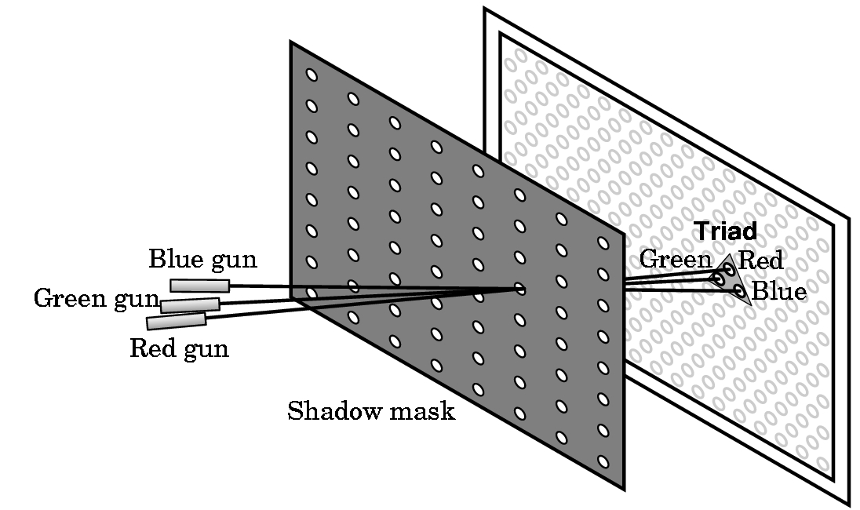
Color Display

Slide 14
Frame Buffer
Raster images require frame buffers
Frame buffer - A block of memory, dedicated to graphics output, that holds the contents of what will be displayed.
If we want a frame buffer of 640 pixels by 480 pixels, we should allocate:
frame buffer = 640*480 bits
How many colors does 1 bit get you?
How many colors do 8 bits get you?
Monochrome systems use this (green/gray scale)
What bit depth would you want for your frame buffer?

Slide 15
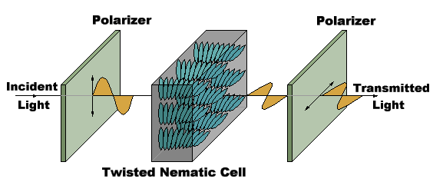
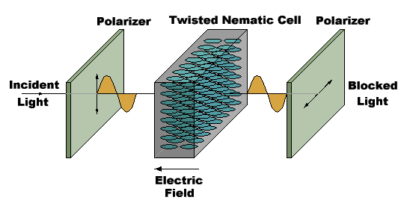
Liquid Crystal Display
Liquid crystal displays use small flat chips which change their transparency properties when a voltage is applied.
LCD elements are arranged in an n x m array call the LCD matrix
Level of voltage controls gray levels.
LCDs elements do not emit light, use backlights behind the LCD matrix

Slide 16
Some Definitions
A rectangular array of points or dots is called Raster.
A Pixel is picture element of raster.
A row of pixels is known as Scan Line.
Picture elements stored in memory are called Frame Buffer.
Pixel
Scan Line

Slide 17
Resolution
The Resolution is defined as the number of dot per inch or centimeter that can be plotted horizontally & vertically.
Higher the resolution, smaller the spot size.
Resolution is related with quality of the graphics system.
Higher the resolution, better the graphics system
High quality resolution is 1280x1024
The intensity distribution of spots on the screen has Gaussian distribution.
Adjacent points will appear distinct as long as their separation is greater than the diameter at which each spot has intensity of about 60% of that at the center of the spot.

Slide 18
Aspect Ratio
The Aspect Ratio is the ratio between number of scan lines in a rater and the number of pixels in a scan line necessary to produce equal length lines in both directions on the screen.
For example 1280 x 768 has an aspect ratio of 5:3.

Slide 19
Vector Display
The electron beam illuminates only the parts of the screen where a picture is to be drawn.
Works like plotters i.e. draws a one picture line at a time
Used in line drawing and wireframe displays
Picture definition is stored as a set of line-drawing commands stored in a refresh display file.
Number of lines derive Refresh rate and refresh cycle is between 30 and 60 per second
Can draw 100,000 short lines at this refresh rate

Slide 20
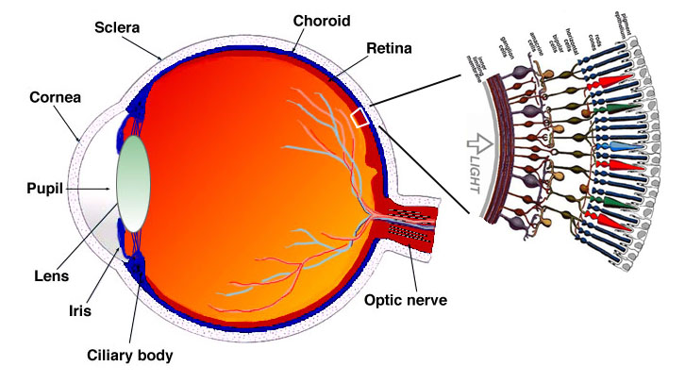
Human Visual System (HVS)

Slide 21
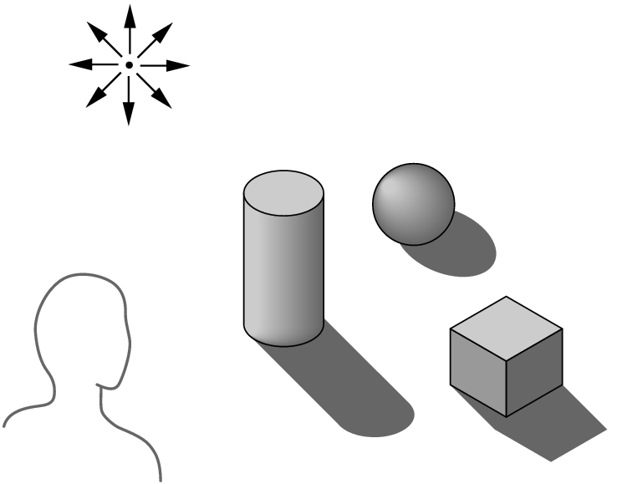
Ray Tracing
Building an imaging model by following light from a source is known as Ray Tracing
A Ray is a semi infinite line that emerges from s source and continues to infinity in one direction
Part of ray contributes
in making image.
Surfaces
Diffusing
Reflecting
Refracting

Slide 22
Ray Tracing
For each pixel intensity must be computed
Contributions of all rays must be taken into account
A ray when intercepted by a surface splits into two rays
Absorbed
Reflected

Slide 23
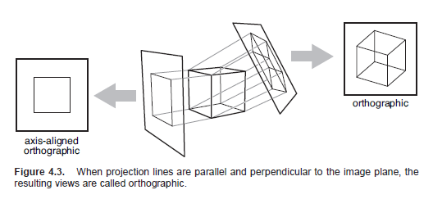
Projections

Slide 24
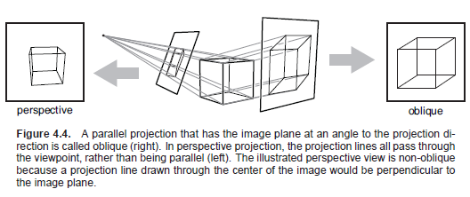
Projections

Slide 25
Viewing
Process of seeing a scene is regarded as viewing.
The world or scenes are in three dimensions (3D)
A 3D Scene has to be “projected” in 2D
A Synthetic camera has to be modeled

Slide 26
Viewing Problems
Where a viewer is located (Location)
Viewing Plane
The visible portion of the scene
i. e., what can be seen (clipping)
Maintaining relation between objects
Parallel lines
Angles
Distances
Relation to the viewer

Slide 27
Scenes and Objects
Viewing a scene or object
Some viewing techniques perform better in viewing objects than a whole scene.
External Viewing: Viewing an object from outside e. g. a building
Internal Viewing: viewing from inside. e.g. internal of a building specially in games.

Slide 28
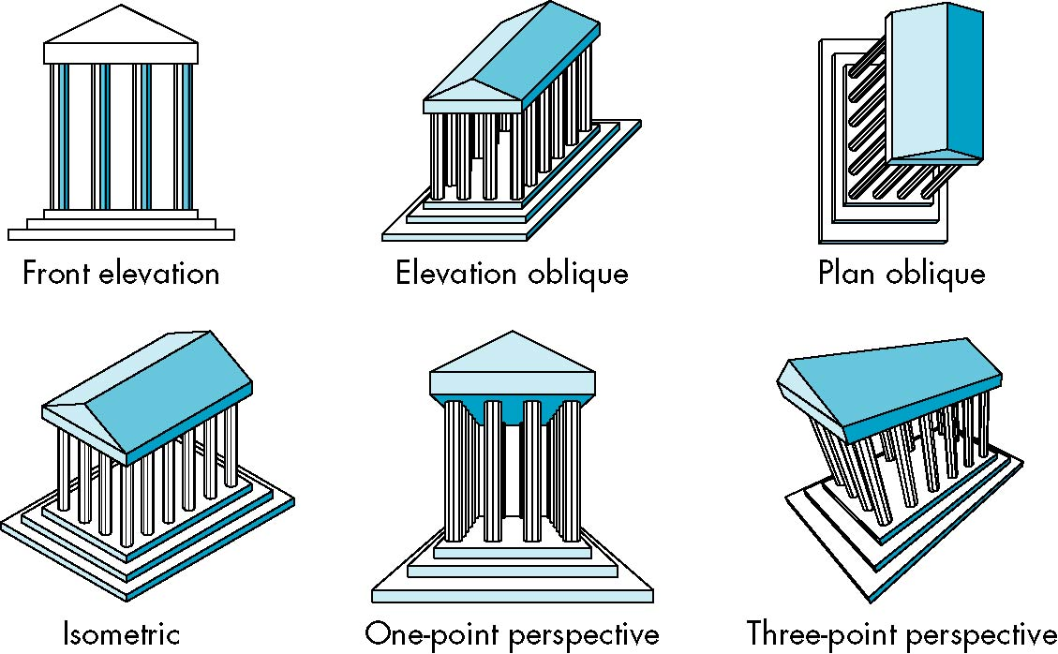
Perspectives and Projections

Slide 29
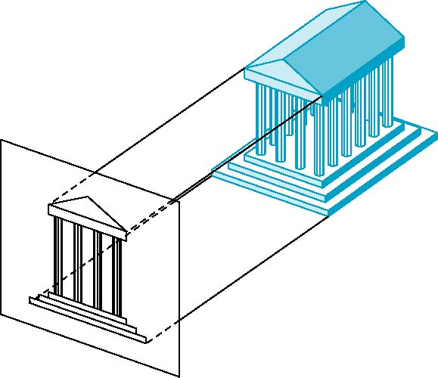
Orthographic Projections
The projectors are orthogonal to the projection surfaces

Slide 30
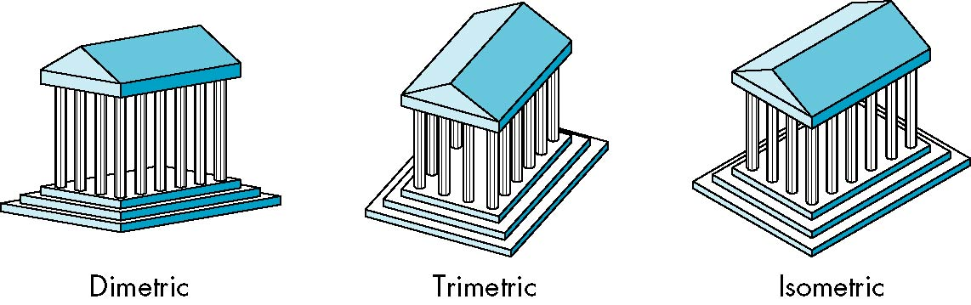
Axonometric Projections
Projection planes can move relative to the object
Axonometric projections are classified by how many angles of a corner of a projected cube are the same
Trimetric (none of the angles is same)
Dimetric (two angles are same)
Isometric (all three angles are same)

Slide 31
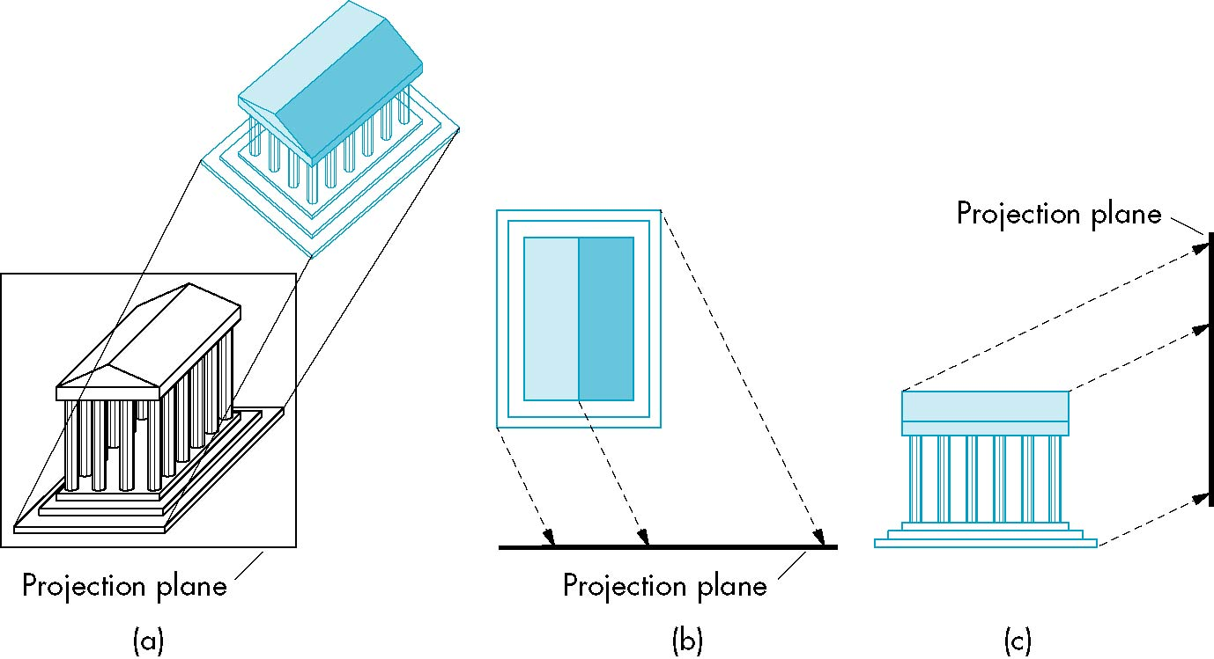
Oblique Projections
Relationship between projectors and projection plane is arbitrary

Slide 32
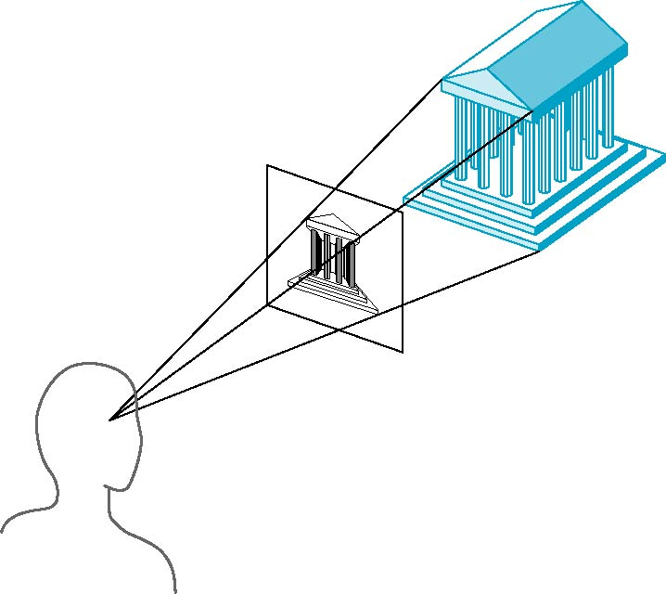
Perspective Projections
Perspective views are characterized by diminution of size.
When objects are moved farther from the viewer, their images become smaller

Slide 33
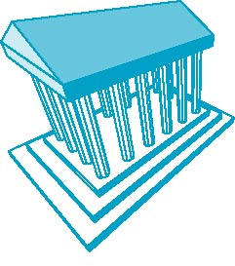
Three Point Perspective
None of the principal face is parallel to projection plane.
No. of vanishing points is three in a cube

Slide 34

Two Point Perspective
One of the principal directions is parallel to projection plane.
No. of vanishing points is two in a cube

Slide 35

One Point Perspective
One of the principal face is parallel to projection plane.
No. of vanishing points is one in a cube

Slide 36
Computer Viewing
Computer viewing comprises following aspects
Positioning of the camera
Selecting a lens (Projections and Perspectives)
Clipping
Can be accomplished with transformations.

Slide 37
Scalars, Points and Vectors
Geometry is a subject that relates objects in n – dimensional space (In computer graphics we deal with 3 dimensional space)
Scalars, vectors and points form minimum set of primitives and are used to build sophisticated objects.
A point is a location in space that neither has size nor shape.
Real numbers (magnitudes) such as distance between two points are a scalars
Vectors are also required to work with directions.

Slide 38
Scalars
Scalars are members of sets which can be combined by addition and multiplication and obey associativity, commutivity and inverses axioms
Scalars don’t possess any geometric properties
Real and Complex numbers

Slide 39
Vectors
A quantity defined by magnitude and direction
Velocity, Force etc.
For computer graphics, a directed line segment (can be used for any vector) is most significant example

Slide 40
Vector Operations
Vectors have following properties
Inverses: Equal in magnitude but opposite in direction
Scalar Multiplication: A vector can be multiplied by a scalar (magnitude changes only not the direction)
Zero vector is also defined with zero magnitude and undefined direction
Head to Tail Rule is used to add vectors

Slide 41
Linear Vector Space Extensions
Linear Vector Space may not have ways to measure a scalar quantity.
A Euclidean space is an extension of a vector space that adds a measure of size or distance and allows us to define such things as the length of a line segment.
An affine space is an extension of the vector space that includes an additional type of object: the point.
Operations between vectors and points are allowed

Slide 42
Transformations

Slide 43
Scaling
Scaling is achieved by multiplying each graphic component by a scalar
Scaling will be uniform if this scalar is same for all components
Different components are scaled differently, scaling in uniform

Slide 44
Rotation

Slide 45
Translation

Slide 46
Shear

Slide 47
Reflection

Slide 48
Homogeneous Coordinates
How a 2D vector is represented by 3 x 3 matrix
x’ = x + a
y’ = y + b

Slide 49
Linear Transformations
Combination of Scaling, rotation and shear are linear transformations
Linear Transformations satisfy following
Origin maps origin
Lines maps lines
Parallelism is preserved
Ratios remain the same
Closed under composition

Slide 50
Affine Transformations
Affine transformations are combinations of linear transformations and Translation
Affine transformations obey the following
Origin does not necessarily map the origin
Lines maps lines
Parallelism is preserved
Ratios remain the same
Closed under composition

Slide 51
Projective Transformations
Affine Transformations and projective warps form projective transformation
Projective Transformations obey the following
Origin does not necessarily map the origin
Lines maps lines
Parallelism is not preserved
Ratios remain are not the same
Closed under composition

