Slide 1

CSC461 – Intro to Data Science CLO:<4> Bloom Taxonomy Level: <Applying> Project: Student Performance Prediction Instructor: Dr. Muhammad Tayyab Ch
Group Members:
Mr. Aoun-Haider [FA21-BSE-133]
Mr. Dawood-Imran [FA21-BSE-152]

Slide 2
Table of content:
Introduction
Data Overview
Feature Selection
Data Pre-processing
Exploratory Data Analysis
Model Selection & Training
Results & Interpretation
Conclusion

Slide 3
Introduction:
In this project, we aim to harness the power of machine learning to predict student performance based on a comprehensive analysis of diverse factors. Our dataset encompasses essential attributes such as gender, race/ethnicity, parental level of education, lunch status, and completion of test preparation courses, alongside students' scores in standardized mathematics, reading, and writing tests.
By delving into this rich dataset, we seek to uncover patterns and relationships that contribute to academic success. This predictive endeavor holds significance for educators, policymakers, and parents alike, offering valuable insights into the multifaceted dynamics influencing student achievement. As we embark on this journey, we strive not only to build an accurate predictive model but also to address ethical considerations associated with sensitive attributes such as race and ethnicity, ensuring a responsible and equitable approach to leveraging machine learning for educational insights.

Slide 4
Data Overview:
The dataset under scrutiny encapsulates a detailed profile of student information crucial for our predictive analysis. Comprising columns such as gender, race/ethnicity, parental level of education, lunch status, and completion of test preparation courses, the dataset offers a panoramic view of the diverse factors that may influence student performance. Each entry includes scores from standardized tests in mathematics, reading, and writing, providing a comprehensive snapshot of academic capabilities. Sourced meticulously, this data enables us to explore the intricate interplay of various variables and their potential impact on educational outcomes. As we delve into the data, we anticipate uncovering meaningful patterns and correlations, ultimately enhancing our understanding of the myriad factors contributing to student success.

Slide 5
Cont.
This project understands how the student's performance (test scores) is affected by other variables such as Gender, Ethnicity, Parental level of education, Lunch and Test preparation course.
Data consist of 8 columns and 1000 rows.
Data collection Source: https://www.kaggle.com/datasets/rkiattisak/student-performance-in-mathematics

Slide 6
Cont.
Column | Description
Gender | Male/Female
Race/Ethnicity | Group A, B, C, D
Parental Level of Education | Bachelor’s degree, Some College, Master’s degree, Associate’s degree, High school
Lunch | Standard, Free/reduced
Test Preparation | Yes/No

Slide 7
Feature Selection:
Feature selection plays a pivotal role in refining the predictive power of our model by identifying and prioritizing the most influential variables in the dataset.
In this project, we employ rigorous feature selection techniques to distill the myriad attributes down to a subset that significantly contributes to predicting student performance. By scrutinizing the relevance and importance of each feature, we aim to streamline the model's complexity while preserving its ability to capture essential patterns in the data. This process not only enhances the model's efficiency but also allows for a more interpretable and actionable understanding of the factors driving academic success. Through careful consideration of feature importance, we aim to distill meaningful insights that empower educators, policymakers, and parents to make informed decisions for the benefit of student learning outcomes.

Slide 8
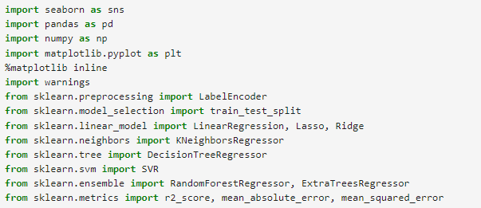
Data Pre-Processing:
Importing Basic Libraries:

Slide 9
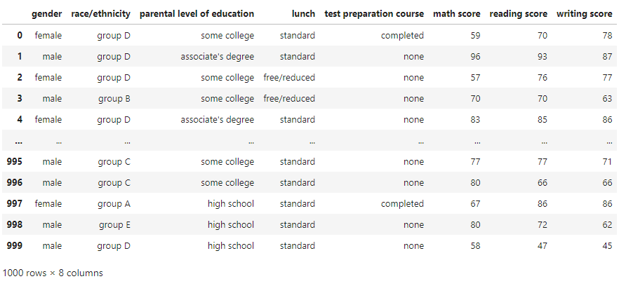
Cont.
Data Inspection:

Slide 10
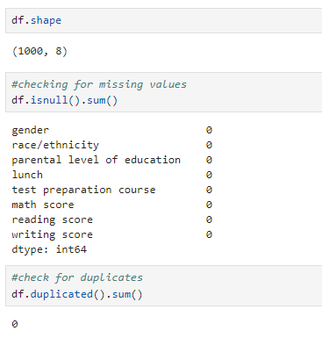
Cont.
Handling Missing Data & Duplicates:

Slide 11
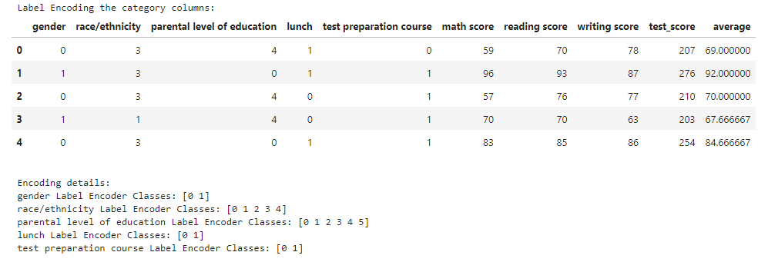
Cont.
Data Transformation:
Overall, 5 columns are categorical and need to be assigned a numerical value. Technique used for this purpose is ‘Label Encoding’.

Slide 12
Feature Engineering:
There can be another feature ‘test_score’ which will provide overall score among math, reading and writing and will be more general and other feature ‘average’ will provide overall estimate of score of individual.
The extended features help in getting more accurate result.

Slide 13
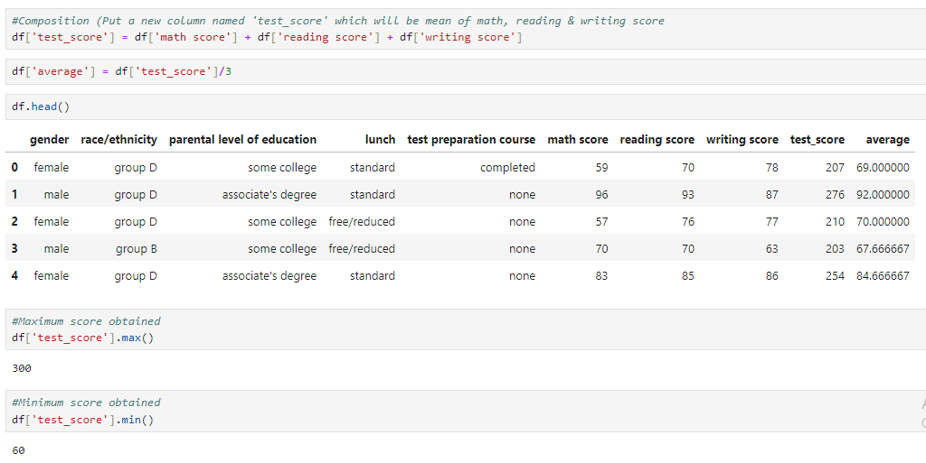
Implementation:

Slide 14
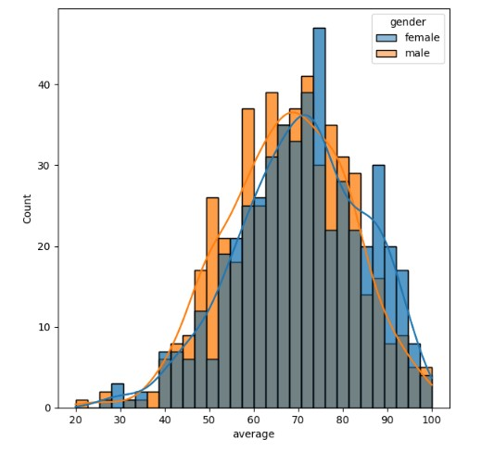
EDA
Exploratory Data Analysis

Slide 15
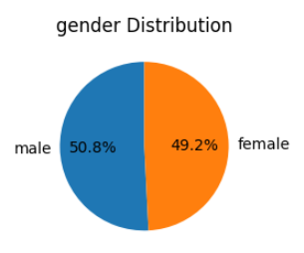
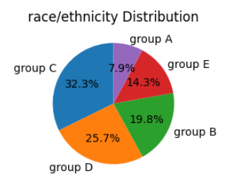
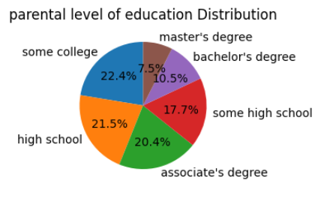
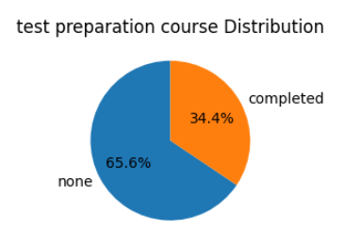
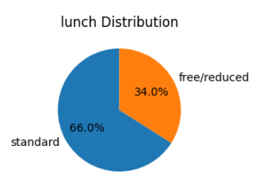
Gender distribution: There is a roughly equal split between genders.
Race/ethnicity distribution: The most common race/ethnicity is "group D", followed by "group B" and "group C".
Parental level of education distribution: The most common level of education for parents is "bachelor's degree", followed by "associate's degree" and "master's degree".
Lunch distribution: The most common lunch option is "standard", followed by "free/reduced" and "group A".
Test preparation course distribution: The most common response is that students did not take a test preparation course.

Slide 16
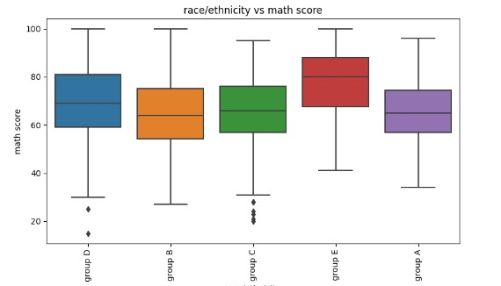
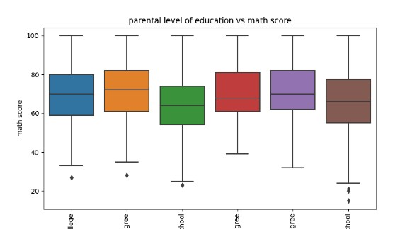
Race/Ethnicity VS Math Score:
The average math score for group E is higher than the average score. The difference is due to some factors including socioeconomic status, access to quality education, and cultural differences.
Parental level of Education vs Math Score : Students whose parents have higher levels of education tend to score higher on the math test.
Anomalies:
The anomalies in these graph may be due to :
Disparities in income
Educational support
Access to resources
Sample Size

Slide 17
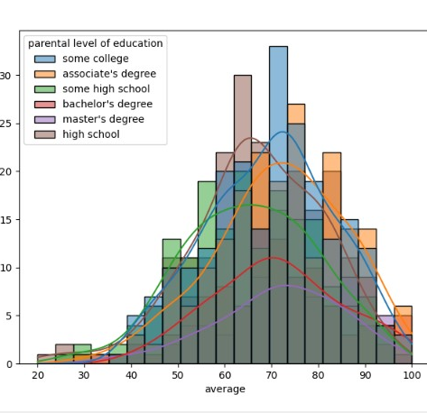
Distribution of Math Score on Parental Education Level
Parental education level has a moderate influence on average math scores, with a slight bump for students with parents who have higher levels of education. Females exhibit a wider spread of scores compared to males.

Slide 18
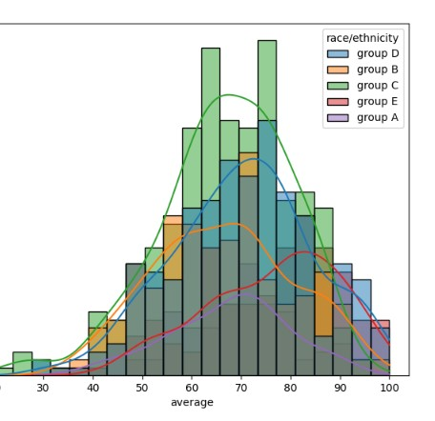
Distribution Math Score on the groups
The distribution of math scores seems to vary across different racial/ethnic groups, with some potential overlaps and gaps between the density curves. Notably, Group C appears to have a higher concentration of students scoring around the 60-80 range compared to other groups.

Slide 19
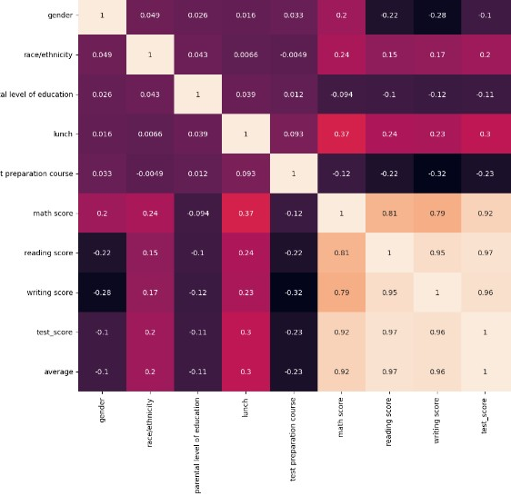
Effect of features on math Score:
Test preparation: has negative association with math score. In other words, students who prepare didn't score significantly higher on average than those who didn't.
Parental level of education: only has a very slight negative impact on student math performance.
Race/ethnicity: A positive correlation of 0.24 shows a moderate positive association between race/ethnicity and math scores.

Slide 20
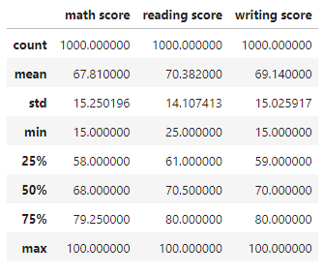
Statistical Analysis:
On average, math score is 67.8100. Most of the data lies in 3rd quartile.

Slide 21

Choosing input and output variables:
Input: gender, race/ethnicity, parental level of education, lunch, test preparation course, reading score, writing score
Output: math score

Slide 22
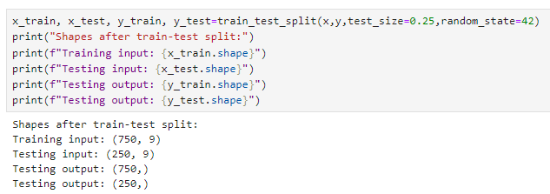
Data Splitting:
To predict the result, we have divided data into two parts, one for training and remaining for testing purpose.
In this project, 75% data is used for training and 25% for testing purpose.

Slide 23
Prediction:
To predict student performance, we have chosen ensemble learning technique. The model which gives more accurate result will be the model for given data.
Chosen Models: [LinearRegression(), Lasso(), Ridge(), KNeighborsRegressor(), SVR(), DecisionTreeRegressor(), RandomForestRegressor(), ExtraTreesRegressor()]

Slide 24
Outcome:
Model | Accuracy (R2_Score)
Linear Regression | 0.874
Lasso Regression | 0.806
Ridge Regression | 0.873
K-Nearest neighbor | 0.641
State Vector Regressor (SVR) | 0.595
Decision Tree Regressor | 0.716
Random Forest Regressor | 0.853
Extra Tree Regressor | 0.851
So, Linear Regression model is the winner!!

Slide 25
Conclusion:
In conclusion, the implementation of a linear model for predicting student performance has proven to be highly effective in this project. Through rigorous analysis and experimentation, we have explored various predictive models, and the linear model has emerged as the frontrunner, achieving the maximum accuracy with an impressive R2 score.

Slide 26
Thank You

