Slide 1
Numbers
Aoun-Haider
FA21-BSE-133@cuilahore.edu.pk

Slide 2
Palindrome number:
A number is said to be palindrome if it is similar after reversing the digits.
222 == True
212 == True
133 == False
Hint: if all digits are same or only central digit is different, then number is absolutely palindrome.

Slide 3
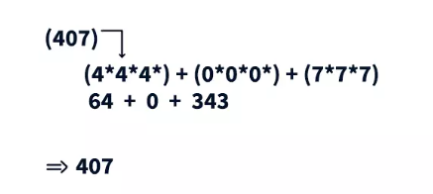
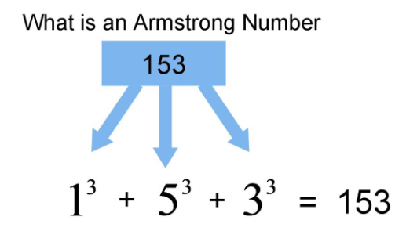
Armstrong Number:
If cubic sum of each digit is equal to the original digit, it is Armstrong number.

Slide 4
Bleak number:
Each number has one special number, which it supports, chosen as follows. It counts the number of ones in its own binary representation and adds this count to itself to obtain the value of the number it supports. That is, if j(m) means the number of ones in the binary representation of m, then m supports m+j(m). For example, the number eight (1000 in binary) supports nine, whereas nine supports eleven.
For example, let x is number of set bits in original number:
3 = 011
x = 2 , bitCount of original number
setBitCount(x) = setBitCount(2) = SetBitCount(010) = 1
x+setBitCount(x) = 2 + 1 =3
3 == 3 (not a bleak number)

Slide 5
Cont.
7 = 111
x = 3 , bitCount of original number
setBitCount(x) = setBitCount(3) = SetBitCount(011) = 2
x+setBitCount(x) = 3 + 2 = 5
3 == 3 (bleak number)

Slide 6
Nude Number:
A number is said to be nude if it is divisible by all of its digits.
For example:
N = 672
YES
Reason: 672 is divisible by 6, 7 and 2
N = 450
No
Reason: 450 is not divisible by zero (exception!!)
If a number contains zero, it is not nude and contains exception which needs attention.

Slide 7
Buzz Number:
If a number is divisible by 7 or its last digit is 7, then it is buzz number.
For Example,
N = 63
divisible by 7 (one condition satisfied, so buzz number)
N = 72
neither divisible by 7 nor last digit is 7
not a buzz number

Slide 8
Ugly Numbers:
If a number is divisible by 2, 3 or 5.
For example,
N = 14
Not an ugly number!! (factor is 7 also)
N = 6
YES (it is multiple of 2 and 3)

Slide 9
Harshad Number:
If a number is divisible by sum of its digits.
For example,
N = 3
YES
N = 18
Yes (it is divisible by 1+8 = 9)
N = 15
Not a Harshad number

Slide 10
Super Niven Number:
A number is divisible by sum of its digits as well as sum of subset of its digits also.
Input: N = 68040 Output: Yes Explanation: 68040 is divisible by 6, 8, 4, 6+8, 6+4, 4+8 and 6+4+8. and N begins also with ’25’. Input: N = 72 Output: No

Slide 11
Moran Number:
If a number is divisible by sum of its digits give a prime quotient.
Input: N = 34 Output: No Explanation: 34 is not a Moran number because it is not completely divisible 7 (sum of its digits). Input: N = 21 Output: Yes Explanation: 21 is a Moran number because 21 divided by the sum of its digits gives a prime number.

Slide 12

Ore Number:
If harmonic mean of divisors of a number is subset of divisors of the original number.
For example, 6 has four divisors namely 1, 2, 3, and 6. The harmonic mean of the divisors is-
2 is subset of {1,2,3,6}
So, 6 is an ore number.

Slide 13
Jumbled number:
A number is said to be Jumbled if for every digit, its neighbours digit differs by max 1.
Input : 6765 Output : True All neighbor digits differ by at most 1.
Input : 1223 Output : True

Slide 14
Unusual Number:
An unusual number is a natural number whose greatest prime factor is strictly greater than square root of n.
Input : N = 14
Output : YES
Explanation : 7 is largest prime factor of 14
and 7 is strictly greater than square root of 14
Input : N = 16
Output : NO
Explanation : 2 is largest prime factor of 16
and 2 is less than square root of 16 ( i.e 4 ).

