Slide 1
Software Requirement Engineering
CSE-305
Dr Ghulam Rasool

Slide 2
Outline
What is Software Requirement?
Levels of Software Requirements.
Importance of Software Requirements
Characteristics of Good Software Requirements
Types of Software Requirements

Slide 3
Background Knowledge
Software Engineering
Software engineering phases
Software development life cycle
Introduction
to
Software Engineering

Slide 4
Introduction
Requirements form the basis for all software products
Requirements engineering is the process, which enables us to systematically determine the requirements for a software product

Slide 5
What is requirement?
Something required, something wanted or needed
Webster’s dictionary
Requirements are…a specification of what should be implemented. They are descriptions of how the system should behave, or of a system property or attribute. They may be a constraint on the development process of the system.
Sommerville and Sawyer 1997
The disciplined application of scientific principles and techniques for developing, communicating and managing requirements

Slide 6
Software Requirement
A complete description of what the software system will do without describing how it will do it is represented by the software requirements
Software requirements are complete specification of the desired external behavior of the software system to be built
Software requirements may be:
Abstract statements of services and/or constraints

Slide 7
Software Requirement
Software requirements may be:
Part of the bid of contract
The contract itself
Part of the technical document, which describes a product
A condition or capability needed by a user to solve a problem or achieve an objective.
A condition or capability that must be met or possessed by a system...to satisfy a contract, standard, specification, or other formally imposed document
IEEE Std 729

Slide 8
Sources of Requirements
Stakeholders
People affected in some way by the system
Documents
Organization standards
Existing systems
Domain/business area
Regulations etc.

Slide 9
Levels of Requirements
Stakeholders describe requirements at different levels of details
Business Requirements
Why the software product is being developed
Vision and Scope document
User Requirements
Look at the functionality of the software product from the user’s perspective
Use Case Document
Product Requirements
Functional Requirements
Non-Functional Requirements
Software Requirement Specification(SRS)

Slide 10
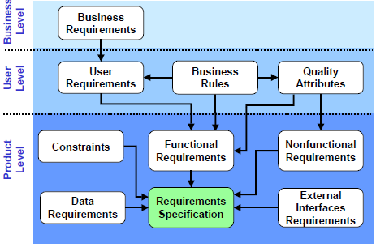
Levels of requirements

Slide 11
Example: Levels of requirements
Business Requirement:
To allow the customer to pay for gas at the pump
User Requirement:
• Swipe credit or debit card
• Enter a security PIN number
• Request a receipt at the pump
Product Requirement:
Prompt the customer to put his or her card into the reader
Detect that the card has been swiped
Determine if the card was incorrectly read and prompt the customer to swipe the card again
Parse the information from the magnetic strip on the card

Slide 12
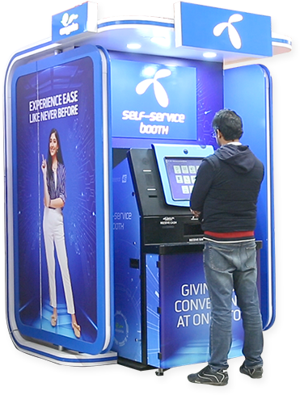
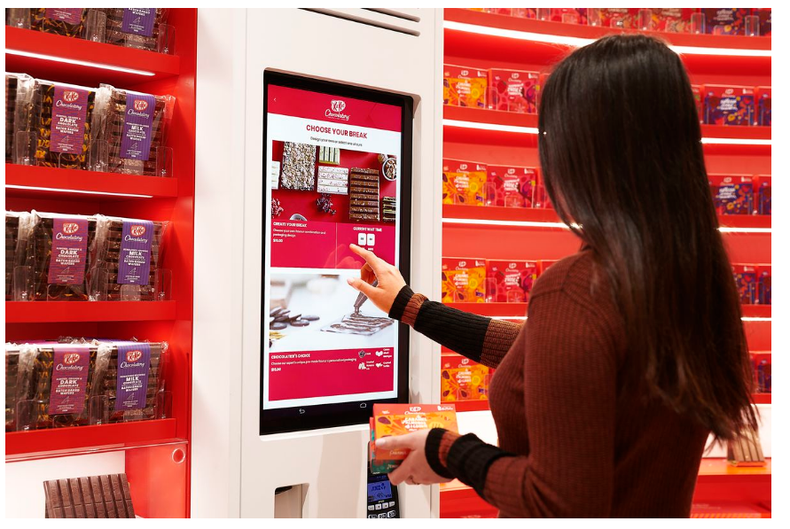
Example of Business Requirement
An embedded system is to be developed for a kiosk (booth). This system will be sold to the retail stores and will be used by the store customers.

Slide 13
Example Continue
For example, a business requirement to generate maximum revenue from the kiosk would imply the early implementation of features directly associated with selling more products or services to the customer, rather than glitzy features that appeal to only a subset of customers.

Slide 14
Importance of Software Requirements
The hardest single part of building a software system is deciding what to build...No other part of the work so cripples the resulting system if done wrong. No other part is difficult to rectify later
Fred Brooks
Examples
The system shall maintain records of all payments made to employees on accounts of salaries, bonuses, travel/daily allowances, medical allowances, etc.
The system shall interface with the central computer to send daily sales and inventory data from every retail store
The system shall support at least twenty transactions per second
The system’s user interface shall be implemented using a web browser

Slide 15
Importance of Software Requirements
A survey on 8000 software projects
Most of the projects failed due to incomplete requirements
Cost to fix software errors
Requirements | 1.0
Design | 5.0
code | 10.0
Testing | 30.0

Slide 16
Importance of Software Requirements
We know why projects fail, we know how to prevent them…so why they still fail. (Cobbs Paradox)
Cost overrun
Time overrun
Content deficiencies
…………………………..

Slide 17
Top Ten Challenged Project Factors
Lack of user involvement
Incomplete requirements and specifications
Changing requirements and specifications
Lack of executive support
Technology incompetence
Lack of resources
Unrealistic expectations
Unclear objectives
Unrealistic timeframe
New technology

Slide 18
Impact of Wrong Requirements
Requirements errors account for 70 percent to 85 percent of the rework costs on a software project (Wiegers 2003).
When requirements are wrong, systems are late, unreliable and don’t meet customers needs
Requirement errors results in enormous loss of time, revenue, market share, and trust of customers

Slide 19
Characteristics of good requirements
Complete
Each requirement must fully describe the functionality to be delivered
Correct
Each requirement must accurately describe the functionality to be built
Feasible
It must be possible to implement each requirement within the known capabilities and limitations of the system and its operating environment
Necessary
Each requirement should document a capability that the customers really need
Prioritize
Assign an implementation priority to each functional requirement

Slide 20
Characteristics of good requirements
Unambiguous
All readers of a requirement statement should arrive at a single, consistent interpretation of it
Verifiable
See whether you can devise a few tests or use other verification approaches, such as inspection, reviews etc
Traceable etc.
A traceable requirement can be linked backward to its origin and forward to the design elements and source code that implement it

Slide 21
Types of Software Requirements
Functional requirements
Non-functional requirements

Slide 22
Functional Requirements
Statements describing what the system does
A requirement that specifies a function that a system or system component must be able to perform.
Statements of services the system should provide
Reaction to particular inputs
Behavior in particular situations
Functional requirements are supported by non-functional requirements
Functional requirements are the backbone of all software products

Slide 23
Examples of Functional requirements
A library system that provides a single interface to a number of databases of articles in different libraries.
The user shall be able to search either the entire database of patients or select a subset from it (admitted patients, or patients with asthma, etc.)
The system shall solve a quadratic equation using the following formula
x = (-b+sqrt(b² – 4*a*c))/(2*a)

Slide 24
Non-Functional Requirements
Most non-functional requirements relate to the system as a whole. They include constraints on timing, performance, reliability, security, maintainability, accuracy, the development process, standards, etc.
They are often more critical than individual functional requirements
Capture the emergent behavior of the system, that is they relate to system as a whole
Must be built into the framework of the software product
Failure to meet a non-functional system requirement may make the whole system unusable

Slide 25
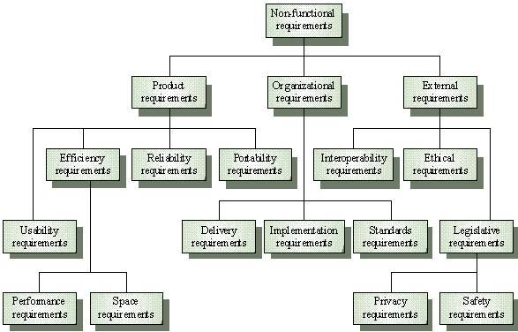
Non-Functional Requirements

Slide 26
Non-Functional Requirements
For example, if an aircraft system does not meet reliability requirements, it will not be certified as ‘safe’
If a real-time control system fails to meet its performance requirements, the control functions will not operate correctly
Non-functional requirements arise through user needs, because of budget constraints, because of organizational policies, because of the need of interoperability with other software and hardware systems, or because of external factors such as safety regulations, privacy legislation, etc

Slide 27
Types of non-Functional Requirements
Product Requirements
Requirements which specify that the delivered product must behave in a particular way e.g. execution speed, reliability, etc
Organizational Requirements
Requirements which are a consequence of organisational policies and procedures e.g. process standards used, implementation requirements, etc.
External Requirements
Requirements which arise from factors which are external to the system and its development process e.g. interoperability requirements, legislative requirements, etc.

Slide 28
Product Requirements
Product
requirements
Usability
requirements
Efficiency
requirements
Reliability
requirements
Portability
requirements
Performance
requirements
Space
requirements

Slide 29
Product Requirement Examples
The system shall allow one hundred thousand hits per minute on the website
The system shall not have down time of more than one second for continuous execution of one thousand hours

Slide 30
Organizational Requirements
Standards Requirements
Implementation Requirements
Delivery Requirements
Examples
The system development process and deliverable documents shall conform to the MIL-STD-2167A
Any development work sub-contracted by the development organization shall be carried out in accordance with Capability Maturity Model

Slide 31
External Requirements
External
requirements
Interoperability
requirements
Ethical
requirements
Legislative
requirements
Privacy
requirements
Safety
requirements

Slide 32
External Requirements Examples
The system shall not disclose any personal information about members of the library system to other members except system administrators
The system shall comply with the local and national laws regarding the use of software tools
Observations on non-Functional Reqs
Non-functional requirements can be written to reflect general goals for the system. Examples include:
Ease of use
Recovery from failure
Rapid user response

Slide 33
Others
Ergonomy, Configurability, Customizability, Dependability, Durability, Extensibility, Evolvability, Installability, Modularity, Reausbility, Scalability, Testability, Understandability

Slide 34
Observations on non-functional Requirements
Goals are open to misinterpretation
Objective verification is difficult
Non-functional requirements should be written in a quantitative manner as much as possible, which is not always easy for customers
Example: For some goals, there are no quantitative measures, e.g., maintainability
Chances of conflicts within non-functional requirements are fairly high, because information is coming from different stakeholders.
Non-functional requirements should be highlighted in the requirements document

Slide 35
How to measure non-functional Reqs
NFRs should be expressed quantitatively using metrics (measures) that can be objectively tested
Property | Measure
Speed | Processed transactions/second Response time Screen refresh time
Size | K bytes Number of function points
Ease of use | Training time Number of help frames
Robustness | Time to restart after failure Percentage of events causing failure Probability of data corruption on failure

Slide 36
Metrics for non-functional Reqs
Property | Measure
Reliability | Mean time to failure Probability of unavailability Rate of failure occurrence Availability
Portability | Percentage of target-dependent statements Number of target systems

Slide 37
Problems with Natural Language
Natural language understanding relies on the specification readers and writers using the same words for same concept
A natural language requirements specification is over-flexible.
“You can say the same thing in completely different ways”
It is not possible to modularize natural language requirements. It may be difficult to find all related requirements

Slide 38
References
Software Engineering 6th Edition, by I. Sommerville, 2000
Software Engineering 5th Edition, by R. Pressman
Software Requirements, Second Edition by Karl E. Wiegers

