Slide 1
Principles of Programming Languages
P. S. Suryateja
Asst. Professor, CSE Dept
Vishnu Institute of Technology

Slide 2
Introduction

Slide 3
Course Prerequisites
Sound math knowledge + Programming skills
C Programming (CP)
Object Oriented Programming through C++ (OOP C++)
Object Oriented Programming through Java (OOP Java)
Data Structures (DS)
Engineering Mathematics (M-I, M-II)
Mathematical Foundations of Computer Science (MFCS)
Formal Languages and Automata Theory (FLAT)

Slide 4
Course Objectives
To learn the key concepts and to get a basic understanding of the most popular programming paradigms and languages, including their strengths and weaknesses and to learn writing small programs in different programming languages.

Slide 5
Course Outcomes
Ability to describe the syntax and semantics of programming languages and gain practical knowledge in lexical analysis and parsing phases of a compiler
Ability to assess the merits and demerits of different constructs in programming languages
Ability to design and implement sub programs in various programming languages
Knowledge regarding different programming language features like object-orientation, concurrency, exception handling and event handling
Knowledge regarding functional paradigm and ability to write small programs using Scheme and ML
Knowledge regarding logic paradigm and ability to write small programs using Prolog

Slide 6
Syllabus
Unit – 1: Syntax and Semantics
Unit – 2: Data, Data Types and Basic Statements
Unit – 3: Subprograms and its Implementation
Unit – 4: Object-Orientation, Concurrency, Event Handling
Unit – 5: Functional Programming Languages (Scheme, ML)
Unit – 6: Logic Programming Languages (Prolog)

Slide 7
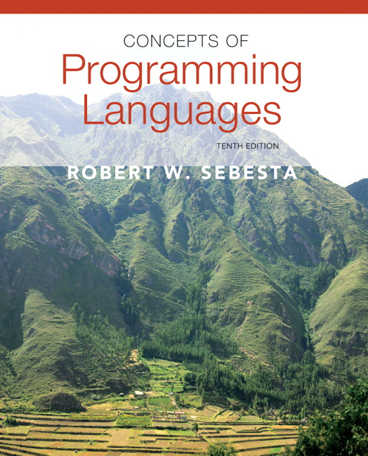
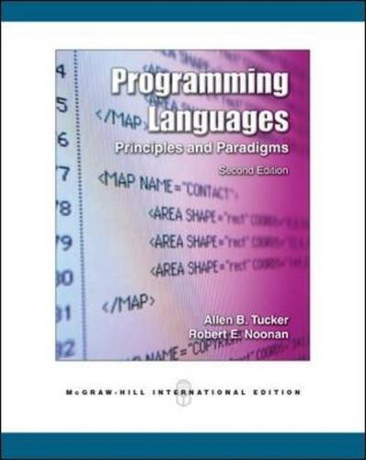
Text Books
Concepts of Programming Languages
Robert W. Sebesta
Tenth Edition
Programming Languages,
Principles & Paradigms
Allen B Tucker & Robert E Noonan
Second Edition

Slide 8
Web References
Course URL:
http://www.startertutorials.com/ppl/
Refer above URL for material, previous question papers and other useful links.

Slide 9
Why Study Programming Languages?
Increased capacity to express ideas
Improved background for choosing appropriate language
Increased ability to learn new languages
Better understanding of the significance of implementation
Better use of languages that are already known
Overall advancement of computing

Slide 10
Programming Domains
Scientific Applications (Fortran)
Business Applications (COBOL)
Artificial Intelligence (LISP, Prolog)
Systems Programming (C)
Web Software (HTML, PHP, Java)

Slide 11
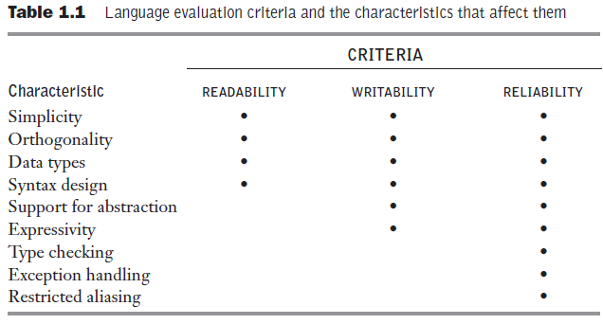
Language Evaluation Criteria
Readability
Writability
Reliability
Cost
Adopted from Concepts of Programming Languages - Sebesta

Slide 12
Readability
Overall simplicity
Orthogonality
Data Types
Syntax Design
Special words (while, if etc...)
Form and meaning (Semantics should follow directly from the syntax. Ex: static has different meaning based on context in C)

Slide 13
Readability – Overall Simplicity
A language with more number of basic constructs is more difficult to learn than one with a smaller number.
Feature multiplicity (having more than one way to accomplish a particular operation).
Ex: incrementing by 1
Operator overloading (ex: using + for adding arrays or difference b/w first elements in the arrays).
Too much simplicity makes program less readable (ex: assembly language).

Slide 14
Readability – Orthogonality
Orthogonality is the ability of combining a small set of primitives to build control and data structures.
The more orthogonal the design of a language, more is the simplicity.
Most orthogonal programming language is ALGOL 68.
Functional languages offer potentially the greatest overall simplicity (as the same construct, a function can be used for all operations).

Slide 15
Readability – Orthogonality (cont...)
IBM mainframe instructions for adding two integers that reside in main memory or registers:
A reg1, memory_cell
AR reg1, reg2
VAX minicomputer instruction:
ADDL operand_1, operand_2
In the above example, VAX instruction is more orthogonal as it supports all four combinations with single instruction.

Slide 16
Readability – Data Types
The presence of meaningful data types aids readability.
If a numeric type is used to indicate Boolean conditions, the statement will be unclear.
Ex: timeOut = 1

Slide 17
Writability
Simplicity and Orthogonality
A language with small set of primitives is better than one with a large set of primitives
Too much orthogonality decreases writability
Support for Abstraction
Expressivity

Slide 18
Writability – Support for Abstraction
Abstraction is the ability to define and use complicated structures or operations in ways that allow many of the details to be ignored.
Programming languages can support two types of abstraction: process and data.
Example for process abstraction is to use a subprogram for sorting that is required several times in a program.
Example for data abstraction is a binary tree that stores integer data in its nodes. It is better to implement a binary tree in C++ or Java using classes rather than in Fortran77 using pointers and dynamic memory management.

Slide 19
Writability – Expressivity
Ability of a language that allows a great deal of computation to be accomplished with a very small program.
In C, count++ is more convenient than writing count = count + 1.
Inclusion of for statement in Java makes writing counting loops easier than with the use of while.

Slide 20
Reliability
A program is said to be reliable if it performs to its specifications under all conditions.
Type Checking
Exception Handling
Aliasing
Readability and Writability

Slide 21
Reliability – Type Checking
Type checking is simply testing for type errors either at compile time or run-time.
As run-time type checking is expensive, compile time checking is desirable. (Ex: Java)

Slide 22
Reliability – Exception Handling
Ability of a program to intercept run-time errors and take corrective measures is known as exception handling.
Ada, C++, Java and C# provides extensive capabilities for exception handling.

Slide 23
Reliability - Aliasing
Aliasing is having two or more distinct names that can be used to access the same memory cell (Ex: Pointers in C and C++).
Many languages greatly restrict aliasing to increase their reliability.

Slide 24
Cost
Total cost of a programming language is a function of:
Cost of training the programmers
Cost of writing the programs
Cost of compiling the programs in the language
Cost of executing programs
Cost of language implementation system (Ex: JVM)
Cost of poor reliability
Cost of maintenance
Other criteria that can be used to evaluate a programming language are: portability, generality and well-definedness.

Slide 25
Influences on Language Design
Computer Architecture
Programming Design Methodologies

Slide 26
Computer Architecture
Imperative languages have been designed around the computer architecture called the von Neumann architecture.
In this architecture, data and programs are stored in memory and they are executed by the CPU.
Central features of imperative languages are variables, which model memory cells; assignment statements, which are based on the piping operation; and iterative form of repetition, which is the most efficient way to implement repetition on this architecture.

Slide 27
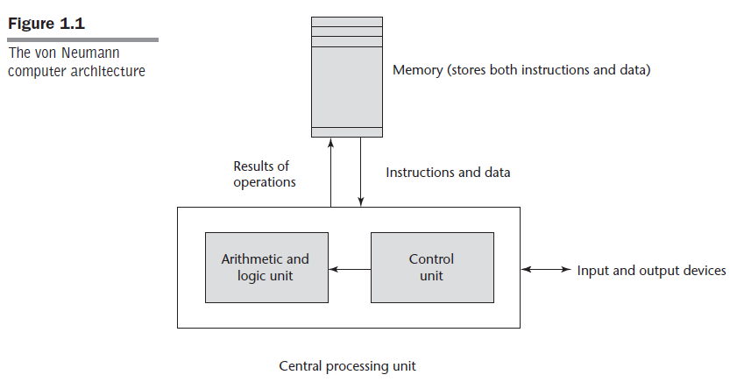
Computer Architecture (cont...)
Adopted from Concepts of Programming Languages - Sebesta

Slide 28
Programming Design Methodologies
Intense analysis begun in large part by the structured programming movement in the late 1960s.
New software development methodologies that emerged as a result of the research in 1970s were called top-down design or stepwise refinement.
In the late 1970s, a shift from procedure-oriented to data-oriented program design methodologies began.

Slide 29
Programming Design Methodologies (cont...)
First language to provide a limited support for data abstraction is SIMULA 67.
Latest step in the evolution of data-oriented software development, which began in the early 1980s, is object-oriented design.
First language to include object-oriented concepts was Smalltalk.

Slide 30
Programming Design Methodologies (cont...)
Imperative language like Ada 95, C++, Java and C# support object-orientation.
Functional languages like CLOS and F# also support object-orientation.
Logic programming language like Prolog++ supports object-orientation.

Slide 31
Language Categories
Imperative languages
Object-oriented languages
Functional languages
Logical languages
Visual languages
Scripting languages
Markup languages

Slide 32
Language Design Trade-offs
Reliability vs. Cost of Execution
Ex: Arrays in Java are more reliable than in C (no bounds checking); whereas cost of execution of C arrays is less than that of Java.
Readability vs. Writability
Ex: APL provides rich set of operators for array operations. This allows to write a complex computation in less number of lines. But the readability of program decreases. (Daniel McCracken took four hours to read and understand a four-line APL program)

Slide 33
Implementation Methods
A language implementation system cannot be the only software on a computer. Requires an operating system also.
The operating system and language implementations are layered over the machine language interface of a computer.

Slide 34
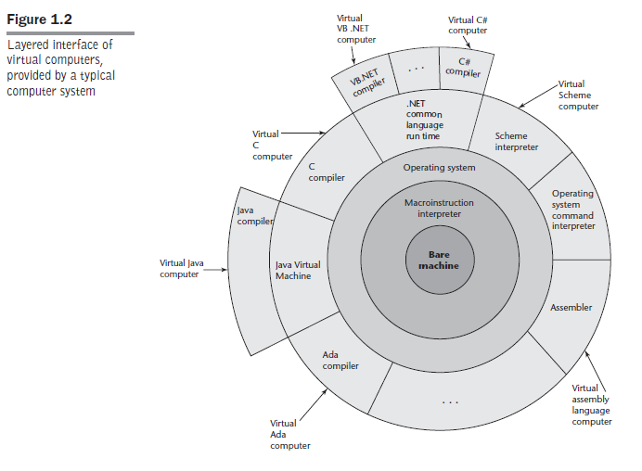
Implementation Methods (cont...)
Adopted from Concepts of Programming Languages - Sebesta

Slide 35
Implementation Methods - Compilation
Programs can be translated to machine language and be directly executed on the computer. This is called compiler implementation.
Very fast program execution.
Ex: C, C++, COBOL, Ada

Slide 36
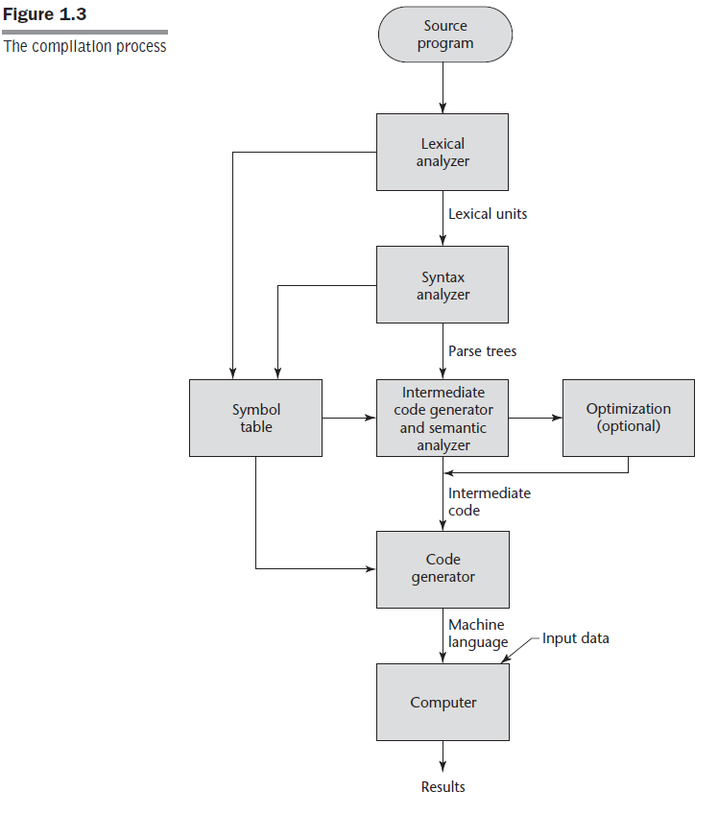
Implementation Methods – Compilation (cont...)
Adopted from Concepts of Programming Languages - Sebesta

Slide 37
Implementation Methods – Compilation (cont...)
The user and system code together is called a load module or executable image.
Process of collecting system programs and linking them to user programs is called linking and loading. This is done by a system program called as linker.
The speed of connection between a computer’s memory and its processor is known as von Neumann bottleneck. This is the primary motivation for research and development of parallel computers.

Slide 38
Implementation Methods – Pure Interpretation
Programs are interpreted by another program called an interpreter, with no translation.
Advantage is easy implementation of many source-level debugging operations.
Disadvantage is this method is 10 to 100 times slower than compiled systems.
Statement decoding is the bottleneck of a pure interpreter.

Slide 39
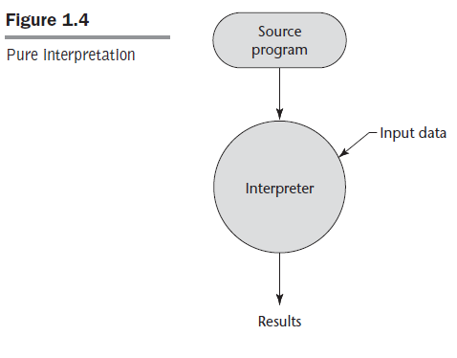
Implementation Methods – Pure Interpretation (cont...)
Adopted from Concepts of Programming Languages - Sebesta

Slide 40
Implementation Methods – Pure Interpretation (cont...)
Another disadvantage is, this method requires more space (for including symbol table along with source code).
Ex: Earlier versions of APL, SNOBOL and LISP

Slide 41
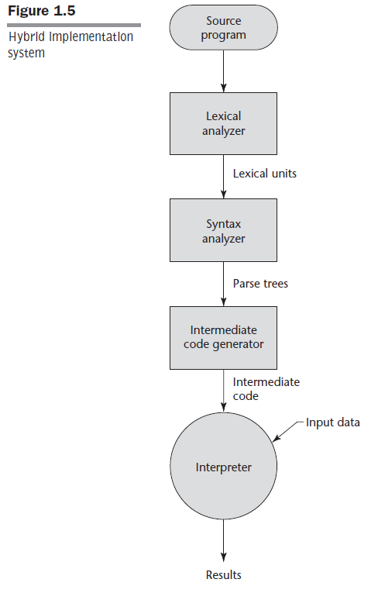
Implementation Methods – Hybrid Approach
Adopted from Concepts of Programming Languages - Sebesta

Slide 42
Implementation Methods – Hybrid Approach (cont...)
High-level programs are translated to an intermediate language designed to allow easy interpretation.
This method is better than pure interpretation as the source language statements are decoded only once.
Ex: Perl, Java and .NET

Slide 43
Programming Environments
A programming environment is a collection of tools used in the development of software.
UNIX is an older programming environment. GUI versions of UNIX or Solaris CDE, GNOME and KDE.
Borland’s JBuilder is an IDE.
Microsoft’s Visual Studio .NET
NetBeans

