Slide 1
Unsupervised learning

Slide 2
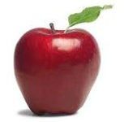
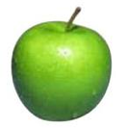
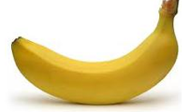
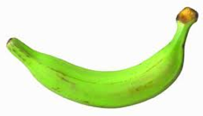
Supervised learning
label
label₁
model/
predictor
label₃
label₄
label₅
Supervised learning: given labeled examples

Slide 3
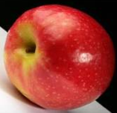
Unsupervised learning
Unupervised learning: given data, i.e. examples, but no labels

Slide 4
Unsupervised learning
Given some example without labels, do something!
learn clusters/groups without any label

Slide 5
What is clustering?
Ch. 16
Clustering: the process of grouping a set of objects into classes of similar objects
Documents within a cluster should be similar.
Documents from different clusters should be dissimilar.
The commonest form of unsupervised learning
Unsupervised learning = learning from raw data, as opposed to supervised data where a classification of examples is given

Slide 6
Unsupervised learning: clustering
Raw data
features
f₁, f₂, f₃, …, f_{n}
f₁, f₂, f₃, …, f_{n}
Clusters
f₁, f₂, f₃, …, f_{n}
f₁, f₂, f₃, …, f_{n}
group into classes/clusters
extract
features
f₁, f₂, f₃, …, f_{n}
No “supervision”, we’re only given data and want to find natural groupings

Slide 7
Unsupervised learning applications
customer segmentation (i.e. grouping)
image compression
bioinformatics: learn motifs
find important features
…

Slide 8
Gene expression data
Data from Garber et al.
PNAS (98), 2001.

Slide 9
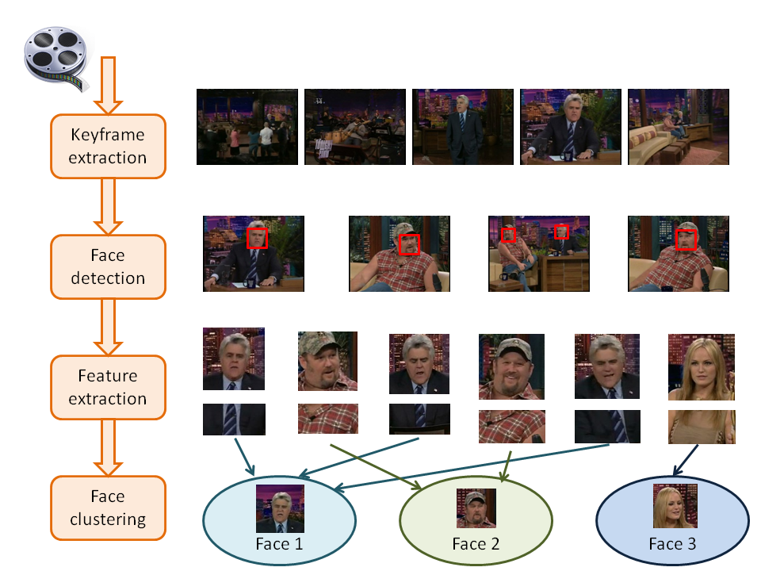
Face Clustering

Slide 10
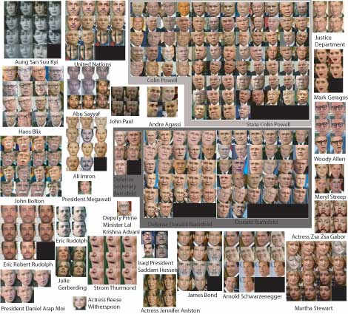
Face clustering

Slide 11
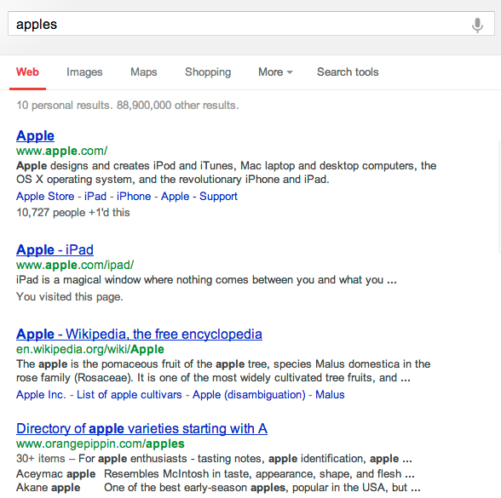
Search result clustering

Slide 12
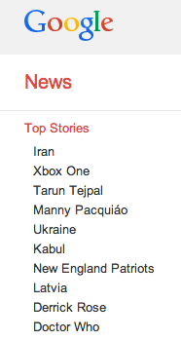
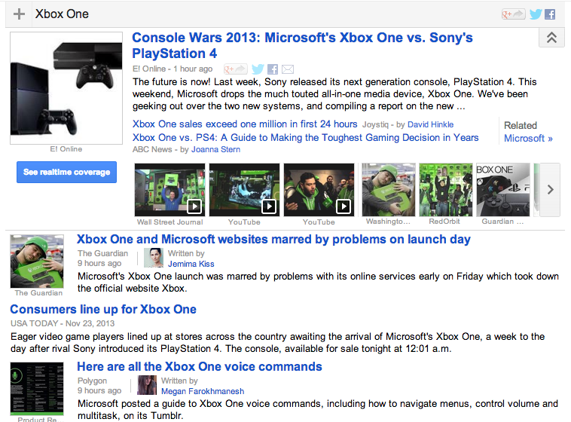
Google News: automatic clustering gives an effective news presentation metaphor

Slide 13
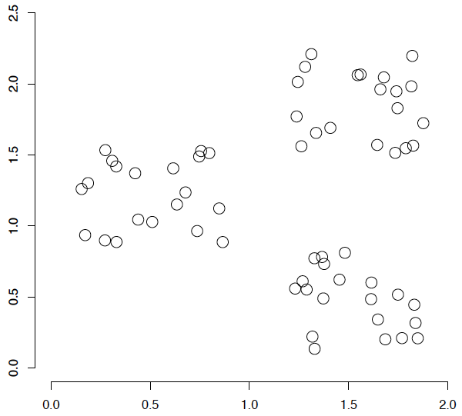
A data set with clear cluster structure
How would you design an algorithm for finding the three clusters in this case?

Slide 14
Yahoo! Hierarchy isn’t clustering but is the kind of output you want from clustering
www.yahoo.com/Science
… (30)
agriculture
biology
physics
CS
space
...
...
...
...
...
dairy
crops
botany
cell
AI
courses
craft
magnetism
HCI
missions
forestry
agronomy
evolution
relativity
Notes:
Final data set:
Yahoo Science hierarchy, consisting of text of web pages pointed to by Yahoo, gathered summer of 1997.
264 classes, only sample shown here.

Slide 15
Issues for clustering
Representation for clustering
How do we represent an example
features, etc.
Similarity/distance between examples
Flat clustering or hierarchical
Number of clusters
Fixed a priori
Data driven?

Slide 16
Clustering Algorithms
Flat algorithms
Usually start with a random (partial) partitioning
Refine it iteratively
K means clustering
Model based clustering
Spectral clustering
Hierarchical algorithms
Bottom-up, agglomerative
Top-down, divisive

Slide 17
Hard vs. soft clustering
Hard clustering: Each example belongs to exactly one cluster
Soft clustering: An example can belong to more than one cluster (probabilistic)
Makes more sense for applications like creating browsable hierarchies
You may want to put a pair of sneakers in two clusters: (i) sports apparel and (ii) shoes

Slide 18
K-means
Most well-known and popular clustering algorithm:
Partitioning method: Construct a partition of n documents into a set of K clusters
Given: a set of documents and the number K
Find: a partition of K clusters that optimizes the chosen partitioning criterion
Iterate:
Assign/cluster each example to closest center
Recalculate centers as the mean of the points in a cluster

Slide 19
K Means Example (K=2)
Sec. 16.4
Pick seeds
Reassign clusters
Compute centroids
Reassign clusters
x
x
x
Compute centroids
x
x
x
Reassign clusters
Converged!

Slide 20
K-means: an example

Slide 21
K-means: Initialize centers randomly

Slide 22
K-means: assign points to nearest center

Slide 23
K-means: readjust centers

Slide 24
K-means: assign points to nearest center

Slide 25
K-means: readjust centers

Slide 26
K-means: assign points to nearest center

Slide 27
K-means: readjust centers

Slide 28
K-means: assign points to nearest center
http://alekseynp.com/viz/k-means.html
No changes: Done

Slide 29
Termination conditions
Sec. 16.4
Several possibilities, e.g.,
A fixed number of iterations.
Doc partition unchanged.
Centroid positions don’t change.

Slide 30
Convergence
Sec. 16.4
Why should the K-means algorithm ever reach a fixed point?
A state in which clusters don’t change.
K-means is a special case of a general procedure known as the Expectation Maximization (EM) algorithm.
EM is known to converge.
Number of iterations could be large.
But in practice usually isn’t

Slide 31
Convergence of K-Means
Sec. 16.4
Lower case!
Define goodness measure of cluster k as sum of squared distances from cluster centroid:
G_{k} = Σ_{i} (d_{i} – c_{k})² (sum over all d_{i} in cluster k)
G = Σ_{k} G_{k}
Reassignment monotonically decreases G since each vector is assigned to the closest centroid.

Slide 32
Time Complexity
Sec. 16.4
Computing distance between two docs is O(M) where M is the dimensionality of the vectors.
Reassigning clusters: O(KN) distance computations, or O(KNM).
Computing centroids: Each doc gets added once to some centroid: O(NM).
Assume these two steps are each done once for I iterations: O(IKNM).

Slide 33

Seed Choice
Sec. 16.4
Results can vary based on random seed selection.
Some seeds can result in poor convergence rate, or convergence to sub-optimal clusterings.
Select good seeds using a heuristic (e.g., doc least similar to any existing mean)
Try out multiple starting points
Initialize with the results of another method.
Example showing
sensitivity to seeds
In the above, if you start
with B and E as centroids
you converge to {A,B,C}
and {D,E,F}
If you start with D and F
you converge to
{A,B,D,E} {C,F}

Slide 34
Distance measures
Euclidean:
good for spatial data

Slide 35
Furthest centers heuristic
μ₁ = pick random point
for i = 2 to K:
μ_{i} = point that is furthest from any previous centers
point with the largest distance to any previous center
smallest distance from x to any previous center

Slide 36
K-means: Initialize furthest from centers
Pick a random point for the first center

Slide 37
K-means: Initialize furthest from centers
What point will be chosen next?

Slide 38
K-means: Initialize furthest from centers
Furthest point from center
What point will be chosen next?

Slide 39
K-means: Initialize furthest from centers
Furthest point from center
What point will be chosen next?

Slide 40
K-means: Initialize furthest from centers
Furthest point from center
Any issues/concerns with this approach?

Slide 41
Furthest points concerns
If k = 4, which points will get chosen?

Slide 42
Furthest points concerns
If we do a number of trials, will we get different centers?
Notes:
yes and no
we will get different centers, but the three outliers will always get chosen!

Slide 43
Furthest points concerns
Doesn’t deal well with outliers

