Slide 1


Data Ethics, Data Privacy, and Support Systems

Slide 2


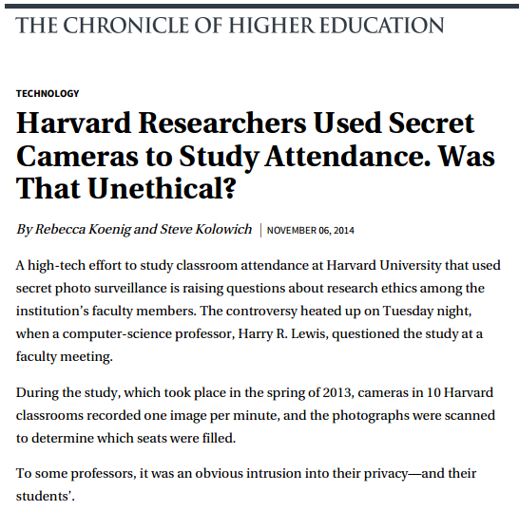
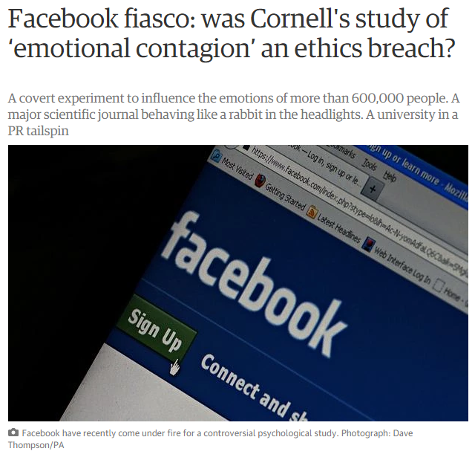
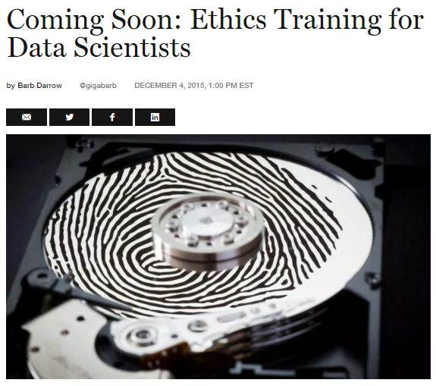
Ethics in the News

Slide 3
Ethical Concerns
Data Collection
Data Storage
Data Sharing, Reuse, Replicability
Re-identification and Consent
Unknown and Emerging

Slide 4
Data Collection
Web scraping
TOS violations
Secondary reuse

Slide 5
Data Storage
3rd Party Storage
Improper Storage
Data Security

Slide 6
Sharing, Reuse, Replicability
Questions about ‘Public Data’
Non-intrusive research
Value of Data Reuse

Slide 7
Unknown and Emerging
“The thing that worries me more is that as we develop new methods and new techniques and new types of research, new potentials for harm, new ethical questions are coming up for which we don’t have many examples yet and people are not aware - the unknown ‘gotchas’ that I worry about people falling into.”

Slide 8
Reframing Ethics
Definitions
Violations
Trustworthy
Morality
Conscience
Mistakes
Transparency
Responsibility
Protection
Integrity
Anonymity
Accountability
Responsibility
Teaching
Consent
Objectivity
Security

Slide 9
Privacy in Research Data
Advancements in data science & data exchange & social changes … meet scholarly communication
Increased publication of data & data deposit mandates
Privacy relevant in STM but concerns also present in HSS

Slide 10
Initial Issues
Data does not contain PII but could if data set is combined with related data sets
Data that is historical in nature contains PII
Data from back-end usage of systems and policies regarding tracking of researcher behavior
Security of data replication and interaction with other systems
Privacy metadata about the data set

Slide 11
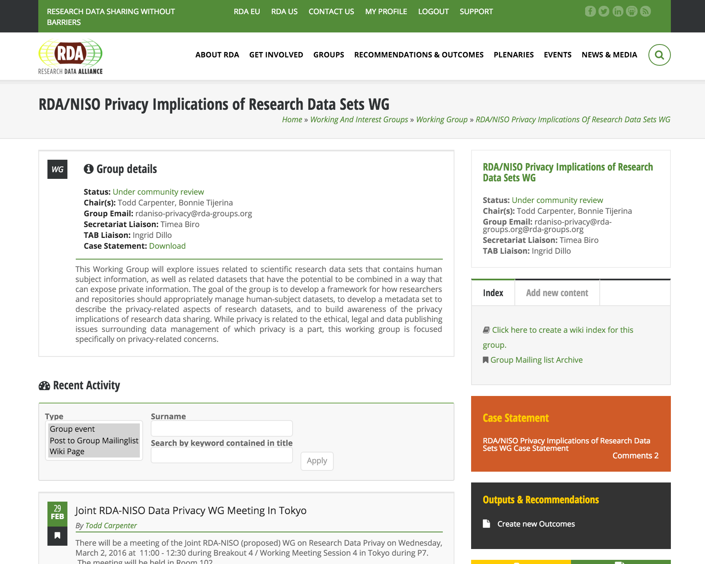

Slide 12
More Issues
When is privacy about a community, not just an individual?
Replication is not being evaluated
Reuse restrictions
Longitudinal consent
Ethical but not legal responsibilities
Library repositories will not take PII
“Privacy is a footnote in the policy world and OA Movement. It’s being left to the local community”

Slide 13
Ethics in Research Data Project
How can infrastructures that exist around technical researchers support the emerging ethical issues in data research?

Slide 14
Teaching Ethics
Apprenticeship
Required click-through training
Embedded ethical questioning
Lecture series
Case studies
For-credit courses

