Slide 1
Supervised Learning NEAREST NEIGHBOR CLASSIFICATION

Slide 2
Instance Based Learning
Idea:
Similar examples have similar label.
Classify new examples like similar training examples.
Algorithm:
Given some new example x for which we need to predict its class y
Find most similar training examples
Classify x “like” these most similar examples
Questions:
How to determine similarity?
How many similar training examples to consider?
How to resolve inconsistencies among the training examples?

Slide 3
Instance-Based Classifiers
Store the training records
Use training records to predict the class label of unseen cases

Slide 4
Instance Based Classifiers
Examples:
Rote-learner
Memorizes entire training data and performs classification only if attributes of record match one of the training examples exactly
Nearest neighbor
Uses k “closest” points (nearest neighbors) for performing classification

Slide 5
Nearest Neighbor Classifiers
Basic idea:
If it walks like a duck, quacks like a duck, then it’s probably a duck
Compute Distance
Test Record
Training Records
Choose k of the “nearest” records

Slide 6
Nearest-Neighbor Classifiers
Requires three things
The set of stored records
Distance Metric to compute distance between records
The value of k, the number of nearest neighbors to retrieve
To classify an unknown record:
Compute distance to other training records
Identify k nearest neighbors
Use class labels of nearest neighbors to determine the class label of unknown record (e.g., by taking majority vote)

Slide 7
Definition of Nearest Neighbor
K-nearest neighbors of a record x are data points that have the k smallest distance to x

Slide 8
1-Nearest Neighbor
One of the simplest of all machine learning classifiers
Simple idea: label a new point the same as the closest known point
Label it red.

Slide 9
k-Nearest Neighbor
Generalizes 1-NN to smooth away noise in the labels
A new point is now assigned the most frequent label of its k nearest neighbors
Label it red, when k = 3
Label it blue, when k = 7

Slide 10
Nearest Neighbor Classification
Compute distance between two points:
Euclidean distance
Determine the class from nearest neighbor list
take the majority vote of class labels among the k-nearest neighbors
Weigh the vote according to distance
weight factor, w = 1/d²

Slide 11
KNN Example
Similarity metric: Number of matching attributes (k=2)
New examples:
Example 1 (great, no, no, normal, no)
Example 2 (mediocre, yes, no, normal, no)
Yes
→ most similar: number 2 (1 mismatch, 4 match) → yes
→Second most similar example: number 1 (2 mismatch, 3 match) → yes
Yes/No
→ Most similar: number 3 (1 mismatch, 4 match) → no
→Second most similar example: number 1 (2 mismatch, 3 match) → yes
Notes:
Distance metric: Number of matching attributes
Example 1:
Most similar example: number 2 (1 mismatch, 4 match) -> classify yes
Second most similar example: number 1 (2 mismatch, 3 match) -> classify yes
Example 2:
Most similar example: number 3 (1 mismatch, 4 match) -> classify no
Second most similar example: number 1 (2 mismatch, 3 match) -> classify yes/no

Slide 12
Selecting the Number of Neighbors
Choosing the value of k:
If k is too small, sensitive to noise points
If k is too large, neighborhood may include points from other classes

Slide 13
Nearest Neighbor Classification…
Scaling issues
Attributes may have to be scaled to prevent distance measures from being dominated by one of the attributes
Example:
height of a person may vary from 1.5m to 1.8m
weight of a person may vary from 90lb to 300lb
income of a person may vary from $10K to $1M

Slide 14
Curse-of-Dimensionality
Prediction accuracy can quickly degrade when number of attributes grows.
Irrelevant attributes easily “swamp” information from relevant attributes
When many irrelevant attributes, similarity/distance measure becomes less reliable
1 1 1 1 1 1 1 1 1 1 1 0
1 0 0 0 0 0 0 0 0 0 0 0
vs
0 1 1 1 1 1 1 1 1 1 1 1
0 0 0 0 0 0 0 0 0 0 0 1
d = 1.4142
d = 1.4142
Solution: Normalize the vectors to unit length

Slide 15
Curse-of-Dimensionality
Remedy
Try to remove irrelevant attributes in pre-processing step
Weight attributes differently
Increase k (but not too much)
1 1 1 1 1 1 1 1 1 1 1 0
1 0 0 0 0 0 0 0 0 0 0 0
vs
0 1 1 1 1 1 1 1 1 1 1 1
0 0 0 0 0 0 0 0 0 0 0 1
d = 1.4142
d = 1.4142
Solution: Normalize the vectors to unit length

Slide 16
Advantages and Disadvantages of KNN
Need distance/similarity measure and attributes that “match” target function.
predicting a person’s height may depend on different attributes than predicting their IQ
For large training sets, must make a pass through the entire dataset for each classification. This can be prohibitive for large data sets.
Prediction accuracy can quickly degrade when number of attributes grows
Simple to implement algorithm;
Requires little tuning;
Often performs quite well!
(Try it first on a new learning problem).

Slide 17
Nearest neighbor Classification…
k-NN classifiers are lazy learners
It does not build models explicitly
Unlike eager learners such as decision tree induction and rule-based systems
Classifying unknown records are relatively expensive
Naïve algorithm: O(n)
Need for structures to retrieve nearest neighbors fast.
The Nearest Neighbor Search problem.

Slide 18
Nearest Neighbor Search
Two-dimensional kd-trees
Data structure for answering nearest neighbor queries faster
kd-tree construction algorithm
Select the x or y dimension (alternating between the two)
Partition the space into two with a line passing from the median point
Repeat recursively in the two partitions as long as there are enough points

Slide 19
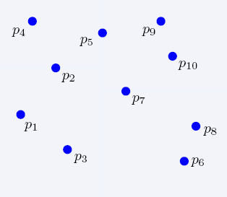
Nearest Neighbor Search
2-dimensional kd-trees

Slide 20
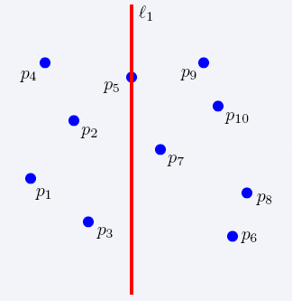
Nearest Neighbor Search
2-dimensional kd-trees

Slide 21
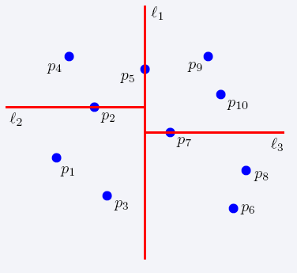
Nearest Neighbor Search
2-dimensional kd-trees

Slide 22
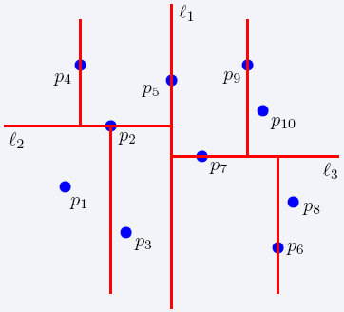
Nearest Neighbor Search
2-dimensional kd-trees

Slide 23
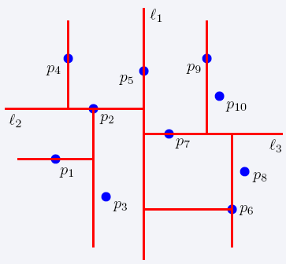
Nearest Neighbor Search
2-dimensional kd-trees

Slide 24
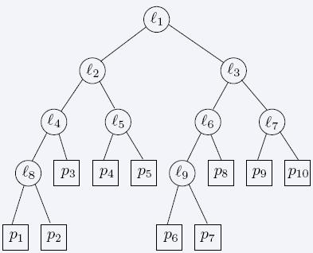
Nearest Neighbor Search
2-dimensional kd-trees

Slide 25
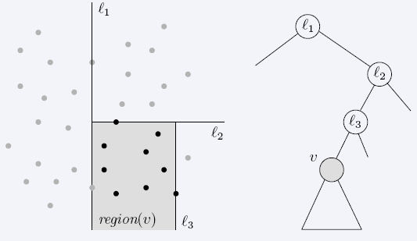
Nearest Neighbor Search
2-dimensional kd-trees
region(u) – all the black points in the subtree of u

Slide 26
Nearest Neighbor Search
2-dimensional kd-trees
A binary tree:
Size O(n)
Depth O(logn)
Construction time O(nlogn)
Query time: worst case O(n), but for many cases O(logn)
Generalizes to d dimensions
Example of Binary Space Partitioning

Slide 27
Decision Trees

Slide 28
Introduction
Decision tree learning is one of the most widely used techniques for classification.
Its classification accuracy is competitive with other methods,
and it is very efficient.
The classification model is a tree, called decision tree.
A decision tree is a tree where each node represents a feature(attribute), each link(branch) represents a decision(rule) and each leaf represents an outcome.
Decision tree algorithms transform raw data to rule based decision making trees

Slide 29
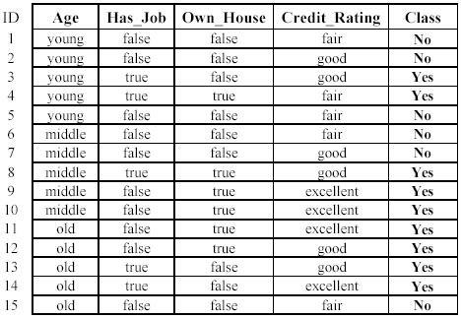
The loan data example
Approved or not

Slide 30
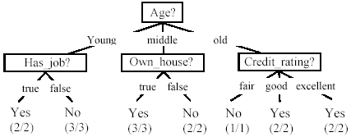
A decision tree from the loan data
Decision nodes and leaf nodes (classes)

Slide 31
Use the decision tree
No

Slide 32
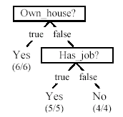
Is the decision tree unique?
No. Here is a simpler tree.
We want smaller tree and accurate tree.
Easy to understand and perform better.
Finding the best tree is NP-hard.
All current tree building algorithms are heuristic algorithms

Slide 33

From a decision tree to a set of rules
A decision tree can be converted to a set of rules
Each path from the root to a leaf is a rule.

Slide 34
Algorithm for decision tree learning
Basic algorithm (a greedy divide-and-conquer algorithm)
Assume attributes are categorical (continuous attributes can be handled too)
Tree is constructed in a top-down recursive manner
At start, all the training examples are at the root
Examples are partitioned recursively based on selected attributes
Attributes are selected on the basis of an impurity function (e.g., information gain)
Conditions for stopping partitioning
All examples for a given node belong to the same class
There are no remaining attributes for further partitioning – majority class is the leaf
There are no examples left

Slide 35
Choose an attribute to partition data
The key to building a decision tree - which attribute to choose in order to branch.
The objective is to reduce impurity or uncertainty in data as much as possible.
A subset of data is pure if all instances belong to the same class.
The heuristic in C4.5 is to choose the attribute with the maximum Information Gain or Gain Ratio based on information theory.

Slide 36
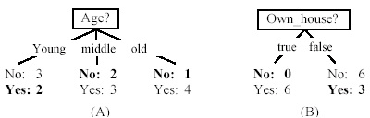
Two possible roots, which is better?
Fig. (B) seems to be better.

Slide 37
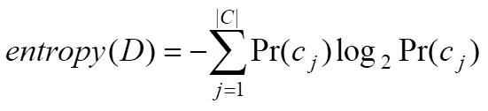
Entropy Measure
The entropy formula,
Pr(c_{j}) is the probability of class c_{j} in data set D
We use entropy as a measure of impurity or disorder of data set D. (Or, a measure of information in a tree)

Slide 38
How to choose the best attribute?
use the attribute with the highest information gain
In order to define information gain precisely, we begin by defining a measure commonly used in information theory, called entropy that characterizes the (im)purity of an arbitrary collection of examples.

Slide 39
Entropy Measure
For a binary classification problem
If all examples are positive or all are negative then entropy will be zero i.e, low.
If half of the examples are of positive class and half are of negative class then entropy is one i.e, high.
As the data become purer and purer, the entropy value becomes smaller and smaller. This is useful to us!

Slide 40
Information Gain
If we make attribute A_{i}, with v values, the root of the current tree, this will partition D into v subsets D₁, D₂ …, D_{v} . The expected entropy if A_{i} is used as the current root:
Information gained by selecting attribute A_{i} to branch or to partition the data is:
We choose the attribute with the highest gain to branch/split the current tree.

Slide 41
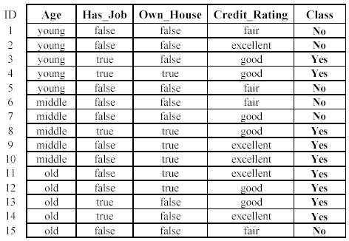

An example
Own_house is the best choice for the root.

Slide 42
We build the final tree
We can use information gain ratio to evaluate the impurity as well

Slide 43
Handling continuous attributes
Handle continuous attribute by splitting into two intervals (can be more) at each node.
How to find the best threshold to divide?
Use information gain or gain ratio again
Sort all the values of an continuous attribute in increasing order {v₁, v₂, …, v_{r}},
One possible threshold between two adjacent values v_{i} and v_{i+1}. Try all possible thresholds and find the one that maximizes the gain (or gain ratio).

Slide 44
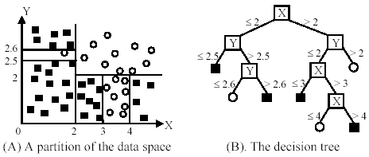
An example in a continuous space

Slide 45
Avoid overfitting in classification
Overfitting: A tree may overfit the training data
Good accuracy on training data but poor on test data
Symptoms: tree too deep and too many branches, some may reflect anomalies due to noise or outliers
Two approaches to avoid overfitting
Pre-pruning: Halt tree construction early
Difficult to decide because we do not know what may happen subsequently if we keep growing the tree.
Post-pruning: Remove branches or sub-trees from a “fully grown” tree.
This method is commonly used. C4.5 uses a statistical method to estimates the errors at each node for pruning.
A validation set may be used for pruning as well.

Slide 46
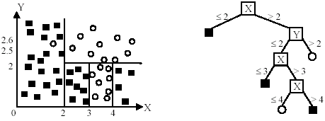
An example
Likely to overfit the data

Slide 47
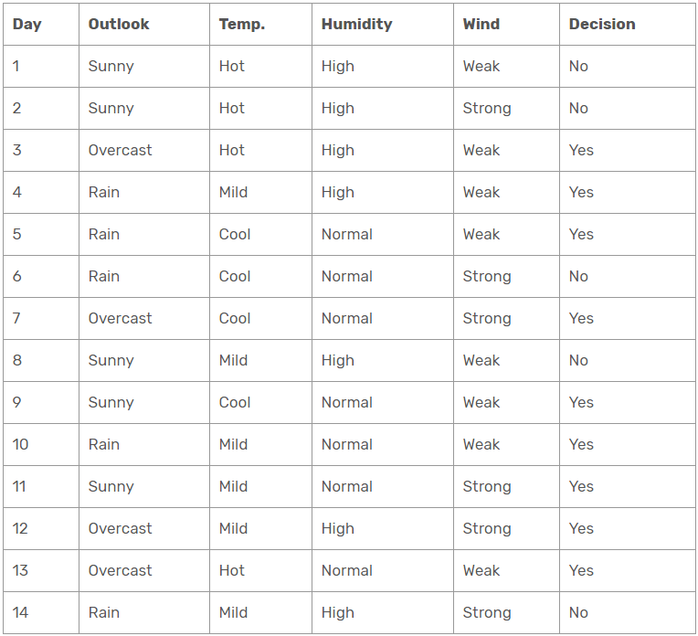
Example-1

Slide 48
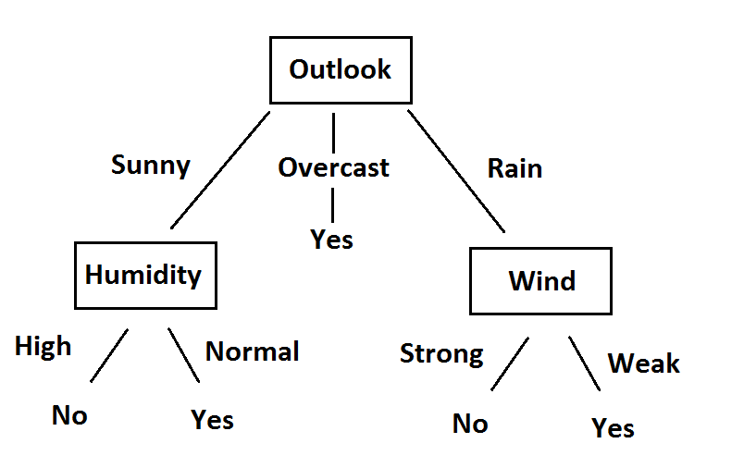
Solution

Slide 49










Example-2
Person | Hair Length | Weight | Age | Class
Homer | 0” | 250 | 36 | M
Marge | 10” | 150 | 34 | F
Bart | 2” | 90 | 10 | M
Lisa | 6” | 78 | 8 | F
Maggie | 4” | 20 | 1 | F
Abe | 1” | 170 | 70 | M
Selma | 8” | 160 | 41 | F
Otto | 10” | 180 | 38 | M
Krusty | 6” | 200 | 45 | M
Comic | 8” | 290 | 38 | ?

Slide 50
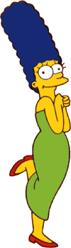


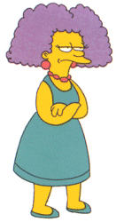
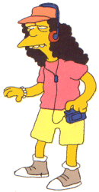
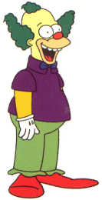
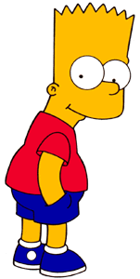

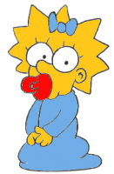
Entropy(4F,5M) = -(4/9)log₂(4/9) - (5/9)log₂(5/9)
= 0.9911
yes
no
Hair Length <= 5?
Let us try splitting on Hair length
Entropy(1F,3M) = -(1/4)log₂(1/4) - (3/4)log₂(3/4)
= 0.8113
Entropy(3F,2M) = -(3/5)log₂(3/5) - (2/5)log₂(2/5)
= 0.9710
Gain(Hair Length <= 5) = 0.9911 – (4/9 * 0.8113 + 5/9 * 0.9710 ) = 0.0911

Slide 51
Entropy(4F,5M) = -(4/9)log₂(4/9) - (5/9)log₂(5/9)
= 0.9911
yes
no
Weight <= 160?
Let us try splitting on Weight
Entropy(4F,1M) = -(4/5)log₂(4/5) - (1/5)log₂(1/5)
= 0.7219
Entropy(0F,4M) = -(0/4)log₂(0/4) - (4/4)log₂(4/4)
= 0
Gain(Weight <= 160) = 0.9911 – (5/9 * 0.7219 + 4/9 * 0 ) = 0.5900

Slide 52
Entropy(4F,5M) = -(4/9)log₂(4/9) - (5/9)log₂(5/9)
= 0.9911
yes
no
age <= 40?
Let us try splitting on Age
Entropy(3F,3M) = -(3/6)log₂(3/6) - (3/6)log₂(3/6)
= 1
Entropy(1F,2M) = -(1/3)log₂(1/3) - (2/3)log₂(2/3)
= 0.9183
Gain(Age <= 40) = 0.9911 – (6/9 * 1 + 3/9 * 0.9183 ) = 0.0183

Slide 53
Of the 3 features we had, Weight was best. But while people who weigh over 160 are perfectly classified (as males), the under 160 people are not perfectly classified… So we simply recurse!
yes
no
Weight <= 160?
This time we find that we can split on Hair length, and we are done!
yes
no
Hair Length <= 2?

Slide 54
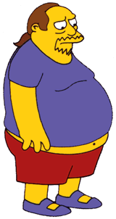
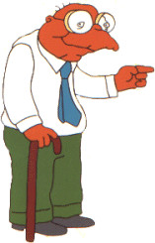

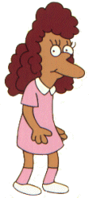
We need don’t need to keep the data around, just the test conditions.
Weight <= 160?
yes
no
How would these people be classified?
Hair Length <= 2?
Male
yes
no
Male
Female

Slide 55
It is trivial to convert Decision Trees to rules…
Weight <= 160?
yes
no
Hair Length <= 2?
Male
yes
no
Male
Female
Rules to Classify Males/Females
If Weight greater than 160, classify as Male
Elseif Hair Length less than or equal to 2, classify as Male
Else classify as Female

