Slide 1
Data Management in the Cloud

Slide 2
Outline
Motivation
what is cloud computing?
what is cloud data management?
Challenges, opportunities and limitations
what makes data management in the cloud difficult?
New solutions
key/value, document, column family, graph, array, and object databases
scalable SQL databases
Application
graph data and algorithms
usage scenarios

Slide 3
What is Cloud Computing?
Different definitions for “Cloud Computing” exist
http://tech.slashdot.org/article.pl?sid=08/07/17/2117221
Common ground of many definitions
processing power, storage and software are commodities that are readily available from large infrastructure
service-based view: “everything as a service (*aaS)”, where only “Software as a Service (SaaS)” has a precise and agreed-upon definition
utility computing: pay-as-you-go model

Slide 4
Service-Based View on Computing
Source: Wikipedia (http://www.wikipedia.org)

Slide 5
Terminology
Term cloud computing usually refers to both
SaaS: applications delivered over the Internet as services
The Cloud: data center hardware and systems software
Public clouds
available in a pay-as-you-go manner to the public
service being sold is utility computing
Amazon Web Service, Microsoft Azure, Google AppEngine
Private clouds
internal data centers of businesses or organizations
normally not included under cloud computing
Based on: “Above the Clouds: A Berkeley View of Cloud Computing”, RAD Lab, UC Berkeley

Slide 6
Utility Computing
Illusion of infinite computing resources
available on demand
no need for users to plan ahead for provisioning
No up-front cost or commitment by users
companies can start small (demand unknown in advance)
increase resources only when there is an increase in need (demand varies with time)
Pay for use on short-term basis as needed
processors by the hour and storage by the day
release them as needed, reward conservation
“Cost associativity”
1000 EC2 machines for 1 hour = 1 EC2 machine for 1000 hours
Based on: “Above the Clouds: A Berkeley View of Cloud Computing”, RAD Lab, UC Berkeley
Notes:
Foundry example, electric company example, intro from abadi

Slide 7
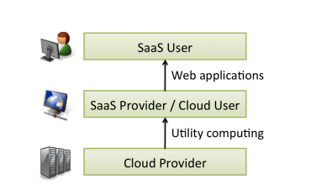
Cloud Computing Users and Providers
Picture credit: “Above the Clouds: A Berkeley View of Cloud Computing”, RAD Lab, UC Berkeley

Slide 8
Virtualization
Virtual resources abstract from physical resources
hardware platform, software, memory, storage, network
fine-granular, lightweight, flexible and dynamic
Relevance to cloud computing
centralize and ease administrative tasks
improve scalability and work loads
increase stability and fault-tolerance
provide standardized, homogenous computing platform through hardware virtualization, i.e. virtual machines

Slide 9
Spectrum of Virtualization
Computation virtualization
Instruction set VM (Amazon EC2, 3Tera)
Byte-code VM (Microsoft Azure)
Framework VM (Google AppEngine, Force.com)
Storage virtualization
Network virtualization
Lower-level,
Less management
Higher-level,
More management
EC2
Azure
AppEngine
Force.com
Slide Credit: RAD Lab, UC Berkeley

Slide 10
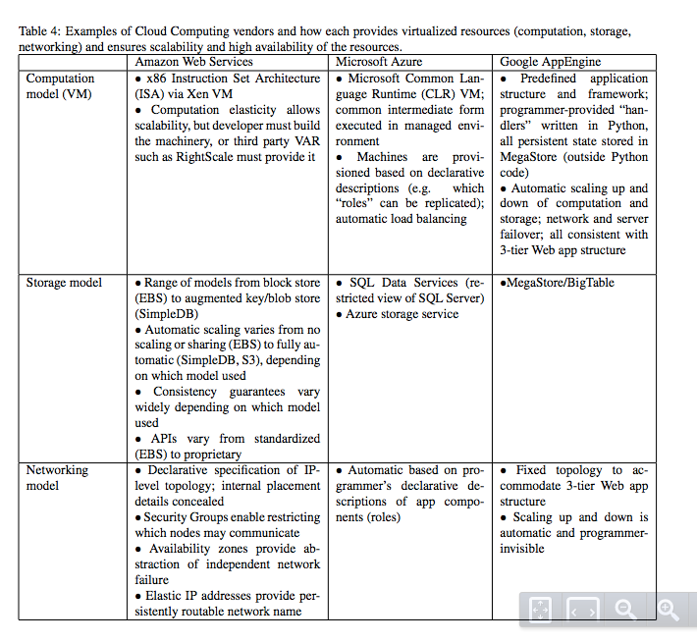
Table credit: “Above the Clouds: A Berkeley View of Cloud Computing”, RAD Lab, UC Berkeley

Slide 11
Economics of Cloud Users
Pay by use instead of provisioning for peak
Static data center
Data center in the cloud
Capacity
Resources
Resources
Capacity
Demand
Demand
Time
Time
Unused resources
Slide Credit: RAD Lab, UC Berkeley

Slide 12
Economics of Cloud Users
Risk of over-provisioning: underutilization
Static data center
Capacity
Resources
Demand
Time
Unused resources
Slide Credit: RAD Lab, UC Berkeley

Slide 13
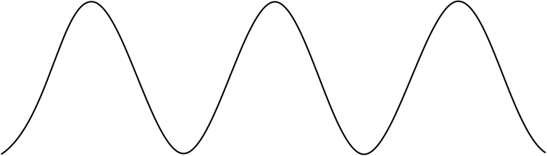
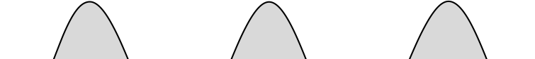
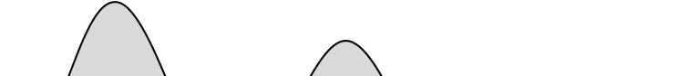

Economics of Cloud Users
Heavy penalty for under-provisioning
Resources
Capacity
Demand
1
2
3
Time (days)
Lost revenue
Lost users
Resources
Resources
Capacity
Capacity
Demand
Demand
1
2
3
1
2
3
Time (days)
Time (days)
Slide Credit: RAD Lab, UC Berkeley

Slide 14
Economics of Cloud Providers
Cloud computing is 5-7x cheaper than traditional in-house computing
Power/cooling costs: approx double cost of storage, CPU, network
Added benefits (to cloud providers)
utilize off-peak capacity (Amazon)
sell .NET tools (Microsoft)
reuse existing infrastructure (Google)
Resource | Cost in Medium Data Center | Cost in Very Large Data Center | Ratio
Network | $95/Mbps/month | $13/Mbps/month | 7.1x
Storage | $2.20/GB/month | $0.40/GB/month | 5.7x
Administration | ≈140 servers/admin | >1000 servers/admin | 7.1x
Source: James Hamilton (http://perspectives.mvdirona.com)
Slide Credit: RAD Lab, UC Berkeley

Slide 15
What is Cloud Data Management?
Data management applications are potential candidates for deployment in the cloud
industry: enterprise database system have significant up-front cost that includes both hardware and software costs
academia: manage, process and share mass-produced data in the cloud
Many “Cloud Killer Apps” are in fact data-intensive
Batch Processing as with map/reduce
Online Transaction Processing (OLTP) as in automated business applications
Online Analytical Processing (OLAP) as in data mining or machine learning

Slide 16
Scientific Data Management Applications
Old model
“Query the world”
data acquisition coupled to a specific hypothesis
New model
“Download the world”
data acquired en masse, in support of many hypotheses
E-science examples
astronomy: high-resolution, high-frequency sky surveys, …
oceanography: high-resolution models, cheap sensors, satellites, …
biology: lab automation, high-throughput sequencing, ...
Slide Credit: Bill Howe, U Washington

Slide 17
Scaling Databases
Flavors of database scalability
lots of (small) transactions
lots of copies of the data
lots of processors running on a single query (compute intensive tasks)
extremely large data set for one query (data intensive tasks)
Data replication
move data to where it is needed
managed replication for availability and reliability

Slide 18
Revisit Cloud Characteristics
Compute power is elastic, but only if workload is parallelizable
transactional database management systems do not typically use a shared-nothing architecture
shared-nothing is a good match for analytical data management
some things parallelize well (i.e. sum), some do not (i.e. median)
Think about: Google gmail, Amazon web site – easy? Difficult?
Google App Engine – API forces ability to run in shared nothing
Scalability
in the past: out-of-core, works even if data does not fit in main memory
in the present: exploits thousands of (cheap) nodes in parallel
Based on: “Data Management in the Cloud: Limitations and Opportunities”, IEEE, 2009.

Slide 19
Parallel Database Architectures
Shared nothing
Shared disc
Shared memory
interconnect
…
…
interconnect
…
interconnect
processor
memory
disk
Source: D. DeWitt and J. Gray: “Parallel Database Systems: The Future of High Performance Database Processing”, CACM 36(6), pp. 85-98, 1992.

Slide 20
Revisit Cloud Characteristics
Data is stored at an untrusted host
there are risks with respect to privacy and security in storing transactional data on an untrusted host
particularly sensitive data can be left out of analysis or anonymized
sharing and enabling access is often precisely the goal of using the cloud for scientific data sets
where exactly is your data? and what are that country’s laws?
Based on: “Data Management in the Cloud: Limitations and Opportunities”, IEEE, 2009.

Slide 21
Revisit Cloud Characteristics
Data is replicated, often across large geographic distances
it is hard to maintain ACID guarantees in the presence of large-scale replication
full ACID guarantees are typically not required in analytical applications
Virtualizing large data collections is challenging
data loading takes more time than starting a VM
storage cost vs. bandwidth cost
online vs. offline replication
Based on: “Data Management in the Cloud: Limitations and Opportunities”, IEEE, 2009.

Slide 22
Challenges
Trade-off between functionality and operational cost
restricted interface, minimalist query language, limited consistency guarantees
pushes more programming burden on developers
enables predictable services and service level agreements
Manageability
limited human intervention, high-variance workloads, and a variety of shared infrastructures
need for self-managing and adaptive database techniques
Based on: “The Claremont Report on Database Research”, 2008

Slide 23
Challenges
Scalability
today’s SQL databases cannot scale to the thousands of nodes deployed in the cloud context
hard to support multiple, distributed updaters to the same data set
hard to replicate huge data sets for availability, due to capacity (storage, network bandwidth, …)
storage: different transactional implementation techniques, different storage semantics, or both
query processing and optimization: limitations on either the plan space or the search will be required
programmability: express programs in the cloud
Based on: “The Claremont Report on Database Research”, 2008

Slide 24
Challenges
Data privacy and security
protect from other users and cloud providers
specifically target usage scenarios in the cloud with practical incentives for providers and customers
New applications: “mash up” interesting data sets
expect services pre-loaded with large data sets, stock prices, web crawls, scientific data
data sets from private or public domain
might give rise to federated cloud architectures
Based on: “The Claremont Report on Database Research”, 2008

Slide 25
Transactional Data Management – Cloud or not?
Transactional Data Management
Banking, airline reservation, e-commerce, etc…
Require ACID, write-intensive
Features
Do not typically use shared-nothing architectures (changing a bit)
Hard to maintain ACID guarantees in the face of data replication over large geographic distances
There are risks in storing transactional data on an untrusted host
Conclusion: not appropriate for the cloud
Based on: “Data Management in the Cloud: Limitations and Opportunities”, IEEE, 2009.

Slide 26
Analytical Data Management – Cloud or not?
Analytical Data Management
Query data from a data store for planning, problem solving, decision support
Large scale
Read-mostly
Features
Shared-nothing architecture is a good match for analytical data management (Teradata, Greenplum, Vertica…)
ACID guarantees typically not needed
Particularly sensitive data left out of analysis
Conclusion: appropriate for the cloud
Based on: “Data Management in the Cloud: Limitations and Opportunities”, IEEE, 2009.

Slide 27
Cloud DBMS Wish List
Efficiency
Fault tolerance (query restart not required, commodity hw)
Heterogeneous environment (performance of compute nodes not consistent)
Operate on encrypted data
Interface with business intelligence products
Based on: “Data Management in the Cloud: Limitations and Opportunities”, IEEE, 2009.

Slide 28
Option 1: MapReduce-like software
Fault tolerance (yes, commodity hw)
Heterogeneous environment (yes, by design)
Operate on encrypted data (no)
Interface with business intelligence products (no, not SQL-compliant, no standard)
Efficiency (up for debate)
Questionable results in the MapReduce paper
Absence of a loading phase (no indices, materialized views)
Based on: “Data Management in the Cloud: Limitations and Opportunities”, IEEE, 2009.

Slide 29
Option 2: Shared-Nothing Parallel Database
Interface with business intelligence products (yes, by design)
Efficiency (yes)
Fault tolerance (no - query restart required)
Heterogeneous environment (no)
Operate on encrypted data (no)
Based on: “Data Management in the Cloud: Limitations and Opportunities”, IEEE, 2009.

Slide 30
Option 3: A Hybrid Solution
HadoopDB (http://db.cs.yale.edu/hadoopdb/hadoopdb.html)
A hybrid of DBMS and MapReduce technologies that targets analytical workloads
Designed to run on a shared-nothing cluster of commodity machines, or in the cloud
An attempt to fill the gap in the market for a free and open source parallel DBMS
Much more scalable than currently available parallel database systems and DBMS/MapReduce hybrid systems.
As scalable as Hadoop, while achieving superior performance on structured data analysis workload
Commercialized as Hadapt (hadapt.com)

Slide 31
Why NoSQL?
Value of relational databases
Persistent data
Concurrency/transactions
Integration
(Mostly) Standard Model
Impedance Mismatch
Application vs. Integration databases
Based on: “NoSQL Distilled: A Brief Guide to the Emerging World of Polyglot Persistence”, 2013

Slide 32
Attack of the Clusters
Data growth (links, social networks, logs, users)
Need to scale to accommodate growth
Traditional RDBMS (Oracle / Microsoft SQL Server) – shared disk – don’t scale well
“technical issues are exacerbated by licensing costs”
Google, Amazon influential
“The interesting thing about Cloud Computing is that we’ve redefined Cloud Computing to include everything that we already do… I don’t’ understand what we would do differently in the light of Cloud Computing other than change the wording of some of our ads.” – Larry Ellison
Based on: “NoSQL Distilled: A Brief Guide to the Emerging World of Polyglot Persistence”, 2013

Slide 33
Emergence of NoSQL
No strong definition, but…
Do not use SQL
Typically open-source
Typically oriented towards clusters (but not all)
Operate without a schema
Various types (in order of complexity)
Key-value stores
Document Stores
Extensible Record Stores
Based on: “NoSQL Distilled: A Brief Guide to the Emerging World of Polyglot Persistence”, 2013

Slide 34
What were we talking about?
Cloud Computing
Utility Computing
Virtualization
Economics (pay as you go)
Data management in the cloud
Cloud characteristics (elasticity if parallelizable, untrusted host, large distances)
Transactional vs. Analytical
Wish List
Map Reduce vs. Shared-Nothing -> Hybrid
DB vs. NoSQL in two lines…
Database: complex / concurrent
NoSQL: simple / scalable

Slide 35
References
M. Armbrust, A. Fox, R. Griffith, A. D. Joseph, R. H. Katz, A. Konwinski, G. Lee, D. A. Patterson, A. Rabkin, I. Stoica, M. Zaharia: Above the Clouds: A Berkeley View of Cloud Computing. Tech. Rep. No. UCB/EECS-2009-28, 2009.
D. J. Abadi: Data Management in the Cloud: Limitations and Opportunities. IEEE Data Eng. Bull. 32(1), pp. 3—12, 2009.
R. Agrawal, A. Ailamaki, P. A. Bernstein, E. A. Brewer, M. J. Carey, S. Chaudhuri, A. Doan, D. Florescu, M. J. Franklin, H. Garcia‐ Molina, J. Gehrke, L. Gruenwald, L. M. Haas, A. Y. Halevy, J. M. Hellerstein, Y. E. Ioannidis, H. F. Korth, D. Kossmann, S. Madden, R. Magoulas, B. Chin Ooi, T. O’Reilly, R. Ramakrishnan, S. Sarawagi, M. Stonebraker, A. S. Szalay, G. Weikum: The Claremont Report on Database Research. 2008.
P. Sadalage, M. Fowler. NoSQL Distilled: A Brief Guide to the Emerging World of Polyglot Persistence. 2013

