Slide 1
Linear correlation and linear regression

Slide 2
Continuous outcome (means)
Outcome Variable | Are the observations independent or correlated? |  | Alternatives if the normality assumption is violated (and small sample size):
 | independent | correlated
Continuous (e.g. pain scale, cognitive function) | Ttest: compares means between two independent groups ANOVA: compares means between more than two independent groups Pearson’s correlation coefficient (linear correlation): shows linear correlation between two continuous variables Linear regression: multivariate regression technique used when the outcome is continuous; gives slopes | Paired ttest: compares means between two related groups (e.g., the same subjects before and after) Repeated-measures ANOVA: compares changes over time in the means of two or more groups (repeated measurements) Mixed models/GEE modeling: multivariate regression techniques to compare changes over time between two or more groups; gives rate of change over time | Non-parametric statistics Wilcoxon sign-rank test: non-parametric alternative to the paired ttest Wilcoxon sum-rank test (=Mann-Whitney U test): non-parametric alternative to the ttest Kruskal-Wallis test: non-parametric alternative to ANOVA Spearman rank correlation coefficient: non-parametric alternative to Pearson’s correlation coefficient

Slide 3
Recall: Covariance

Slide 4
Interpreting Covariance
cov(X,Y) > 0 X and Y are positively correlated
cov(X,Y) < 0 X and Y are inversely correlated
cov(X,Y) = 0 X and Y are independent

Slide 5
Correlation coefficient
Pearson’s Correlation Coefficient is standardized covariance (unitless):

Slide 6
Correlation
Measures the relative strength of the linear relationship between two variables
Unit-less
Ranges between –1 and 1
The closer to –1, the stronger the negative linear relationship
The closer to 1, the stronger the positive linear relationship
The closer to 0, the weaker any positive linear relationship

Slide 7
Scatter Plots of Data with Various Correlation Coefficients
Y
Y
Y
X
X
X
r = -1
r = -.6
r = 0
Y
Y
Y
X
X
X
r = +1
r = +.3
r = 0
Slide from: Statistics for Managers Using Microsoft® Excel 4th Edition, 2004 Prentice-Hall

Slide 8
Linear Correlation
Linear relationships
Curvilinear relationships
Y
Y
X
X
Y
Y
X
X
Slide from: Statistics for Managers Using Microsoft® Excel 4th Edition, 2004 Prentice-Hall

Slide 9
Linear Correlation
Strong relationships
Weak relationships
Y
Y
X
X
Y
Y
X
X
Slide from: Statistics for Managers Using Microsoft® Excel 4th Edition, 2004 Prentice-Hall

Slide 10
Linear Correlation
No relationship
Y
X
Y
X
Slide from: Statistics for Managers Using Microsoft® Excel 4th Edition, 2004 Prentice-Hall

Slide 11
Calculating by hand…

Slide 12
Simpler calculation formula…
Numerator of covariance
Numerators of variance

Slide 13
Continuous outcome (means)
Outcome Variable | Are the observations independent or correlated? |  | Alternatives if the normality assumption is violated (and small sample size):
 | independent | correlated
Continuous (e.g. pain scale, cognitive function) | Ttest: compares means between two independent groups ANOVA: compares means between more than two independent groups Pearson’s correlation coefficient (linear correlation): shows linear correlation between two continuous variables Linear regression: multivariate regression technique used when the outcome is continuous; gives slopes | Paired ttest: compares means between two related groups (e.g., the same subjects before and after) Repeated-measures ANOVA: compares changes over time in the means of two or more groups (repeated measurements) Mixed models/GEE modeling: multivariate regression techniques to compare changes over time between two or more groups; gives rate of change over time | Non-parametric statistics Wilcoxon sign-rank test: non-parametric alternative to the paired ttest Wilcoxon sum-rank test (=Mann-Whitney U test): non-parametric alternative to the ttest Kruskal-Wallis test: non-parametric alternative to ANOVA Spearman rank correlation coefficient: non-parametric alternative to Pearson’s correlation coefficient

Slide 14
Linear regression
In correlation, the two variables are treated as equals. In regression, one variable is considered independent (=predictor) variable (X) and the other the dependent (=outcome) variable Y.
In a cause and effect relationship, the independent variable is the cause, and the dependent variable is the effect. Least squares linear regression is a method for predicting the value of a dependent variable Y, based on the value of an independent variable X.

Slide 15
What is “Linear”?
Remember this:
Y=mX+B?
m
B

Slide 16
What’s Slope?
A slope of 2 means that every 1-unit change in X yields a 2-unit change in Y.

Slide 17
Prediction
If you know something about X, this knowledge helps you predict something about Y. (Sound familiar?…sound like conditional probabilities?)

Slide 18
Regression equation…
Expected value of y at a given level of x=

Slide 19
Predicted value for an individual…
y_{i}= α + β*x_{i} + random error_{i}
Fixed – exactly on the line
Follows a normal distribution

Slide 20
Assumptions (or the fine print)
Linear regression assumes that…
1. The relationship between X and Y is linear
2. Y is distributed normally at each value of X
3. The variance of Y at every value of X is the same (homogeneity of variances)
4. The observations are independent

Slide 21
The standard error of Y given X is the average variability around the regression line at any given value of X. It is assumed to be equal at all values of X.
Sy/x
Sy/x
Sy/x
Sy/x
Sy/x
Sy/x

Slide 22
Regression Picture
y_{i}
C
A
B
y
B
A
C
y_{i}
*Least squares estimation gave us the line (β) that minimized C²
x
R²=SSreg/SStotal
A² B² C²
SS_{total}
Total squared distance of observations from naïve mean of y
Total variation
SS_{reg}
Distance from regression line to naïve mean of y
Variability due to x (regression)
SS_{residual}
Variance around the regression line
Additional variability not explained by x—what least squares method aims to minimize

Slide 23
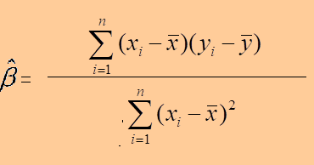
Regression Picture
Slope =
= r * sy/sx
Intercept=
Regression line always goes through the point:

Slide 24
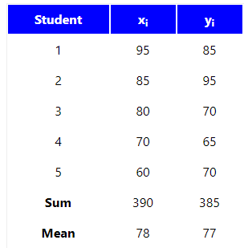
Regression Example
https://stattrek.com/regression/regression-example.aspx?Tutorial=AP
Last year, five randomly selected students took a math aptitude test before they began their statistics course. The Statistics Department has three questions.
What linear regression equation best predicts statistics performance, based on math aptitude scores?
If a student made an 80 on the aptitude test, what grade would we expect her to make in statistics?
How well does the regression equation fit the data?
Solution: ŷ = 26.768 + 0.644x

Slide 25
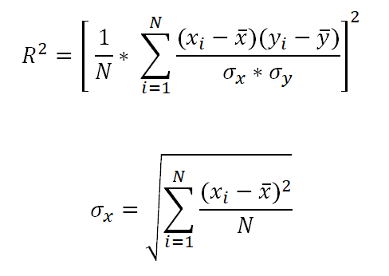
Coefficient of Determination
Coefficient of Determination is the square of the correlation (r) between predicted Y scores and actual Y scores.
It is also equal to the square of correlation (r) between X and Y scores.
R² = 0 means that dependent variable Y cannot be predicted from X.
R² = 1 means that dependent variable Y can be predicted from X with zero error.

Slide 26
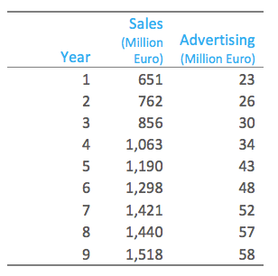
Regression Example
Solution: ŷ = 168 + 23x
R2 = 0.98

