Slide 1
Parallel Databases

Slide 2
Parallel Databases
Introduction
Parallelism in Database
I/O Parallelism
Interquery Parallelism
Intraquery Parallelism
Intraoperation Parallelism
Interoperation Parallelism
Design of Parallel Systems

Slide 3
Parallel Databases

Slide 4
Introduction
Parallel machines are becoming quite common and affordable
Prices of microprocessors, memory and disks have dropped sharply
Databases are growing increasingly large
large volumes of transaction data are collected and stored for later analysis.
multimedia objects like images are increasingly stored in databases
Large-scale parallel database systems increasingly used for:
storing large volumes of data
processing time-consuming decision-support queries
providing high throughput for transaction processing

Slide 5
Parallelism in Databases
Data can be partitioned across multiple disks for parallel I/O.
Individual relational operations (e.g., sort, join, aggregation) can be executed in parallel
data can be partitioned and each processor can work independently on its own partition.
Queries are expressed in high level language (SQL, translated to relational algebra)
makes parallelization easier.
Different queries can be run in parallel with each other. Concurrency control takes care of conflicts.
Thus, databases naturally lend themselves to parallelism.

Slide 6
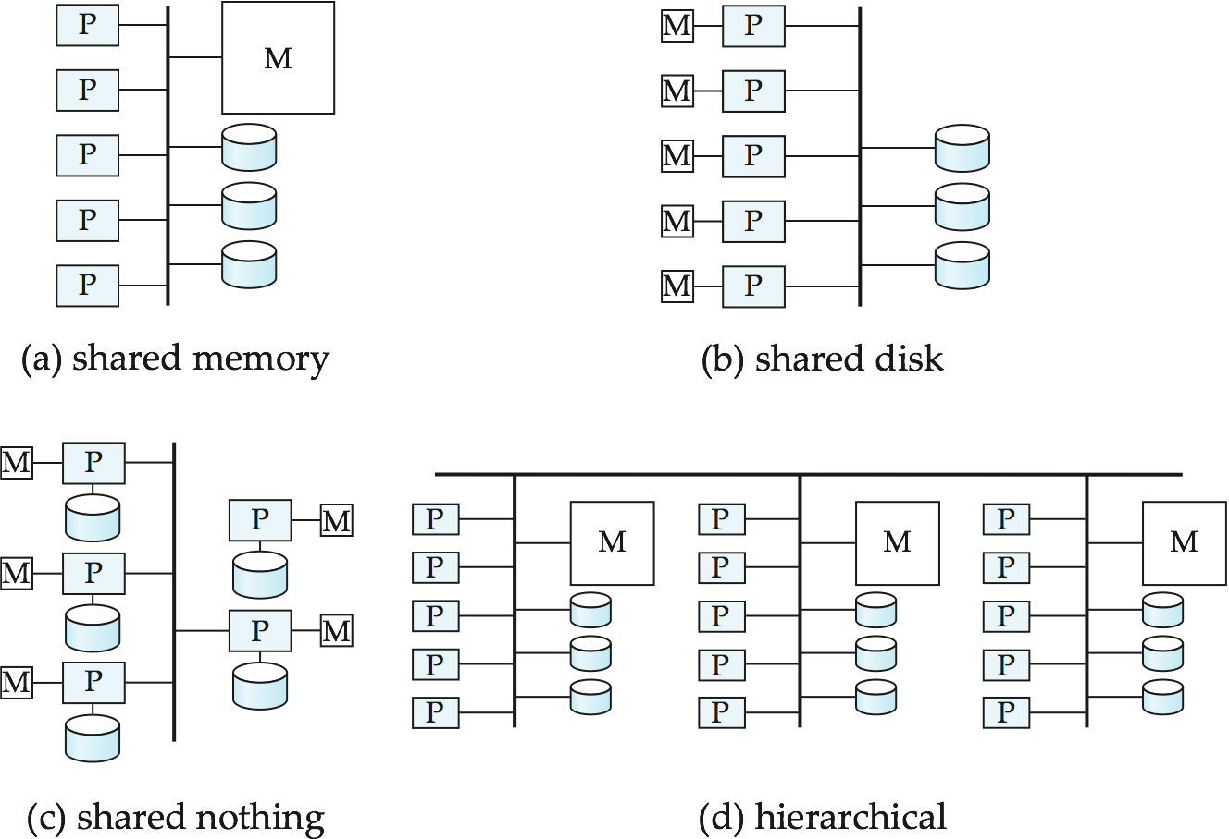
Parallel Database Architectures

Slide 7
Parallel Database Architectures
Shared memory -- processors share a common memory
Shared disk -- processors share a common disk
Shared nothing -- processors share neither a common memory nor common disk
Hierarchical -- hybrid of the above architectures

Slide 8
Shared Memory
Processors and disks have access to a common memory, typically via a bus or through an interconnection network.
Extremely efficient communication between processors — data in shared memory can be accessed by any processor without having to move it using software.
Downside – architecture is not scalable beyond 32 or 64 processors since the bus or the interconnection network becomes a bottleneck
Widely used for lower degrees of parallelism (4 to 8).

Slide 9
Shared Disk
All processors can directly access all disks via an interconnection network, but the processors have private memories.
The memory bus is not a bottleneck
Architecture provides a degree of fault-tolerance — if a processor fails, the other processors can take over its tasks since the database is resident on disks that are accessible from all processors.
Examples: IBM Sysplex and DEC clusters (now part of Compaq) running Rdb (now Oracle Rdb) were early commercial users
Downside: bottleneck now occurs at interconnection to the disk subsystem.
Shared-disk systems can scale to a somewhat larger number of processors, but communication between processors is slower.

Slide 10
Shared Nothing
Node consists of a processor, memory, and one or more disks. Processors at one node communicate with another processor at another node using an interconnection network. A node functions as the server for the data on the disk or disks the node owns.
Examples: Teradata, Tandem, Oracle-n CUBE
Data accessed from local disks (and local memory accesses) do not pass through interconnection network, thereby minimizing the interference of resource sharing.
Shared-nothing multiprocessors can be scaled up to thousands of processors without interference.
Main drawback: cost of communication and non-local disk access; sending data involves software interaction at both ends.

Slide 11
Hierarchical
Combines characteristics of shared-memory, shared-disk, and shared-nothing architectures.
Top level is a shared-nothing architecture – nodes connected by an interconnection network, and do not share disks or memory with each other.
Each node of the system could be a shared-memory system with a few processors.
Alternatively, each node could be a shared-disk system, and each of the systems sharing a set of disks could be a shared-memory system.
Reduce the complexity of programming such systems by distributed virtual-memory architectures
Also called non-uniform memory architecture (NUMA)

Slide 12

Apple Supercomputer
“Soon after the announcement, Varadarajan took delivery of his very first PowerBook laptop running Mac OS X. Within days, he placed an order for the 1100 dual processor, 2.0 GHz Power Mac G5 computers that now drive Virginia Tech’s new supercomputer. Smart choice: In November of 2003 the giant system — named System X — became the third fastest supercomputer in the world.
System X is radically different from traditional, high-performance supercomputers. Unlike most, it is based on a “supercluster” of Power Mac G5 computers, each of which has 4GB of main memory, and 160GB of serial ATA storage. Not only is System X the world’s fastest, most powerful “home-built” supercomputer, it quite possibly has the cheapest price/performance of any supercomputer on the TOP500 list.”
--- From Apple Website

Slide 13
Parallel Level
A coarse-grain parallel machine consists of a small number of powerful processors
A massively parallel or fine grain parallel machine utilizes thousands of smaller processors.
Notes:
Coarse-grained: A few ojects hold a lot of related data that's why services have broader scope in functionality. Example: A single "Account" object holds the customer name, address, account balance, opening date, last change date, etc. Thus: Increased design complexity, smaller number of cells to various operations
Fine-grained: More objects each holding less data that's why services have more narrow scope in functionality. Example: An Account object holds balance, a Customer object holds name and address, a AccountOpenings object holds opening date, etc. Thus: Decreased design complexity , higher number of cells to various service operations. These are relationships defined between these objects.

Slide 14
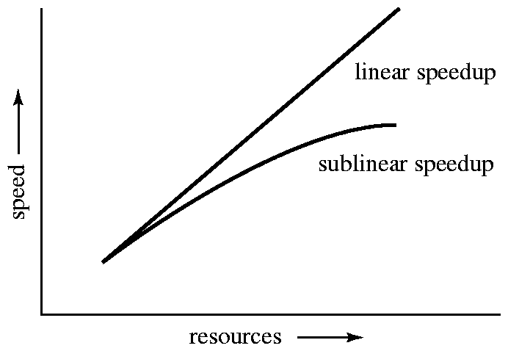
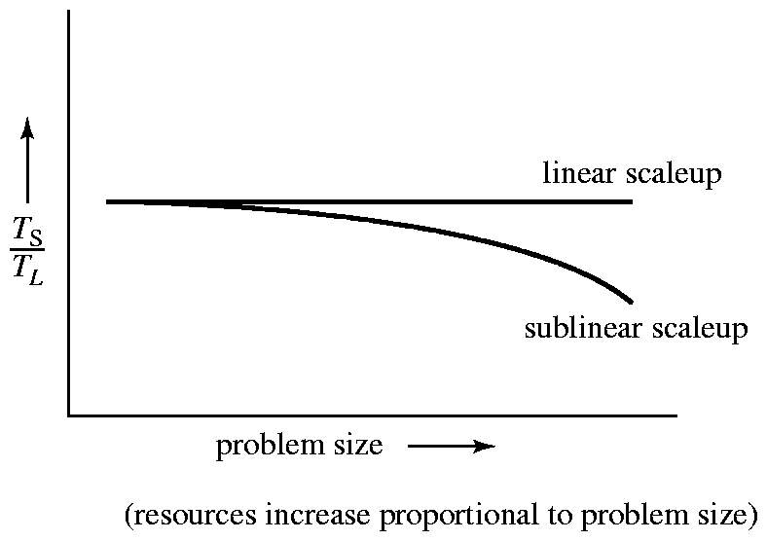
Parallel System Performance Measure
Speedup: = small system elapsed time
large system elapsed time
Scaleup: = small system small problem elapsed time
big system big problem elapsed time

Slide 15
Database Performance Measures
throughput --- the number of tasks that can be completed in a given time interval
response time --- the amount of time it takes to complete a single task from the time it is submitted

Slide 16
Batch and Transaction Scaleup
Batch scaleup:
A single large job; typical of most database queries and scientific simulation.
Use an N-times larger computer on N-times larger problem.
Transaction scaleup:
Numerous small queries submitted by independent users to a shared database; typical transaction processing and timesharing systems.
N-times as many users submitting requests (hence, N-times as many requests) to an N-times larger database, on an N-times larger computer.
Well-suited to parallel execution.

Slide 17
Factors Limiting Speedup and Scaleup
Speedup and scaleup are often sublinear due to:
Startup costs: Cost of starting up multiple processes may dominate computation time, if the degree of parallelism is high.
Interference: Processes accessing shared resources (e.g., system bus, disks, or locks) compete with each other
Skew: Overall execution time determined by slowest of parallelly executing tasks.

Slide 18
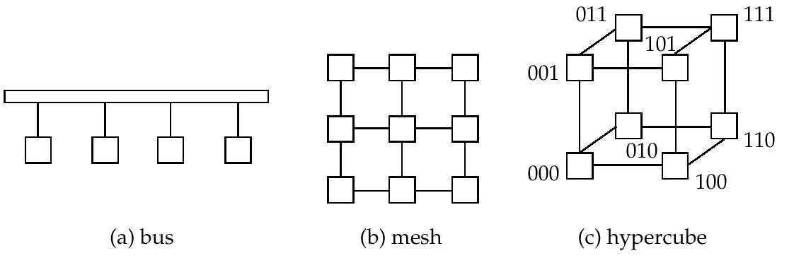
Interconnection Architectures

Slide 19
Parallel Database Issues
Data Partitioning
Parallel Query Processing

Slide 20
Introduction
Parallel machines are becoming quite common and affordable
Prices of microprocessors, memory and disks have dropped sharply
Recent desktop computers feature multiple processors and this trend is projected to accelerate
Databases are growing increasingly large
large volumes of transaction data are collected and stored for later analysis.
multimedia objects like images are increasingly stored in databases
Large-scale parallel database systems increasingly used for:
storing large volumes of data
processing time-consuming decision-support queries
providing high throughput for transaction processing

Slide 21
Parallelism in Databases
Data can be partitioned across multiple disks for parallel I/O.
Individual relational operations (e.g., sort, join, aggregation) can be executed in parallel
data can be partitioned and each processor can work independently on its own partition.
Queries are expressed in high level language (SQL, translated to relational algebra)
makes parallelization easier.
Different queries can be run in parallel with each other. Concurrency control takes care of conflicts.
Thus, databases naturally lend themselves to parallelism.

Slide 22
I/O Parallelism
Reduce the time required to retrieve relations from disk by partitioning
The relations on multiple disks.
Horizontal partitioning – tuples of a relation are divided among many disks such that each tuple resides on one disk.
Partitioning techniques (number of disks = n):
Round-robin:
Send the I ^{th} tuple inserted in the relation to disk i mod n.
Hash partitioning:
Choose one or more attributes as the partitioning attributes.
Choose hash function h with range 0…n - 1
Let i denote result of hash function h applied to the partitioning attribute value of a tuple. Send tuple to disk i.

Slide 23
I/O Parallelism (Cont.)
Partitioning techniques (cont.):
Range partitioning:
Choose an attribute as the partitioning attribute.
A partitioning vector [v_{o}, v₁, ..., v_{n-2}] is chosen.
Let v be the partitioning attribute value of a tuple. Tuples such that v_{i} ≤ v_{i+1} go to disk I + 1. Tuples with v < v₀ go to disk 0 and tuples with v ≥ v_{n-2} go to disk n-1.
E.g., with a partitioning vector [5,11], a tuple with partitioning attribute value of 2 will go to disk 0, a tuple with value 8 will go to disk 1, while a tuple with value 20 will go to disk2.
Notes:
CREATE TABLE emp ( empno NUMBER(4), ename VARCHAR2(30), sal NUMBER )
PARTITION BY RANGE(empno) ( partition e1 values less than (1000) tablespace ts1,
partition e2 values less than (2000) tablespace ts2,
partition e3 values less than (MAXVALUE) tablespace ts3 );

Slide 24
Comparison of Partitioning Techniques
Evaluate how well partitioning techniques support the following types of data access:
1. Scanning the entire relation.
2. Locating a tuple associatively – point queries.
E.g., r.A = 25.
3. Locating all tuples such that the value of a given attribute lies within a specified range – range queries.
E.g., 10 ≤ r.A < 25.

Slide 25
Comparison of Partitioning Techniques (Cont.)
Round robin:
Advantages
Best suited for sequential scan of entire relation on each query.
All disks have almost an equal number of tuples; retrieval work is thus well balanced between disks.
Range queries are difficult to process
No clustering -- tuples are scattered across all disks

Slide 26
Comparison of Partitioning Techniques (Cont.)
Hash partitioning:
Good for sequential access
Assuming hash function is good, and partitioning attributes form a key, tuples will be equally distributed between disks
Retrieval work is then well balanced between disks.
Good for point queries on partitioning attribute
Can lookup single disk, leaving others available for answering other queries.
Index on partitioning attribute can be local to disk, making lookup and update more efficient
No clustering, so difficult to answer range queries

Slide 27
Comparison of Partitioning Techniques (Cont.)
Range partitioning:
Provides data clustering by partitioning attribute value.
Good for sequential access
Good for point queries on partitioning attribute: only one disk needs to be accessed.
For range queries on partitioning attribute, one to a few disks may need to be accessed
Remaining disks are available for other queries.
Good if result tuples are from one to a few blocks.
If many blocks are to be fetched, they are still fetched from one to a few disks, and potential parallelism in disk access is wasted
Example of execution skew.

Slide 28
Partitioning a Relation across Disks
If a relation contains only a few tuples which will fit into a single disk block, then assign the relation to a single disk.
Large relations are preferably partitioned across all the available disks.
If a relation consists of m disk blocks and there are n disks available in the system, then the relation should be allocated min(m,n) disks.

Slide 29
Handling of Skew
The distribution of tuples to disks may be skewed — that is, some disks have many tuples, while others may have fewer tuples.
Types of skew:
Attribute-value skew.
Some values appear in the partitioning attributes of many tuples; all the tuples with the same value for the partitioning attribute end up in the same partition.
Can occur with range-partitioning and hash-partitioning.
Partition skew.
With range-partitioning, badly chosen partition vector may assign too many tuples to some partitions and too few to others.
Less likely with hash-partitioning if a good hash-function is chosen.

Slide 30
Handling Skew in Range-Partitioning
To create a balanced partitioning vector (assuming partitioning attribute forms a key of the relation):
Sort the relation on the partitioning attribute.
Construct the partition vector by scanning the relation in sorted order as follows.
After every 1/n^{th} of the relation has been read, the value of the partitioning attribute of the next tuple is added to the partition vector.
n denotes the number of partitions to be constructed.
Duplicate entries or imbalances can result if duplicates are present in partitioning attributes.
Alternative technique based on histograms used in practice

Slide 31
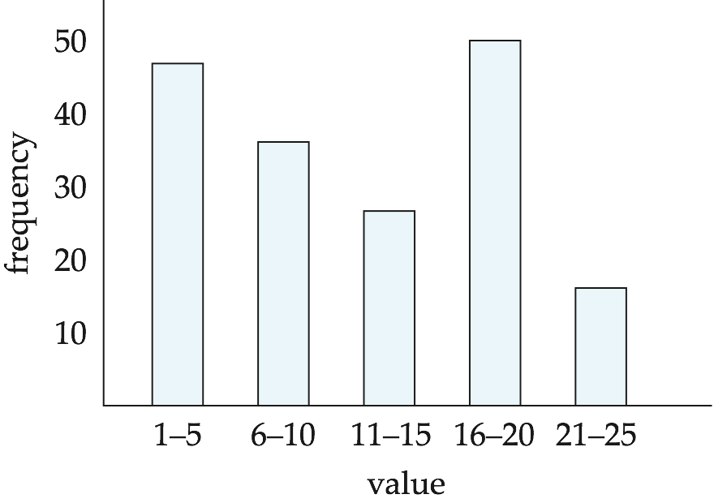
Handling Skew using Histograms
Balanced partitioning vector can be constructed from histogram in a relatively straightforward fashion
Assume uniform distribution within each range of the histogram
Histogram can be constructed by scanning relation, or sampling (blocks containing) tuples of the relation

Slide 32
Handling Skew Using Virtual Processor Partitioning
Skew in range partitioning can be handled elegantly using virtual processor partitioning:
create a large number of partitions (say 10 to 20 times the number of processors)
Assign virtual processors to partitions either in round-robin fashion or based on estimated cost of processing each virtual partition
Basic idea:
If any normal partition would have been skewed, it is very likely the skew is spread over a number of virtual partitions
Skewed virtual partitions get spread across a number of processors, so work gets distributed evenly!

Slide 33
Query Parallelism
Interquery Parallelism
Intraquery Parallelism

Slide 34
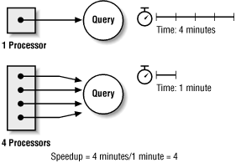
Query Parallelism

Slide 35
Query Parallelism
In parallel database systems to improve the performance of the system, Parallelism is used.
It is achieved through query parallelism.
Transaction throughput is increased by parallel execution of one or more queries.

Slide 36
Forms of Query Parallelism
Intraquery Parallelism
Intraoperation parallelism
Interoperation Parallelism
Pipeline parallelism
Independent parallelism
Interquery Parallelism

Slide 37
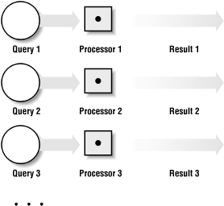
Interquery Parallelism
Parallelism among queries
Different queries and transactions are processed in parallel with one another.
Main-Aim: Scaling up Transaction processing system.

Slide 38
Interquery Parallelism
Queries/transactions execute in parallel with one another.
Increases transaction throughput; used primarily to scale up a transaction processing system to support a larger number of transactions per second.
Easiest form of parallelism to support, particularly in a shared-memory parallel database, because even sequential database systems support concurrent processing.
More complicated to implement on shared-disk or shared-nothing architectures
Locking and logging must be coordinated by passing messages between processors.
Data in a local buffer may have been updated at another processor.
Notes:
In online transaction processing (OLTP) applications, each query is independent and takes a relatively short time to execute. As the number of OLTP users increases, more queries are generated. Without inter-query parallelism, all queries will be performed by a single processor in a time-shared manner. This slows down response time. With inter-query parallelism, queries generated by OLTP users can be distributed over multiple processors. Since the queries are performed simultaneously by multiple processors, response time remains satisfactory.

Slide 39
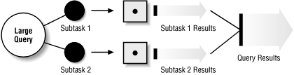
Intraquery Parallelism
Parallelism within a query
Execution of single query in parallel on multiple processors and disks.
Main Aim: Speeding up long-running quires

Slide 40
Intraquery Parallelism
Execution of a single query can be parallelized in two ways
Each individual operation in a query is parallelized
Example: Parallel sort , parallel search
A single operation sorting is parallelized.
Different operations in a query are executed in parallel.
Example: Simultaneous searching or sorting.
The operations searching and sorting are parallelized.

Slide 41
Intraquery Parallelism
Execution of a single query in parallel on multiple processors/disks; important for speeding up long-running queries.
Two complementary forms of intraquery parallelism:
Intraoperation Parallelism – parallelize the execution of each individual operation in the query.
Interoperation Parallelism – execute the different operations in a query expression in parallel.
the first form scales better with increasing parallelism because the number of tuples processed by each operation is typically more than the number of operations in a query.

Slide 42

Intraoperation parallelism
Partitioned parallelism
Parallelism due to the data being portioned.
The degree of parallelism is increased based on the large number of records in the table.
Operation 1
P1
Q
1.2
P2
Operation m
Pk
Q1
Q
1.2
Q
1.3

Slide 43
Interoperation parallelism
Within same query or transaction, different operations are concurrently executing.
Pipeline parallelism
Output record of one operation A is being consumed by another operation B without completing first operation.
Like an assembly line multiple operations are carried out parallelly.
Partitioned parallelism
Multiple operations in a query that do not depend on one another are executed in parallel.
Does not provide high degree of parallelism.

Slide 44
Design of Parallel Systems
Some issues in the design of parallel systems:
Parallel loading of data from external sources is needed in order to handle large volumes of incoming data.
Flexibility to failure of some processors or disks.
Probability of some disk or processor failing is higher in a parallel system.
Operation (perhaps with degraded performance) should be possible in spite of failure.
Redundancy achieved by storing extra copy of every data item at another processor.

Slide 45
Design of Parallel Systems (Cont.)
On-line reorganization of data and schema changes must be supported.
For example, index construction on terabyte databases can take hours or days even on a parallel system.
Need to allow other processing (insertions/deletions/updates) to be performed on relation even as index is being constructed.
Basic idea: index construction tracks changes and “catches up” on changes at the end.
Also need support for on-line repartitioning and schema changes (executed concurrently with other processing).

