Slide 1
Project Management with Jira Software
A Comprehensive Guide to Project Management Excellence
Group Members:
1. Mr. Aoun Haider (FA21-BSE-133)
2. Dawood Imran (FA21-BSE-142)
3. Saad Athar (FA21-BSE-124)
4. Syed Hashir Ghazanfar (FA21-BSE-043)

Slide 2
Introduction
Definition:
Comprehensive project management tool developed by Atlassian.
Initially designed for software development, now used across various industries.
Importance in Project Management:
Centralized platform for task tracking, collaboration, and reporting.
Brief History and Development:
Released in 2002
Evolved to include Agile and customizable workflows

Slide 3
What is jira software?
Jira is project management ,bug tracking tool that lets you :
create projects
manage them
assign tasks
track progress
and audit your issues.

Slide 4
Project management
Is a discipline of planning, organizing , and overseeing all the aspects of a project from its initiation to completion.
Planning : Outlining the tasks (what things are required for project), creating a project schedule and allocating resources.
Organizing : assembling of team and allocating responsibilities.
Overseeing aspects : Monitoring , checking progress and making adjustments which are necessary.

Slide 5
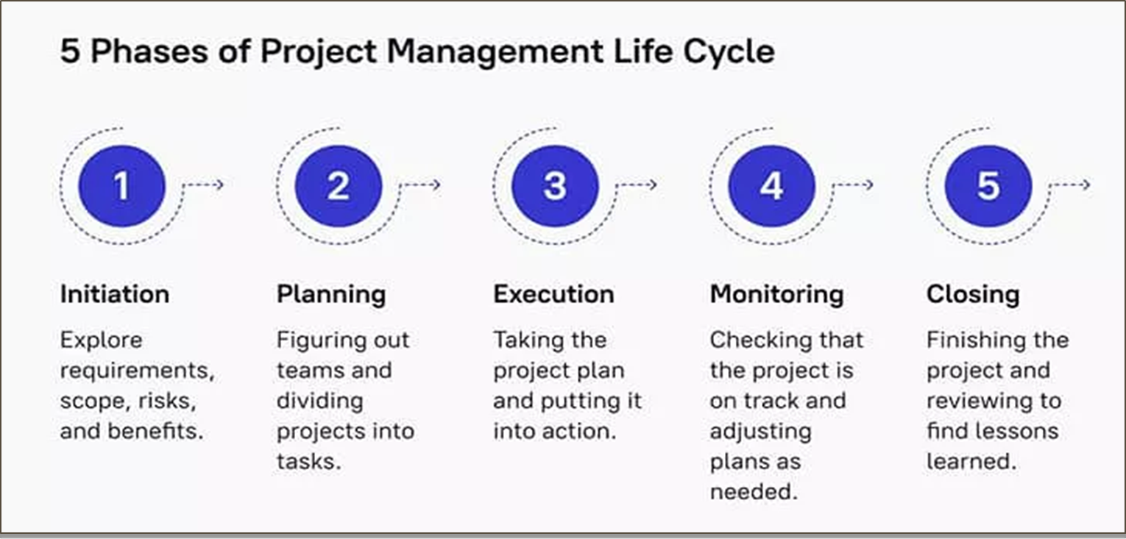

Slide 6
Key features
Issue Tracking:
Customizable workflows for bug tracking, task management, and project planning
Agile Project Management:
Scrum and Kanban boards for agile methodologies
Sprints, backlogs, and velocity tracking
Customization:
Create custom fields, screens, and workflows to suit project requirements

Slide 7
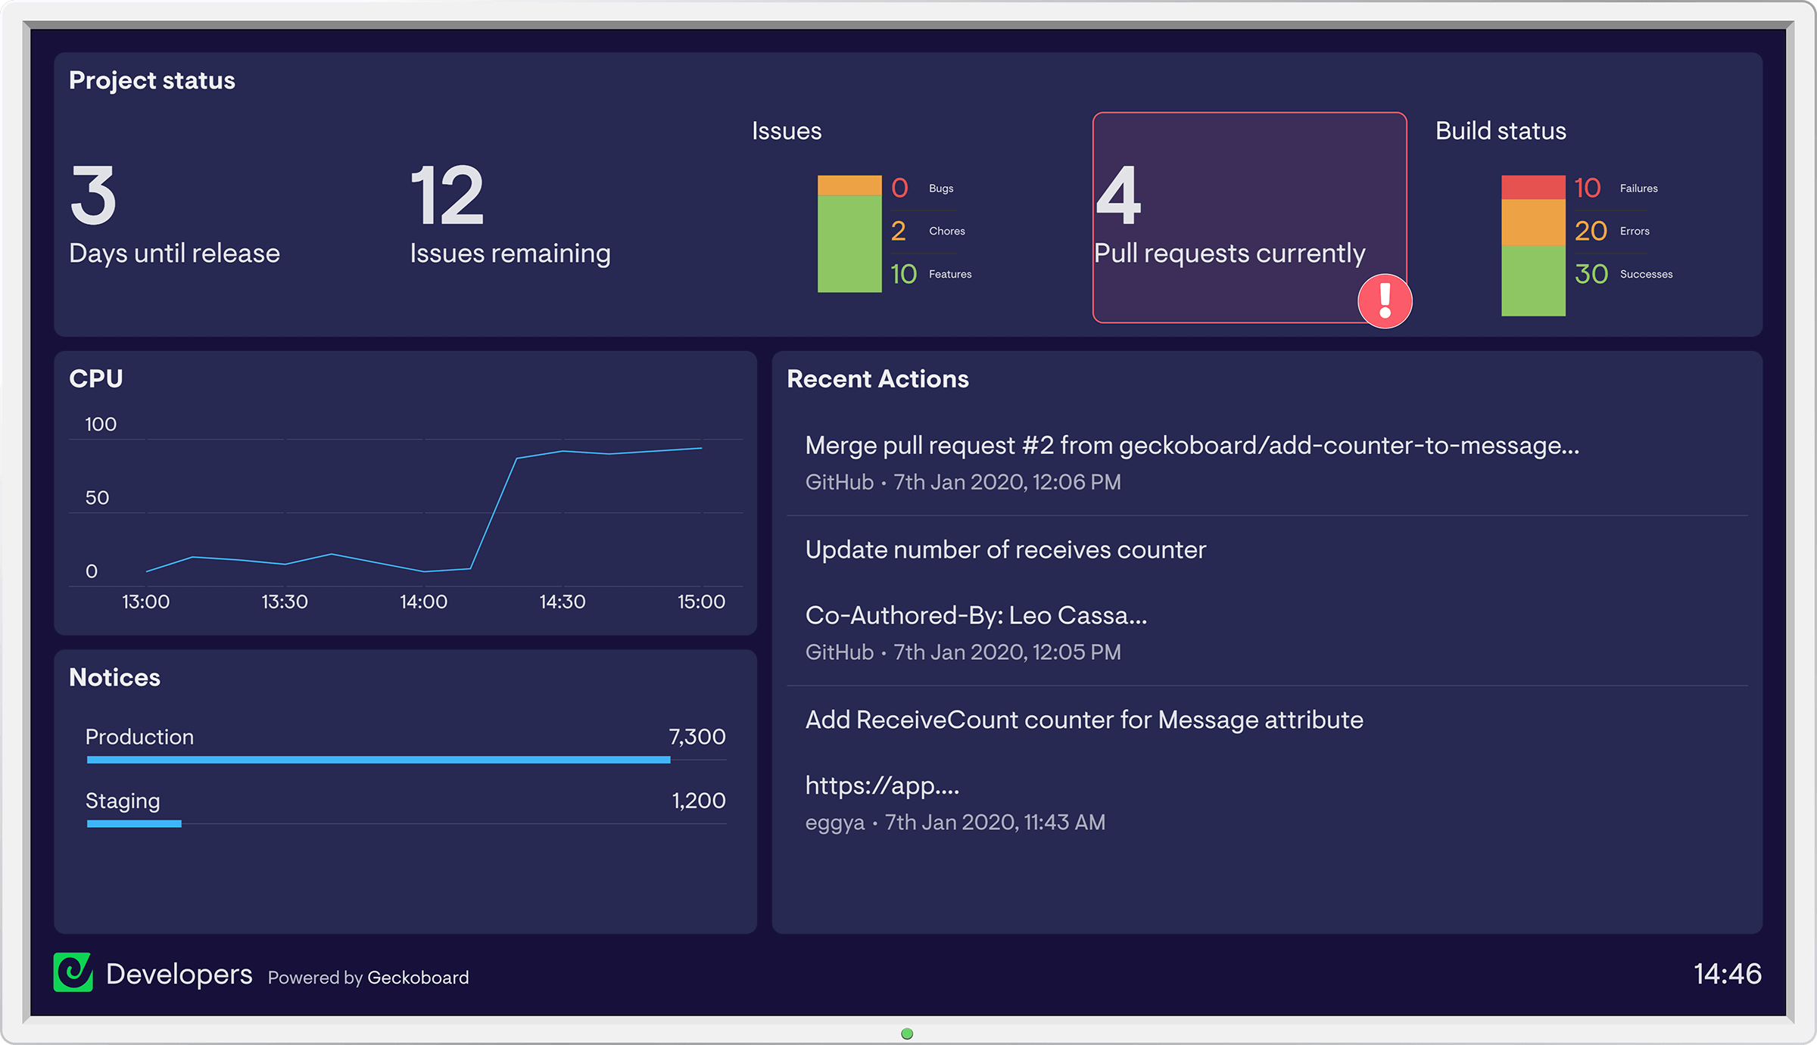
User interface

Slide 8
Terminologies used in jira
Story
Task
Epic
Tells what project is about.
Epic is further divided into Stories, It is a way to express a requirement from end user’s perspective.
A detailed specific activity or work item that needs to be completed.

Slide 9
Workflow in jira
Workflow can be customized to match specific requirements of the project.
The basic workflow is:
To-do Column
In Progress
Done
List down the task.
When you start working on task add to this column.
When task is done add to this column.

Slide 10
Agile methodologies
Scrum and Kanban Integration:
Scrum boards for structured project management
Kanban boards for continuous delivery and improvement
Backlog Management:
Prioritize and manage work in the backlog
Plan and execute sprints

Slide 11
Collaboration and communication
Comments and Discussions:
Real-time collaboration on issues
Notifications and updates for team members
@Mentions and Assignments:
Tagging team members for specific tasks
Assigning and tracking ownership of issues

Slide 12
Reporting and analytics
Built-in Reports:
Burndown charts, velocity charts, and cumulative flow diagrams
Insights into project progress and team performance
Custom Reports:
Create custom reports for unique project metrics
Data visualization for informed decision-making

Slide 13
Benefits of jira software
Improved Collaboration:
Centralized platform for team communication
Enhanced visibility into project progress
Increased Efficiency:
Automation of repetitive tasks
Streamlined workflows for faster project delivery
Customization for Diverse Needs:
Adaptable to different project types and industries
Tailored to meet specific project requirements

Slide 14
Use cases
Software Development Projects:
Bug tracking, sprint planning, and code integration
IT Service Management:
Incident and problem management, service requests
Marketing and Content Creation:
Content planning, editorial calendars, and campaign tracking
Any Project Requiring Collaboration:
Versatile application across industries

Slide 15
Pricing and licensing
Overview of Jira Software Pricing Models:
Cloud, server, and data center options
Different plans based on team size and requirements
Licensing Options:
Explore the most suitable licensing option for your organization's needs

Slide 16
conclusion
Recap of Key Points:
Comprehensive project management tool
Customizable for various project types
Improved collaboration and efficiency

