Slide 1

Multi-Entertainment Application
Object Oriented Software Engineering
GROUP PROJECT BY:
ASAD HUSSAIN (FA21-BSE-052)
OMAR FAROOQ (FA21-BSE-106)
DAWOOD IMRAN (FA21-BSE-142)
AOUN HAIDER (FA21-BSE-133)
UMAR ATIQ (FA21-BSE-007)

Slide 2
INTRODUCTION
we present our JavaFX project—a multimedia interface designed to provide an immersive and interactive experience for accessing various multimedia functionalities. Through this project, we aimed to create a user-friendly interface that seamlessly integrates an audio player, video player, memory card game, rock-paper-scissors game, and tic-tac-toe game. The purpose of this presentation is to walk you through the key features and functionalities of our project, highlighting the collective effort and creativity that went into its development. So, without further ado, let's delve into the exciting world of this multimedia interface and explore how it can enhance your multimedia experience.

Slide 3
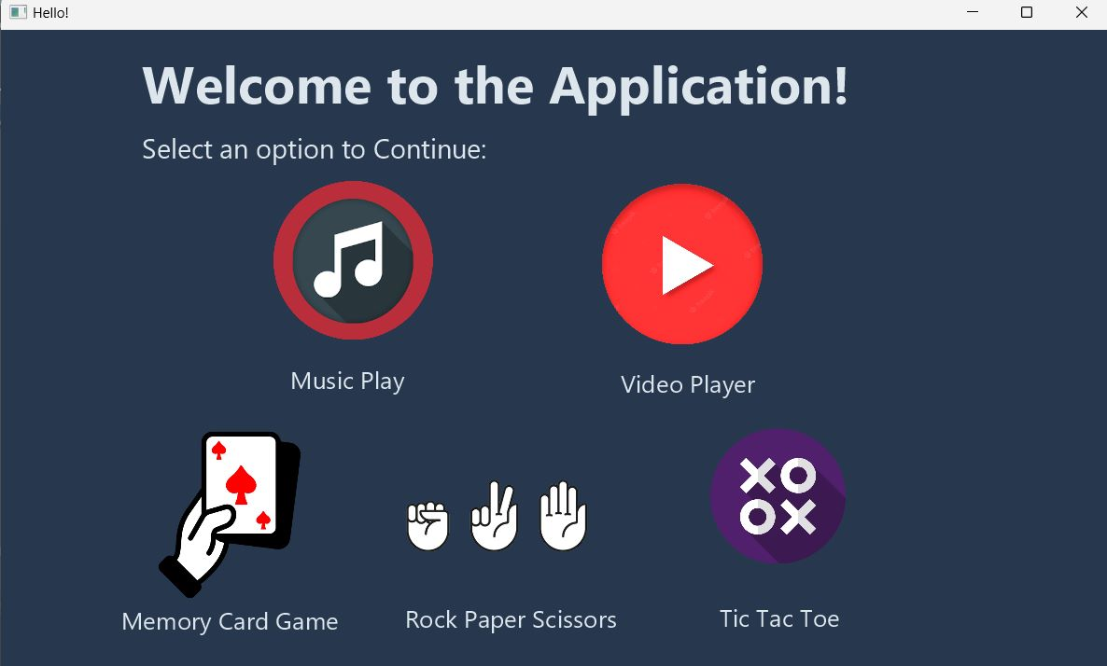
INTERFACE
The homepage serves as the main interface for users to access the various multimedia modules.
It provides an organized layout with intuitive navigation options.
Users can easily navigate to the audio player, video player, memory card game, rock-paper-scissors game, and tic-tac-toe game from the homepage.
Each module is represented by a distinct icon or button, making it visually appealing and easy to identify.
Clicking on an icon or button redirects users to the respective module interface.

Slide 4

INTERFACE – HOW WAS IT CREATED?
Interface was created through JavaFx on IntelliJ IDE with Object Oriented Programming concepts implemeted
6 Classes were used
InterfaceClass
MusicPlayerClass
VideoPlayerClass
MemoryGameClass
RockPaperScissorClass
TicTacToeClass

Slide 5
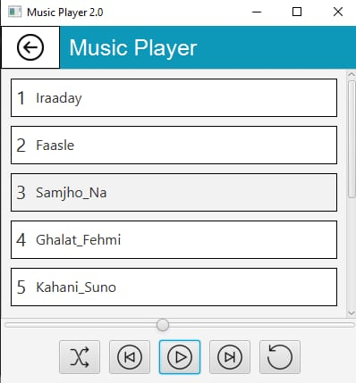
First Application Music Player
User will be able to listen to music saved in their device’s database
Sub Modules of Music Player:
Play next song button
play previous song button
pause music button
Restart music button
Shuffle music button

Slide 6
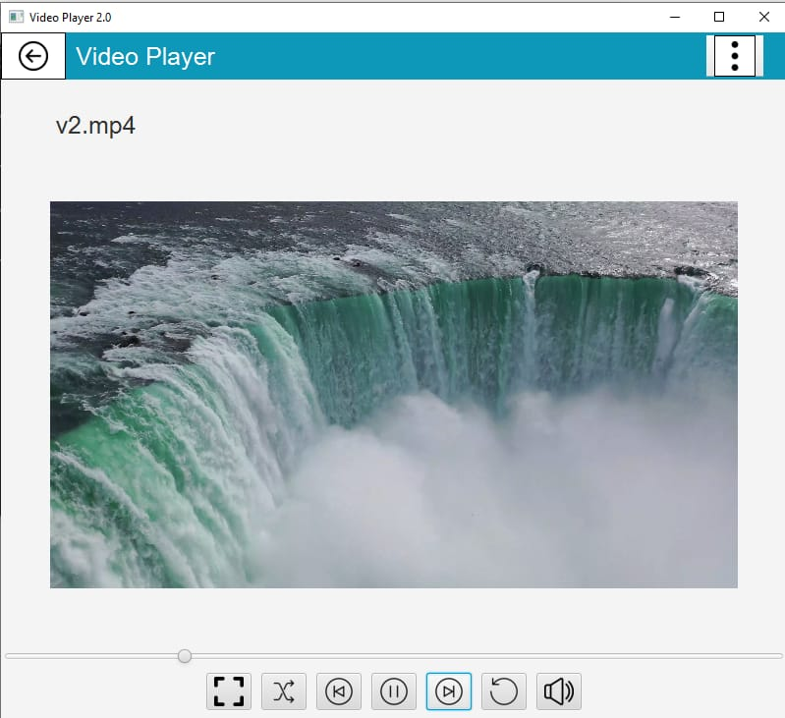
Second Application Video Player
Play, pause, and stop functionality for video playback.
Support for various video file formats (e.g., MP4, AVI, MKV).
Full-screen mode for an immersive viewing experience.
Volume control to adjust the audio output of the video.
Seek functionality to jump to specific parts of the video.
Display of video information such as title, duration, and resolution.
Playback controls, including next and previous video options.
Integration with the interface's overall design and theme for a consistent user experience.

Slide 7

MUSIC & VIDEO PLAYER HOW WERE THEY CREATED?
Both of them were created through JavaFx on IntelliJ IDE with Object Oriented Programming concepts implemeted
Classes used
Player ( super class)
videoPlayer (SubClass)
musicPlayer (SubClass)
these classes inherit some common attributes

Slide 8
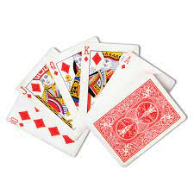
Third Application Memory Card Game
A card game with the aim to test the user’s memory span. A user is supposed to flip two consecutive cards with same pattern in order to proceed to the next level.
Sub Modules of Memory Game:
Cards
Pattern of cards

Slide 9
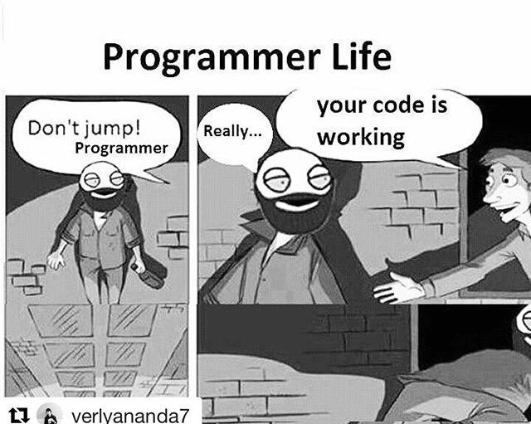
MEMORY CARD GAME- HOW WAS IT CREATED?
This was created through JavaFx on IntelliJ IDE with Object Oriented Programming concepts implemented
Classes used
Card class
Deck of card class
Playing card extends card

Slide 10
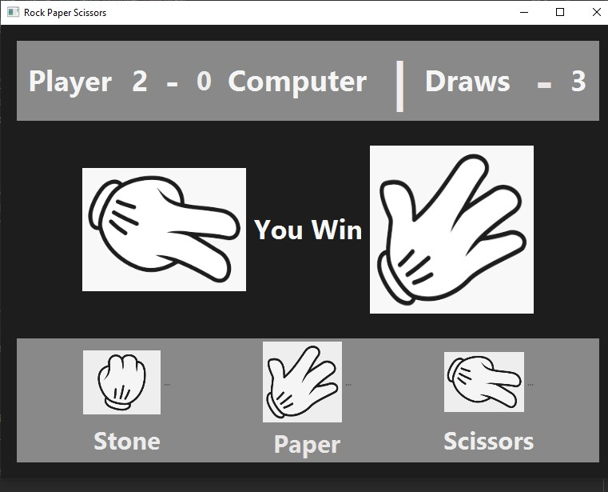
FOURTH APPLICATION ROCK , PAPER , SCISSOR GAME
A fun game designed where a user competes with a computer. User has 3 options to select from (ROCK- PAPER - SCISSOR), with basic universal rule:
Rock beats Scissor
Scissor beats Paper
Paper beats Rock
Incase the user and computer’s option , it will be a draw
Sub Modules of Rock ,Paper & Scissors Game
Rock option
Paper option
Scissor Option

Slide 11
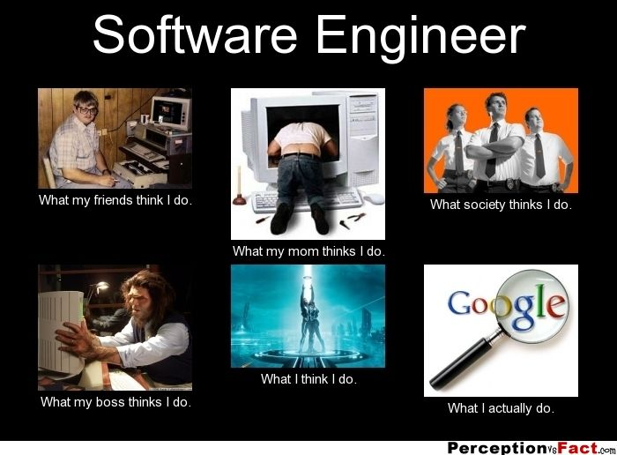
ROCK , PAPER SCISSORS- HOW WAS THIS MADE?
This was also created through JavaFx on IntelliJ IDE with Object Oriented Programming concepts implemented
Classes used
RockClass
PaperClass
ScissorsClass
GameChoiceClass
HelloControllerClass

Slide 12
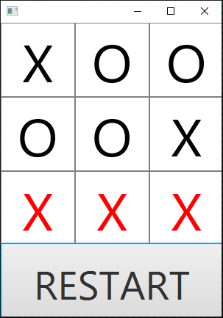
Fifth Application TIC-TAC-TOE GAME
Classic game of Tic-Tac-Toe played on a grid.
Two-player gameplay, allowing users to compete against each other.
Interactive grid where players take turns placing X and O symbols.
Detection of winning combinations to determine the winner.
Option to restart the game for continuous play.
Clear and intuitive interface for easy gameplay.
Score tracking to keep record of wins, losses, and ties.

Slide 13
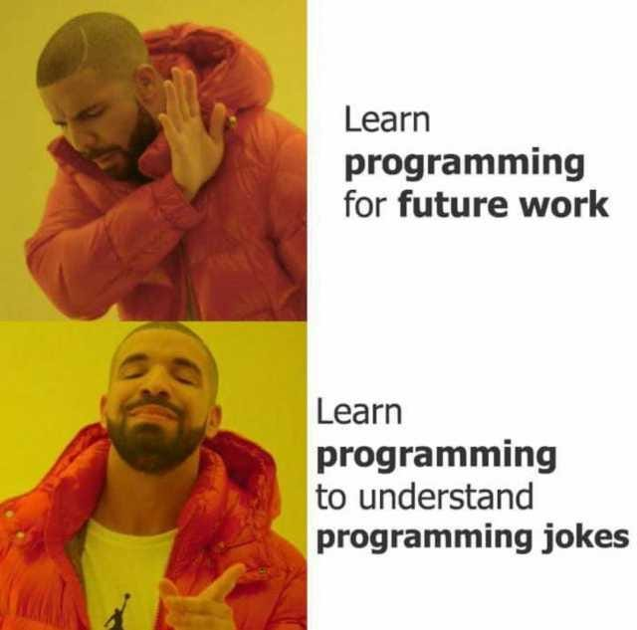
…AND LIKE EVERYTIME…. HOW WAS THIS CREATED?! (DAMN)
This was also created through JavaFx on IntelliJ IDE with Object Oriented Programming concepts implemented
Classes Used
Main Class
Board Class
Cell Class
Player (enum type)

Slide 14

THE END SEE YOU ON THE OTHER SIDE
In conclusion, our JavaFX multimedia interface project has provided an engaging and enjoyable user experience, bringing together audio, video, and gaming functionalities in a single platform. We are proud of our accomplishments and look forward to further enhancing and refining our project based on user feedback. Thank you for your attention and we welcome any questions you may have.

