Slide 1
CSC 221 Computer Organization and Assembly Language
Lecture 03: Data Representation 02

Slide 2
Lecture 02: Review
Data Representation
Decimal Representation
Binary Representation
Two’s Complement
Hexadecimal Representation

Slide 3
Lecture Outline
Data Representation
Binary Multiplication
Binary Division
Floating Point Representation

Slide 4
Binary Multiplication
Multiplication follows the general principal of shift and add.
The rules include:
0 * 0 = 0
0 * 1 = 0
1 * 0 = 0
1 * 1 = 1

Slide 5
Binary Multiplication
EXAMPLE 1
Complete 15 * 5 in binary.
Convert to binary
15 = 00001111₂
5 = 00000101₂
Ignore any insignificant zeros.
00001111₂
00000101₂
x

Slide 6
Binary Multiplication
EXAMPLE 1
Multiply the first number.
1 1 1 1₂
1 0 1 ₂
1 1 1 1
Now this is where the shift and takes place.
x
1111 x 1 = 1111

Slide 7
Binary Multiplication
EXAMPLE 1
Shift one place to the left and multiple the second digit.
1 1 1 1₂
1 0 1 ₂
1 1 1 1
0 0 0 0 0
1111 x 0 = 0000
x
Shift One Place

Slide 8
Binary Multiplication
EXAMPLE 1
Shift one place to the left and multiple the third digit.
1 1 1 1₂
1 0 1 ₂
1 1 1 1
0 0 0 0 0
1 1 1 1 0 0
1111 x 1 = 1111
x
Shift One Place

Slide 9
Binary Multiplication
EXAMPLE :
Add the total of all the steps.
1 1 1 1
0 0 0 0 0
1 1 1 1 0 0
1 0 0 1 0 1 1
Convert back to decimal to check.
+

Slide 10
Binary Division
Division in binary is similar to long division in decimal.
It uses what is called a shift and subtract method.

Slide 11
Binary Division
EXAMPLE :
Complete 575 / 25 using long division.
25 575 | Take the first digit of 575 (5) and see if 25 will go into it. If it can not put a zero above and take the next number.
25 575 | How many times does 25 go into 57? TWICE
0
02

Slide 12
Binary Division
25 575 50 7 | How much is left over? 57 – (25 * 2) = 7
25 575 50 75 | Drop down the next value
02
02

Slide 13
Binary Division
023
25 575 50 75 | Divide 75 by 25 Result = 3
25 575 50 75 75 0 | Check for remainder 75 – (3 * 25) = 0 FINISH!
023

Slide 14
Binary Division
Step 1: Convert both numbers to binary.
25 = 1 1 0 0 1
5 = 1 0 1
Step 2: Place the numbers accordingly:
1 0 1 1 1 0 0 1

Slide 15
Binary Division
Step 3: Determine if 1 0 1 (5) will fit into the first bit of dividend.
1 0 1 1 1 0 0 1
1 0 1(5) will not fit into 1(1)
Step 4: Place a zero above the first bit and try the next bit.

Slide 16
Binary Division
Step 5: Determine if 1 0 1 (5) will fit into the next two bits of dividend.
1 0 1 1 1 0 0 1
1 0 1(5) will not fit into 1 1(3)
Step 6: Place a zero above the second bit and try the next bit.
0

Slide 17
Binary Division
Step 7: Determine if 1 0 1 (5) will fit into the next three bits of dividend.
1 0 1 1 1 0 0 1
1 0 1(5) will fit into 1 1 0(6)
Step 8: Place a one above the third bit and times it by the divisor (1 0 1)
0
0

Slide 18
Binary Division
Step 9: The multiplication of the divisor should be placed under the THREE bits you have used.
1 0 1 1 1 0 0 1
1 0 1
A subtraction should take place. Therefore, the two’s complement of the 2nd number must be found and the two numbers added together to get a result.
0
0
1

Slide 19
Binary Division
Step 10: The two’s complement of 1 0 1 is 0 1 1
1 0 1 1 1 0 0 1
+ 0 1 1
0 0 1
0
0
1

Slide 20
Binary Division
Step 11: Determine if 1 0 1 will fit into the remainder 0 0 1. The answer is no so you must bring down the next number.
1 0 1 1 1 0 0 1
0 1 1
0 0 1 0
0
0
1
+

Slide 21
Binary Division
Step 12: 1 01 does not fit into 0 0 1 0. Therefore, a zero is placed above the last bit. And the next number is used.
1 0 1 1 1 0 0 1
0 1 1
0 0 1 0 1
0
0
1
0
+

Slide 22
Binary Division
Step 13: 1 0 1 does fit into 1 0 1 so therefore, a one is placed above the final number and the process of shift and add must be continued.
1 0 1 1 1 0 0 1
0 1 1
0 0 1 0 1
0 1 1
0 0 0
0
0
1
0
1
+
+

Slide 23
Binary Division
Step 14: The final answer is 1 0 1 (5) remainder zero.

Slide 24
Floating-Point Representation
The signed magnitude, one’s complement, and two’s complement representation that we have just presented deal with integer values only.
Without modification, these formats are not useful in scientific or business applications that deal with real number values.
Floating-point representation solves this problem.

Slide 25
Floating-Point Representation
If we are clever programmers, we can perform floating-point calculations using any integer format.
This is called floating-point emulation, because floating point values aren’t stored as such, we just create programs that make it seem as if floating-point values are being used.
Most of today’s computers are equipped with specialized hardware that performs floating-point arithmetic with no special programming required.

Slide 26
Floating-Point Representation
Floating-point numbers
Can represent very large or very small numbers based on scientific notation. Binary point “floats”.
Two Parts
Mantissa represents magnitude of number
Exponent represents number of places that binary point is to be moved
Floating-point numbers allow an arbitrary number of decimal places to the right of the decimal point.
For example: 0.5 × 0.25 = 0.125
They are often expressed in scientific notation.
e.g. 0.125 = 1.25 × 10⁻¹
5,000,000 = 5.0 × 10⁶

Slide 27
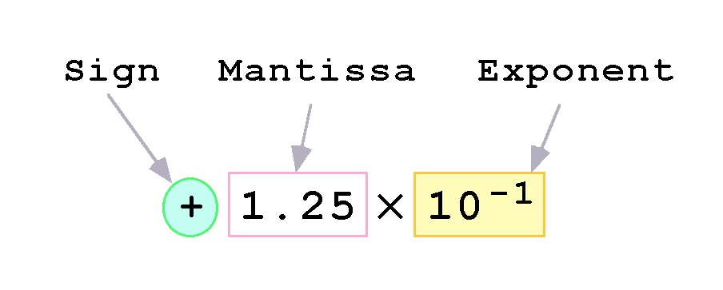
Floating-Point Representation
Computers use a form of scientific notation for floating-point representation
Numbers written in scientific notation have three components:

Slide 28
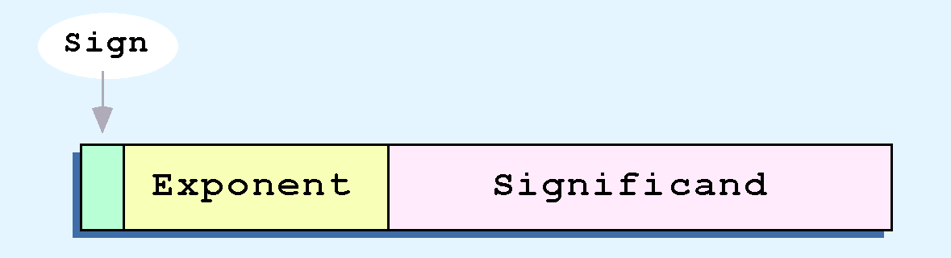
Floating-Point Representation
Computer representation of a floating-point number consists of three fixed-size fields:
This is the standard arrangement of these fields.

Slide 29
Floating-Point Representation
The one-bit sign field is the sign of the stored value.
The size of the exponent field, determines the range of values that can be represented.
The size of the significand determines the precision of the representation.

Slide 30
Floating-Point Representation
The IEEE-754 single precision floating point standard uses an 8-bit exponent and a 23-bit significand.
The IEEE-754 double precision standard uses an 11-bit exponent and a 52-bit significand.
For illustrative purposes, we will use a 14-bit model with a 5-bit exponent and an 8-bit significand.

Slide 31
Floating-Point Representation
The significand of a floating-point number is always preceded by an implied binary point.
Thus, the significand always contains a fractional binary value.
The exponent indicates the power of 2 to which the significand is raised.

Slide 32
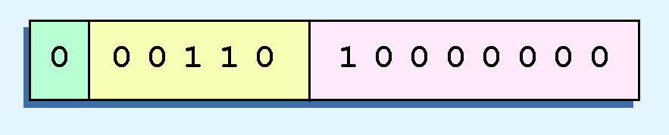
Floating-Point Representation
Example:
Express 32₁₀ in the simplified 14-bit floating-point model.
We know that 32 is 2⁵. So in (binary) scientific notation 32 = 1.0 x 2⁵ = 0.1 x 2⁶.
Using this information, we put 110 (= 6₁₀) in the exponent field and 1 in the significand as shown.

Slide 33
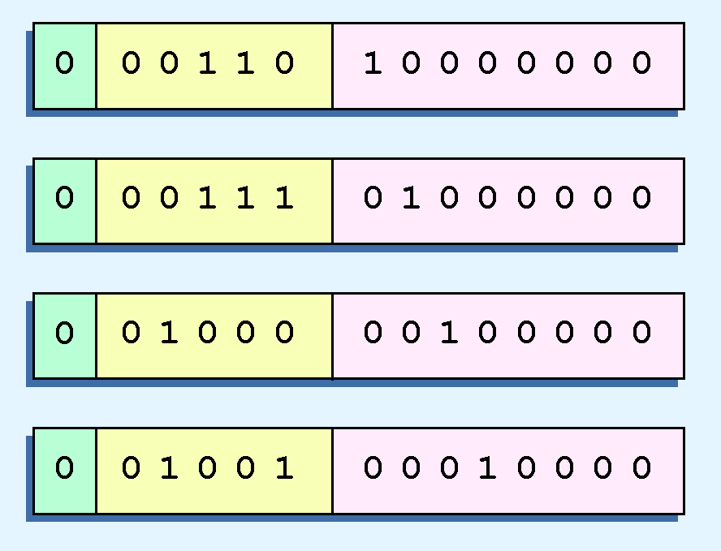
Floating-Point Representation
The illustrations shown at the right are all equivalent representations for 32 using our simplified model.
Not only do these synonymous representations waste space, but they can also cause confusion.

Slide 34
Floating-Point Representation
Another problem with our system is that we have made no allowances for negative exponents. We have no way to express 0.5 (=2 ⁻¹)! (Notice that there is no sign in the exponent field!)
All of these problems can be fixed with no changes to our basic model.

Slide 35
Floating-Point Representation
To resolve the problem of synonymous forms, we will establish a rule that the first digit of the significand must be 1. This results in a unique pattern for each floating-point number.
In the IEEE-754 standard, this 1 is implied meaning that a 1 is assumed after the binary point.
By using an implied 1, we increase the precision of the representation by a power of two.
In our simple instructional model, we will use no implied bits.

Slide 36
Floating-Point Representation
To provide for negative exponents, we will use a biased exponent.
A bias is a number that is approximately midway in the range of values expressible by the exponent. We subtract the bias from the value in the exponent to determine its true value.
In our case, we have a 5-bit exponent. We will use 16 for our bias. This is called excess-16 representation.
In our model, exponent values less than 16 are negative, representing fractional numbers.

Slide 37
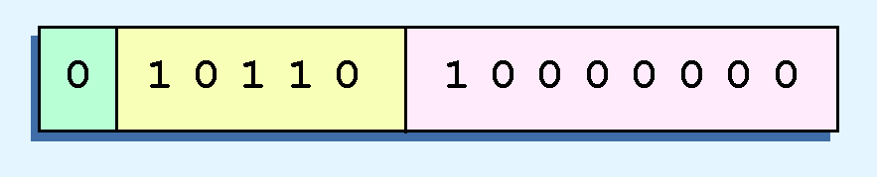
Floating-Point Representation
Example:
Express 32₁₀ in the revised 14-bit floating-point model.
We know that 32 = 1.0 x 2⁵ = 0.1 x 2⁶.
To use our excess 16 biased exponent, we add 16 to 6, giving 22₁₀ (=10110₂).
Graphically:

Slide 38

Floating-Point Representation
Example:
Express 0.0625₁₀ in the revised 14-bit floating-point model.
We know that 0.0625 is 2⁻⁴. So in (binary) scientific notation 0.0625 = 1.0 x 2⁻⁴ = 0.1 x 2 ⁻³.
To use our excess 16 biased exponent, we add 16 to -3, giving 13₁₀ (=01101₂).

Slide 39

Floating-Point Representation
Example:
Express -26.625₁₀ in the revised 14-bit floating-point model.
We find 26.625₁₀ = 11010.101₂. Normalizing, we have: 26.625₁₀ = 0.11010101 x 2 ⁵.
To use our excess 16 biased exponent, we add 16 to 5, giving 21₁₀ (=10101₂). We also need a 1 in the sign bit.

Slide 40
Floating-Point Representation
The IEEE-754 single precision floating point standard uses bias of 127 over its 8-bit exponent.
An exponent of 255 indicates a special value.
If the significand is zero, the value is ± infinity.
If the significand is nonzero, the value is NaN, “not a number,” often used to flag an error condition.
The double precision standard has a bias of 1023 over its 11-bit exponent.
The “special” exponent value for a double precision number is 2047, instead of the 255 used by the single precision standard.

Slide 41
Floating-Point Representation
Both the 14-bit model that we have presented and the IEEE-754 floating point standard allow two representations for zero.
Zero is indicated by all zeros in the exponent and the significand, but the sign bit can be either 0 or 1.
This is why programmers should avoid testing a floating-point value for equality to zero.
Negative zero does not equal positive zero.

Slide 42
Floating-Point Representation
Floating-point addition and subtraction are done using methods analogous to how we perform calculations using pencil and paper.
The first thing that we do is express both operands in the same exponential power, then add the numbers, preserving the exponent in the sum.
If the exponent requires adjustment, we do so at the end of the calculation.

Slide 43
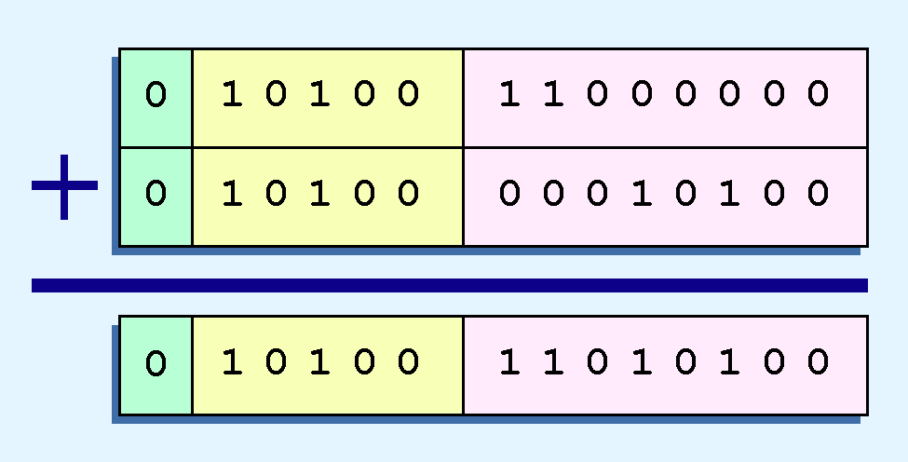
Floating-Point Representation
Example:
Find the sum of 12₁₀ and 1.25₁₀ using the 14-bit floating-point model.
We find 12₁₀ = 0.1100 x 2 ⁴. And 1.25₁₀ = 0.101 x 2 ¹ = 0.000101 x 2 ⁴.
Thus, our sum is 0.110101 x 2 4.

Slide 44
Floating-Point Representation
Floating-point multiplication is also carried out in a manner akin to how we perform multiplication using pencil and paper.
We multiply the two operands and add their exponents.
If the exponent requires adjustment, we do so at the end of the calculation.

Slide 45
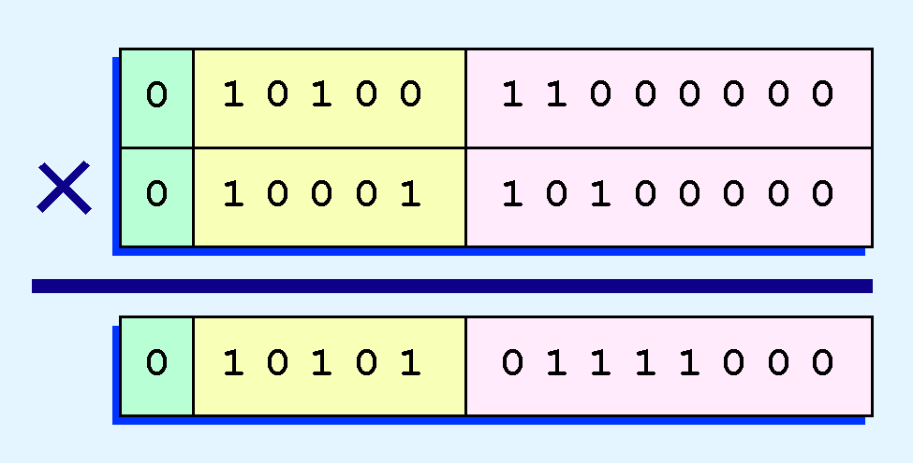
Floating-Point Representation
Example:
Find the product of 12₁₀ and 1.25₁₀ using the 14-bit floating-point model.
We find 12₁₀ = 0.1100 x 2 ⁴. And 1.25₁₀ = 0.101 x 2 ¹.
Thus, our product is 0.0111100 x 2 5 = 0.1111 x 2 4.
The normalized product requires an exponent of 20₁₀ = 10110₂.

Slide 46
Floating-Point Representation
No matter how many bits we use in a floating-point representation, our model must be finite.
The real number system is, of course, infinite, so our models can give nothing more than an approximation of a real value.
At some point, every model breaks down, introducing errors into our calculations.
By using a greater number of bits in our model, we can reduce these errors, but we can never totally eliminate them.

Slide 47
Floating-Point Representation
Our job becomes one of reducing error, or at least being aware of the possible magnitude of error in our calculations.
We must also be aware that errors can compound through repetitive arithmetic operations.
For example, our 14-bit model cannot exactly represent the decimal value 128.5. In binary, it is 9 bits wide:
10000000.1₂ = 128.5₁₀

Slide 48
Summary
Binary Arithmetic
Multiplication
Division
Floating Point Representation
Floating Point Arithmetic
Addition
Multiplication

