Slide 1
CSC 221 Computer Organization and Assembly Language
Lecture 06:
Machine Instruction Characteristics

Slide 2
Lecture 05: Review
Memory Access:
Real Mode memory-addressing techniques.
Protected Mode memory-addressing techniques.
Memory Access:
64-bit Flat Memory model.
Program-invisible registers in the 80286~Core2 microprocessors.

Slide 3
Lecture Outline
Instruction Set
Instruction Format
Instruction Cycle State Diagram
Operation Types
Operands
Data Types
Little and Big-Endian

Slide 4
What is an Instruction Set?
The complete collection of instructions that are understood by a CPU
Machine Code
Binary
Usually represented by assembly codes
Notes:
2

Slide 5
Simple Instruction Format
The instruction is divided into fields, corresponding to the basic elements of the instruction.
Instruction is read into an Instruction Register (IR)
The CPU must be able to extract the data from the various instruction fields to perform the required operation.
Opcode
Operand(s) and/or Address(es)

Slide 6
Elements of an Instruction
Operation code (Op code) → Do this…
Specifies the operation to be performed (e.g.. ADD, SUB, I/O).
Source Operand reference → To this…
The operation may involve one or more source operands, that is, operands that are inputs for the operation.
Result Operand reference → Put the answer here…
The operation may produce a result.
Next Instruction Reference → When done that, do this...
It tells the CPU where to fetch the next instruc­tion after the execution of this instruction is complete.
Notes:
3

Slide 7
Location of all the Operands
Including source and result operands can be found:
Main or virtual memory.
Processor register- contains registers that can be used by machine instructions.
Immediate- the operand value is being contained when the instruction is being executed.
I/O devices- instruction specifies I/O module and device but if memory mapped then just another main or virtual memory address.
Notes:
4

Slide 8
Instruction Length
Affected by and affects:
Memory size
Memory organization - addressing
Bus structure, e.g. width
CPU complexity
CPU speed
Trade off between powerful instruction set and saving space.

Slide 9
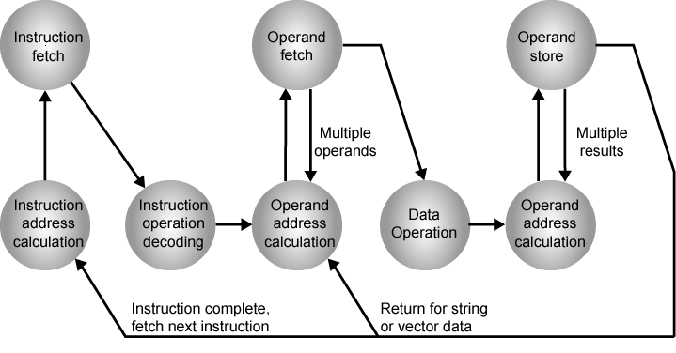
Instruction Cycle State Diagram

Slide 10
Instruction Representation
Within a Computer or in machine code each instruction is represented by the sequence of bits and has a unique bit pattern.
For human consumption (well, programmers anyway) a symbolic representation is used.
Opcodes are represented by abbreviations, called mnemonics, that indicate the operation.
Common examples:
ADD Add
SUB Subtract
MUL Multiply
DIV Divide
LOAD Load data from memory
STOR Store data to memory etc.
Operands can also be represented in this way
ADD A,B
Notes:
5

Slide 11
Example
X = X+Y
Assume that the variable X and Y correspond to locations 513 and 514
Operation: (by assuming a simple set of machine instructions)
Load a register with the contents of memory location 513.
Add the contents of memory location 514 to the register.
Store the contents of the register in memory location 513.
Single High-Level Expression ←→Multiple Machine Level Instructions
Notes:
6

Slide 12
Instruction Types
Data processing
Arithmetic and logic instructions
Data storage (main memory)
Moving data into or out of register or memory locations
Data movement (I/O)
I/O instructions
Program flow control
Test and branch instructions
Notes:
6

Slide 13
Number of Addresses
A traditional way of describing processor architecture
What is the maximum number of addresses one might need in an instruction?
An instruction could be required to contain four addresses.

Slide 14
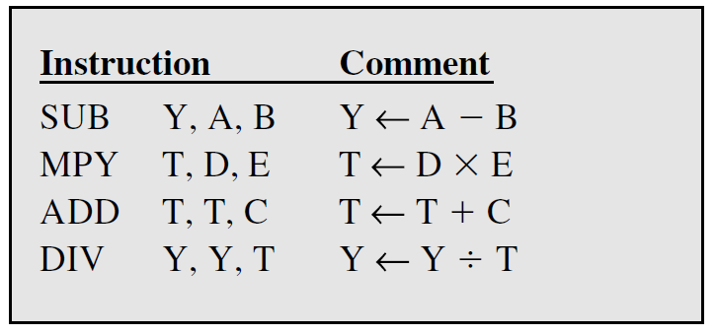
Number of Addresses (a)
3 addresses
Operand 1, Operand 2, Result
a = b + c;
May be a forth - next instruction (usually implicit)
Not common
Needs very long words to hold everything
Notes:
7

Slide 15
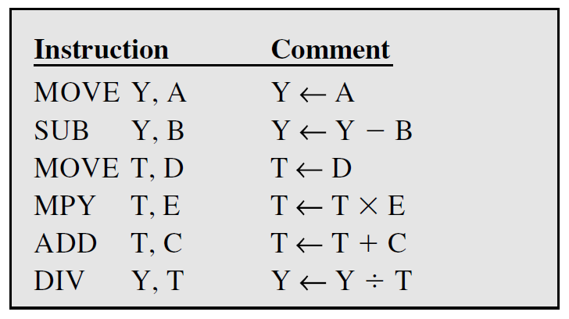
Number of Addresses (b)
2 addresses
One address doubles as operand and result
a = a + b
Reduces length of instruction
Requires some extra work
Temporary storage to hold some results
Notes:
8

Slide 16
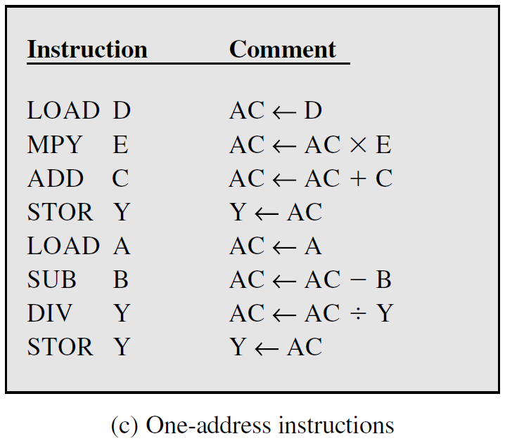
Number of Addresses (c)
1 address
Implicit second address
Usually a register (accumulator)
Common on early machines
Notes:
9

Slide 17
Number of Addresses (d)
0 (zero) addresses
All addresses implicit
Uses a stack
e.g. push a
push b
add
pop c
c = a + b
Notes:
10

Slide 18
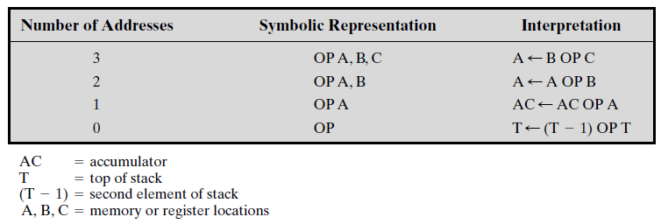
Number of Addresses (Summarized)
Utilization of Instruction Addresses (Nonbranching Instructions)

Slide 19
How Many Addresses?
More addresses
More complex instructions
More registers →Inter-register operations are quicker
Fewer instructions per program
Fewer addresses
Less complex instructions
More instructions per program
Faster fetch/execution of instructions
Example: Y=(A-B):[(C+(DxE)]
Notes:
11

Slide 20
Design Decisions
Operation range
How many operations?
What can they do?
How complex are they?
Data types
The various types of data upon which operations are performed.
Instruction formats
Length/Size of fields (in bits)
Number of addresses
Notes:
12

Slide 21
Design Decisions
(cont.)
Registers
Number of processor registers available and can be referenced by the instructions.
Which operations can be performed on which registers?
Addressing modes (later…)
The mode or modes by which the address of an operand is specified.
RISC v CISC
Notes:
13

Slide 22
Types of Operand
Addresses: immediate, direct, indirect, stack …
Numbers:
Integer or fixed point (binary, twos complement),
Floating point (sign, significand, exponent),
(packed) decimal (246 = 0000 0010 0100 0110)
Characters:
ASCII (128 printable and control characters + bit for error detection)
Logical Data
bits or flags, e.g. Boolean 0 and 1
Data Structures
Notes:
14

Slide 23
Numbers
A limit to the magnitude of numbers representable on a machine
Types of operands
A limit to their precision in the case of floating-point numbers
Rounding, overflow and underflow
Three types of numerical data
Integer of fixed point
Floating point
Decimal
Notes:
14

Slide 24
Characters
ASCII code (unique 7-bit pattern,128 characters)
The eighth bit may be set to 0 or used as a parity bit for error detection
Bit pattern 011XXXX, the digits 0 through 9 are represented by their binary equivalents, 0000 through 1001, in the right-most 4 digits
Notes:
14

Slide 25
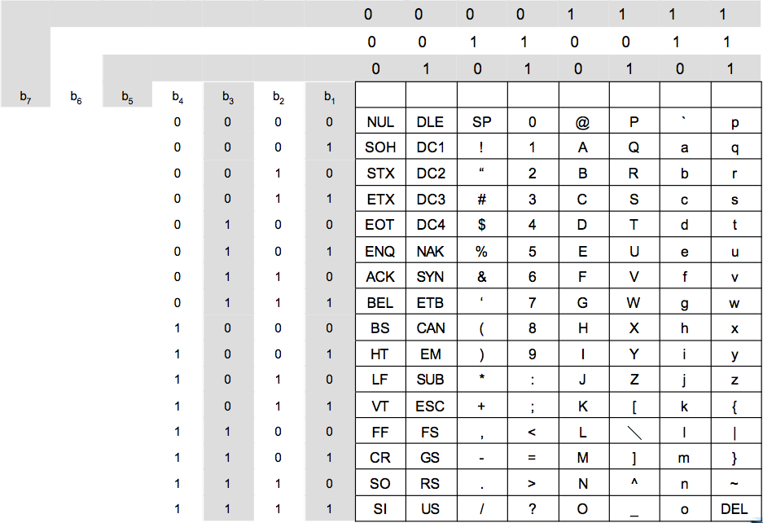
Characters
Notes:
14

Slide 26
x86 Data Types
8 bit Byte
16 bit word
32 bit double word
64 bit quad word
128 bit double quadword
Addressing is by 8 bit unit
Words do not need to align at even-numbered address
Data accessed across 32 bit bus in units of double word read at addresses divisible by 4
Notes:
15

Slide 27
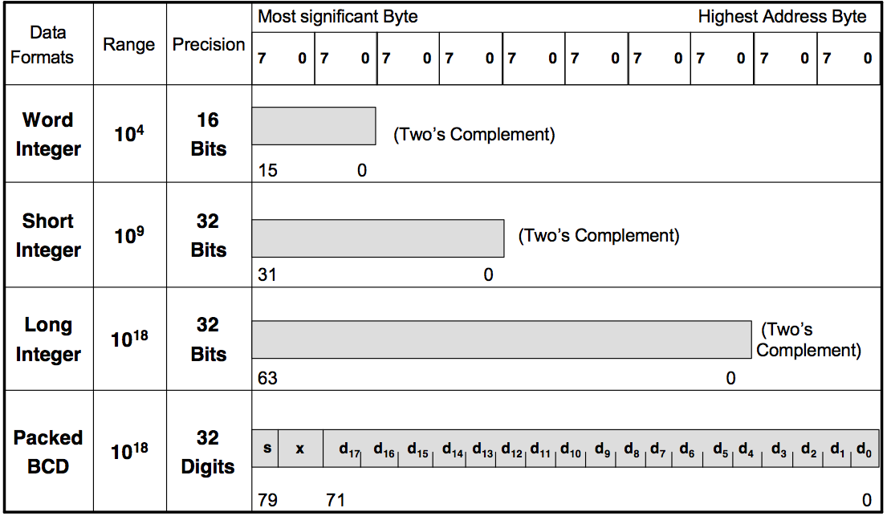
Pentium II Numerical Data Formats
Notes:
15

Slide 28
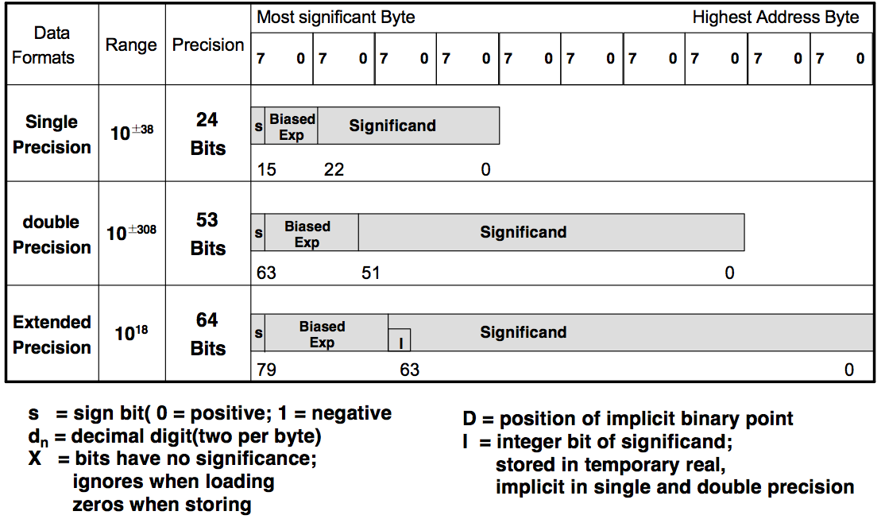
Pentium II Numerical Data Formats
Notes:
15

Slide 29
Types of Operations
Data Transfer
Arithmetic
Logical
Conversion
I/O
System Control
Transfer of Control
Notes:
18

Slide 30
Data Transfer
Specify
Source
Destination
Amount of data
May be different instructions for different movements
e.g. IBM 370
Or one instruction and different addresses
e.g. VAX (Virtual Address eXtension – ISA)
Notes:
19

Slide 31
Arithmetic
Add, Subtract, Multiply, Divide ….
Signed Integer
Floating point
May include
Increment (a++)
Decrement (a--)
Negate (-a)
Notes:
20

Slide 32
Shift and Rotate Operations
Logical Shifts:
Logical shift – shifting left (LShiftL/LSL) and shifting right (LShiftR/LSR)
C
R3
0
before:
0
0
1
1
1
0
.
.
.
0
1
1
after:
1
1
1
0
.
.
.
0
1
1
0
0
(a) Logical shift left
LSL R3, #2
0
R3
C
before:
0
1
1
1
0
.
.
.
0
1
1
0
after:
0
0
0
1
1
1
0
.
.
.
0
1
(b) Logical shift right
LSR R3,#2

Slide 33
Shift and Rotate Operations
Arithmetic Shifts:
Arithmetic Shift Right (ASR)
R3
C
before:
1
0
0
1
1
.
.
.
0
1
0
0
after:
1
1
1
0
0
1
1
.
.
.
0
1
(a) Arithmetic shift right
ASR R3,#2

Slide 34
Shift and Rotate Operations
Rotate:
C
R3
C
R3
before:
0
0
1
1
1
0
.
.
.
0
1
1
before:
0
0
1
1
1
0
.
.
.
0
1
1
after:
1
1
1
0
.
.
.
0
1
1
0
1
after:
1
1
1
0
.
.
.
0
1
1
0
0
(a) Rotate left without carry
ROR R3, #2
(b) Rotate left with carry
RCL R3, #2
Rotate Right without carry
Rotate Right with carry

Slide 35
Logical
Bitwise operations:
AND,
OR,
NOT,
XOR,
TEST,
CMP,
SET …
Notes:
21

Slide 36
Conversion
Change the format or operate on the format of data
e.g. Binary to Decimal
Notes:
22

Slide 37
Input/Output
May be specific instructions
May be done using data movement instructions (memory mapped)
May be done by a separate controller (DMA)
Notes:
23

Slide 38
Systems Control
Executed only while
The processor is in a certain privileged state
The processor is executing a program in a special privileged area of memory
CPU needs to be in specific state
Ring 0 on 80386+
Kernel mode
For the use of operating systems
Examples
Read or alter a control register
Read or modify a storage protection key
Access to process control blocks in a multiprogramming system
Privileged instructions
Notes:
24

Slide 39
Transfer of Control
Branch
e.g. branch to x if result is zero
Conditional branch instruction
Two ways of generating the condition
Most machines provide a 1-bit or multiple- bit condition code that is set as the result of some operations
To perform a comparison and specify a branch in the same instruction
Subroutine call
c.f. interrupt call
Notes:
25

Slide 40
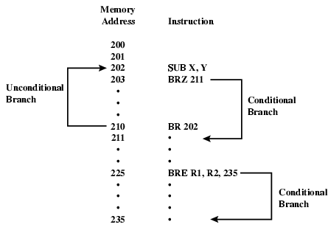
Branch Instruction

Slide 41
Procedure Calls
Procedure Call Instructions
Self-contained computer program incorporated into a larger program
Two principal reasons for the use of procedures
Economy and modularity
Two basic instructions
A call instruction branching from the present location to the procedure
A Return instruction returning from the procedure to the place from which it was called

Slide 42
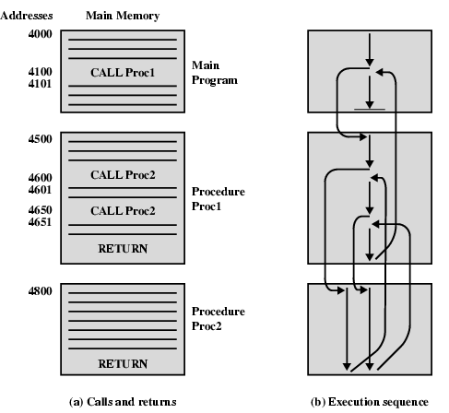
Nested Procedure Calls

Slide 43
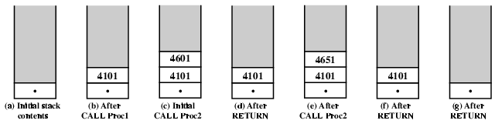
Use of Stack

Slide 44
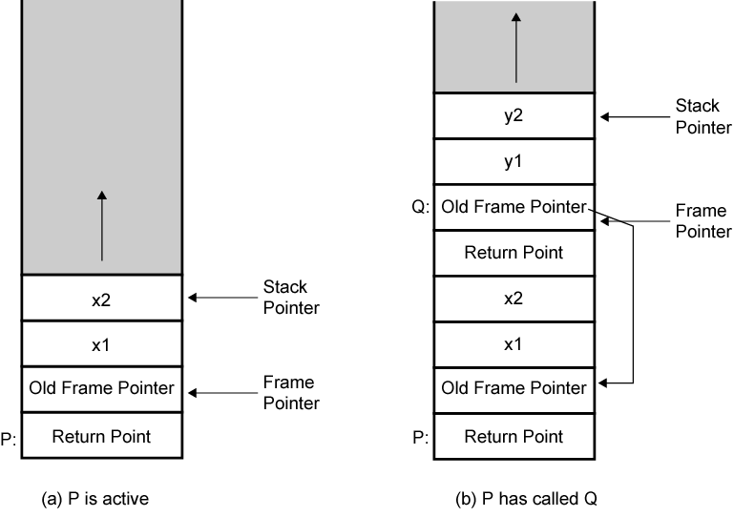
Stack Frame Growth Using Sample Procedures P and Q

Slide 45
Byte Order
In what order do we read numbers that occupy more than one byte?
e.g. (numbers in hex to make it easy to read)
12345678 can be stored in 4x8bit locations as follows:
Address | Data | Address | Data
00F00 | 12 | 00F00 | 78
00F01 | 34 | 00F01 | 56
00F02 | 56 | 00F02 | 34
00F03 | 78 | 00F03 | 12
How to read? top down or bottom up?
Notes:
27

Slide 46
Byte Order Names
The problem is called Endian
The system on the left has the Most significant byte first or in the lowest address
This is called Big-endian
The system on the right has the least significant byte first or in the Lowest address
This is called little-endian
Address | Data | Address | Data
00F00 | 12 | 00F00 | 78
00F01 | 34 | 00F01 | 56
00F02 | 56 | 00F02 | 34
00F03 | 78 | 00F03 | 12
Notes:
29

Slide 47
Standard…What Standard?
Pentium (x86), VAX (Virtual Address eXtension - ISA) are little-endian
IBM 370, Motorola 680x0 (Mac), and most RISC are big-endian
Internet is big-endian
Makes writing Internet programs on PC more awkward!
WinSock provides htoi and itoh (Host to Internet & Internet to Host) functions to convert.
Notes:
30

Slide 48
SUMMARY
Instruction Set
Instruction Format
Instruction Cycle State Diagram
Operation Types
Operands
Data Types
Little and Big-Endian

