Slide 1
CSC 221 Computer Organization and Assembly Language
Lecture 07: Addressing Modes
REFERENCE:
CHAPTER 03
The Intel Microprocessors: 8086/8088, 80186/80188, 80286, 80386, 80486 Pentium,
Pentium Pro Processor, Pentium II, Pentium, 4, and Core2 with 64-bit Extensions
Architecture, Programming, and Interfacing, Eighth Edition Barry B. Brey

Slide 2
Lecture 06: Review
Opcode
Operand(s) and/or Address(es)
opcode field.
designed to hold the instruction, or opcode
Right of the opcode field is the operand field.
contains information used by the opcode
the MOV AL,BL instruction has the opcode MOV and operands AL and BL
The comment field, the final field, contains a comment about the instruction(s).
comments always begin with a semicolon (;)

Slide 3
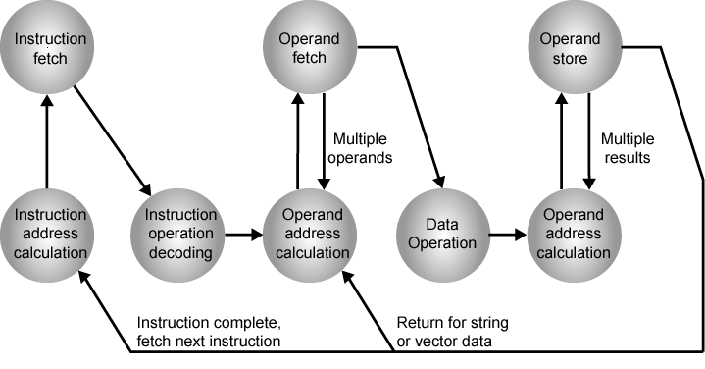
Lecture 06: Review
(cont.)
Instruction Cycle State Diagram

Slide 4
Lecture 06: Review
(cont.)
Types of Operands
Addresses: immediate, direct, indirect, stack …
Numbers:
Integer or fixed point (binary, twos complement),
Floating point (sign, significand, exponent),
(packed) decimal (246 = 0000 0010 0100 0110)
Characters:
ASCII (128 printable and control characters + bit for error detection)
Logical Data
bits or flags, e.g. Boolean 0 and 1
Data Structures
Notes:
14

Slide 5
Types of Operations
Lecture 06: Review
(cont.)
Data Transfer
Arithmetic
Logical
Conversion
I/O
System Control
Transfer of Control
Notes:
18

Slide 6
Lecture 06: Extension
(cont.)
label
Opcode
Operand(s) and/or Address(es)
; comments
Each statement in an assembly language program consists of four parts or fields.
The leftmost field is called the label.
used to store a symbolic name for the memory location it represents
All labels must begin with a letter or one of the following special characters: @, $, -, or ?.
a label may any length from 1 to 35 characters
The label appears in a program to identify the name of a memory location for storing data and for other purposes.

Slide 7
Lecture Outline
Operation of each data-addressing mode.
The Data-addressing modes to form assembly language statements.
The operation of each program memory-addressing mode.
The program memory-addressing modes to form assembly and machine language statements.

Slide 8
Lecture Outline
(cont.)
Select the appropriate addressing mode to accomplish a given task.
Difference between addressing memory data using real mode and protected mode operation.
Describe sequence of events that place data onto the stack or remove data from the stack.
Explain how a data structure is placed in memory and used with software.

Slide 9
Addressing Modes
Two Basic Questions
Where are the operands?
How memory addresses are computed?
Intel IA-32 supports 3 fundamental addressing modes
Register addressing: operand is in a register
Immediate addressing: operand is stored in the instruction itself
Memory addressing: operand is in memory
Memory Addressing
Variety of addressing modes
Direct and indirect addressing
Support high-level language constructs and data structures

Slide 10
Addressing Modes
Efficient software development for the microprocessor requires a complete familiarity with the addressing modes employed by each instruction.

Slide 11
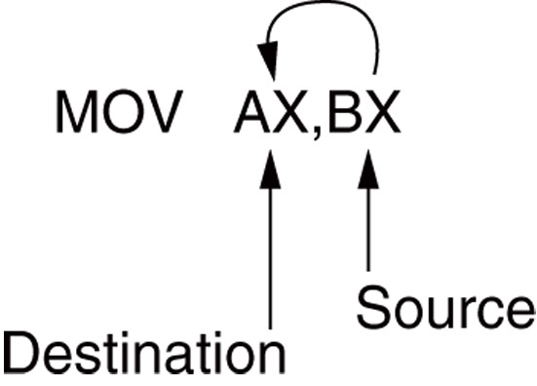
Data Addressing Modes
MOV instruction is a common and flexible instruction.
provides a basis for explanation of data-addressing modes
Following Figure: illustrates the MOV instruction and defines the direction of data flow.
Source is to the right and destination the left, next to the opcode MOV.
REVIEW: an opcode, or operation code, tells the microprocessor which operation to perform.
Figure: The MOV instruction showing the source, destination, and direction of data flow.

Slide 12
Data Addressing Modes
All possible variations of the data-addressing modes using MOV are shown in next slide.
These data-addressing modes are found with all versions of the Intel microprocessor.
except for the scaled-index-addressing mode, found only in 80386 through Core2
RIP relative (instruction pointer relative) addressing mode is not illustrated.
only available on the Pentium 4 and Core2 in the 64-bit mode

Slide 13

8086–Core2 data-addressing modes.
Type | Instruction
Register | MOV AX,BX
Immediate | MOV CH,3AH
Direct | MOV [1234H],AX
Register Indirect | MOV [BX[,CL
Base-Plus-Index | MOV [BX+SI],BP
Register Relative | MOV CL, [BX+4]
Base Relative-Plus-Index | MOV ARRAY[BX+SI],DX
Scaled Index | MOV [EBX+2+ESI],AX
Source
Destination
Register
BX
Register
BX
Data
34H
Register
CH
Register
AX
DS x 10H + DISPL.
10000H + 1234H
Memory Address
11234H
Register
CL
DS x 10H + BX
10000H + 0300H
Memory Address
10300H
Register
SP
DS x 10H + BX + SI
10000H + 0300H + 0200H
Memory Address
10500H
Memory Address
10304H
DS x 10H + BX + 4
10000H + 0300H + 4
Register
CL
Register
DX
DSx10H + ARRAY+BX+SI
10000H+1000H + 0300H+0200H
Memory Address
11500H
Register
AX
DSx10H + EBX + 2 + ESI
10000H+00000300H + 00000400H
Memory Address
10700H
Notes: EBX = 00000300H , ESI = 00000200H , ARRAY = 1000H , and DS = 1000H

Slide 14
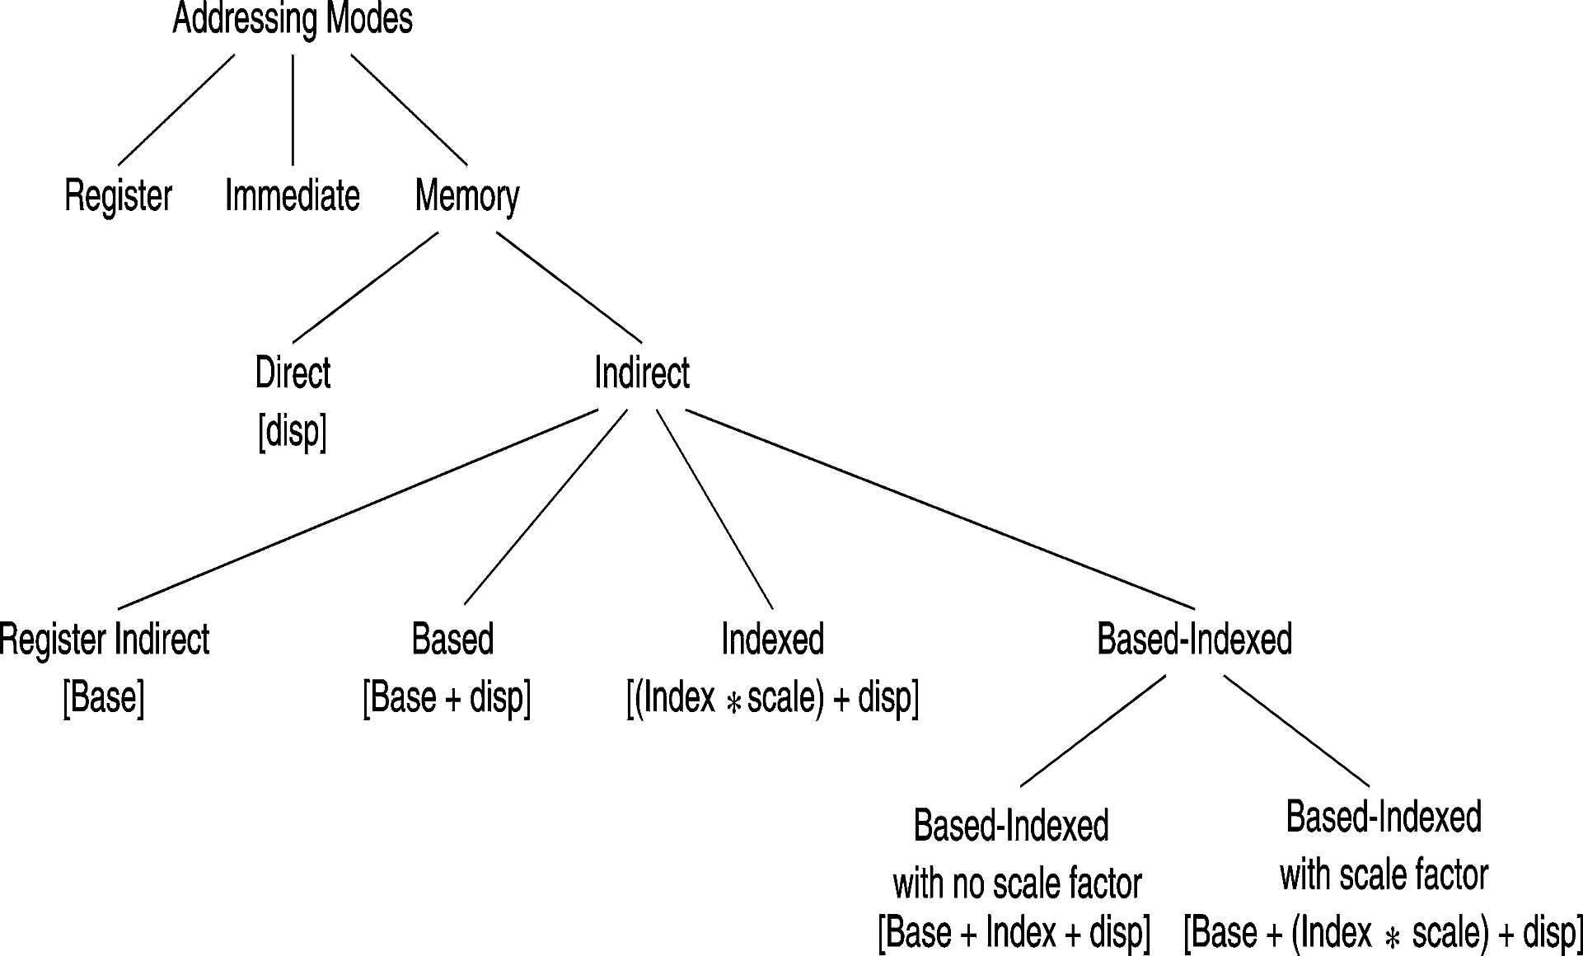
Layout of Addressing Modes
Assembler converts a variable name into a constant offset (called also a displacement)
For indirect addressing, a base/index register contains an address/index
CPU computes the effective address of a memory operand

Slide 15
Register Addressing
The most common form of data addressing.
once register names learned, easiest to apply.
The microprocessor contains these 8-bit register names used with register addressing: AH, AL, BH, BL, CH, CL, DH, and DL.
16-bit register names: AX, BX, CX, DX, SP, BP, SI, and DI.

Slide 16
Register Addressing
In 80386 and above, extended 32-bit register names are: EAX, EBX, ECX, EDX, ESP, EBP, EDI, and ESI.
64-bit mode register names are: RAX, RBX, RCX, RDX, RSP, RBP, RDI, RSI, and R8 through R15.
Important for instructions to use registers that are the same size.
never mix an 8-bit \with a 16-bit register, an 8- or a 16-bit register with a 32-bit register
this is not allowed by the microprocessor and results in an error when assembled

Slide 17
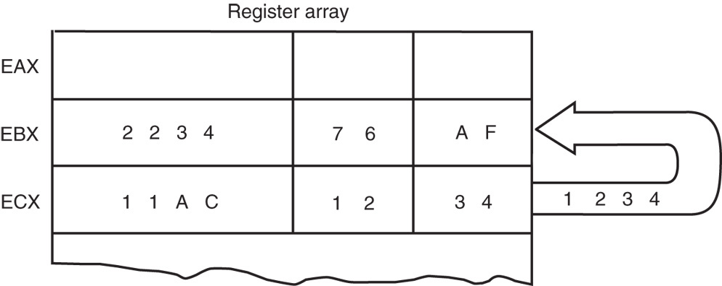
[MOV BX, CX] instruction
The source register’s contents do not change.
the destination register’s contents do change
The contents of the destination register or destination memory location change for all instructions except the CMP and TEST instructions.
The MOV BX, CX instruction does not affect the leftmost 16 bits of register EBX.
Figure: The effect of executing the MOV BX, CX instruction at the point just before the BX register changes. Note that only the rightmost 16 bits of register EBX change.

Slide 18
Immediate Addressing
Term immediate implies that data immediately follow the hexadecimal opcode in the memory.
immediate data are constant data
data transferred from a register or memory location are variable data
Immediate addressing operates upon a byte or word of data.
Figure in the Next Slide→ shows the operation of a MOV EAX,13456H instruction.

Slide 19
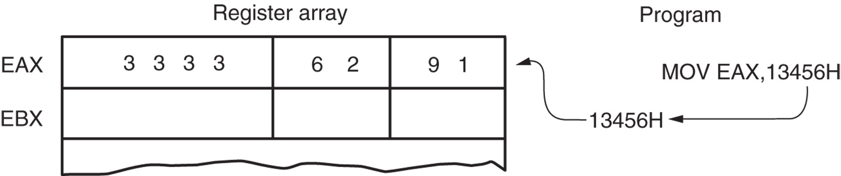

Immediate Addressing
(cont.)
As with the MOV instruction illustrated in the following Figure, the source data overwrites the destination data.
Figure: The operation of the MOV EAX,3456H instruction. This instruction copies the immediate data (13456H) into EAX.

Slide 20
NOTES
In symbolic assembly language, the symbol # precedes immediate data in some assemblers.
MOV AX,#3456H instruction is an example
Most assemblers do not use the # symbol, but represent immediate data as in the MOV AX,3456H instruction.
an older assembler used with some Hewlett-Packard logic development does, as may others
in this text, the # is not used for immediate data

Slide 21
NOTES
(cont.)
The symbolic assembler portrays immediate data in many ways.
The letter H appends hexadecimal data.
If hexadecimal data begin with a letter, the assembler requires the data start with a 0.
to represent a hexadecimal F2, 0F2H is used in assembly language
Decimal data are represented as is and require no special codes or adjustments.
an example is the 100 decimal in the MOV AL,100 instruction

Slide 22
NOTES
(cont.)
An ASCII-coded character or characters may be depicted in the immediate form if the ASCII data are enclosed in apostrophes.
be careful to use the apostrophe (‘) for ASCII data and not the single quotation mark (‘)
Binary data are represented if the binary number is followed by the letter B.
in some assemblers, the letter Y

Slide 23
Direct Data Addressing
Applied to many instructions in a typical program.
Two basic forms of direct data addressing:
direct addressing, which applies to a MOV between a memory location and AL, AX, or EAX
displacement addressing, which applies to almost any instruction in the instruction set
Address is formed by adding the displacement to the default data segment address or an alternate segment address.

Slide 24
Direct Addressing
Direct addressing with a MOV instruction transfers data between a memory location, located within the data segment, and the AL (8-bit), AX (16-bit), or EAX (32-bit) register.
usually a 3-byte long instruction
MOV AL,DATA loads AL from the data segment memory location DATA (1234H).
DATA is a symbolic memory location, while 1234H is the actual hexadecimal location

Slide 25
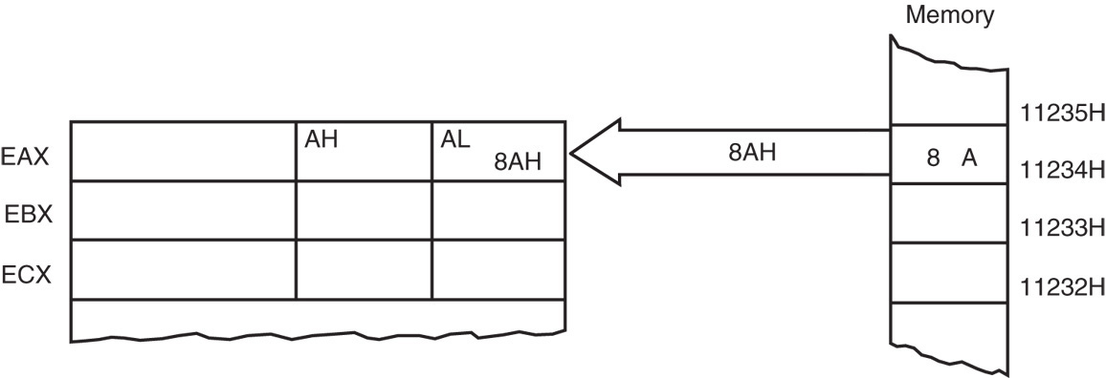
Direct Addressing: Example
This instruction transfers a copy contents of memory location 11234H into AL.
the effective address is formed by adding 1234H (the offset address) and 10000H (the data segment address of 1000H times 10H) in a system operating in the real mode
Figure: The operation of the MOV AL,[1234H] instruction when DS=1000H .

Slide 26
Displacement Addressing
Almost identical to direct addressing, except the instruction is 4 bytes wide instead of 3.
In 80386 through Pentium 4, this instruction can be up to 7 bytes wide if a 32-bit register and a 32-bit displacement are specified.
This type of direct data addressing is much more flexible because most instructions use it.

Slide 27
Register Indirect Addressing
Allows data to be addressed at any memory location through an offset address held in any of the following registers: BP, BX, DI, and SI.
In addition, 80386 and above allow register indirect addressing with any extended register except ESP.
In the 64-bit mode, the segment registers serve no purpose in addressing a location in the flat model.

Slide 28
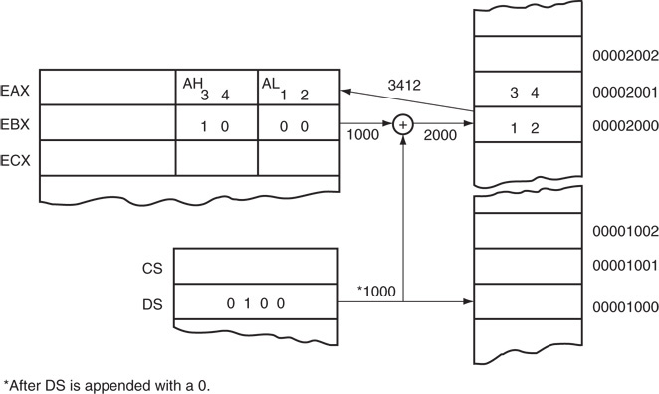
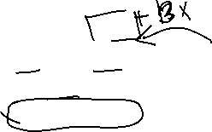


Register Indirect Addressing: Example
MOV AX,[BX]
Figure: The operation of the MOV AX,[BX] instruction when BX = 1000H and DS = 0100H. Note that this instruction is shown after the contents of memory are transferred to AX.

Slide 29
Review: Segment Registers
The data segment is used by default with register indirect addressing or any other mode that uses BX, DI, or SI to address memory.
If the BP register addresses memory, the Stack Segment is used by default.
these settings are considered the default for these four index and base registers
For the 80386 and above, EBP addresses memory in the stack segment by default.
EAX, EBX, ECX, EDX, EDI, and ESI address memory in the data segment by fault.

Slide 30
Review: Memory Access Mode
When using a 32-bit register to address memory in the real mode, contents of the register must never exceed 0000FFFFH.
In the protected mode, any value can be used in a 32-bit register that is used to indirectly address memory.
as long as it does not access a location outside the segment, dictated by the access rights byte
In the 64-bit mode / Flat Memory Mode, segment registers are not used in address calculation; the register contains the actual linear memory address.

Slide 31


Indirect Addressing
In some cases, indirect addressing requires specifying the size of the data by the special assembler directive BYTE PTR, WORD PTR, DWORD PTR, or QWORD PTR.
these directives indicate the size of the memory data addressed by the memory pointer (PTR)
The directives are with instructions that address a memory location through a pointer or index register with immediate data.

Slide 32
Indirect Addressing: Tabular Data
Indirect addressing often allows a program to refer to tabular data located in memory.
Figure in the NEXT SLIDE → shows the table and the BX register used to sequentially address each location in the table.
To accomplish this task, load the starting location of the table into the BX register with a MOV immediate instruction.
After initializing the starting address of the table, use register indirect addressing to store the 50 samples sequentially.

Slide 33
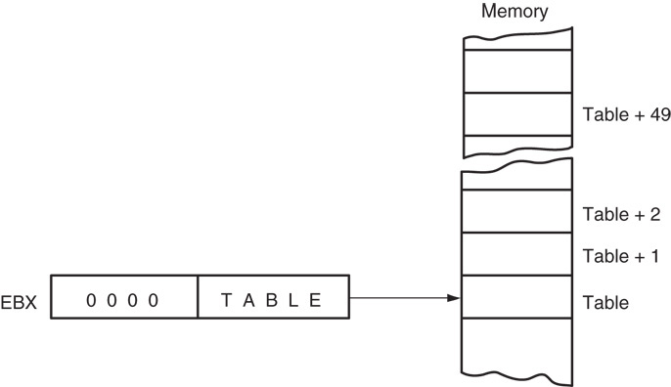

Indirect Addressing: Tabular Data
Figure: An array (TABLE) containing 50 bytes that are indirectly addressed through register BX.

Slide 34
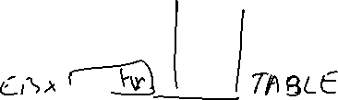

Base-Plus-Index Addressing
Similar to indirect addressing because it indirectly addresses memory data.
The base register often holds the beginning location of a memory array.
the index register holds the relative position of an element in the array
whenever BP addresses memory data, both the stack segment register and BP generate the effective address

Slide 35


Locating Data with Base-Plus-Index Addressing
Figure in NEXT SLIDE → shows how data are addressed by the MOV DX,[BX + DI] instruction when the microprocessor operates in the real mode.
The Intel assembler requires this addressing mode appear as [BX][DI] instead of [BX + DI].
The MOV DX,[BX + DI] instruction is MOV DX,[BX][DI] for a program written for the Intel ASM assembler.

Slide 36
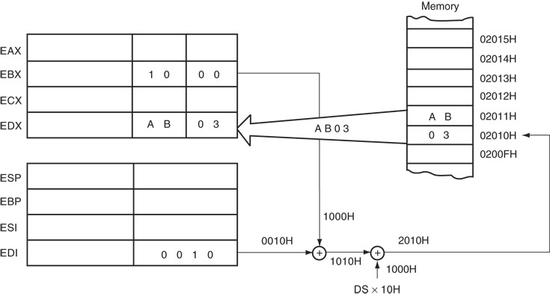

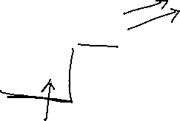




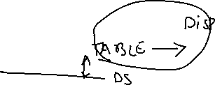

Locating Data with Base-Plus-Index Addressing
Figure: An example showing how the base-plus-index addressing mode functions for the MOV DX,[BX + DI] instruction. Notice that memory address 02010H is accessed because DS=0100H, BX=100H and DI=0010H.

Slide 37
Locating Array Data Using Base-Plus-Index Addressing
A major use is to address elements in a memory array.
To accomplish this, load the BX register (base) with the beginning address of the array and the DI register (index) with the element number to be accessed.
Figure in NEXT SLIDE → shows the use of BX and DI to access an element in an array of data.

Slide 38
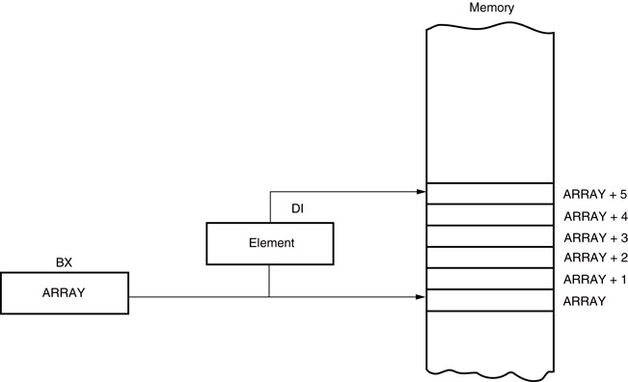




Locating Array Data Using Base-Plus-Index Addressing
Figure: An example of the base-plus-index addressing mode. Here an element (DI) of an ARRAY (BX) is addressed.

Slide 39
Register Relative Addressing
Similar to base-plus-index addressing and displacement addressing.
data in a segment of memory are addressed by adding the displacement to the contents of a base or an index register (BP, BX, DI, or SI)
Figure in NEXT SLIDE → shows the operation of the MOV AX,[BX+1000H] instruction.
A real mode segment is 64K bytes long.

Slide 40
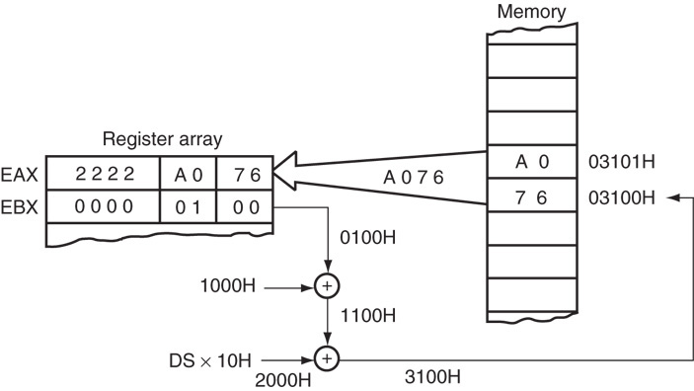

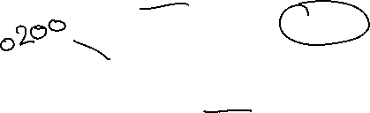


Register Relative Addressing
MOV AX,[BX+1000H]
Figure: The operation of the MOV AX, [BX=1000H] instruction, when BX=1000H and DS=0200H .

Slide 41
Addressing Array Data with Register Relative
It is possible to address array data with register relative addressing.
such as with base-plus-index addressing
Figure at NEXT SLIDE→, register relative addressing is illustrated with the same example as for base-plus-index addressing.
this shows how the displacement ARRAY adds to index register DI to generate a reference to an array element

Slide 42
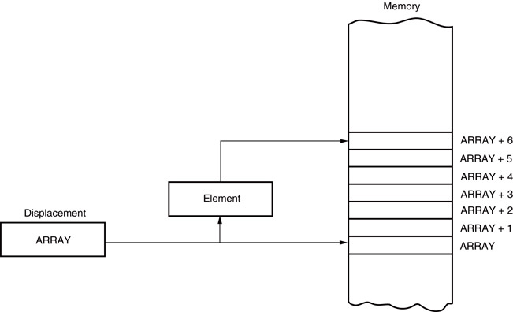
Addressing Array Data with Register Relative
Figure: Register relative addressing used to address an element of ARRAY. The displacement addresses the start of ARRAY, and DI accesses an element.

Slide 43
Base Relative-Plus-Index Addressing
Similar to base-plus-index addressing.
adds a displacement
uses a base register and an index register to form the memory address
This type of addressing mode often addresses a two-dimensional array of memory data.

Slide 44
Addressing Data with Base Relative-Plus-Index
Least-used addressing mode.
Figure in NEXT SLIDE → shows how data are referenced if the instruction executed by the microprocessor is MOV AX,[BX + SI + 100H].
displacement of 100H adds to BX and SI to form the offset address within the data segment
This addressing mode is too complex for frequent use in programming.

Slide 45
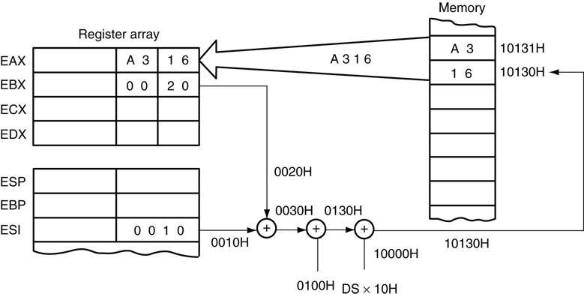
Addressing Data with Base Relative-Plus-Index
MOV AX,[BX + SI + 100H]
Figure: An example of base relative-plus-index addressing using a MOV AX,[BX+SI=1000H] instruction. Note: DS=1000H

Slide 46
Addressing Arrays with Base Relative-Plus-Index
Suppose a file of many records exists in memory, each record with many elements.
displacement addresses the file, base register addresses a record, the index register addresses an element of a record
Following figure illustrates this very complex form of addressing.

Slide 47
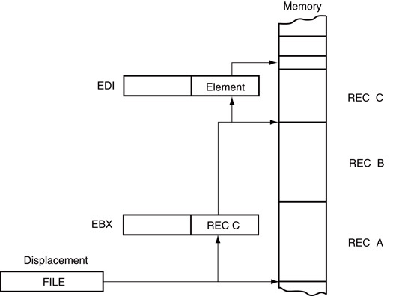



Addressing Arrays with Base Relative-Plus-Index
Figure: Base relative-plus-index addressing used to access a FILE that contains multiple records (REC).

Slide 48
Scaled-Index Addressing
Unique to 80386 - Core2 microprocessors.
uses two 32-bit registers (a base register and an index register) to access the memory
The second register (index) is multiplied by a scaling factor.
the scaling factor can be 1x, 2x, 4x, 8x
A scaling factor is implied and need not be included in the assembly language instruction (MOV AL,[EBX + ECX]).

Slide 49
RIP Relative Addressing
Uses the 64-bit instruction pointer register in the 64-bit mode to address a linear location in the flat memory model.
Inline assembler program available to Visual does not contain any way of using this mode or any other 64-bit addressing mode.
The Microsoft Visual does not at present support developing 64-bit assembly code.

Slide 50
PROGRAM MEMORY-ADDRESSING MODES
Used with the JMP (jump) and CALL instructions.
Consist of three distinct forms:
direct, relative, and indirect

Slide 51
Direct Program Memory Addressing
Used for all jumps and calls by early microprocessor; also used in high-level languages, such as BASIC.
GOTO and GOSUB instructions
The microprocessor uses this form, but not as often as relative and indirect program memory addressing.
The instructions for direct program memory addressing store the address with the opcode.

Slide 52

Direct Program Memory Addressing
Figure: The 5-byte machine language version of a JMP [10000H] instruction.

Slide 53
Direct Program Memory Addressing
This JMP instruction loads CS with 1000H and IP with 0000H to jump to memory location 10000H for the next instruction.
an intersegment jump is a jump to any memory location within the entire memory system
Often called a far jump because it can jump to any memory location for the next instruction.
in real mode, any location within the first 1M byte
In protected mode operation, the far jump can jump to any location in the 4G-byte address range in the 80386 - Core2 microprocessors

Slide 54
Direct Program Memory Addressing
The only other instruction using direct program addressing is the intersegment or far CALL instruction.
Usually, the name of a memory address, called a label, refers to the location that is called or jumped to instead of the actual numeric address.
When using a label with the CALL or JMP instruction, most assemblers select the best form of program addressing.

Slide 55
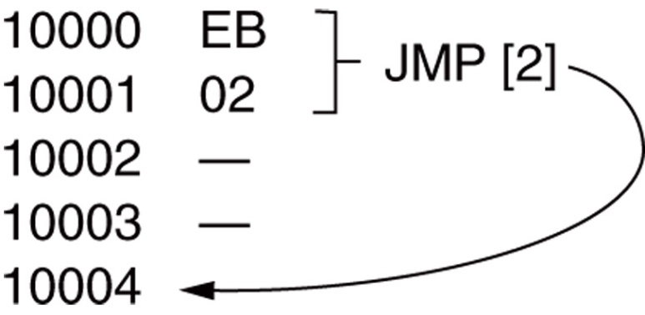
Relative Program Memory Addressing
Not available in all early microprocessors, but it is available to this family of microprocessors.
The term relative means “relative to the instruction pointer (IP)”.
The JMP instruction is a 1-byte instruction, with a 1-byte or a 2-byte displacement that adds to the instruction pointer.
Figure: A JMP [2] instruction. This instruction skips over the 2 bytes of memory that follow the JMP instruction.

Slide 56
Indirect Program Memory Addressing
The microprocessor allows several forms of program indirect memory addressing for the JMP and CALL instructions.
In 80386 and above, an extended register can be used to hold the address or indirect address of a relative JMP or CALL.
for example, the JMP EAX jumps to the location address by register EAX

Slide 57
If a relative register holds the address, the jump is considered to be an indirect jump.
For example, JMP [BX] refers to the memory location within the data segment at the offset address contained in BX.
at this offset address is a 16-bit number used as the offset address in the intrasegment jump
this type of jump is sometimes called an indirect-indirect or double-indirect jump

Slide 58
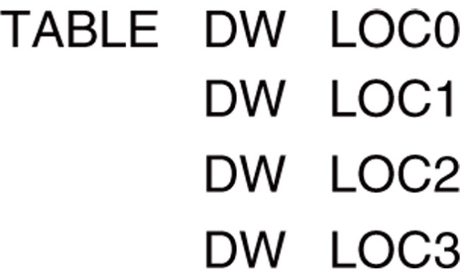
Figure: A jump table that stores addresses of various programs. The exact address chosen from the TABLE is determined by an index stored with the jump instruction.
Following figure shows a jump table that is stored, beginning at memory location TABLE.

Slide 59
STACK MEMORY-ADDRESSING MODES
The stack plays an important role in all microprocessors.
holds data temporarily and stores return addresses used by procedures
Stack memory is LIFO (last-in, first-out) memory
describes the way data are stored and removed from the stack

Slide 60
STACK MEMORY-ADDRESSING MODES
Data are placed on the stack with a PUSH instruction; removed with a POP instruction.
Stack memory is maintained by two registers:
the stack pointer (SP or ESP)
the stack segment register (SS)
Whenever a word of data is pushed onto the stack, the high-order 8 bits are placed in the location addressed by SP – 1.
low-order 8 bits are placed in the location addressed by SP – 2

Slide 61
STACK MEMORY-ADDRESSING MODES
The SP is decremented by 2 so the next word is stored in the next available stack location.
the SP/ESP register always points to an area of memory located within the stack segment.
In protected mode operation, the SS register holds a selector that accesses a descriptor for the base address of the stack segment.
When data are popped from the stack, the low-order 8 bits are removed from the location addressed by SP.
high-order 8 bits are removed; the SP register is incremented by 2

Slide 62
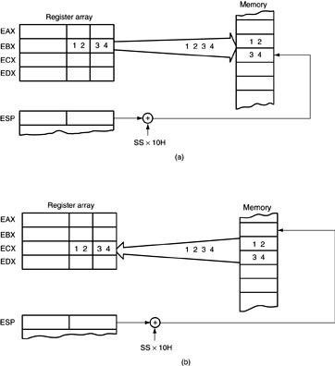
Figure: The PUSH and POP instructions: (a) PUSH BX places the contents of BX onto the stack; (b) POP CX removes data from the stack and places them into CX. Both instructions are shown after execution.

Slide 63
STACK MEMORY-ADDRESSING MODES
Note that PUSH and POP store or retrieve words of data—never bytes—in 8086 - 80286.
80386 and above allow words or doublewords to be transferred to and from the stack.
Data may be pushed onto the stack from any 16-bit register or segment register.
in 80386 and above, from any 32-bit extended register
Data may be popped off the stack into any register or any segment register except CS.

Slide 64
STACK MEMORY-ADDRESSING MODES
PUSHA and POPA instructions push or pop all except segment registers, on the stack.
Not available on early 8086/8088 processors.
80386 and above allow extended registers to be pushed or popped.
64-bit mode for Pentium and Core2 does not contain a PUSHA or POPA instruction

Slide 65
SUMMARY
The MOV instruction copies the contents of the source operand into the destination operand.
The source never changes for any instruction.
Register addressing specifies any 8-bit register (AH, AL, BH, BL, CH, CL, DH, or DL) or any 16-bit register (AX, BX, CX, DX, SP, BP, SI, or DI).

Slide 66
SUMMARY
(cont.)
The segment registers (CS, DS, ES, or SS) are also addressable for moving data between a segment register and a 16-bit register/memory location or for PUSH and POP.
In the 80386 through the Core2 microprocessors, the extended registers also are used for register addressing; they consist of EAX, EBX, ECX, EDX, ESP, EBP, EDI, and ESI.

Slide 67
SUMMARY
(cont.)
Direct addressing occurs in two forms in the microprocessor: direct addressing and displacement addressing.
In the 64-bit mode, the registers are RAX, RBX, RCX, RDX, RSP, RBP, RDI, RSI, and R8 through R15.
The MOV immediate instruction transfers the byte or word that immediately follows the opcode into a register or a memory location.
Immediate addressing manipulates constant data in a program.

Slide 68
SUMMARY
(cont.)
Both forms of addressing are identical except that direct addressing is used to transfer data between EAX, AX, or AL and memory; displacement addressing is used with any register-memory transfer.
Direct addressing requires 3 bytes of memory, whereas displacement addressing requires 4 bytes.

Slide 69
SUMMARY
(cont.)
Register indirect addressing allows data to be addressed at the memory location pointed to by either a base (BP and BX) or index register (DI and SI).
In the 80386 and above, extended registers EAX, EBX, ECX, EDX, EBP, EDI, and ESI are used to address memory data.

Slide 70
SUMMARY
(cont.)
Base-plus-index addressing often addresses data in an array.
The memory address for this mode is formed by adding a base register, index register, and the contents of a segment register times 10H.
In the 80386 and above, the base and index registers may be any 32-bit register except EIP and ESP.

Slide 71
SUMMARY
(cont.)
Register relative addressing uses a base or index register, plus a displacement to access memory data.
Base relative-plus-index addressing is useful for addressing a two-dimensional memory array.
The address is formed by adding a base register, an index register, displacement, and the contents of a segment register times 10H.

Slide 72
SUMMARY
(cont.)
Scaled-index addressing is unique to the 80386 through the Core2.
The second of two registers (index) is scaled by a factor of to access words, doublewords, or quadwords in memory arrays.
The MOV AX, [ EBX + 2*ECX] and the MOV [4 * ECX ], EDX are examples of scaled-index instructions.

Slide 73
SUMMARY
(cont.)
Data structures are templates for storing arrays of data and are addressed by array name and field.
Direct program memory addressing is allowed with the JMP and CALL instructions to any location in the memory system.
With this addressing mode, the offset address and segment address are stored with the instruction.

Slide 74
SUMMARY
(cont.)
Relative program addressing allows a JMP or CALL instruction to branch for-ward or backward in the current code segment by bytes.
In the 80386 and above, the 32-bit displacement allows a branch to any location in the cur-rent code segment by using a displacement value of bytes.
The 32-bit displacement can be used only in protected mode.

Slide 75
SUMMARY
(cont.)
Indirect program addressing allows the JMP or CALL instructions to address another portion of the program or subroutine indirectly through a register or memory location.
The PUSH and POP instructions transfer a word between the stack and a register or memory location.
A PUSH immediate instruction is available to place immediate data on the stack.

