Slide 1
CSC 221 Computer Organization and Assembly Language
Lecture 08:
Assembly Language Fundamentals

Slide 2
Reference
Most of the Slides are taken from Presentation:
Chapter 3
Assembly Language for Intel-Based Computers, 4th Edition
Kip R. Irvine
(c) Pearson Education, 2002. All rights reserved. You may modify and copy this slide show for your personal use, or for use in the classroom, as long as this copyright statement, the author's name, and the title are not changed.

Slide 3
Lecture 07: Review
label
Opcode
Operand(s) and/or Address(es)
; Comments
The MOV instruction copies the contents of the source operand into the destination operand.
The source never changes for any instruction.
Register addressing specifies any 8-bit register (AH, AL, BH, BL, CH, CL, DH, or DL) or any 16-bit register (AX, BX, CX, DX, SP, BP, SI, or DI).

Slide 4
Lecture 07: Review
(cont.)
The segment registers (CS, DS, ES, or SS) are also addressable for moving data between a segment register and a 16-bit register/memory location or for PUSH and POP.
In the 80386 through the Core2 microprocessors, the extended registers also are used for register addressing; they consist of EAX, EBX, ECX, EDX, ESP, EBP, EDI, and ESI.

Slide 5
Lecture 07: Review
(cont.)
Direct addressing occurs in two forms in the microprocessor: direct addressing and displacement addressing.
In the 64-bit mode, the registers are RAX, RBX, RCX, RDX, RSP, RBP, RDI, RSI, and R8 through R15.
The MOV immediate instruction transfers the byte or word that immediately follows the opcode into a register or a memory location.
Immediate addressing manipulates constant data in a program.

Slide 6
Lecture Outline
Basic Elements of Assembly Language
Example: Adding and Subtracting Integers
Defining Data
Configuring Microsoft Visual C++ for Assembly Programming

Slide 7
Basic Elements of Assembly Language
Integer constants
Integer expressions
Character and string constants
Reserved words and identifiers
Directives and instructions
Labels
Mnemonics and Operands
Comments

Slide 8
Integer Constants
Optional leading + or – sign
Binary, Decimal, Hexadecimal, or Octal digits
Common radix characters:
h – hexadecimal
d – decimal
b – binary
r – encoded real
Examples: 30d, 6Ah, 42, 1101b
Hexadecimal beginning with letter: 0A5h

Slide 9
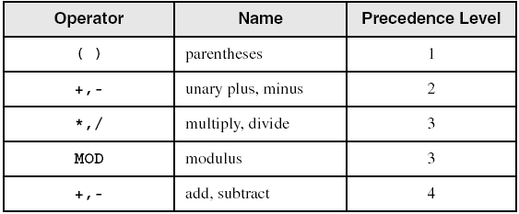
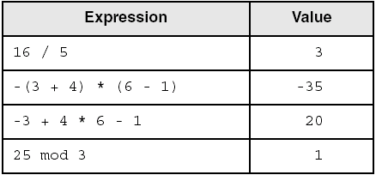
Integer Expressions
Operators and precedence levels:
Examples:

Slide 10
Character and String Constants
Enclose character in single or double quotes
'A', "x"
ASCII character = 1 byte
Enclose strings in single or double quotes
"ABC"
'xyz'
Each character occupies a single byte
Embedded quotes:
'Say "Goodnight," Gracie'

Slide 11
Reserved Words and Identifiers
Reserved words cannot be used as identifiers
Instruction mnemonics, directives, type attributes, operators, predefined symbols
Identifiers
1-247 characters, including digits
not case sensitive
first character must be a letter, _, @, ?, or $

Slide 12
Directives
Commands that are recognized and acted upon by the assembler
Not part of the Intel instruction set
Used to declare Code, Data areas, select memory model, D\declare procedures, etc.
not case sensitive
Different assemblers have different directives
NASM not the same as MASM, for example

Slide 13
Instructions
Assembled into machine code by assembler
Executed at runtime by the CPU
We use the Intel IA-32 instruction set
An instruction contains:
Label (optional)
Mnemonic (required)
Operand (depends on the instruction)
Comment (optional)

Slide 14
Labels
Act as place markers
marks the address (offset) of code and data
Follow identifier rules
Data label
must be unique
example: myArray (not followed by colon)
Code label
target of jump and loop instructions
example: L1: (followed by colon)

Slide 15
Mnemonics and Operands
Instruction Mnemonics
memory aid
examples: MOV, ADD, SUB, MUL, INC, DEC
Operands
constant
constant expression
register
memory (data label)
Constants and constant expressions are often called immediate values

Slide 16
Comments
Comments are good!
explain the program's purpose
when it was written, and by whom
revision information
tricky coding techniques
application-specific explanations
Single-line comments ; CSC221 Assembly
begin with semicolon (;)
Multi-line comments
begin with COMMENT directive and a programmer-chosen character
end with the same programmer-chosen character
COMMENT @
This is some text And
some more text
@

Slide 17
Instruction Format Examples
No operands
stc ; set Carry flag
One operand
inc eax ; register
inc myByte ; memory
Two operands
add ebx,ecx ; register, register
sub myByte,25 ; memory, constant
add eax,36 * 25 ; register, constant-expression

Slide 18
Example: Adding and Subtracting Integers
example001.asm
.386
.model flat,stdcall
option casemap:none
include windows.inc
include kernel32.inc
includelib kernel32.lib
.data
.code
start:
mov eax,10000h; EAX = 10000h
add eax,40000h; EAX = 50000h
sub eax,20000h; EAX = 30000h
invoke ExitProcess, NULL
end start

Slide 19
Example Output
Program output, showing registers and flags:
EAX=00030000
EBX=7FFDF000
ECX=00000101
EDX=FFFFFFFF
ESI=00000000
EDI=00000000
EBP=0012FFF0
ESP=0012FFC4
EIP=00401024
EFL=00000206
CF=0 SF=0 ZF=0 OF=0

Slide 20
Suggested Coding Standards
Some approaches to capitalization
capitalize nothing
capitalize everything
capitalize all reserved words, including instruction mnemonics and register names
capitalize only directives and operators
Other suggestions
descriptive identifier names
spaces surrounding arithmetic operators
blank lines between procedures

Slide 21
Program Template
.386
INCLUDE windows.inc
INCLUDE kernel32.inc
INCLUDELIB kernel32.lib
INCLUDE XXXXXX
.data
; (insert variables here)
.code
XXXYYY:
; (insert executable instructions here)
invoke ExitProcess, NULL
END XXXYYY

Slide 22
Intrinsic Data Types (1 of 2)
BYTE, SBYTE
8-bit unsigned integer; 8-bit signed integer
WORD, SWORD
16-bit unsigned & signed integer
DWORD, SDWORD
32-bit unsigned & signed integer
QWORD
64-bit integer

Slide 23
Intrinsic Data Types (2 of 2)
REAL4
4-byte IEEE short real
REAL8
8-byte IEEE long real
REAL10
10-byte IEEE extended real

Slide 24
Data Definition Statement
A data definition statement sets aside storage in memory for a variable.
May optionally assign a name (label) to the data
Syntax:
[name] directive initializer [,initializer] . . .
value1 BYTE 10
All initializers become binary data in memory

Slide 25
Defining BYTE and SBYTE Data
Each of the following defines a single byte of storage:
value1 BYTE 'A' ; character constant
value2 BYTE 0 ; smallest unsigned byte
value3 BYTE 255 ; largest unsigned byte
value4 SBYTE -128 ; smallest signed byte
value5 SBYTE +127 ; largest signed byte
value6 BYTE ? ; uninitialized byte
A variable name is a data label that implies an offset (an address).

Slide 26
Defining Byte Arrays
Examples that use multiple initializers:
list1 BYTE 10,20,30,40
list2 BYTE 10,20,30,40
BYTE 50,60,70,80
BYTE 81,82,83,84
list3 BYTE ?,32,41h,00100010b
list4 BYTE 0Ah,20h,‘A’,22h

Slide 27
Defining Strings (1 of 3)
A string is implemented as an array of characters
For convenience, it is usually enclosed in quotation marks
It often will be null-terminated
Examples:
str1 BYTE "Enter your name",0
str2 BYTE 'Error: halting program',0
str3 BYTE 'A','E','I','O','U'
greeting BYTE "Welcome to the Encryption Demo program "
BYTE "created by Kip Irvine.",0

Slide 28
Defining Strings (2 of 3)
To continue a single string across multiple lines, end each line with a comma:
menu BYTE "Checking Account",0dh,0ah,0dh,0ah,
"1. Create a new account",0dh,0ah,
"2. Open an existing account",0dh,0ah,
"3. Credit the account",0dh,0ah,
"4. Debit the account",0dh,0ah,
"5. Exit",0ah,0ah,
"Choice> ",0

Slide 29
Defining Strings (3 of 3)
End-of-line character sequence:
0Dh = carriage return
0Ah = line feed
str1 BYTE "Enter your name: ",0Dh,0Ah
BYTE "Enter your address: ",0
newLine BYTE 0Dh,0Ah,0

Slide 30
Using the DUP Operator
Use DUP to allocate (create space for) an array or string. Syntax: counter DUP ( argument )
Counter and argument must be constants or constant expressions
var1 BYTE 20 DUP(0) ; 20 bytes, all equal to zero
var2 BYTE 20 DUP(?) ; 20 bytes, uninitialized
var3 BYTE 4 DUP("STACK") ; 20 bytes: "STACKSTACKSTACKSTACK"
var4 BYTE 10,3 DUP(0),20 ; 5 bytes

Slide 31
Defining WORD and SWORD Data
Define storage for 16-bit integers
or double characters
single value or multiple values
word1 WORD 65535 ; largest unsigned value
word2 SWORD –32768 ; smallest signed value
word3 WORD ? ; uninitialized, unsigned
word4 WORD "AB" ; double characters
myList WORD 1,2,3,4,5 ; array of words
array WORD 5 DUP(?) ; uninitialized array

Slide 32
Defining DWORD and SDWORD Data
Storage definitions for signed and unsigned 32-bit integers:
val1 DWORD 12345678h ; unsigned
val2 SDWORD –2147483648 ; signed
val3 DWORD 20 DUP(?) ; unsigned array
val4 SDWORD –3,–2,–1,0,1 ; signed array

Slide 33
Defining QWORD, TBYTE, Real Data
Storage definitions for quadwords, tenbyte values, and real numbers:
quad1 QWORD 1234567812345678h
val1 TBYTE 1000000000123456789Ah
rVal1 REAL4 -2.1
rVal2 REAL8 3.2E-260
rVal3 REAL10 4.6E+4096
ShortArray REAL4 20 DUP(0.0)

Slide 34
Adding Variables to AddSub
.386
.model flat,stdcall
option casemap:none
include windows.inc
include kernel32.inc
includelib kernel32.lib
.data
val1 dword 10000h
val2 dword 40000h
val3 dword 20000h
.code
start:
moveax,val1; EAX = 10000h
addeax,val2; EAX = 50000h
subeax,val3; EAX = 30000h
invoke ExitProcess, NULL
end start

Slide 35
Setting up Visual C++ Express for Assembly

Slide 36
Microsoft Visual C++ 2010 Express
Microsoft Visual Studio 2010 and Visual C++ 2010 Express Edition : both include the current version of the Microsoft Assembler.
ml.exe in the \vc\bin folder of your Visual Studio installation directory, such as c:\Program Files\Microsoft Visual Studio 10.x\vc\bin.

Slide 37
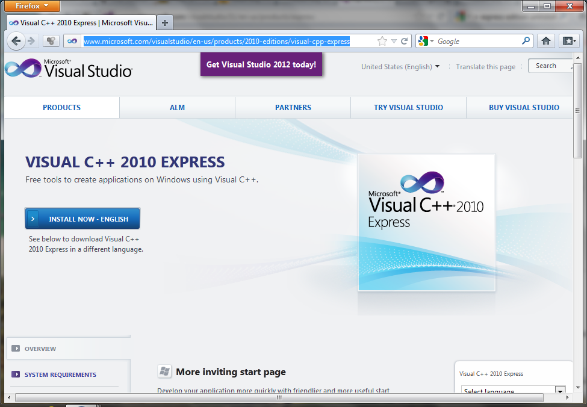
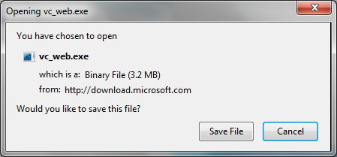
http://www.microsoft.com/visualstudio/en-us/products/2010-editions/visual-cpp-express

Slide 38
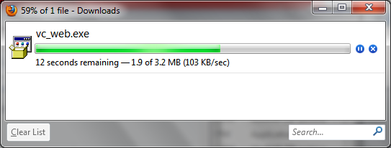
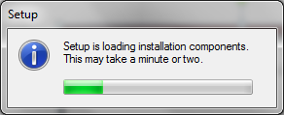
Microsoft Visual C++ 2010 Express

Slide 39
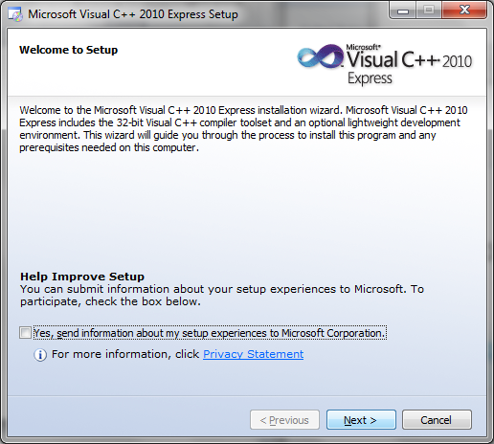
Microsoft Visual C++ 2010 Express

Slide 40
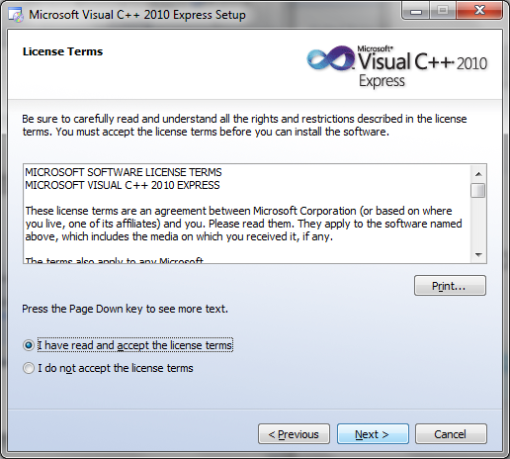
Microsoft Visual C++ 2010 Express

Slide 41
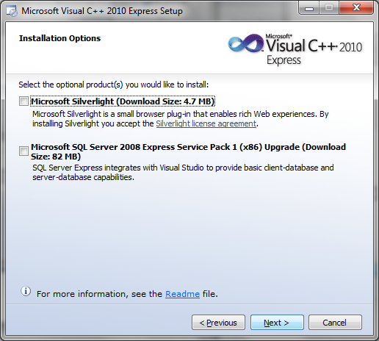
Microsoft Visual C++ 2010 Express

Slide 42
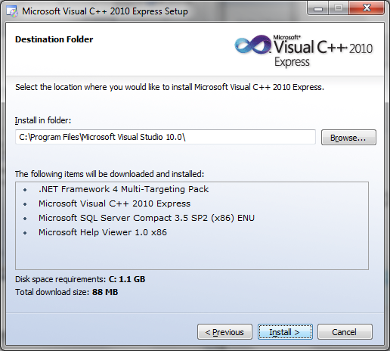
Microsoft Visual C++ 2010 Express

Slide 43
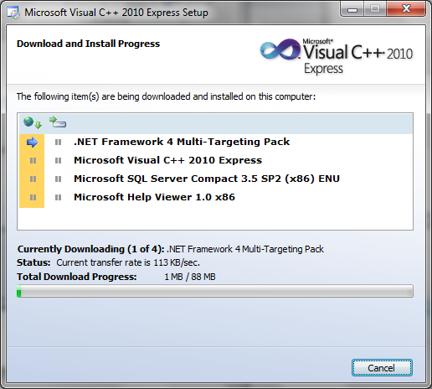
Microsoft Visual C++ 2010 Express

Slide 44
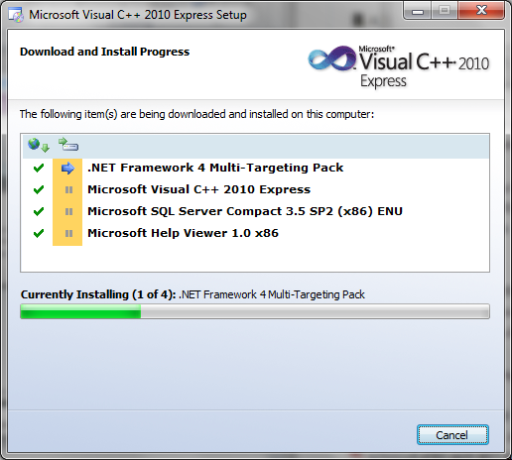
Microsoft Visual C++ 2010 Express

Slide 45
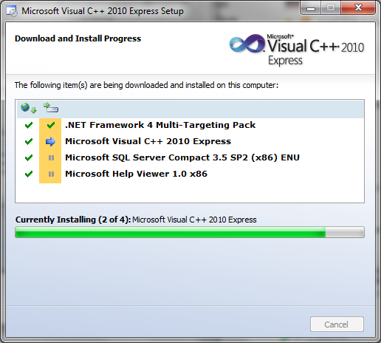
Microsoft Visual C++ 2010 Express

Slide 46
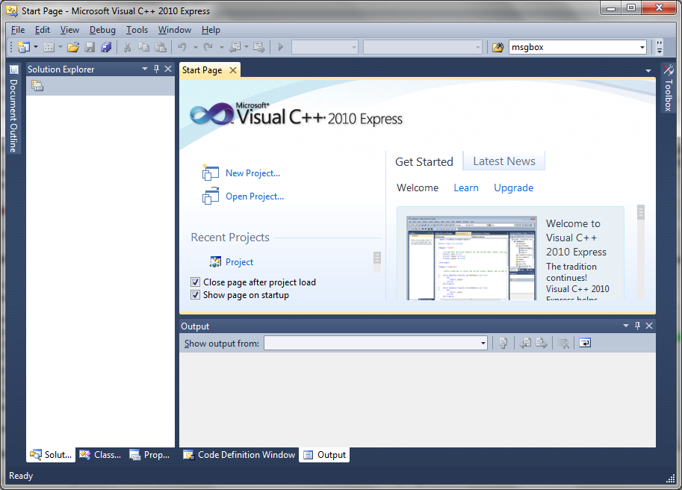

Slide 47
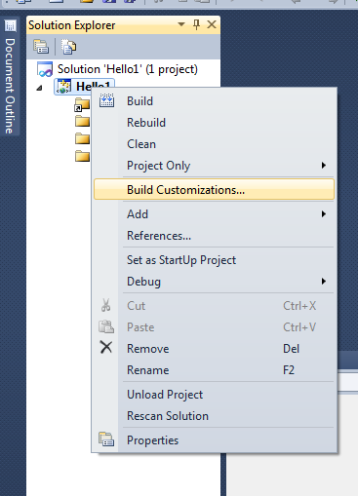
Microsoft Visual C++ 2010 Express

Slide 48
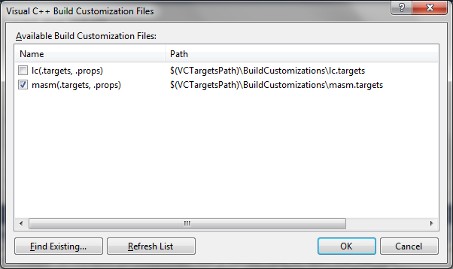
Microsoft Visual C++ 2010 Express

Slide 49
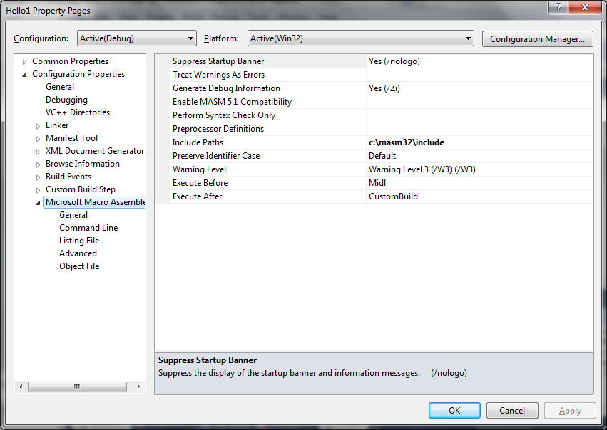
Microsoft Visual C++ 2010 Express

Slide 50
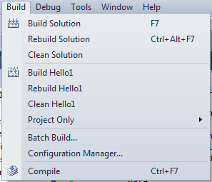
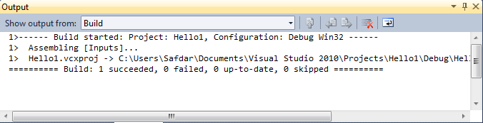
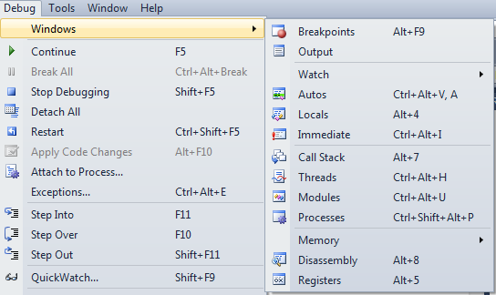
Microsoft Visual C++ 2010 Express

Slide 51
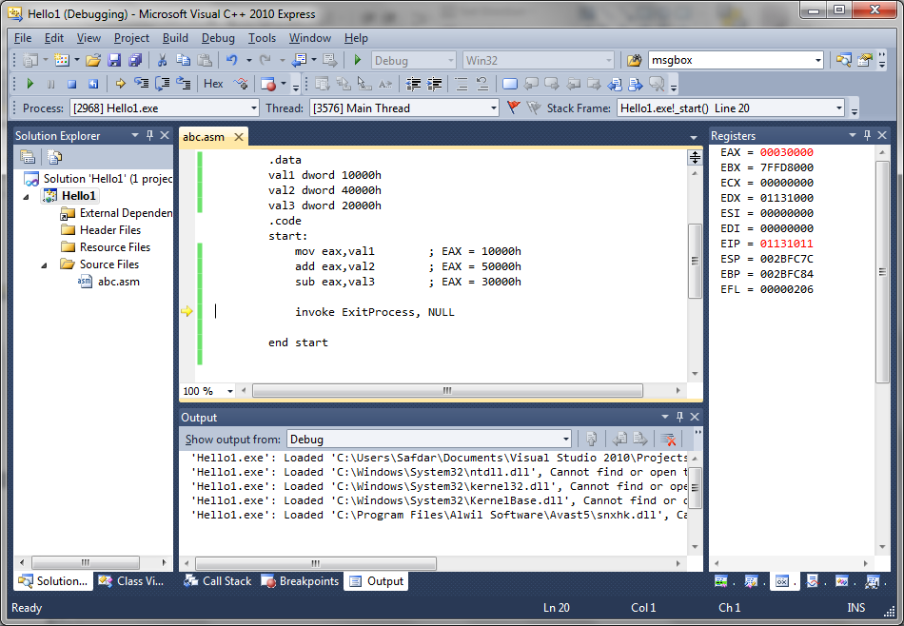

Slide 52
Summary
Basic Elements of Assembly Language
Integer constants
Integer expressions
Character and string constants
Reserved words and identifiers
Directives and instructions
Labels
Mnemonics and Operands
Comments

Slide 53
Summary
(cont.)
Example: Adding and Subtracting Integers
Suggested Coding Standards
Intrinsic Data Types:
BYTE, SBYTE : 8-bit unsigned integer; 8-bit signed integer
WORD, SWORD: 16-bit unsigned & signed integer
DWORD, SDWORD: 32-bit unsigned & signed integer
QWORD : 64-bit integer
TBYTE : 80-bit integer
REAL4 : 4-byte IEEE short real
REAL8 : 8-byte IEEE long real
REAL10 : 10-byte IEEE extended real
Microsoft Visual C++ Configuration for Assembly Programming

