Slide 1
CSC 221 Computer Organization and Assembly Language
Lecture 13:
Instruction Execution, Flow Control and Stack Related Instructions

Slide 2
Lecture 12: Review
Programming Examples:
Data-Related Operators and Directives
OFFSET Operator
PTR Operator
TYPE Operator
LENGTHOF Operator
SIZEOF Operator
LABEL Directive

Slide 3
Lecture 12: Review
(cont.)
Programming Examples:
Indirect Addressing
Indirect Operands
Array Sum Example
Indexed Operands
Pointers

Slide 4
Lecture Outline
Instruction Cycle
Program Execution
Control Flow
JMP and LOOP Instructions
JMP Instruction
LOOP Instruction
LOOP Example
Summing an Integer Array
Stack Operations

Slide 5
Basic Microcomputer Design
Clock synchronizes CPU operations.
Control unit (CU) coordinates Sequence of Execution Steps.
ALU performs arithmetic and bitwise processing

Slide 6
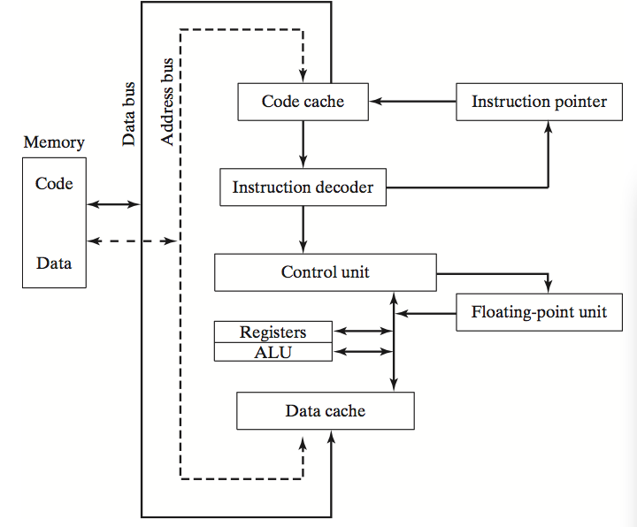
Simplified CPU Block Diagram

Slide 7
Clock
Synchronizes all CPU and BUS operations.
Machine (clock) cycle measures time of a single operation.
Clock is used to trigger events.

Slide 8
Instruction Cycle
Each machine language instruction is first fetched from the memory and stored in an Instruction Register (IR).
The address of the instruction to be fetched is stored in a register called Program Counter or simply PC. In some computers this register is called the Instruction Pointer or IP.
After the instruction is fetched, the PC (or IP) is incremented to point to the address of the next instruction.
The fetched instruction is decoded (to determine what needs to be done) and executed by the CPU.

Slide 9
Instruction Execution Cycle
Instruction
Fetch
Obtain instruction from program storage
Instruction
Decode
Determine required actions and instruction size
Operand
Fetch
Infinite Cycle
Locate and obtain operand data
Execute
Compute result value and status
Writeback
Result
Deposit results in storage for later use

Slide 10
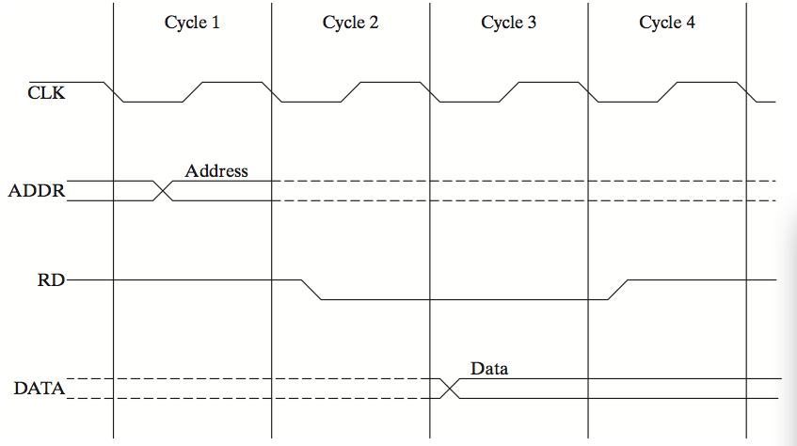
Timing Diagram
^{Memory Read Cycle}

Slide 11
Instruction Execution Cycle
(cont.)
PC
program
I1
I2
I3
I4
. . .
memory
fetch
read
op1
op2
registers
registers
I1
instruction
register
decode
write
write
flags
ALU
execute
(output)

Slide 12
Program Execution
CPU loads and executes programs sequentially.
The instruction might be conditional:
It transfers control to a new location in the program based on the values of CPU status flags (Zero, Sign, Carry, etc.).
….
I1
I2
I3
….

Slide 13
Program Execution
(cont.)
A transfer of control, or branch, is a way of altering the order in which statements are executed.
Transfer of Control
/ Branch
Unconditional
Conditional

Slide 14
JMP Instruction
JMP is an unconditional jump to a label that is usually within the same procedure.
Syntax: JMP target
Logic: EIP ← target
Example:
top:
.
.
jmp top

Slide 15
LOOP Instruction
The LOOP instruction creates a counting loop
Syntax: LOOP target
Logic:
ECX ← ECX – 1
if ECX != 0, jump to target
Implementation:
The assembler calculates the distance, in bytes, between the offset of the following instruction and the offset of the target label. It is called the relative offset.
The relative offset is added to EIP.

Slide 16
LOOP Example
The following loop calculates the sum of the integers 5 + 4 + 3 +2 + 1:
offset machine code source code
00000000 66 B8 0000 mov ax,0
00000004 B9 00000005 mov ecx,5
00000009 66 03 C1 L1: add ax,cx
0000000C E2 FB loop L1
0000000E
When LOOP is assembled:
Current Location = 0000000E (offset of the next instruction).
–5 (FBh) is added to the the current location, causing a jump to location 00000009:
00000009 ← 0000000E + FB

Slide 17
Drill ….
If the relative offset is encoded in a single signed byte:
what is the largest possible backward jump?
(b) what is the largest possible forward jump?
−128
+127

Slide 18
Drill …..
mov ax,6
mov ecx,4
L1:
inc ax
loop L1
What will be the final value of AX?
10
How many times will the loop execute?
mov ecx,0
X2:
inc ax
loop X2
4,294,967,296

Slide 19
Drill …..
How many times will the loop execute?
^{top: .}
.
^{inc ecx}
^{loop top}
INFINITE !!!!!

Slide 20
Nested Loop
If you need to code a loop within a loop, you must save the outer loop counter's ECX value. In the following example, the outer loop executes 100 times, and the inner loop 20 times.
.data
count DWORD ?
.code
mov ecx,100 ; set outer loop count
L1:
mov count,ecx ; save outer loop count
mov ecx,20 ; set inner loop count
L2: .
.
loop L2 ; repeat the inner loop
mov ecx,count ; restore outer loop count
loop L1 ; repeat the outer loop

Slide 21
Summing an Integer Array
The following code calculates the sum of an array of 16-bit integers.
.data
intarray WORD 100h,200h,300h,400h
.code
mov edi,OFFSET intarray ; address of intarray
mov ecx,LENGTHOF intarray ; loop counter
mov ax,0 ; zero the accumulator
L1:
add ax,[edi] ; add an integer
add edi,TYPE intarray ; point to next integer
loop L1 ; repeat until ECX = 0

Slide 22
Stack Operations
Runtime Stack
PUSH Operation
POP Operation
PUSH and POP Instructions
Using PUSH and POP
Example: Reversing a String
Related Instructions

Slide 23
Runtime Stack
Imagine a stack of plates . . .
plates are only added to the top
plates are only removed from the top
LIFO structure

Slide 24
Runtime Stack
Managed by the CPU, using two registers
SS (stack segment)
ESP (stack pointer) *
* SP in Real-address mode

Slide 25
PUSH Operation (1 of 2)
A 32-bit push operation decrements the stack pointer by 4 and copies a value into the location pointed to by the stack pointer.

Slide 26
PUSH Operation (2 of 2)
Same stack after pushing two more integers:
The stack grows downward. The area below ESP is always available (unless the stack has overflowed).

Slide 27
POP Operation
Copies value at stack[ESP] into a register or variable.
Adds n to ESP, where n is either 2 or 4.
value of n depends on the attribute of the operand receiving the data

Slide 28
PUSH and POP Instructions
PUSH syntax:
PUSH r/m16
PUSH r/m32
PUSH imm32
POP syntax:
POP r/m16
POP r/m32

Slide 29
Using PUSH and POP
Save and restore registers when they contain important values. PUSH and POP instructions occur in the opposite order.
push esi ; push registers
push ecx
push ebx
mov esi,OFFSET dwordVal ; display some memory
mov ecx,LENGTHOF dwordVal
mov ebx,TYPE dwordVal
………
pop ebx ; restore registers
pop ecx
pop esi

Slide 30
Example: Nested Loop
Remember the nested loop we created on page 129? It's easy to push the outer loop counter before entering the inner loop:
mov ecx,100 ; set outer loop count
L1: ; begin the outer loop
push ecx ; save outer loop count
mov ecx,20 ; set inner loop count
L2: ; begin the inner loop
;
;
loop L2 ; repeat the inner loop
pop ecx ; restore outer loop count
loop L1 ; repeat the outer loop

Slide 31
Related Instructions
PUSHFD and POPFD
push and pop the EFLAGS register
PUSHAD pushes the 32-bit general-purpose registers on the stack
order: EAX, ECX, EDX, EBX, ESP, EBP, ESI, EDI
POPAD pops the same registers off the stack in reverse order
PUSHA and POPA do the same for 16-bit registers

Slide 32
Summary
Instruction Execution Cycle
Program Execution
JMP Instruction
LOOP Instruction
PUSH and POP
PUSHFD and POPFD: Flags
PUSHAD: order: EAX, ECX, EDX, EBX, ESP, EBP, ESI, EDI
POPAD pops the same registers off the stack in reverse order.

Slide 33
Reference
Most of the Slides are taken from Presentation:
Chapter 4 and 5
Assembly Language for Intel-Based Computers, 4th Edition
Kip R. Irvine
(c) Pearson Education, 2002. All rights reserved. You may modify and copy this slide show for your personal use, or for use in the classroom, as long as this copyright statement, the author's name, and the title are not changed.

