Slide 1
CSC 221 Computer Organization and Assembly Language
Lecture 18:
Program Components, I/O and Conditional Jump Instructions

Slide 2
Lecture 17: Review
AND Instruction
AND destination, source
OR Instruction
OR destination, source
XOR Instruction
XOR destination, source
NOT Instruction
NOT destination

Slide 3
Lecture 17: Review
(cont.)
Applications
TEST Instruction
Performs a nondestructive AND operation between each pair of matching bits in two operands. ZERO Flag
CMP Instruction
CMP destination, source
Zero (Dest. Equal) and Carry (Dest. Less)
ZF = CF = 0 (Dest. > Src)

Slide 4
Lecture Outline
Program Components
I/O Instructions
Jumps Based On . . .
Specific flags
Equality
Unsigned comparisons
Signed Comparisons
Applications

Slide 5
Program Components
.386
Assembler directive tells the assembler to use the 386 instruction set.
There are hardly any processors out there that are older than the 386 nowadays.
Alternatively, you can use .486, .586 or .686, but .386 will be the most compatible instruction set.

Slide 6
Program Components
(cont.)
.model flat, stdcall
.MODEL memorymodel [, langtype] [, stackoption]
memorymodel Required parameter that determines the size of code and data pointers.
langtype Optional parameter that sets the calling and naming conventions for procedures and public symbols.
stackoption Optional parameter.
stackoption is not used if memory model is FLAT.
NEARSTACK groups the stack segment into a single physical segment along with data (DS=SS)

Slide 7
Program Components
(cont.)
Parameter | 32-bit values | 16-bit values (support for earlier 16-bit development)
memorymodel | FLAT | TINY , SMALL, COMPACT, MEDIUM, LARGE, HUGE, FLAT
langtype | C , STDCALL | C , BASIC, FORTRAN, PASCAL, SYSCALL, STDCALL
stackoption | Not used | NEARSTACK , FARSTACK

Slide 8
Program Components
(cont.)
.model flat, stdcall
MODEL is an assembler directive that specifies the memory model of your program.
flat is the model for Windows programs.
stdcall is the parameter passing method used by Windows functions, which means you need to push your parameters from right-to-left.
NOTE: The flat memory model uses 32-bit segments and must be preceded by a .386 or .486 directive.

Slide 9
Program Components
(cont.)
option casemap :none
Forces your labels to be case sensitive, which means Hello and hello are treated differently.
This is a good habit to learn because, Most high level programming languages are also case sensitive.

Slide 10
Program Components
(cont.)
Include files required for Windows programs.
include \masm32\include\windows.inc
It is always included, since it contains the declarations for the Win32 API constants and definitions.
include \masm32\include\kernel32.inc
Contains the ExitProcess function that we use.

Slide 11
Libraries
includelib \masm32\lib\kernel32.lib
includelib \masm32\lib\masm32.lib
Functions need libraries in order to function

Slide 12
I/O Instructions
StdIn proc lpszBuffer:DWORD,bLen:DWORD
Description
StdIn receives text input from the console and places it in the buffer required as a parameter.
The function terminates when Enter is pressed.
Parameters
1. lpszBuffer The buffer to receive the text input from the console.
2. bLen The length of the buffer.
Return Value
There is no return value.
Include \masm32\include\masm32.inc
includelib \masm32\lib\masm32.lib
invoke StdIn, addr buffer, 100
Source: C:\masm32\help\masmlib.chm

Slide 13
I/O Instructions
(cont.)
StdOut proc lpszText:DWORD
Description: StdOut will display a zero terminated string at the current position in the console.
Parameter
lpszText : A zero terminates string.
Return Value
There is no return value.
Include \masm32\include\masm32.inc
includelib \masm32\lib\masm32.lib
invoke StdOut, addr message1
Source: C:\masm32\help\masmlib.chm

Slide 14
I/O Instructions: Example
.data
message1 BYTE "Type your name: ", 0
message2 BYTE "Your name is ", 0
.data?
buffer BYTE 100 dup(?)
.code
start:
invoke StdOut, addr message1
invoke StdIn, addr buffer, 100
invoke StdOut, addr message2
invoke StdOut, addr buffer
invoke StdIn, addr buffer, 100
invoke ExitProcess, 0
end start

Slide 15
Conditional Jump (Jcond) Instructions
A conditional jump instruction branches to a label when specific register or flag conditions are met.
Examples:
JB, JC jump to a label if the Carry flag is set
JE, JZ jump to a label if the Zero flag is set
JS jumps to a label if the Sign flag is set
JNE, JNZ jump to a label if the Zero flag is clear
JECXZ jumps to a label if ECX equals 0

Slide 16
Jcond Ranges
Prior to the 386:
jump must be within –128 to +127 bytes from current location counter.
IA-32 processors:
32-bit offset permits jump anywhere in memory.

Slide 17
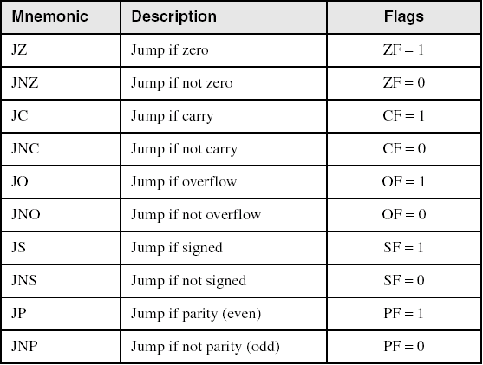
Jumps Based on Specific Flags

Slide 18
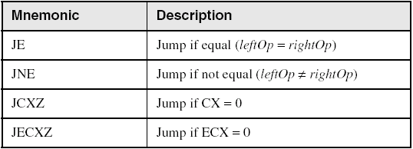
Jumps Based on Equality

Slide 19
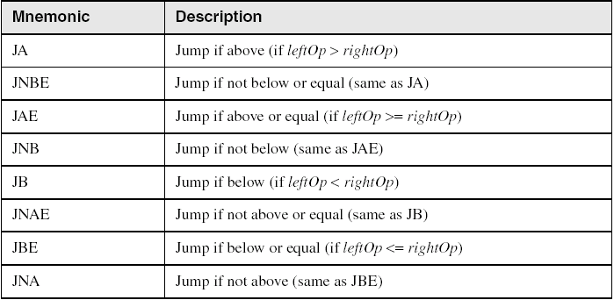
Jumps Based on Unsigned Comparisons

Slide 20
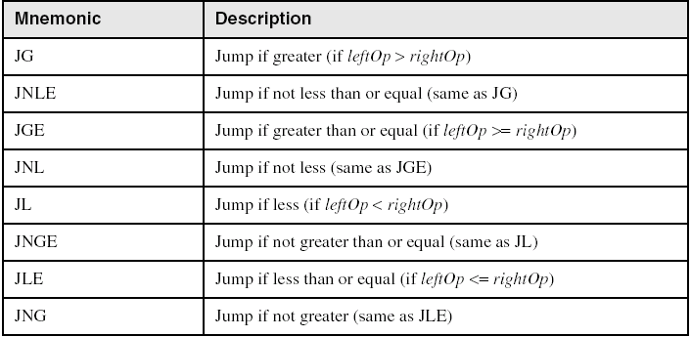
Jumps Based on Signed Comparisons

Slide 21
Applications (1 of 5)
Task: Jump to a label if unsigned EAX is greater than EBX
Solution: Use CMP, followed by JA
cmp eax,ebx
ja Larger
Task: Jump to a label if signed EAX is greater than EBX
Solution: Use CMP, followed by JG
cmp eax,ebx
jg Greater

Slide 22
Applications (2 of 5)
Jump to label L1 if unsigned EAX is less than or equal to Val1
cmp eax,Val1
jbe L1 ; below or equal
Jump to label L1 if signed EAX is less than or equal to Val1
cmp eax,Val1
jle L1

Slide 23
Applications (3 of 5)
Compare unsigned AX to BX, and copy the larger of the two into a variable named Large
mov Large,bx
cmp ax,bx
jna Next
mov Large,ax
Next:
Compare signed AX to BX, and copy the smaller of the two into a variable named Small
mov Small,ax
cmp bx,ax
jnl Next
mov Small,bx
Next:

Slide 24
Applications (4 of 5)
Jump to label L1 if the memory word pointed to by ESI equals Zero
cmp WORD PTR [esi],0
je L1
Jump to label L2 if the doubleword in memory pointed to by EDI is even
test DWORD PTR [edi],1
jz L2

Slide 25
Applications (5 of 5)
Task: Jump to label L1 if bits 0, 1, and 3 in AL are all set.
Solution: Clear all bits except bits 0, 1,and 3. Then compare the result with 00001011 binary.
and al,00001011b ; clear unwanted bits
cmp al,00001011b ; check remaining bits
je L1 ; all set? jump to L1

Slide 26
Summary
Program Components
Processor
.MODEL etc.
I/O Instructions
StdIn
invoke StdIn, addr buffer, 100
StdOut
invoke StdOut, addr message1

Slide 27
Summary
Conditional Jump Instructions
Jumps Based on Specific Flags
JZ, JNZ, JC, JNC, ……
Jumps Based on Equality
JE, JNE, JCXZ, …..
Jumps Based on Unsigned Comparison
JA, JB, JAE, JBE, …..
Jumps Based on Signed Comparison
JG, JL, JGE, JLE, ….

Slide 28
Reference
Most of the Slides are taken from Presentation:
Chapter 6
Assembly Language for Intel-Based Computers, 4th Edition
Kip R. Irvine
(c) Pearson Education, 2002. All rights reserved. You may modify and copy this slide show for your personal use, or for use in the classroom, as long as this copyright statement, the author's name, and the title are not changed.

