Slide 1
CSC 221 Computer Organization and Assembly Language
Lecture 19:
I/O and Conditional Jumps in Assembly

Slide 2
Lecture 18: Review
Program Components
I/O Instructions
StdIn proc lpszBuffer:DWORD,bLen:DWORD
Description
StdIn receives text input from the console and places it in the buffer required as a parameter.
The function terminates when Enter is pressed.
Parameters
1. lpszBuffer The buffer to receive the text input from the console.
2. bLen The length of the buffer.
Include \masm32\include\masm32.inc
includelib \masm32\lib\masm32.lib
invoke StdIn, addr buffer, 100
Source: C:\masm32\help\masmlib.chm

Slide 3
Lecture 18: Review
(cont.)
StdOut proc lpszText:DWORD
Description: StdOut will display a zero terminated string at the current position in the console.
Parameter
lpszText : A zero terminates string.
Return Value
There is no return value.
Include \masm32\include\masm32.inc
includelib \masm32\lib\masm32.lib
invoke StdOut, addr message1
Source: C:\masm32\help\masmlib.chm

Slide 4
I/O Instructions: Example
.data
message1 BYTE "Type your name: ", 0
message2 BYTE "Your name is ", 0
.data?
buffer BYTE 100 dup(?)
.code
start:
invoke StdOut, addr message1
invoke StdIn, addr buffer, 100
invoke StdOut, addr message2
invoke StdOut, addr buffer
invoke StdIn, addr buffer, 100
invoke ExitProcess, 0
end start

Slide 5
Conditional Jump (Jcond) Instructions
A conditional jump instruction branches to a label when specific register or flag conditions are met.
Examples:
JB, JC jump to a label if the Carry flag is set
JE, JZ jump to a label if the Zero flag is set
JS jumps to a label if the Sign flag is set
JNE, JNZ jump to a label if the Zero flag is clear
JECXZ jumps to a label if ECX equals 0

Slide 6
Jcond Ranges
Prior to the 386:
jump must be within –128 to +127 bytes from current location counter.
IA-32 processors:
32-bit offset permits jump anywhere in memory.

Slide 7
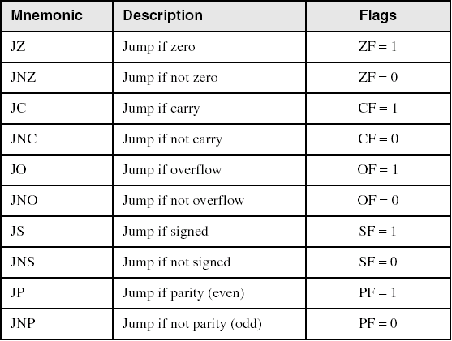
Jumps Based on Specific Flags

Slide 8
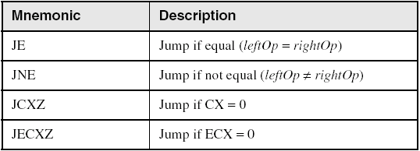
Jumps Based on Equality

Slide 9
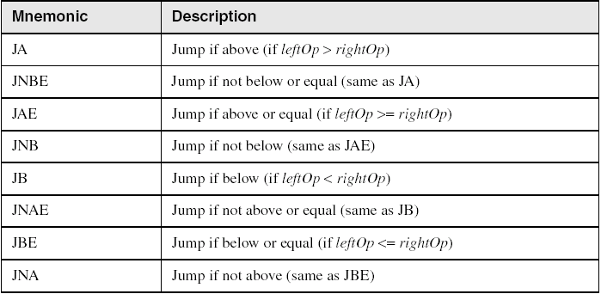
Jumps Based on Unsigned Comparisons

Slide 10
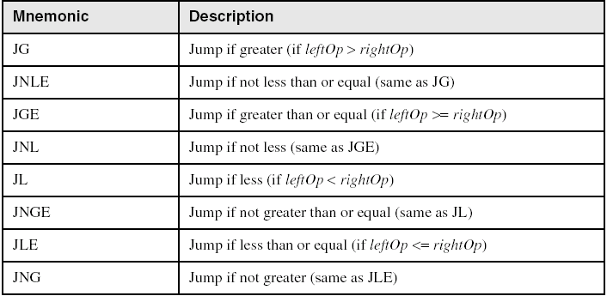
Jumps Based on Signed Comparisons

Slide 11
Lecture Outline
ASSEMBLY LANGUAGE IMPLEMENTATION
I/O Instructions
Jumps Based On . . .
Specific flags
Equality
Unsigned comparisons
Signed Comparisons

Slide 12
Let’s enjoy assembly

Slide 14
Summary
Assembly Language Implementation:
I/O Instructions
StdIn
invoke StdIn, addr buffer, 100
StdOut
invoke StdOut, addr message1

Slide 15
Summary
Assembly Language Implementation:
Conditional Jump Instructions
Jumps Based on Specific Flags
JZ, JNZ, JC, JNC, ……
Jumps Based on Equality
JE, JNE, JCXZ, …..
Jumps Based on Unsigned Comparison
JA, JB, JAE, JBE, …..
Jumps Based on Signed Comparison
JG, JL, JGE, JLE, ….

Slide 16
Reference
Most of the Slides are taken from Presentation:
Chapter 6
Assembly Language for Intel-Based Computers, 4th Edition
Kip R. Irvine
(c) Pearson Education, 2002. All rights reserved. You may modify and copy this slide show for your personal use, or for use in the classroom, as long as this copyright statement, the author's name, and the title are not changed.

