Slide 1
CSC 221 Computer Organization and Assembly Language
Lecture 20:
Conditional and Block Structures

Slide 2
Lecture 19: Review
I/O Instructions
StdIn proc lpszBuffer:DWORD,bLen:DWORD
StdOut proc lpszText:DWORD
invoke StdOut, addr message1
invoke StdIn, addr buffer, 100
Conditional Jumps
Specific flags
Equality
Unsigned comparisons
Signed Comparisons

Slide 3
Lecture 19: Review
(cont.)
Conditional Jumps
JB, JC jump to a label if the Carry flag is set
JE, JZ jump to a label if the Zero flag is set
JS jumps to a label if the Sign flag is set
JNE, JNZ jump to a label if the Zero flag is clear
JECXZ jumps to a label if ECX equals 0
Assembly Examples

Slide 4
Lecture Outline
Bit Test Instruction
Conditional LOOP Instructions
LOOPZ and LOOPE
LOOPNZ and LOOPNE
Block Structures
Block-Structured IF Statements
Compound Expressions with AND
Compound Expressions with OR
WHILE Loops
REPEAT Loops

Slide 5
BT (Bit Test) Instruction
Copies bit n from an operand into the Carry flag
Syntax: BT bitBase, n
bitBase may be r/m16 or r/m32
n may be r16, r32, or imm8
Example: jump to label L1 if bit 9 is set in the AX register:
bt AX,9 ; CF = bit 9
jc L1 ; jump if Carry

Slide 6
Conditional Loop Instructions
LOOPZ and LOOPE
LOOPNZ and LOOPNE

Slide 7
LOOPZ and LOOPE
Syntax:
LOOPE destination
LOOPZ destination
Logic:
ECX ← ECX – 1
if ECX > 0 and ZF=1, jump to destination
Useful when scanning an array for the first element that does not match a given value.

Slide 8
LOOPNZ and LOOPNE
LOOPNZ (LOOPNE) is a conditional loop instruction
Syntax:
LOOPNZ destination
LOOPNE destination
Logic:
ECX ← ECX – 1;
if ECX > 0 and ZF=0, jump to destination
Useful when scanning an array for the first element that matches a given value.

Slide 9
LOOPNZ Example
The following code finds the first positive value in an array:
.data
array SWORD -3,-6,-1,-10,10,30,40,4
sentinel SWORD 0
.code
mov esi,OFFSET array
mov ecx,LENGTHOF array
next:
test WORD PTR [esi],8000h ; test sign bit
pushfd ; push flags on stack
add esi,TYPE array
popfd ; pop flags from stack
loopnz next ; continue loop
jnz quit ; none found
sub esi,TYPE array ; ESI points to value
quit:

Slide 10
Drill . . .
Locate the first nonzero value in the array. If none is found, let ESI point to the sentinel value:
.data
array SWORD 50 DUP(?)
sentinel SWORD 0FFFFh
.code
mov esi,OFFSET array
mov ecx,LENGTHOF array
L1: cmp WORD PTR [esi],0 ; check for zero
(fill in your code here)
quit:

Slide 11
. . . (solution)
.data
array SWORD 50 DUP(?)
sentinel SWORD 0FFFFh
.code
mov esi,OFFSET array
mov ecx,LENGTHOF array
L1: cmp WORD PTR [esi],0 ; check for zero
pushfd ; push flags on stack
add esi,TYPE array
popfd ; pop flags from stack
loope L1 ; continue loop
jz quit ; none found
sub esi,TYPE array ; ESI points to value
quit:

Slide 12
Conditional Structures
Block-Structured IF Statements
Compound Expressions with AND
Compound Expressions with OR
WHILE Loops
REPEAT Loops

Slide 13
Block-Structured IF Statements
Assembly language programmers can easily translate logical statements written in C++/Java into assembly language. For example:
if( op1 == op2 )
X = 1;
else
X = 2;
mov eax,op1
cmp eax,op2
jne L1
mov X,1
jmp L2
L1: mov X,2
L2:

Slide 14
Drill . . .
Implement the following pseudocode in assembly language. All values are unsigned:
if( ebx <= ecx )
{
eax = 5;
edx = 6;
}
cmp ebx,ecx
ja next
mov eax,5
mov edx,6
next:
(There are multiple correct solutions to this problem.)

Slide 15
Drill . . .
Implement the following pseudocode in assembly language. All values are 32-bit signed integers:
if( var1 <= var2 )
var3 = 10;
else
{
var3 = 6;
var4 = 7;
}
mov eax,var1
cmp eax,var2
jle L1
mov var3,6
mov var4,7
jmp L2
L1: mov var3,10
L2:
(There are multiple correct solutions to this problem.)

Slide 16
Compound Expression with AND (1 of 3)
When implementing the logical AND operator, consider that HLLs use short-circuit evaluation
In the following example, if the first expression is false, the second expression is skipped:
if (al > bl) AND (bl > cl)
X = 1;

Slide 17
Compound Expression with AND (2 of 3)
if (al > bl) AND (bl > cl)
X = 1;
This is one possible implementation . . .
cmp al,bl ; first expression...
ja L1
jmp next
L1:
cmp bl,cl ; second expression...
ja L2
jmp next
L2: ; both are true
mov X,1 ; set X to 1
next:

Slide 18
Compound Expression with AND (3 of 3)
if (al > bl) AND (bl > cl)
X = 1;
But the following implementation uses 29% less code by reversing the first relational operator. We allow the program to "fall through" to the second expression:
cmp al,bl ; first expression...
jbe next ; quit if false
cmp bl,cl ; second expression...
jbe next ; quit if false
mov X,1 ; both are true
next:

Slide 19
Drill . . .
Implement the following pseudocode in assembly language. All values are unsigned:
if( ebx <= ecx
&& ecx > edx )
{
eax = 5;
edx = 6;
}
cmp ebx,ecx
ja next
cmp ecx,edx
jbe next
mov eax,5
mov edx,6
next:
(There are multiple correct solutions to this problem.)

Slide 20
Compound Expression with OR (1 of 2)
When implementing the logical OR operator, consider that HLLs use short-circuit evaluation
In the following example, if the first expression is true, the second expression is skipped:
if (al > bl) OR (bl > cl)
X = 1;

Slide 21
Compound Expression with OR (1 of 2)
if (al > bl) OR (bl > cl)
X = 1;
We can use "fall-through" logic to keep the code as short as possible:
cmp al,bl ; is AL > BL?
ja L1 ; yes
cmp bl,cl ; no: is BL > CL?
jbe next ; no: skip next statement
L1: mov X,1 ; set X to 1
next:

Slide 22
WHILE Loops
A WHILE loop is really an IF statement followed by the body of the loop, followed by an unconditional jump to the top of the loop. Consider the following example:
while( eax < ebx)
eax = eax + 1;
This is a possible implementation:
top:cmp eax,ebx ; check loop condition
jae next ; false? exit loop
inc eax ; body of loop
jmp top ; repeat the loop
next:

Slide 23
Drill . . .
Implement the following loop, using unsigned 32-bit integers:
while( ebx <= val1)
{
ebx = ebx + 5;
val1 = val1 - 1
}
top: cmp ebx,val1 ; check loop condition
ja next ; false? exit loop
add ebx,5 ; body of loop
dec val1
jmp top ; repeat the loop
next:

Slide 24
Using the .IF Directive
Runtime Expressions
Relational and Logical Operators
MASM-Generated Code
.REPEAT Directive
.WHILE Directive

Slide 25
Runtime Expressions
.IF, .ELSE, .ELSEIF, and .ENDIF can be used to evaluate runtime expressions and create block-structured IF statements.
Examples:
.IF eax > ebx
mov edx,1
.ELSE
mov edx,2
.ENDIF
.IF eax > ebx && eax > ecx
mov edx,1
.ELSE
mov edx,2
.ENDIF
MASM generates "hidden" code for you, consisting of code labels, CMP and conditional jump instructions.

Slide 26
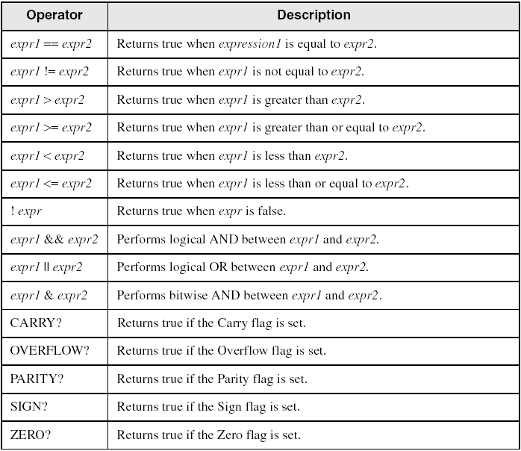
Relational and Logical Operators

Slide 27
MASM-Generated Code
.data
val1 DWORD 5
result DWORD ?
.code
mov eax,6
.IF eax > val1
mov result,1
.ENDIF
Generated code:
mov eax,6
cmp eax,val1
jbe @C0001
mov result,1
@C0001:
MASM automatically generates an unsigned jump (JBE) because val1 is unsigned.

Slide 28
MASM-Generated Code
.data
val1 SDWORD 5
result SDWORD ?
.code
mov eax,6
.IF eax > val1
mov result,1
.ENDIF
Generated code:
mov eax,6
cmp eax,val1
jle @C0001
mov result,1
@C0001:
MASM automatically generates a signed jump (JLE) because val1 is signed.

Slide 29
MASM-Generated Code
.data
result DWORD ?
.code
mov ebx,5
mov eax,6
.IF eax > ebx
mov result,1
.ENDIF
Generated code:
mov ebx,5
mov eax,6
cmp eax,ebx
jbe @C0001
mov result,1
@C0001:
MASM automatically generates an unsigned jump (JBE) when both operands are registers . . .

Slide 30
MASM-Generated Code
.data
result SDWORD ?
.code
mov ebx,5
mov eax,6
.IF SDWORD PTR eax > ebx
mov result,1
.ENDIF
Generated code:
mov ebx,5
mov eax,6
cmp eax,ebx
jle @C0001
mov result,1
@C0001:
. . . unless you prefix one of the register operands with the SDWORD PTR operator. Then a signed jump is generated.

Slide 31
.REPEAT Directive
Executes the loop body before testing the loop condition associated with the .UNTIL directive.
Example:
; Display integers 1 – 10:
mov eax,0
.REPEAT
inc eax
call WriteDec
call Crlf
.UNTIL eax == 10

Slide 32
.WHILE Directive
Tests the loop condition before executing the loop body The .ENDW directive marks the end of the loop.
Example:
; Display integers 1 – 10:
mov eax,0
.WHILE eax < 10
inc eax
call WriteDec
call Crlf
.ENDW

Slide 33
Summary
Bit Test Instruction
Copies bit n from an operand into the Carry flag
Syntax: BT bitBase, n
Conditional LOOP Instructions
LOOPZ and LOOPE
LOOPZ/LOOPE destination
Logic:
ECX ← ECX – 1
if ECX > 0 and ZF=1, jump to destination
LOOPNZ and LOOPNE
LOOPZ/LOOPE destination
Logic:
ECX ← ECX – 1
if ECX > 0 and ZF=0, jump to destination

Slide 34
Summary
(cont.)
Block Structures
Block-Structured IF Statements
Compound Expressions with AND
Compound Expressions with OR
WHILE Loops
REPEAT Loops

Slide 35
Reference
Most of the Slides are taken from Presentation:
Chapter 6
Assembly Language for Intel-Based Computers, 4th Edition
Kip R. Irvine
(c) Pearson Education, 2002. All rights reserved. You may modify and copy this slide show for your personal use, or for use in the classroom, as long as this copyright statement, the author's name, and the title are not changed.

