Slide 1
CSC 221 Computer Organization and Assembly Language
Lecture 28:
Macros &
Win32 Console Programming

Slide 2
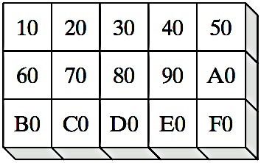
Lecture 27: Review
Two Dimensional Arrays
Basic Concept
2-D Array Representation
Order
Row-major:
(Most Common)
Col.-major:

Slide 3
Lecture 27: Review
(cont.)
Base-Index Operands
A base-index operand adds the values of two registers (called base and index), producing an effective address.
[base + index]
.data array WORD 1000h,2000h,3000h
.code mov ebx,OFFSET array mov esi,2 mov ax,[ebx+esi] ; AX = 2000h
mov edi,OFFSET array
mov ecx,4 mov ax,[edi+ecx] ; AX = 3000h
mov ebp,OFFSET array
mov esi,0 mov ax,[ebp+esi] ; AX = 1000h

Slide 4
Lecture 27: Review
(cont.)
Base-Index Displacement
A base-index-displacement operand adds base and index registers to a constant, producing an effective address. Displacement can be the name of a variable or a constant expression.
[ base + index + displacement ]
displacement [ base + index ]
RowNumber = 1
ColumnNumber = 2
mov ebx,NumCols * RowNumber
mov esi,ColumnNumber
mov al,table[ebx + esi]

Slide 5
Lecture 27: Review
(cont.)
name STRUCT
field-declarations
name ENDS
Structures
Employee STRUCT ; bytes
IdNum BYTE "000000000" ; 9
LastName BYTE 30 DUP(0) ; 30
Years WORD 0 ; 2
SalaryHistory DWORD 0,0,0,0 ; 16
Employee ENDS
.data
worker Employee <>
mov eax,TYPE Employee ; 57
mov eax,SIZEOF Employee ; 57
mov eax,SIZEOF worker ; 57
mov eax,TYPE Employee.SalaryHistory ; 4
mov eax,LENGTHOF Employee.SalaryHistory ; 4
mov eax,SIZEOF Employee.SalaryHistory ; 16

Slide 6
Lecture Outline
Macros
Introducing Macros
Defining Macros
Invoking Macros
Windows 32 Console Programming
Background Information
Win32 Console Programs
API and SDK
Windows Data Types
Standard Console Handles
Console Input
Console Output

Slide 7
Introducing Macros
A macro¹ is a named block of assembly language statements.
Once defined, it can be invoked (called) one or more times.
During the assembler's preprocessing step, each macro call is expanded into a copy of the macro.
The expanded code is passed to the assembly step, where it is checked for correctness.
¹Also called a macro procedure.

Slide 8
Defining Macros
A macro must be defined before it can be used.
Parameters are optional.
Each parameter follows the rules for identifiers. It is a string that is assigned a value when the macro is invoked.
Syntax:
macroname MACRO [parameter-1, parameter-2,...]
statement-list
ENDM

Slide 9
clearRegs Macro Example
This is how you define and invoke a simple macro.
clearRegs MACRO ; define the macro
xor eax,eax
xor ebx,ebx
xor ecx,ecx
ENDM
.data
.code
clearRegs ; invoke the macro
The assembler will substitute XOR instructions for “clearRegs".

Slide 10
writeStr Macro
Writes a String to standard output.
writeStr MACRO buffer1
pushad
invoke StdOut, addr buffer1
popad
ENDM
Definition:
Invocation:
str BYTE “HELLO STRING”,0
.code
writeStr str
1 pushad
1 invoke StdOut, addr str
1 popad
Expansion:
viewed in the listing file

Slide 11
Invoking Macros (1 of 2)
When you invoke a macro, each argument you pass matches a declared parameter.
Each parameter is replaced by its corresponding argument when the macro is expanded.
When a macro expands, it generates assembly language source code.
Arguments are treated as simple text by the preprocessor.

Slide 12
Invoking Macros (2 of 2)
Relationships between macros, arguments, and parameters:

Slide 13
WriteStr Macro (1 of 2)
Provides a convenient way to display a string, by passing the string name as an argument.
writeStr MACRO buffer1
pushad
invoke StdOut, addr buffer1
popad
ENDM
.data
str BYTE “HELLO STRING”,0
.code
writeStr str

Slide 14
WriteStr Macro (2 of 2)
The expanded code shows how the str argument replaced the parameter named buffer1:
writeStr MACRO buffer1
pushad
invoke StdOut, addr buffer1
popad
ENDM
1 pushad
1 invoke StdOut, addr str
1 popad

Slide 15
Invalid Argument
If you pass an invalid argument, the error is caught when the expanded code is assembled.
Example:
mPutchar MACRO char
push eax
mov al,char
………
pop eax
ENDM
.code
mPutchar 1234h
1 push eax
1 mov al,1234h ; error!
1 …………
1 pop eax

Slide 16
Blank Argument
If you pass a blank argument, the error is also caught when the expanded code is assembled.
Example:
.code
mPutchar
1 push eax
1 mov al,
1 …………
1 pop eax

Slide 17
Windows 32 Console Programming
Useful Questions:
How do 32-bit programs handle text input-output?
How are colors handled in 32-bit console mode?
How are times and dates handled in MS-Windows?
How can I use MS-Windows functions to read and write data files?
Is it possible to write a graphical Windows application in assembly language?
……..

Slide 18
Win32 Console Programs
Run in Protected mode
Emulate MS-DOS
Standard text-based input and output
The console input buffer contains a queue of input records, each containing data about an input event.
Examples of input events are keyboard input, mouse clicks, and the user’s resizing of the con- sole window.
A console screen buffer(s) is a two-dimensional array of character and color data that affects the appearance of text in the console window.

Slide 19
Classifying Console Functions
Text-oriented (high-level) console functions
Read character streams from input buffer
Write character streams to screen buffer
Redirect input and output
Event-oriented (low-level) console functions
Retrieve keyboard and mouse events
Detect user interactions with the console window
Control window size & position, text colors

Slide 20
API and SDK
Microsoft Win32 Application Programming Interface
API: a collection of types, constants, and functions that provide a way to directly manipulate objects through programming
Microsoft Platform Software Development Kit
SDK: a collection of tools, libraries, sample code, and documentation that helps programmers create applications
Platform: an operating system or a group of closely related operating systems

Slide 21
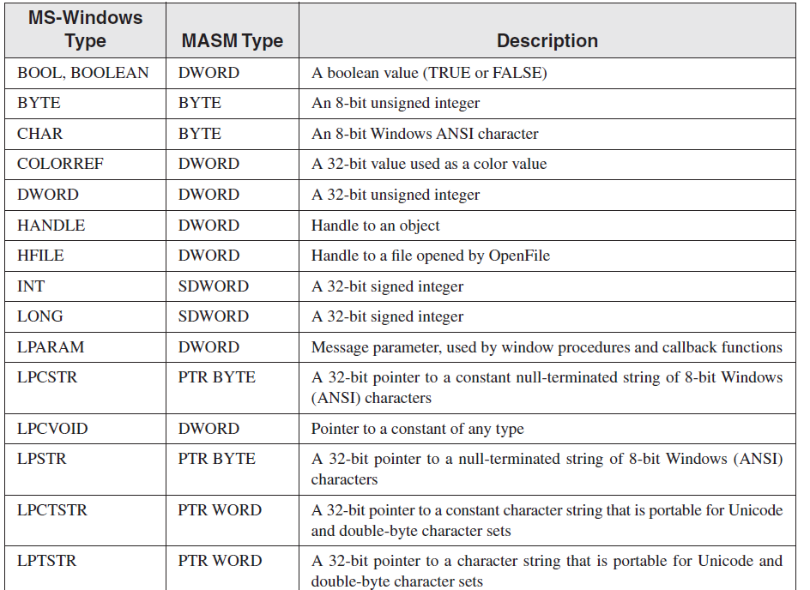
Windows Data Types

Slide 22
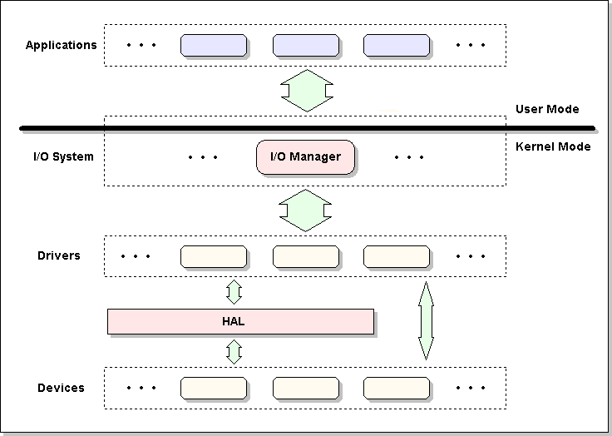
Handles
Driver tells the I/O Manager: "Here is the device for me to control. If you will receive some I/O request to this device, send it to me, and I'll take care about the rest.”
It just means some new object will be created in the memory (namely device object) representing a physical or logical device on the system and describing its characteristics.
http://four-f.webs.com/KmdTut/kmd04.html

Slide 23
Standard Console Handles
Nearly all Win32 console functions require you to pass a handle as the first argument.
A handle is an unsigned 32-bit integer that uniquely identifies an object such as a bitmap, drawing pen, or any input/output device.
The following MS-Windows constants are predefined to specify the type of handle requested:
STD_INPUT_HANDLE : standard input
STD_OUTPUT_HANDLE : standard output
STD_ERROR_HANDLE : standard error output
The latter two handles are used when writing to the console’s active screen buffer.
Kernel32.inc + .lib and User32.inc + .lib

Slide 24
GetStdHandle Function
GetStdHandle returns a handle to a console stream
Input, Output or Error Output
Specify the type of handle (see previous slide)
The handle is returned in EAX
Prototype:
Sample call:
GetStdHandle PROTO,
nStdHandle:DWORD ; handle type
INVOKE GetStdHandle, STD_OUTPUT_HANDLE
mov myHandle, eax

Slide 25
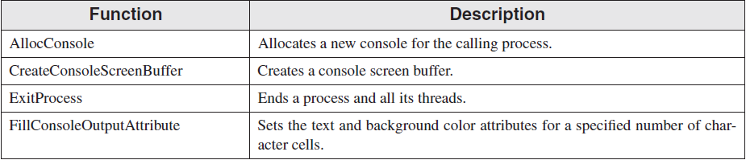
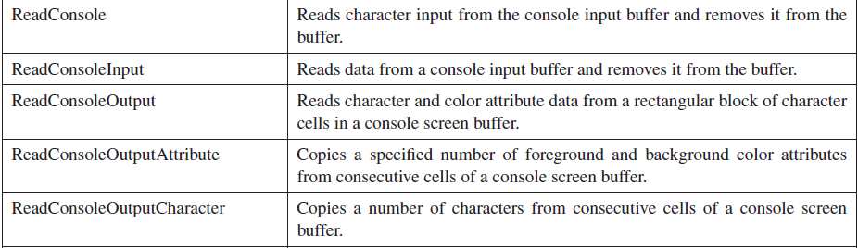
Win32 Console Functions
All these functions accept the device (not the driver) handle as an argument.

Slide 26
Console Input
The ReadConsole function provides a convenient way to read text input and put it in a buffer.
Prototype:
ReadConsole PROTO,
handle:DWORD, ; input handle
pBuffer:PTR BYTE, ; pointer to buffer
maxBytes:DWORD, ; number of chars to read
pBytesRead:PTR DWORD, ; ptr to num bytes read
notUsed:DWORD ; (not used)

Slide 27
Single-Character Input
Here's how to input single characters:
Get a copy of the current console flags by calling GetConsoleMode. Save the flags in a variable.
Change the console flags by calling SetConsoleMode.
Input a character by calling ReadConsole.
Restore the previous values of the console flags by calling SetConsoleMode.

Slide 28
Excerpts from ReadChar (1 of 2)
From the ReadChar procedure in the Irvine32 library:
.data
consoleInHandle DWORD ?
saveFlags DWORD ? ; backup copy of flags
.code
start:
; Get & save the current console input mode flags
INVOKE GetConsoleMode, consoleInHandle, ADDR saveFlags
; Clear all console flags
INVOKE SetConsoleMode, consoleInHandle, 0

Slide 29
Excerpts from ReadChar (2 of 2)
From the ReadChar procedure in the Irvine32 library:
; Read a single character from input
INVOKE ReadConsole,
consoleInHandle, ; console input handle
ADDR buffer, ; pointer to buffer
1, ; max characters to read
ADDR bytesRead, ; return num bytes read
0 ; not used
; Restore the previous flags state
INVOKE SetConsoleMode, consoleInHandle, saveFlags

Slide 30
Example: Read Characters and Print
BufSize = 80
.data
buffer BYTE BufSize DUP(?),0,0
stdInHandle HANDLE ?
bytesRead DWORD ?
.code
start:
; Get handle to standard input
INVOKE GetStdHandle, STD_INPUT_HANDLE
mov stdInHandle,eax
; Wait for user input
INVOKE ReadConsole, stdInHandle, ADDR buffer,
BufSize, ADDR bytesRead, 0
invoke StdOut, addr buffer
mov esi,OFFSET buffer
mov ecx,bytesRead
mov ebx,TYPE buffer
invoke ExitProcess, 0
end start

Slide 31
COORD and SMALL_RECT
The COORD structure specifies X and Y screen coordinates in character measurements, which default to 0-79 and 0-24.
The SMALL_RECT structure specifies a window’s location in character measurements.
SMALL_RECT STRUCT
Left WORD ?
Top WORD ?
Right WORD ?
Bottom WORD ?
SMALL_RECT ENDS
COORD STRUCT
X WORD ?
Y WORD ?
COORD ENDS

Slide 32
WriteConsole
The WriteConsole function writes a string to the screen, using the console output handle.
It acts upon standard ASCII control characters such as tab, carriage return, and line feed.
Prototype:
WriteConsole PROTO,
handle:DWORD, ; output handle
pBuffer:PTR BYTE, ; pointer to buffer
bufsize:DWORD, ; size of buffer
pCount:PTR DWORD, ; output count
lpReserved:DWORD ; (not used)

Slide 33
Example
.data
endl EQU <0dh,0ah> ; end of line sequence
message LABEL BYTE
BYTE "This program is a simple demonstration of"
BYTE "console mode output, using the GetStdHandle"
BYTE "and WriteConsole functions.",endl
messageSize DWORD ($ - message)
consoleHandle HANDLE 0 ; handle to standard output device
bytesWritten DWORD ? ; number of bytes written
.code
start:
; Get the console output handle:
INVOKE GetStdHandle, STD_OUTPUT_HANDLE
mov consoleHandle,eax
; Write a string to the console:
INVOKE WriteConsole,
consoleHandle, ; console output handle
ADDR message, ; string pointer
messageSize, ; string length
ADDR bytesWritten, ; returns num bytes written
0 ; not used
INVOKE ExitProcess, 0
end start

Slide 34
WriteConsoleOutputCharacter
The WriteConsoleOutputCharacter function copies an array of characters to consecutive cells of the console screen buffer, beginning at a specified location.
Prototype:
WriteConsoleOutputCharacter PROTO,
handleScreenBuf:DWORD, ; console output handle
pBuffer:PTR BYTE, ; pointer to buffer
bufsize:DWORD, ; size of buffer
xyPos:COORD, ; first cell coordinates
pCount:PTR DWORD ; output count

Slide 35
Summary
Macros
Introducing Macros
Defining Macros
Invoking Macros
Windows 32 Console Programming
Background Information
Win32 Console Programs
API and SDK
Windows Data Types
Standard Console Handles
Console Input
Console Output

Slide 36
Reference
Most of the Slides are taken from Presentation:
Chapter 10/11
Assembly Language for Intel-Based Computers, 4th Edition
Kip R. Irvine
(c) Pearson Education, 2002. All rights reserved. You may modify and copy this slide show for your personal use, or for use in the classroom, as long as this copyright statement, the author's name, and the title are not changed.

