Slide 1
CSC 221 Computer Organization and Assembly Language
Lecture 29:
Win32 Console Programming-02

Slide 2
Lecture 28: Review
Macros
Introducing Macros
Defining Macros
Invoking Macros
Windows 32 Console Programming
Background Information
Win32 Console Programs
API and SDK
Windows Data Types
Standard Console Handles
Console Input
Console Output

Slide 3
Lecture Outline
Win32 API Functions that create, read, and write to files:
CreateFile
ReadFile
WriteFile
SetFilePointer
Console Window Manipulation Functions
Screen buffer
Console window
Controlling the cursor
Controlling the text color

Slide 4
Lecture Outline
(cont.)
Time and Date Functions
GetLocalTime, SetLocalTime
GetTickCount, Sleep
GetDateTime
SYSTEMTIME Structure
Creating a Stopwatch Timer
Graphical Window Functions
POINT, RECT Structures
MSGStruct, WNDCLASS Structures
MessageBox Function
WinMain, WinProc Procedures

Slide 5
File Manipulation
Win32 API Functions that create, read, and write to files:
CreateFile
ReadFile
WriteFile
SetFilePointer

Slide 6
CreateFile (1 of 5)
CreateFile either creates a new file or opens an existing file. If successful, it returns a handle to the open file; otherwise, it returns a special constant named INVALID_HANDLE_VALUE.
Prototype:
CreateFile PROTO,
pFilename:PTR BYTE, ; ptr to filename
desiredAccess:DWORD, ; access mode
shareMode:DWORD, ; share mode
lpSecurity:DWORD, ; ptr to security attribs
creationDisposition:DWORD, ; file creation options
flagsAndAttributes:DWORD, ; file attributes
htemplate:DWORD ; handle to template file
If the file was created successfully, EAX contains a valid file handle.

Slide 7
CreateFile (2 of 5)
Parameter | Description
lpFileName | Points to a null-terminated string containing either a partial or fully qualified filename (drive:\path\filename).
dwDesiredAccess | Specifies how the file will be accessed (reading or writing).
dwShareMode | Controls the ability for multiple programs to access the file while it is open.
lpSecurityAttributes | Points to a security structure controlling security rights.
dwCreationDisposition | Specifies what action to take when a file exists or does not exist.
dwFlagsAndAttributes | Holds bit flags specifying file attributes such as archive, encrypted, hidden, normal, system, and temporary.
hTemplateFile | Contains an optional handle to a template file that supplies file attributes and extended attributes for the file being created; when not using this parameter, set it to zero.

Slide 8
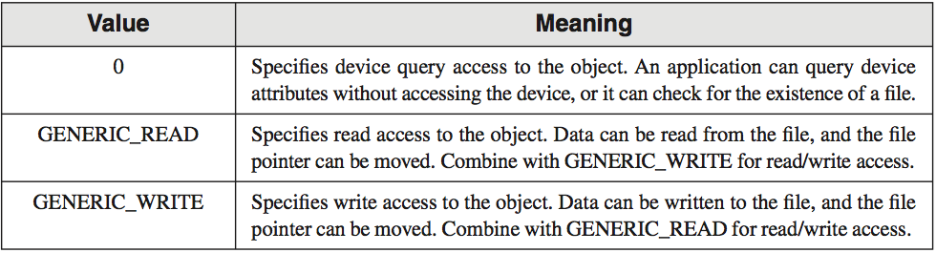
CreateFile (3a of 5)
dwDesiredAccess: lets you specify read, write, read/write access, or device query access to the file.

Slide 9
CreateFile (3b of 5)
dwShareMode: Controls the ability for multiple programs to access the file while it is open.
Value | Meaning
0 | Prevents other processes from opening a file or device if they request delete, read, or write access.
FILE_SHARE_DELETE 0x00000004 | Enables subsequent open operations on a file or device to request delete access. Note Delete access allows both delete and rename operations.
FILE_SHARE_READ 0x00000001 | Enables subsequent open operations on a file or device to request read access.
FILE_SHARE_WRITE 0x00000002 | Enables subsequent open operations on a file or device to request write access.

Slide 10
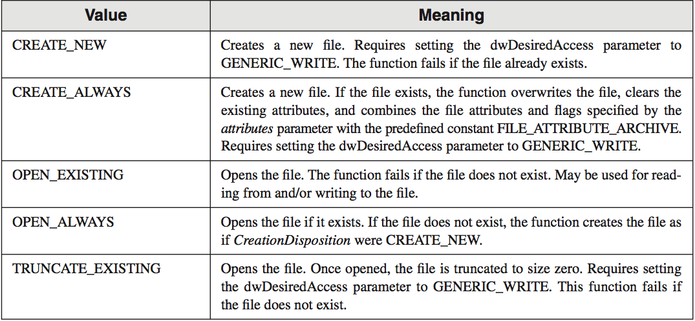
CreateFile (4 of 5)
dwCreationDisposition: specifies which action to take on files that exist and which action to take when files do not exist.

Slide 11
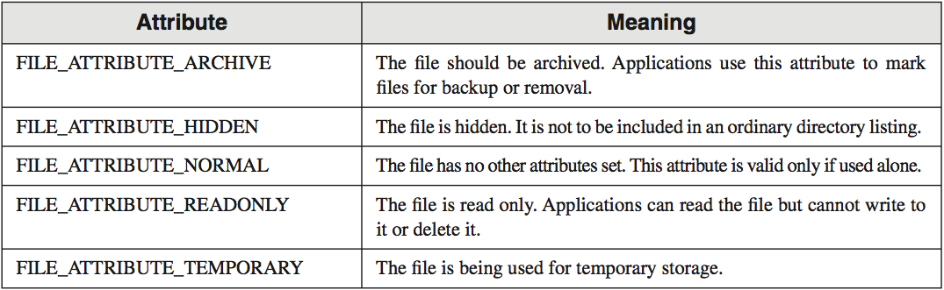
CreateFile (5 of 5)
dwFlagsAndAttributes: most commonly used Flags and Attributes are shown in the following table.

Slide 12
CreateFile Examples (1 of 3)
Opens an existing file for reading:
INVOKE CreateFile,
ADDR filename, ; ptr to filename
GENERIC_READ, ; access mode
FILE_SHARE_READ, ; share mode
NULL, ; ptr to security attributes
OPEN_EXISTING, ; file creation options
FILE_ATTRIBUTE_NORMAL, ; file attributes
0 ; handle to template file

Slide 13
CreateFile Examples (2 of 3)
Opens an existing file for writing:
INVOKE CreateFile,
ADDR filename,
GENERIC_WRITE, ; access mode
FILE_SHARE_WRITE,
NULL,
OPEN_EXISTING,
FILE_ATTRIBUTE_NORMAL,
0

Slide 14
CreateFile Examples (3 of 3)
Creates a new file with normal attributes, erasing any existing file by the same name:
INVOKE CreateFile,
ADDR filename,
GENERIC_WRITE,
FILE_SHARE_WRITE,
NULL,
CREATE_ALWAYS, ; overwrite existing file
FILE_ATTRIBUTE_NORMAL,
0

Slide 15
ReadFile
ReadFile reads text from an input file
Prototype:
ReadFile PROTO,
handle:DWORD, ; handle to file
pBuffer:PTR BYTE, ; ptr to buffer
nBufsize:DWORD, ; num bytes to read
pBytesRead:PTR DWORD, ; bytes actually read
pOverlapped:PTR DWORD ; ptr to asynch info

Slide 16
WriteFile
WriteFile writes data to a file, using an output handle. The handle can be the screen buffer handle, or it can be one assigned to a text file.
Prototype:
WriteFile PROTO,
fileHandle:DWORD, ; output handle
pBuffer:PTR BYTE, ; pointer to buffer
nBufsize:DWORD, ; size of buffer
pBytesWritten:PTR DWORD, ; num bytes written
pOverlapped:PTR DWORD ; ptr to asynch info

Slide 17
SetFilePointer
SetFilePointer moves the position pointer of an open file. You can use it to append data to a file, and to perform random-access record processing:
SetFilePointer PROTO,
handle:DWORD, ; file handle
nDistanceLo:SDWORD, ; bytes to move pointer
pDistanceHi:PTR SDWORD, ; ptr to bytes to move
moveMethod:DWORD ; starting point
; Move to end of file:
INVOKE SetFilePointer,
fileHandle,0,0,FILE_END
Example:

Slide 18
Console Window Manipulation
Screen buffer
Console window
Controlling the cursor
Controlling the text color

Slide 19
Screen Buffer and Console Window
The active screen buffer includes data displayed by the console window.

Slide 20
SetConsoleTitle
SetConsoleTitle changes the console window's title. Pass it a null-terminated string:
.data
titleStr BYTE "Console title",0
.code
INVOKE SetConsoleTitle, ADDR titleStr

Slide 21
GetConsoleScreenBufferInfo
GetConsoleScreenBufferInfo returns information about the current state of the console window.
It has two parameters: a handle to the console screen, and a pointer to a structure that is filled in by the function:
.data
outHandle DWORD ?
consoleInfo CONSOLE_SCREEN_BUFFER_INFO <>
.code
INVOKE GetConsoleScreenBufferInfo,
outHandle,
ADDR consoleInfo
INVOKE GetStdHandle, STD_OUTPUT_HANDLE
mov outHandle,eax

Slide 22
CONSOLE_SCREEN_BUFFER_INFO
CONSOLE_SCREEN_BUFFER_INFO STRUCT
dwSize COORD <>
dwCursorPos COORD <>
wAttributes WORD ?
srWindow SMALL_RECT <>
maxWinSize COORD <>
CONSOLE_SCREEN_BUFFER_INFO ENDS
dwSize - size of the screen buffer (char columns and rows)
dwCursorPos - cursor location
wAttributes - colors of characters in console buffer
srWindow - coords of console window relative to screen buffer
maxWinSize - maximum size of the console window

Slide 23
SetConsoleWindowInfo
SetConsoleWindowInfo lets you set the size and position of the console window relative to its screen buffer.
Prototype:
SetConsoleWindowInfo PROTO,
nStdHandle:DWORD, ; screen buffer handle
bAbsolute:DWORD, ; coordinate type
pConsoleRect:PTR SMALL_RECT ; window rectangle

Slide 24
SetConsoleScreenBufferSize
SetConsoleScreenBufferSize lets you set the screen buffer size to X columns by Y rows.
Prototype:
SetConsoleScreenBufferSize PROTO,
outHandle:DWORD, ; handle to screen buffer
dwSize:COORD ; new screen buffer size

Slide 25
Controlling the Cursor
GetConsoleCursorInfo
returns the size and visibility of the console cursor
SetConsoleCursorInfo
sets the size and visibility of the cursor
SetConsoleCursorPosition
sets the X, Y position of the cursor

Slide 26
CONSOLE_CURSOR_INFO
Structure containing information about the console’s cursor size and visibility:
CONSOLE_CURSOR_INFO STRUCT
dwSize DWORD ?
bVisible DWORD ?
CONSOLE_CURSOR_INFO ENDS

Slide 27
SetConsoleTextAttribute
Sets the foreground and background colors of all subsequent text written to the console.
Prototype:
SetConsoleTextAttribute PROTO,
outHandle:DWORD, ; console output handle
nColor:DWORD ; color attribute

Slide 28
WriteConsoleOutputAttribute
Copies an array of attribute values to consecutive cells of the console screen buffer, beginning at a specified location.
Prototype:
WriteConsoleOutputAttribute PROTO,
outHandle:DWORD, ; output handle
pAttribute:PTR WORD, ; write attributes
nLength:DWORD, ; number of cells
xyCoord:COORD, ; first cell coordinates
lpCount:PTR DWORD ; number of cells written

Slide 29
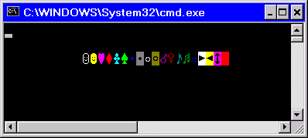
WriteColors Program
Creates an array of characters and an array of attributes, one for each character
Copies the attributes to the screen buffer
Copies the characters to the same screen buffer cells as the attributes
Sample output:
View the source code
(starts in row 2, column 10)

Slide 30
Time and Date Functions
GetLocalTime, SetLocalTime
GetTickCount, Sleep
GetDateTime
SYSTEMTIME Structure
Creating a Stopwatch Timer

Slide 31
GetLocalTime, SetLocalTime
GetLocalTime returns the date and current time of day, according to the system clock.
SetLocalTime sets the system’s local date and time.
GetLocalTime PROTO,
pSystemTime:PTR SYSTEMTIME
SetLocalTime PROTO,
pSystemTime:PTR SYSTEMTIME

Slide 32
GetTickCount, Sleep
GetTickCount function returns the number of milliseconds that have elapsed since the system was started.
Sleep pauses the current program for a specified number of milliseconds.
GetTickCount PROTO ; return value in EAX
Sleep PROTO,
dwMilliseconds:DWORD

Slide 33
SYSTEMTIME Structure
SYSTEMTIME is used by date and time-related Windows API functions:
SYSTEMTIME STRUCT
wYear WORD ? ; year (4 digits)
wMonth WORD ? ; month (1-12)
wDayOfWeek WORD ? ; day of week (0-6)
wDay WORD ? ; day (1-31)
wHour WORD ? ; hours (0-23)
wMinute WORD ? ; minutes (0-59)
wSecond WORD ? ; seconds (0-59)
wMilliseconds WORD ? ; milliseconds (0-999)
SYSTEMTIME ENDS

Slide 34
Creating a Stopwatch Timer
The Timer.asm program demonstrates a simple stopwatch timer
It has two important functions:
TimerStart - receives a pointer to a doubleword, into which it saves the current time
TimerStop - receives a pointer to the same doubleword, and returns the difference (in milliseconds) between the current time and the previously recorded time
Calls the Win32 GetTickCount function
View the source code

Slide 35
Writing a Graphical Windows Application
POINT, RECT Structures
MSGStruct, WNDCLASS Structures
MessageBox Function
WinMain, WinProc Procedures

Slide 36
POINT and RECT Structures
POINT - X, Y screen coordinates
RECT - Holds the graphical coordinates of two opposing corners of a rectangle
POINT STRUCT
ptX DWORD ?
ptY DWORD ?
POINT ENDS
RECT STRUCT
left DWORD ?
top DWORD ?
right DWORD ?
bottom DWORD ?
RECT ENDS

Slide 37
MSGStruct Structure
MSGStruct - holds data for MS-Windows messages (usually passed by the system and received by your application):
MSGStruct STRUCT
msgWnd DWORD ?
msgMessage DWORD ?
msgWparam DWORD ?
msgLparam DWORD ?
msgTime DWORD ?
msgPt POINT <>
MSGStruct ENDS

Slide 38
WNDCLASS Structure (1 of 2)
Each window in a program belongs to a class, and each program defines a window class for its main window:
WNDCLASS STRUC
style DWORD ? ; window style options
lpfnWndProc DWORD ? ; WinProc function pointer
cbClsExtra DWORD ? ; shared memory
cbWndExtra DWORD ? ; number of extra bytes
hInstance DWORD ? ; handle to current program
hIcon DWORD ? ; handle to icon
hCursor DWORD ? ; handle to cursor
hbrBackground DWORD ? ; handle to background brush
lpszMenuName DWORD ? ; pointer to menu name
lpszClassName DWORD ? ; pointer to WinClass name
WNDCLASS ENDS

Slide 39
WNDCLASS Structure (2 of 2)
style is a conglomerate of different style options, such as WS_CAPTION and WS_BORDER, that control the window’s appearance and behavior.
lpfnWndProc is a pointer to a function (in our program) that receives and processes event messages triggered by the user.
cbClsExtra refers to shared memory used by all windows belonging to the class. Can be null.
cbWndExtra specifies the number of extra bytes to allocate following the window instance.
hInstance holds a handle to the current program instance.
hIcon and hCursor hold handles to icon and cursor resources for the current program.
hbrBackground holds a background (color) brush.
lpszMenuName points to a menu string.
lpszClassName points to a null-terminated string containing the window’s class name.

Slide 40
MessageBox Function
Displays text in a box that pops up and waits for the user to click on a button:
MessageBox PROTO,
hWnd:DWORD,
pText:PTR BYTE,
pCaption:PTR BYTE,
style:DWORD
hWnd is a handle to the current window.
pText points to a null-terminated string that will appear inside the box.
pCaption points to a null-terminated string that will appear in the box’s caption bar.
style is an integer that describes both the dialog box’s icon (optional) and the buttons (required).

Slide 41
MessageBox Example
Displays a message box that shows a question, including an OK button and a question-mark icon:
.data
hMainWnd DWORD ?
QuestionText BYTE "Register this program now?"
QuestionTitle BYTE "Trial Period Has Expired"
.code
INVOKE MessageBox,
hMainWnd,
ADDR QuestionText,
ADDR QuestionTitle,
MB_OK + MB_ICONQUESTION

Slide 42
WinMain Procedure
Every Windows application needs a startup procedure, usually named WinMain, which is responsible for the following tasks:
Get a handle to the current program
Load the program’s icon and mouse cursor
Register the program’s main window class and identify the procedure that will process event messages for the window
Create the main window
Show and update the main window
Begin a loop that receives and dispatches messages

Slide 43
WinProc Procedure
WinProc receives and processes all event messages relating to a window
Some events are initiated by clicking and dragging the mouse, pressing keyboard keys, and so on
WinProc decodes each message, carries out application-oriented tasks related to the message
WinProc PROC,
hWnd:DWORD, ; handle to the window
localMsg:DWORD, ; message ID
wParam:DWORD, ; parameter 1 (varies)
lParam:DWORD ; parameter 2 (varies)
(Contents of wParam and lParam vary, depending on the message.)

Slide 44
Sample WinProc Messages
In the example program from this chapter, the WinProc procedure handles three specific messages:
WM_LBUTTONDOWN, generated when the user presses the left mouse button
WM_CREATE, indicates that the main window was just created
WM_CLOSE, indicates that the application’s main window is about to close
(many other messages are possible)

Slide 45
Message Loop
In WinMain, the message loop receives and dispatches (relays) messages:
Message_Loop:
; Get next message from the queue.
INVOKE GetMessage, ADDR msg, NULL,NULL,NULL
; Quit if no more messages.
.IF eax == 0
jmp Exit_Program
.ENDIF
; Relay the message to the program's WinProc.
INVOKE DispatchMessage, ADDR msg
jmp Message_Loop

Slide 46
Processing Messages
WinProc receives each message and decides what to do with it:
WinProc PROC, hWnd:DWORD, localMsg:DWORD,
wParam:DWORD, lParam:DWORD
mov eax, localMsg
.IF eax == WM_LBUTTONDOWN ; mouse button?
INVOKE MessageBox, hWnd, ADDR PopupText,
ADDR PopupTitle, MB_OK
jmp WinProcExit
.ELSEIF eax == WM_CREATE ; create window?
INVOKE MessageBox, hWnd, ADDR AppLoadMsgText,
ADDR AppLoadMsgTitle, MB_OK
jmp WinProcExit
(etc.)

Slide 47
Summary
Win32 API Functions that create, read, and write to files:
CreateFile
ReadFile
WriteFile
SetFilePointer
Console Window Manipulation Functions
Screen buffer
Console window
Controlling the cursor
Controlling the text color

Slide 48
Summary
(cont.)
Time and Date Functions
GetLocalTime, SetLocalTime
GetTickCount, Sleep
GetDateTime
SYSTEMTIME Structure
Creating a Stopwatch Timer
Graphical Window Functions
POINT, RECT Structures
MSGStruct, WNDCLASS Structures
MessageBox Function
WinMain, WinProc Procedures

Slide 49
Reference
Most of the Slides are taken from Presentation:
Chapter 11
Assembly Language for Intel-Based Computers, 4th Edition
Kip R. Irvine
(c) Pearson Education, 2002. All rights reserved. You may modify and copy this slide show for your personal use, or for use in the classroom, as long as this copyright statement, the author's name, and the title are not changed.

