Slide 1
CSC 221 Computer Organization and Assembly Language
Lecture 31:
High-Level Language Interface (2/2)

Slide 2
Lecture 30: Review
Why Link ASM and HLL Programs?
HLL
Hides low-level details, Less time, Slow Speed and Large Size
Assembly
Speed up critical sections of code, Access nonstandard hardware devices, Write platform-specific code, Extend the HLL's capabilities
External Identifier:
is a name that has been placed in a module’s object file in such a way that the linker can make the name available to other program modules.
Naming convention:
rules or characteristics regarding the naming of variables and procedures

Slide 3
Lecture 30: Review
(cont.)
Calling Convention:
Refers to the low-level details about how procedures are called
Registers that must be preserved by procedures.
How arguments are passed to procedures?
The order in which arguments are passed by calling programs to procedures.
Whether arguments are passed by value or by reference.
How the stack pointer is restored after a procedure call?
How functions return values?

Slide 4
Lecture 30: Review
(cont.)
.MODEL Directive
stdcall
AddTwo(5, 6)→ last to 1st.
push 6
push 5
call AddTwo
Saves EBP, ESP and access parameters using EBP.
ret 8 ; clean up the stack
_name@nn
C specifier:
push 6 ; Second Argument
push 5 ; First Argument
call AddTwo
add esp,8 ; clean up the stack
_AddTwo

Slide 5
Lecture 30: Review
(cont.)
_asm Directive in Microsoft Visual C++stdcall
Syntax:
__asm statement
__asm {
statement-1
statement-2
...
statement-n
}

Slide 6
Lecture Outline
Function Call Overhead
Linking to Visual C++ Programs
Linking to Visual C++
Optimizing Your Code
Loop Optimization Example
FindArray Example
Creating the FindArray Project

Slide 7
Function Call Overhead
using namespace std;
int main( )
{
const int BUFSIZE = 2000;
char buffer[BUFSIZE];
unsigned int count;
unsigned char encryptCode;
cout << "Encryption code [0-255]? ";
cin >> encryptCode;
ifstream infile( "plain1.txt", ios::binary );
ofstream outfile( "cipher1.txt", ios::binary );
cout << “ENCODING“<< endl;
while (!infile.eof() )
{
infile.read(buffer, BUFSIZE);
count = infile.gcount();
TranslateBuffer(buffer, count, encryptCode);
outfile.write(buffer, count);
}
return 0;
}
movzx eax,byte ptr [ebp+FFFFF7FBh]
push eax
mov ecx,dword ptr [ebp+FFFFF804h]
push ecx
lea edx,[ebp+FFFFF810h]
push edx
call TranslateBuffer (00C813E8)
add esp,0Ch

Slide 8
Function Call Overhead
void TranslateBuffer( char * buf,
unsigned count, unsigned char eChar )
{
__asm {
mov esi,buf
mov ecx,count
mov al,eChar
L1:
xor [esi],al
inc esi
loop L1
} // asm
}
push ebp
mov ebp,esp
sub esp,0C0h
push ebx
push esi
push edi
lea edi,[ebp+FFFFFF40h]
mov ecx,30h
mov eax,0CCCCCCCCh
rep stos dword ptr es:[edi]
pop edi
pop esi
pop ebx
add esp,0C0h
cmp ebp,esp
call 00C8147E
mov esp,ebp
pop ebp
ret
Automatically # of statements inserted by the compiler to set up EBP.
Save standard set of registers whether or not they are actually modified by the procedure.

Slide 9
Function Call Overhead
Thousands of function calls will cause considerable overhead/delay.
To avoid this overhead, inserting the inline code will create a more efficient program.
while (!infile.eof() )
{
infile.read(buffer, BUFSIZE );
count = infile.gcount();
__asm {
lea esi,buffer
mov ecx,count
mov al,encryptCode
L1:
xor [esi],al
inc esi
Loop L1
} // asm
outfile.write(buffer, count);
}

Slide 10
Linking Assembly Language to C++
Basic Structure - Two Modules
The first module, written in assembly language, contains the external procedure
The second module contains the C/C++ code that starts and ends the program
The C++ module adds the extern qualifier to the external assembly language function prototype.
The "C" specifier must be included to prevent name decoration by the C++ compiler:
extern "C" functionName( parameterList );

Slide 11
Name Decoration
Also known as name mangling. HLL compilers do this to uniquely identify overloaded functions. A function such as:
int ArraySum( int * p, int count )
would be exported as a decorated name that encodes the return type, function name, and parameter types. For example:
int_ArraySum_pInt_int
The problem with name decoration is that the C++ compiler assumes that your assembly language function's name is decorated. The C++ compiler tells the linker to look for a decorated name.
C++ compilers vary in the way they decorate function names.

Slide 12
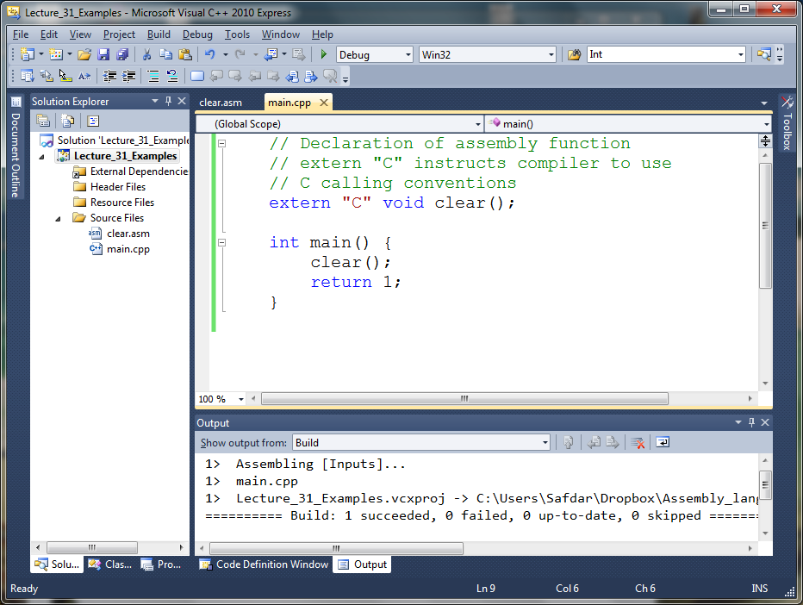

Slide 13
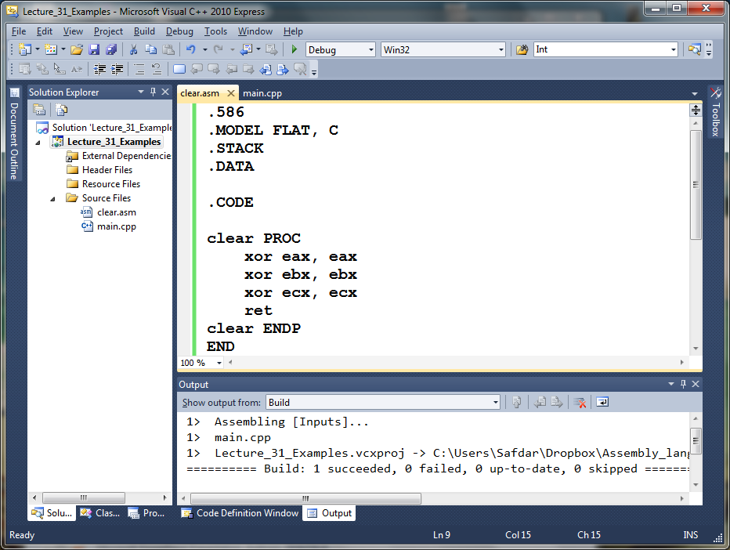

Slide 14
; AddTwo.asm file
.486
.model flat, stdcall
option casemap :none
AddTwo PROTO, Arg1:DWORD, Arg2:DWORD
.code
AddTwo PROC, Arg1:DWORD, Arg2:DWORD
mov eax, Arg1
add eax, Arg2
ret
AddTwo ENDP
END
#include <stdio.h>
#include <iostream>
using namespace std;
extern "C" int __stdcall AddTwo (int, int);
int main()
{
int a=2; int b=3;int c=0;
c = AddTwo(a,b);
cout<<c;
return 1;
}

Slide 15
ASSEMBLY
=================
AddTwo PROC, Arg1:DWORD, Arg2:DWORD
push ebp
mov ebp,esp
mov eax, Arg1
mov eax,dword ptr [Arg1]
add eax, Arg2
add eax,dword ptr [Arg2]
ret
leave
ret 8
Visual C++ Disassembly
======================
mov eax,dword ptr [b]
push eax
mov ecx,dword ptr [a]
push ecx
call @ILT+25(_AddTwo@8) (9F101Eh)
mov dword ptr [c],eax

Slide 16
Using Assembly Language to Optimize C++
FindArray Example
Find out how to make your C++ compiler produce an assembly language source listing
Optimize loops for speed
Use hardware-level I/O for optimum speed
Use BIOS-level I/O for medium speed

Slide 17
Creating the FindArray Project
Run Visual C++ and create a project named FindArray.
Add a CPP source file to the project named main.cpp. This file should contain the C++ main() function that calls FindArray.
Add a new header file named FindArr.h to the project. This file contains the function prototype for FindArray.
Create a file AsmFindArray.asm and FindArray.cpp and place it in the project directory. This file contains the source code for the FindArray procedure.
Build and run the project.

Slide 18
Creating the FindArray Project
// FindArray.cpp
// Implements a linear search of an array of
// long integers.
#include "findarr.h"
bool FindArray( long searchVal, long array[],
long count )
{
for(int i = 0; i < count; i++)
{
if( array[i] == searchVal )
return true;
}
return false;
}

Slide 19
Creating the FindArray Project
// findarr.h
extern "C" {
// Assembly language version
bool AsmFindArray( long n, long array[], long count );
// C++ version
bool FindArray( long n, long array[], long count );
}

Slide 20
TITLE AsmFindArray Procedure (AsmFindArray.asm)
.586
.model flat,C
AsmFindArray PROTO,
srchVal:DWORD, arrayPtr:PTR DWORD, count:DWORD
.code
AsmFindArray PROC USES edi,
srchVal:DWORD, arrayPtr:PTR DWORD, count:DWORD
true = 1
false = 0
mov eax,srchVal ; search value
mov ecx,count ; number of items
mov edi,arrayPtr ; pointer to array
repne scasd ; do the search
jz returnTrue ; ZF = 1 if found
returnFalse:
mov al,false
jmp short exit
returnTrue:
mov al, true
exit: ret
AsmFindArray ENDP
END
Compare EAX with doubleword at ES:(E)DI and set status flags.

Slide 21
Creating the FindArray Project
//findarr_main.cpp
………
#include "findarr.h"
using namespace std;
int main()
{
// Fill an array with pseudorandom integers.
const unsigned ARRAY_SIZE = 10000;
const unsigned LOOP_SIZE = 1000000;
long array[ARRAY_SIZE];
for(unsigned i = 0; i < ARRAY_SIZE; i++)
array[i] = rand();
long searchVal;
time_t startTime, endTime;
cout << "Enter value to find: ";
cin >> searchVal;
cout << "Please wait. This will take between 10 and 30 seconds...\n";
…………

Slide 22
Creating the FindArray Project
//findarr_main.cpp
………
// Test the C++ function:
time( &startTime );
bool found = false;
for( int n = 0; n < LOOP_SIZE; n++)
found = FindArray( searchVal, array, ARRAY_SIZE );
time( &endTime );
cout << "Elapsed CPP time:" << long(endTime - startTime)
<< " seconds. Found = " << found << endl;
…………

Slide 23
Creating the FindArray Project
//findarr_main.cpp
………
// Test the Assembly language procedure:
time( &startTime );
found = false;
for( int n = 0; n < LOOP_SIZE; n++)
found = AsmFindArray( searchVal, array, ARRAY_SIZE );
time( &endTime );
cout << "Elapsed ASM time: " << long(endTime - startTime)
<< " seconds. Found = " << found << endl;
…………

Slide 24
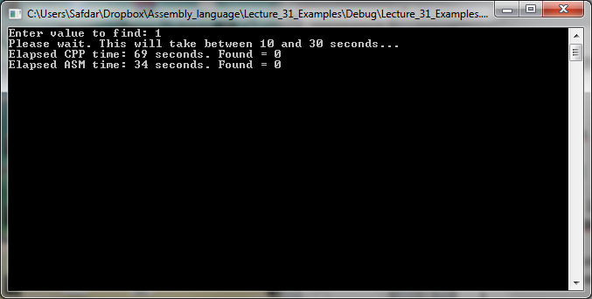
Creating the FindArray Project

Slide 25
Let’s Enjoy Assembly in C/C++

Slide 26
Summary
Function Call Overhead
Linking to Visual C++ Programs
Linking to Visual C++
Optimizing Your Code
Loop Optimization Example
FindArray Example
Creating the FindArray Project

Slide 27
Reference
Most of the Slides are taken from Presentation:
Chapter 13
Assembly Language for Intel-Based Computers, 4th Edition
Kip R. Irvine
(c) Pearson Education, 2002. All rights reserved. You may modify and copy this slide show for your personal use, or for use in the classroom, as long as this copyright statement, the author's name, and the title are not changed.

