Slide 1
Database Design

Slide 2
Database Design
The process of creating a design that will support the enterprise’s mission statement and mission objectives for the required database system.

Slide 3
Approaches to Database Design
Bottom-up
Comparatively small number of attributes (properties of entities and relationships) - Normalization
Top-Down
For comparatively complex databases (contain hundreds to thousands of attributes)
Entity-Relationship (ER) model, beginning with the identification of entities and relationships between the entities, which are of interest to the organization
To gain a data model

Slide 4
Data Modeling
To assist in the understanding of the meaning (semantics) of the data
To facilitate communication about the information requirements.
Data model requires answering questions about entities, relationships, and attributes
We Understand:
Each user’s perspective of the data;
The nature of the data itself, independent of its physical representations;
The use of data across user views.

Slide 5
Criteria for data models
Table 10.2 The criteria to produce an optimal data model.
Structural validity Consistency with the way the enterprise defines and organizes information.
Simplicity Ease of understanding by IS professionals and nontechnical users.
Expressibility Ability to distinguish between different data, relationships between data, and constraints.
Nonredundancy Exclusion of extraneous information; in particular, the representation of any one piece of information exactly once.
Shareability Not specific to any particular application or technology and thereby usable by many.
Extensibility Ability to evolve to support new requirements with minimal effect on existing users.
Integrity Consistency with the way the enterprise uses and manages information.
Diagrammatic representation Ability to represent a model using an easily understood diagrammatic notation.

Slide 6
Integrity:
Integrity is a process of validating system in a consistent state by applying required constraints. It ensures reliability and consistency. There can be various constraints like referential, entity & domain integrity.

Slide 7
Phases of Database Design
Conceptual database design
Logical database design
Physical database design

Slide 8
Conceptual database design
The process of constructing a model of the data used in an enterprise, independent of all physical considerations.
Data model is built using the information documented in the users’ requirements specification
independent of implementation details such as:
The target DBMS software,
application programs, programming languages, hardware platform,
or any other physical considerations

Slide 9
Continue….
Throughout the process of developing a conceptual data model:
The model is tested and validated against the users’ requirements
The conceptual data model of the enterprise is a source of information for the next phase,
Logical database design.
Tasks:
1) Identifying organization structure, entities, relationship, ER-modeling by establishing relationship between entities

Slide 10
Logical database design
The process of constructing a model of the data used in an enterprise based on a specific data model, but independent of a particular DBMS and other physical considerations.
The logical data model is based on the target data model for the database (for example, the relational data model).
Logical model is derived knowing the underlying data model of the target DBMS
we ignore any physical details, such as storage structures or indexes.

Slide 11
Continue……..
The model is tested and validated against the users’ requirements
Checking data for accuracy
The technique of normalization is used to test the correctness of a logical data model
Normalization ensures that data model do not display data redundancy
The logical data model should support the transactions specified by the users.
It also critical for future changes to application programs or data to be accurately and efficiently represented by the database

Slide 12
Physical database design
The process of producing a description of the:
Implementation of the database on secondary storage;
The base relations,
File organizations,
indexes used to achieve efficient access to the data,
Any associated integrity constraints and
security measures like database administration and authorization

Slide 13
Continue…
Identify the target DBMS
Creating a set of relational tables and the constraints on these tables
Identifying the specific storage structures and access methods for the data to achieve an optimum performance for the database system;
Designing security protection for the system.

Slide 14
Conceptual and logical database design for larger systems should be separated from physical design for three main reasons:
• It deals with a different subject matter—the what, not the how;
• It is performed at a different time—the what must be understood
before the how can be determined;
• It requires different skills, which are often found in different people.

Slide 15
Database design is an iterative process that has a starting point and an almost endless procession of refinements.

Slide 16
Approaches to database design
Bottom-up
Normalization
Top-down.
ER Model

Slide 17
Top down approach
Understanding the system by three stakeholders
Designers
Developers
End users
Model of non-technical and free of ambiguity
Identification of important data that is called entity and relationship
Diagrammatic notation language
Unified modeling language (UML)

Slide 18
ER Model/ER Diagram (Entity Relationship)
An Entity Relationship (ER) Diagram is a type of flowchart that illustrates how “entities” such as people, objects or concepts relate to each other within a system.
Used to design or debug relational databases.
Rectangles, diamonds, ovals and connecting lines to depict the interconnectedness of entities, relationships and their attributes.

Slide 19
Entity
A definable thing—such as a person, object, concept —that can have data stored about it. Think of entities as nouns. Examples: a customer, student, car or product. Typically shown as a rectangle
Entity type: A group of definable things, such as students or athletes, whereas the entity would be the specific student or athlete. Other examples: customers, cars or products. (set of related attributes associated with an entity)
Entity set: Same as an entity type, but defined at a particular point in time, such as students enrolled in a class on the first day. (set of related attributes associated with an entity in a specific time)

Slide 20


Entity Categories
A strong entity can be defined solely by its own attributes (Staff, Branch, PropertyForRent, and Client entities), also called parent, owner, or dominant entity. i.e., Book of library has unique ISBN which identifies it.
A weak entity type that is existence-dependent on some other entity type (registration, sales, purchase, is also called (child, dependent, or subordinate) i.e., Copy is a weak entity and depends on Book which is strong entity. Weak entity always exist dependently.

Slide 21
Entity keys:
Candidate key
Primary key
Foreign key

Slide 22



Attribute
Simple Attribute
Composite Attribute
Single Value attribute
Multi-value attribute
Derived Attribute

Slide 23
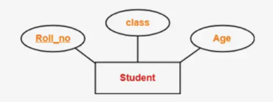
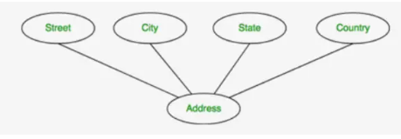
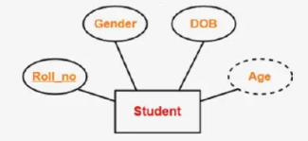
Types of attributes:
Simple attribute
Composite attribute
Derived attribute

Slide 24
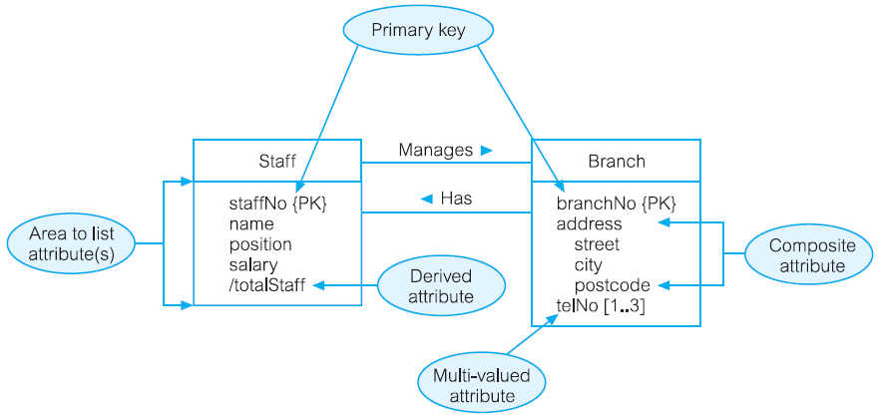
Diagrammatic representation of attributes

Slide 25
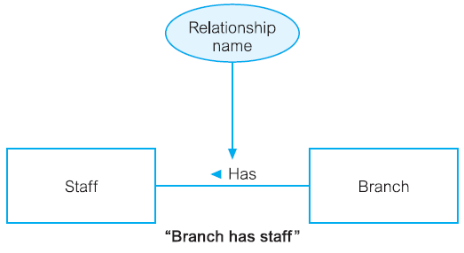
Relationship type
A set of meaningful associations among entity types.

Slide 26
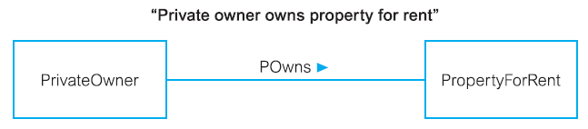
Degree Relationship type
The number of participating entity types in a relationship.
Binary Relationship

Slide 27
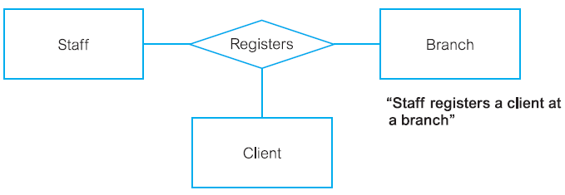
Ternary relationship

Slide 28
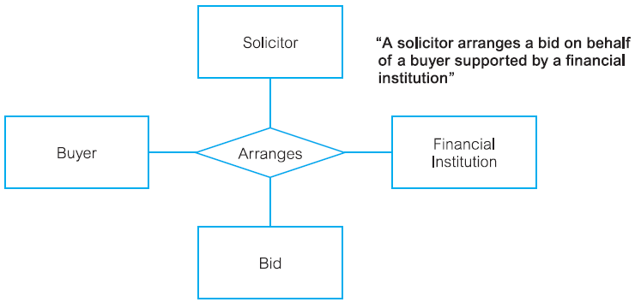
Complex Relationship

Slide 29
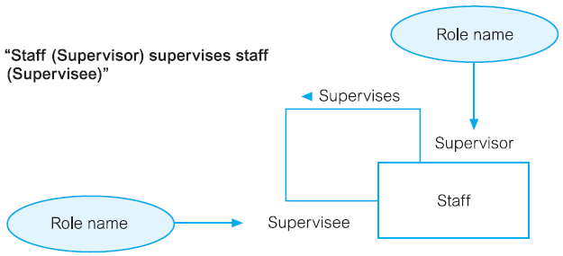
Recursive Relationship
A relationship type in which the same entity type participates more than once in different roles.

Slide 30
Structural Constraints
Multiplicity
The number (or range) of possible occurrences of an entity type that may relate to a single occurrence of an associated entity type through a particular relationship.
one-to-one (1:1),
one-to-many (1:*),
or many-to-many (*:*)
a member of staff manages a branch (1:1);
a member of staff oversees properties for rent (1:*);
newspapers advertise properties for rent (*:*).

Slide 31
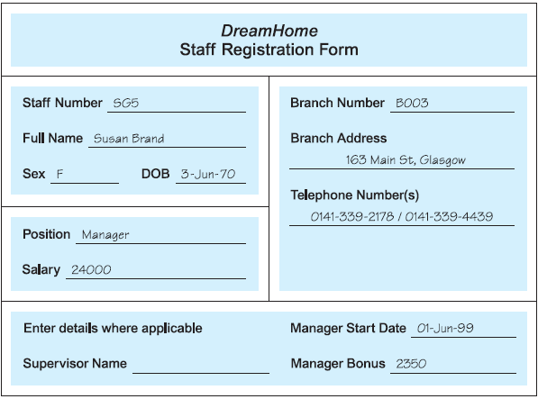

Slide 32
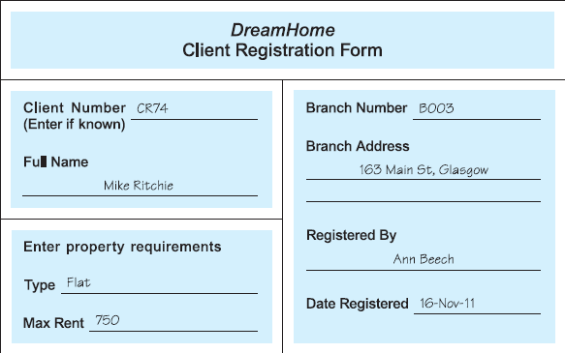

Slide 33
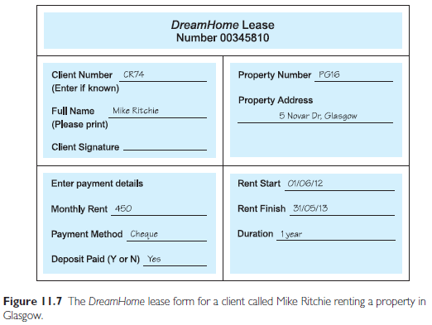

Slide 34
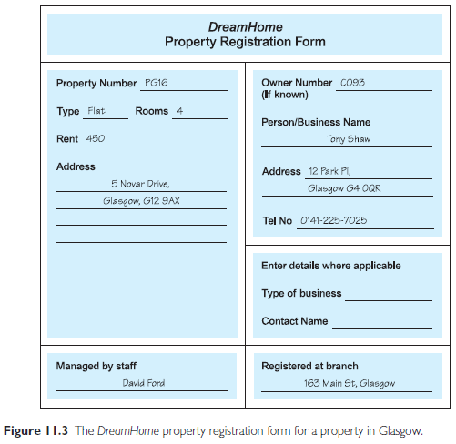

Slide 35
How do we handle composite and multi-valued attributes during conversion from ERD to tables??
Composite attributes are those which composed of many fields like phone number can be composed of street, city, state & zip code. We can create separate field/columns for each of them.
Multi-valued attributes are those having multiple values like a person can have multiple phone numbers. We can handle it making a separate table of phone numbers and join them by making a primary key in base table which can uniquely identify whole tuple and foreign key in other table contains phone numbers.

Slide 36
Entity integrity and referential integrity:
Entity integrity uniquely identifies row in a table. Primary key assures the entity integrity.
Referential integrity refers to relationship between tables. The relationship is established via foreign key. This constraint states that there must have a matching primary key in another table or must be null.

Slide 37
Candidate key:
A key which uniquely identifies a tuple and can be more than one. A candidate key can be primary key at the same time as well. It can be null.
This key enforce data integrity. A primary key chosen from candidate key; remaining keys will be known as alternate key.
Candidate key prevents from data duplication, used in table indexing for efficient information retrieval.
For example, ID and Email in Student table can be candidate key because both are unique.

