Slide 1
Transaction Management
Chapter 22

Slide 2
Transaction
An action, or series of actions, carried out by a single user or application program, that reads or updates the contents of the database.

Slide 3
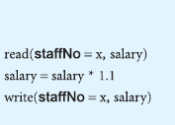

Slide 4
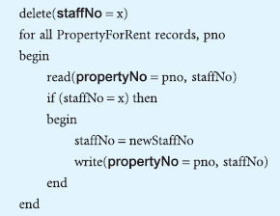

Slide 5
Basic terminologies
Consistent state
inconsistent state
Committed
Abort
Rollback/undone
Compensating transaction

Slide 6
Consistent state
A process to ensure data integrity so that accurate information is delivered in a valid state without any conflict.

Slide 7
Partially committed state
In this state, all the actions/instructions of transaction are executed but not committed yet. Its time to ensure that whether to commit or roll back (if any error occurred).
It is ensured by 2-phase commit protocol. In the 1st phase, coordinator sends a request to leave the transaction by writing the data from primary to secondary memory, if request is not received, roll back is performed in 2nd phase. Roll back is performed using log file of that dbms which is like journal containing all the transaction history their time and other relevant details.
This protocol is ensuring transaction from one consistent state to another.

Slide 8
Compensating transaction
In database management systems (DBMS), a compensating transaction is a mechanism used to undo or reverse the effects of a previously executed transaction. It is typically used in situations where a transaction encounters an error or fails to complete successfully, and it is necessary to restore the database to a consistent state.
Compensating transactions are often associated with long or complex transactions that involve multiple steps or operations. If a failure occurs during such a transaction, it may leave the database in an inconsistent state with partially completed changes. In such cases, a compensating transaction can be designed to reverse the effects of the failed transaction and restore the database to its original state.
The compensating transaction is designed to perform the opposite actions of the original transaction. For example, if the original transaction deducted a certain amount from a bank account, the compensating transaction would add the same amount back to the account. Similarly, if the original transaction inserted new records into a table, the compensating transaction would delete those records.
By executing the compensating transaction, the database can be brought back to a consistent state, ensuring that the failed transaction's effects are reversed. This is important for maintaining data integrity and ensuring that subsequent transactions are not impacted by the incomplete or erroneous changes.

Slide 9
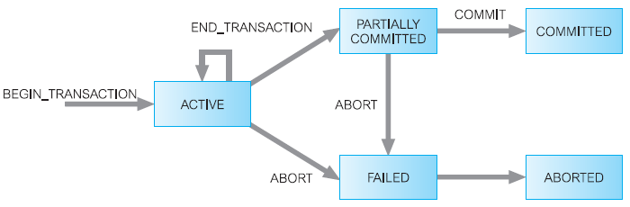

Slide 10
Properties of Transactions
ACID:
Atomicity
Consistency
Isolation
Durability

Slide 11
Cont.
ACID is an acronym that stands for Atomicity, Consistency, Isolation, and Durability. These are the four fundamental properties or principles that ensure reliability, consistency, and integrity in database systems. Let's explore each of these principles in more detail:
Atomicity: Atomicity guarantees that a transaction is treated as a single, indivisible unit of work. It ensures that either all the changes made within a transaction are committed to the database, or none of them are. In other words, a transaction is considered "all or nothing." If any part of a transaction fails, the entire transaction is rolled back, and the database state is left unchanged. Atomicity helps maintain data integrity and prevents the database from being left in an inconsistent state.
Consistency: Consistency ensures that a transaction brings the database from one valid state to another. It enforces the rules and constraints defined in the database schema. When a transaction completes successfully, the database is left in a consistent state. If a transaction violates any integrity constraints, the changes made within the transaction are rolled back, and the database remains unchanged.
Isolation: Isolation ensures that concurrent execution of transactions produces the same result as if they were executed sequentially, one after another. It prevents interference between concurrent transactions, ensuring that each transaction is executed in isolation from others. Isolation is crucial for maintaining data integrity and preventing issues such as dirty reads, non-repeatable reads, and phantom reads. Database systems use various concurrency control mechanisms like locks and isolation levels to provide isolation.
Durability: Durability guarantees that once a transaction is committed, its changes are permanent and will survive any subsequent failures, such as power outages or system crashes. The committed data is stored in a way that even in the event of a failure, it can be recovered and restored to a consistent state. This is typically achieved by writing the changes to disk or other persistent storage. Durability ensures the reliability and permanence of data in the database.
Together, the ACID properties ensure that database transactions are reliable, consistent, and maintain data integrity even in the presence of failures, concurrent access, or other anomalies. They form the foundation for building robust and dependable database systems.

Slide 12
Concurrency control
The process of managing simultaneous operations on the database without having them interfere with one another.
lost update problem
uncommitted dependency problem
inconsistent analysis problem

Slide 13
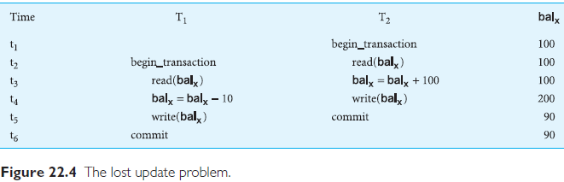

Slide 14
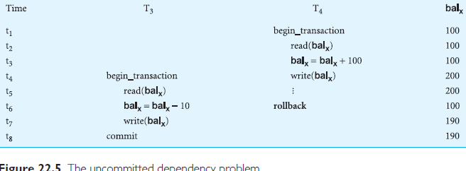

Slide 15
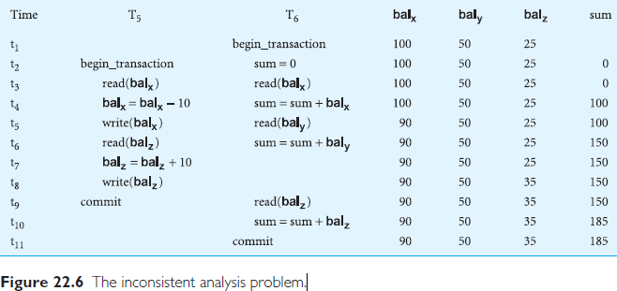

Slide 16
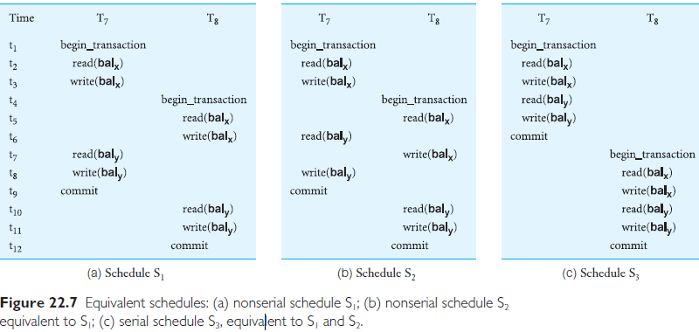

Slide 17
Fuzzy read
Fuzzy means un-clear/ambiguous.
When a transaction reads a value from data and other transaction update it at the same time, then previous transaction has a un-consistent or old value which results in invalid results.

Slide 18
Phantom read
Transaction getting data by applying query and other transaction update that certain record at the same time will result in invalid or old record.

