Slide 1
Relational Algebra
Chapter 5

Slide 2
Both the algebra and the calculus are formal, non-user-friendly languages.
Basis for other, higher-level Data Manipulation Languages (DMLs) for relational databases
The relational algebra is a theoretical language
There are several variations of syntax for relational algebra commands
The five fundamental operations in relational algebra
Selection, Projection, Cartesian product, Union, and Set difference
In addition, there are also the Join, Intersection, and Division operations

Slide 3
Unary and Binary Operations
The Selection and Projection operations are Unary operations
They operate on one relation
Other operations work on pairs of relations and are therefore called Binary operations

Slide 4
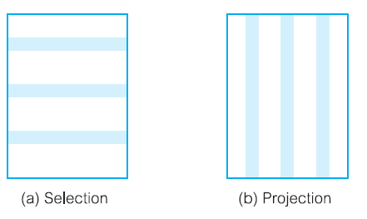
Unary Operations

Slide 5
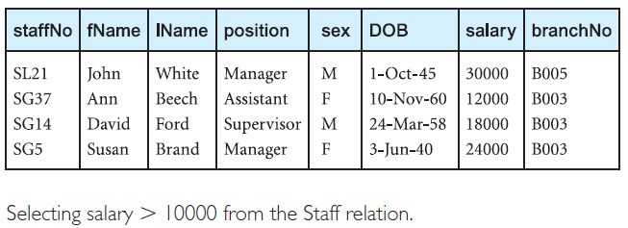
List all staff with a salary greater than £10000.
SELECT * from Staff WHERE salary>10000

Slide 6

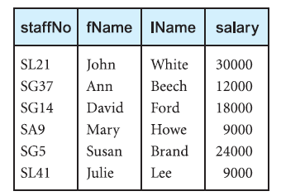
Projection
SELECT staffNo, fName, lName, salary FROM Staff

Slide 7
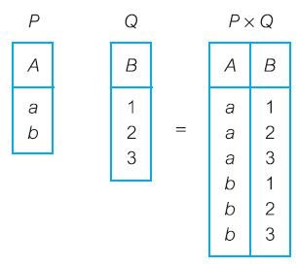
Cartesian Product

Slide 8
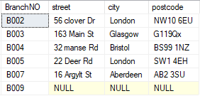

Slide 9
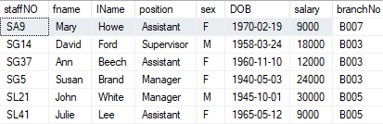

Slide 10
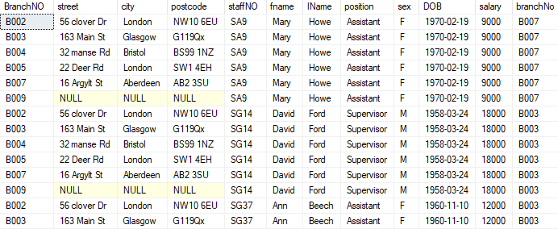

Slide 11
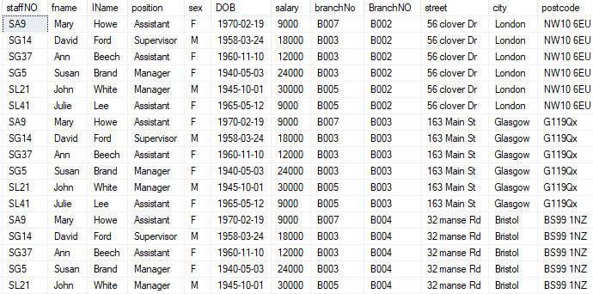

Slide 12
Cartesian product

Slide 13
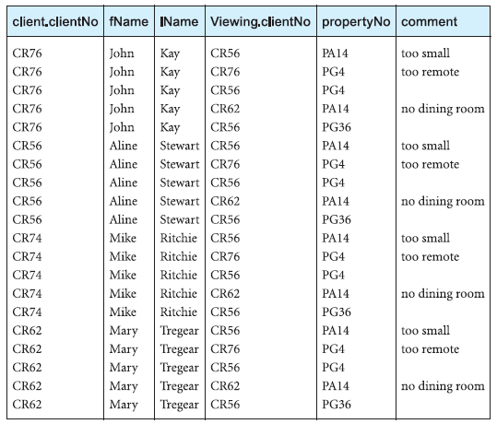

Slide 14
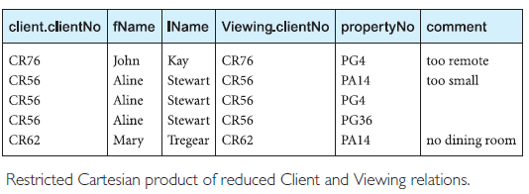

Slide 15
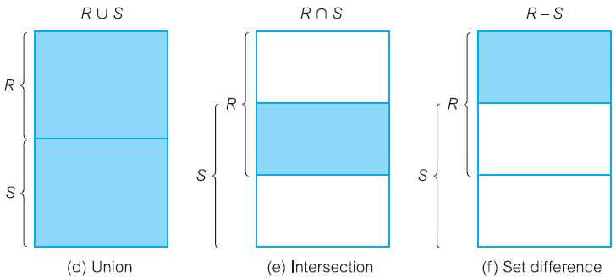

Slide 16
Union Operation
Example 5.3 Union operation
List all cities where there is either a branch office or a property for rent.
πcity(Branch) U πcity(PropertyForRent)

Slide 17
Set difference
Example 5.4 Set difference operation
List all cities where there is a branch office but no properties for rent.
πcity(Branch) - πcity(PropertyForRent)

Slide 18
Intersection
Example 5.5 Intersection operation
List all cities where there is both a branch office and at least one property for rent.
πcity(Branch) ∩ πcity(PropertyForRent)

Slide 19
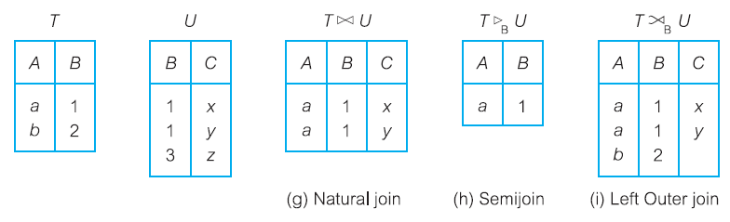
Joins

Slide 20
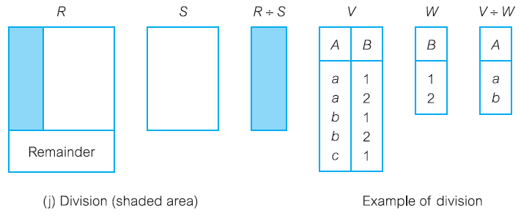
Division

Slide 21
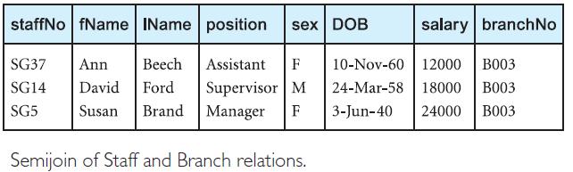
List complete details of all staff who work at the branch in Glasgow

Slide 22
Join Operations
we want only combinations of the Cartesian product that satisfy certain conditions
use a Join operation instead of the Cartesian product operation
The Join operation, which combines two relations to form a new relation
One of the essential operations in the relational algebra
Join is a derivative of Cartesian product
Equivalent to performing a Selection operation,
Using the join predicate as the selection formula, over the Cartesian product of the two operand relations
Difficult to implement in RDBMS

Slide 23
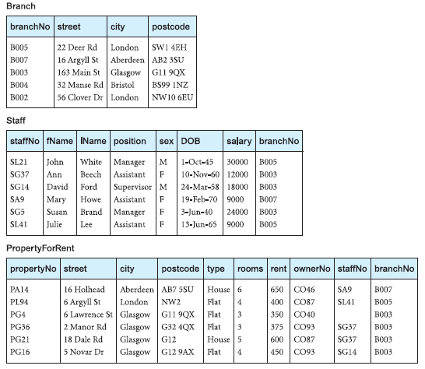

Slide 24
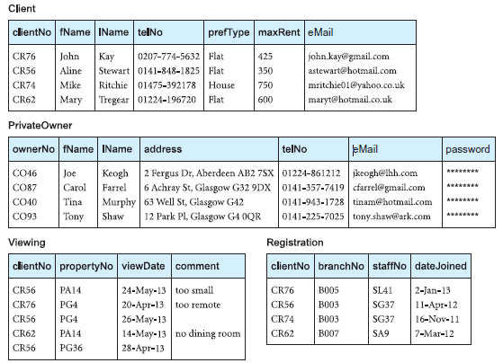

Slide 25
Join Operations
Theta join
Equijoin (a particular type of Theta join)
Natural join
Outer join
Semijoin

Slide 26

Theta join

Slide 27
Equijoin
When equal sign is used as predicate its called equijoin.

Slide 29
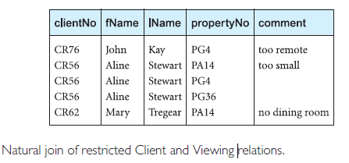
Natural join One occurrence of each common attribute is eliminated from the result

Slide 30
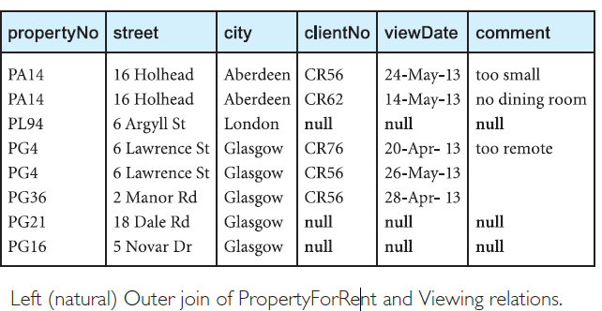
Outerjoin Produce a status report on property viewings.

Slide 31
Semijoin List complete details of all staff who work at the branch in Glasgow.

Slide 32
Quiz:
Convert the following statement to relational statement:
List all the staff salary greater than 10,000$

Slide 33
Properties of a relation:
Atomicity
Non-redundant tuples
Each field/attribute/column with unique name
Entity name must be unique in database
Consistency
All the values in the same field must be from the same field.
Order is non-significant

