Slide 1
Database Analysis and the DreamHome Case Study
Reading
Chapter 11
Pages 375-386

Slide 2
Fact-finding
The formal process of using techniques such as interviews and
questionnaires to collect facts about systems, requirements, and
preferences.

Slide 3
When Are Fact-Finding Techniques Used?
Crucial to the stages of the lifecycle:
including the database planning
system definition
requirements collection
Analysis
Database Design
DBMS selection
Operational maintenance
System tuning
Performance improvement

Slide 4
What Facts Are Collected?
See Table 11.1 page number 377 on your text book

Slide 5
Fact-finding techniques
Examining documentation;
Interviewing;
Observing the enterprise in operation;
Research;
Questionnaires.

Slide 6
Examining documentation
To understand the current system of an organization, following documents are examine:
Forms
Reports
Files associated with the current system
we can quickly gain some understanding of the system. Read Table 11.2 for reference.

Slide 7
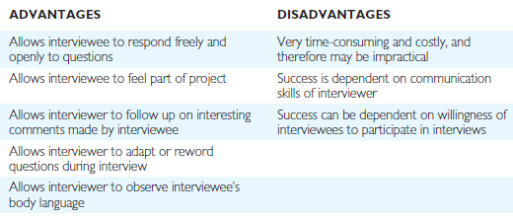
Interviewing
Most commonly used and normally the most useful technique
Face to face interaction

Slide 8
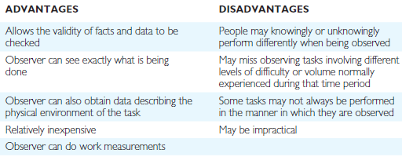
Observing the enterprise in operation
Most effective fact-finding techniques
useful when the validity of data collected through other methods is in question

Slide 9
Research
Technique is to research the application and problem.
A few resources to research:
Computer trade journals,
Reference books,
Internet (including user groups and bulletin boards)
Relevant blogs
Get information on how others have solved similar problems
Software packages exist to solve or even partially solve the problem.

Slide 10
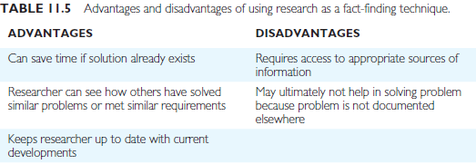

Slide 11
Questionnaires
Conduction of surveys through questionnaires.
Facts to be gathered from a large number of people
Types of Questionnaire:
Free-format questions/open questions – user has multiple options; he can also give explanatory answer.
Fixed-format questions/closed questions – user can only reply from available options like multiple choice questions or true/false.

Slide 12
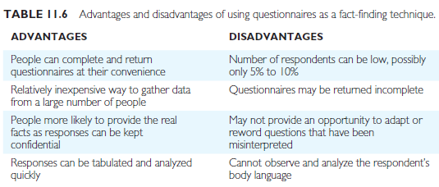

Slide 13
The DreamHome Case Study—An Overview of the Current System
Opened in 1992 in Glasgow in the UK
Now has several offices in most of the main cities of the UK
Increasing amount of paperwork
Need more Administrative staff
Information communication is poor even in a same city.
Also made a lot of mistakes
Director decides to go for Database system solution

Slide 14
DreamHome specializes in property management
Intermediate role between owners and clients
Currently has about 2000 staff working in 100 branches
Staff including a Manager, Supervisors, and Assistants

Slide 15
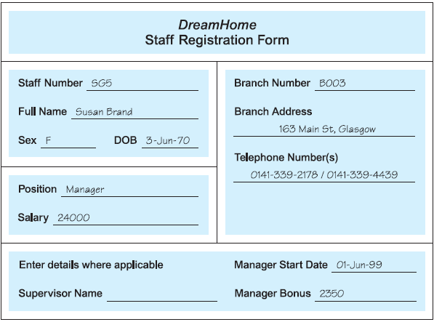

Slide 16
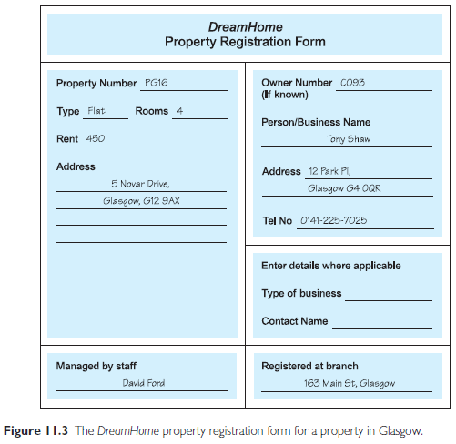

Slide 17
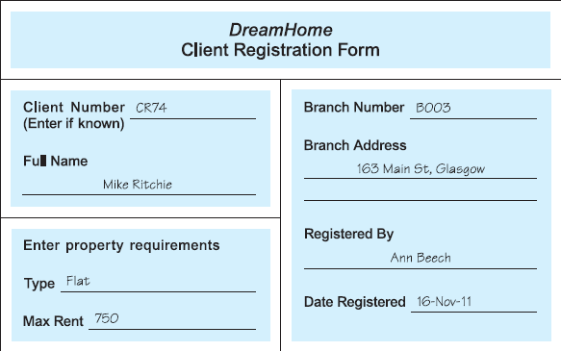

Slide 18
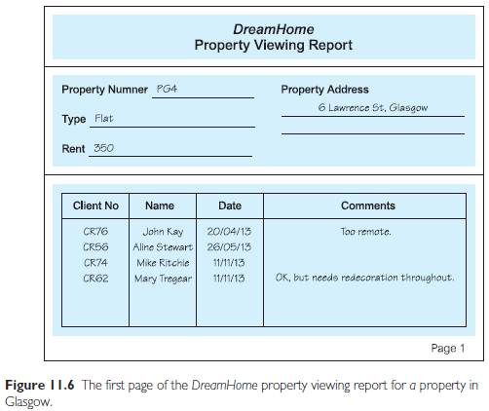

Slide 19
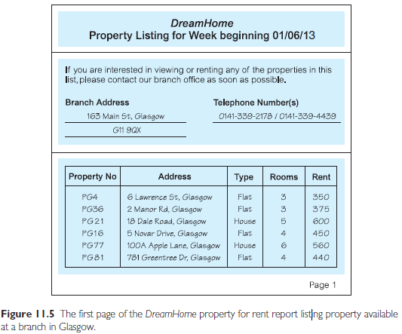

Slide 21
