Slide 1
Introduction to JavaFX
By
Nadeem Ghafoor Chaudhry

Slide 2
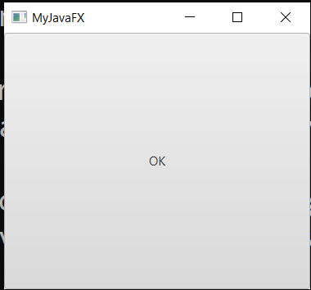
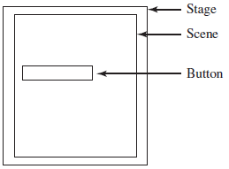
import javafx.application.Application;
import javafx.scene.Scene;
import javafx.scene.control.Button;
import javafx.stage.Stage;
public class MyJavaFX extends Application {
@Override // Override the start method in the Application class
public void start(Stage primaryStage) {
// Create a button and place it in the scene
Button btOK = new Button("OK");
Scene scene = new Scene(btOK, 200, 250);
primaryStage.setTitle("MyJavaFX"); // Set the stage title
primaryStage.setScene(scene); // Place the scene in the stage
primaryStage.show(); // Display the stage
}
/**
* The main method is only needed for the IDE with limited
* JavaFX support. Not needed for running from the command line.
*/
public static void main(String[] args) {
launch(args);
}
}

Slide 3
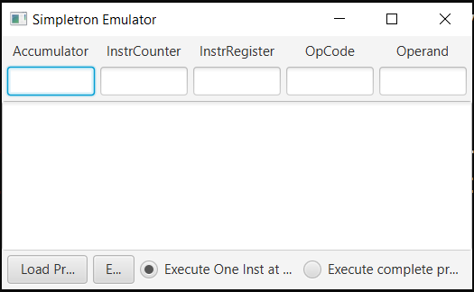
This window is known as Stage
The root node of this scene graph is BorderPane, a layout container that arranges the other nodes
The Stage contains a scene graph of nodes
Each of the JavaFX components in this GUI is a node in the Scene graph

Slide 4
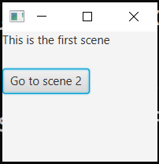
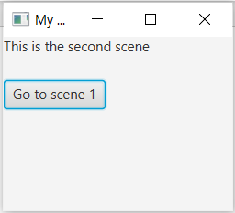
A Stage can have multiple Scenes
public class MultiSceneGUI extends Application {
Scene scene1, scene2;
@Override
public void start(Stage primaryStage) {
primaryStage.setTitle("My First JavaFX GUI");
//Scene 1
Label label1= new Label("This is the first scene");
Button button1= new Button("Go to scene 2");
button1.setOnAction(new EventHandler<ActionEvent>() {
@Override
public void handle(ActionEvent event) {
primaryStage.setScene(scene2);
}
});
VBox layout1 = new VBox(20);
layout1.getChildren().addAll(label1, button1);
scene1= new Scene(layout1, 300, 250);

Slide 5
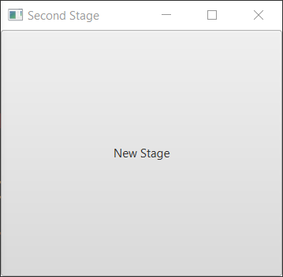
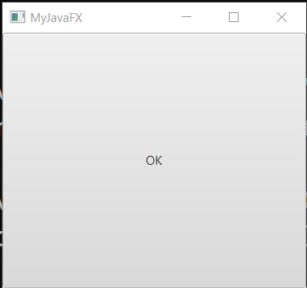
An application have multiple Stages
public class MultipleStageDemo extends Application
{
@Override // Override the start method in the Application class
public void start(Stage primaryStage)
{
// Create a scene and place a button in the scene
Scene scene = new Scene(new Button("OK"), 200, 250);
primaryStage.setTitle("MyJavaFX"); // Set the stage title
primaryStage.setScene(scene); // Place the scene in the stage
primaryStage.show(); // Display the stage
Stage scondaryStage = new Stage(); // Create a new stage
scondaryStage.setTitle("Second Stage"); // Set the stage title
// Set a scene with a button in the stage
scondaryStage.setScene(new Scene(new Button("New Stage"), 200, 250));
scondaryStage.show(); // Display the stage
}
}

Slide 6
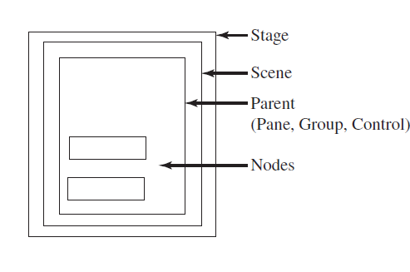

Slide 7
Control : Lable, TextField, Button,…..
Pane : HBox, Vbox, FlowPane, BorderPane, GridPane, StackPane, …… (layout containers that arrange the other nodes)
Group : Lable, TextField, Button…. (A JavaFX Group component is typically used to apply some effect or transformation to a set of controls as a whole - as a group)

Slide 8
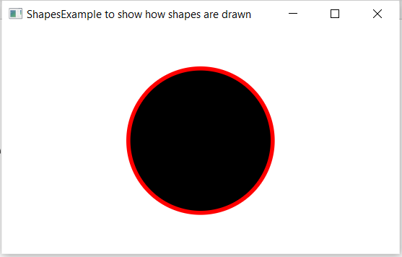
We can also draw geometric shapes like Circle, Rectangle, Ellipse, Arc, Poloygon etc.

Slide 9
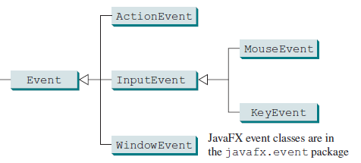
Events and Event Sources
An event is an object created from an event source. Firing an event means to create an event and delegate the handler to handle the event.

Slide 10
When you run a Java GUI program, the program interacts with the user and the events drive its execution. This is called event-driven programming. An event can be defined as a signal to the program that something has happened.

Slide 11
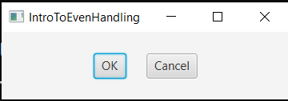
The component that creates an event and fires it is called the event source object, or simply source object or source component.
Event Source objects

Slide 12
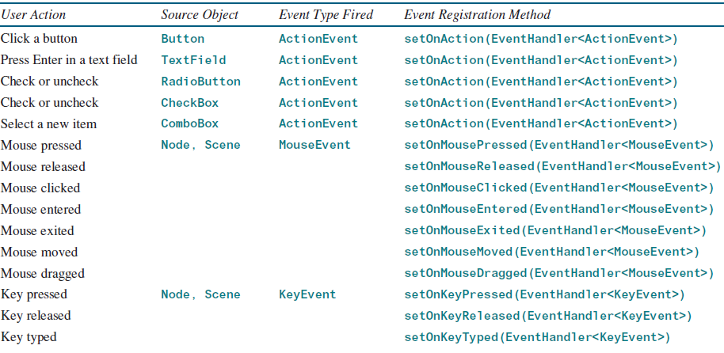

Slide 13
Registering Handlers and Handling Events
A handler is an object that must be registered with an event source object and it must be an instance of an appropriate event-handling interface.
Java uses a delegation-based model for event handling: A source object fires an event, and an object interested in the event handles it. The latter object is called an event handler or an event listener.

Slide 14
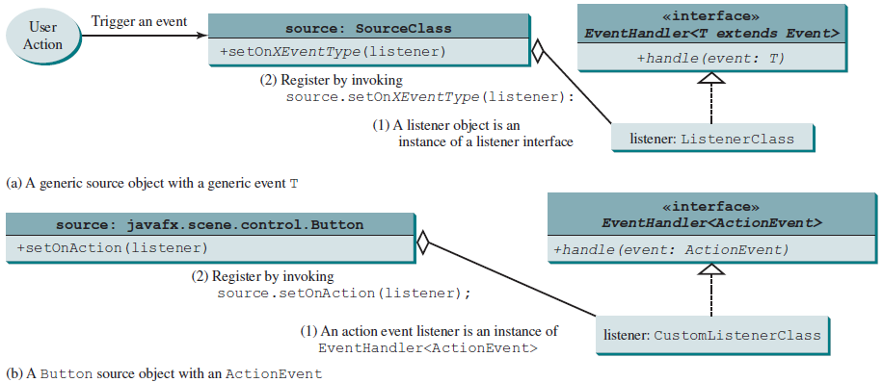

Slide 15
Inner Classes
An inner class, or nested class, is a class defined within the scope of another class.
InnerClassDemo
Class Pearl is an inner class of class Oyster because Pearl is only viable in an oyster. Pearl can access private data members of Oyster which is not possible in any other way.

Slide 16
Anonymous Inner-Class Handlers
An anonymous inner class is an inner class without a name. It combines defining an inner class and creating an instance of the class into one step.
MultiSceneGUI.java contains example of anonymous inner-class

Slide 17
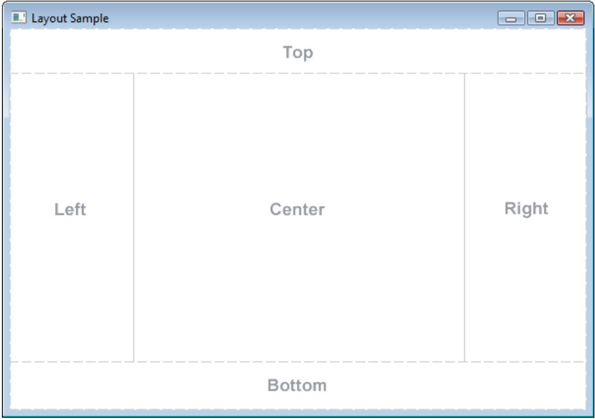
public class BorderPane extends Pane

