Slide 1

CSC322 - Operating Systems
CLO:<4> Bloom Taxonomy Level<Analyzing>
Instructor: Nadeem Ghafoor Ch
Topic: Google File System
Assignment: 04
Name: Mr. Aoun-Haider
ID: FA21-BSE-133
Section: A

Slide 2
Introduction:
Google file system is developed to meet requirements related to data processing needs. It inherits many of the previous model features as of AFS (Andrew file system). It focuses on reliability, availability, scalability & performance.
Different problems to tackle:
Component failure
Huge file size
File mutation
Flexibility for co-designing applications

Slide 3
Assumptions:
System is built from inexpensive commodity components
System stores modest number of large files
Partial and random read (hundreds of KB and 1MB)
Workloads have many large, sequential writes that append data to file
Concurrent append
High bandwidth

Slide 4
Interface:
Supports all traditional file operations like creating, deleting file etc.
It also supports two other operations append write & snapshot.

Slide 5
Architecture:
GFS has three major entities: client (application), master server and chunk server
File is divided into equal size chunks of 64MB
Master maintains all file system meta data
Chunk server contains actual payload whose location is stored in master
Master and client communicates by sharing Heartbeat messages
Client requests for file and master returns corresponding file location, chunk server to which lease was assigned and handle

Slide 6
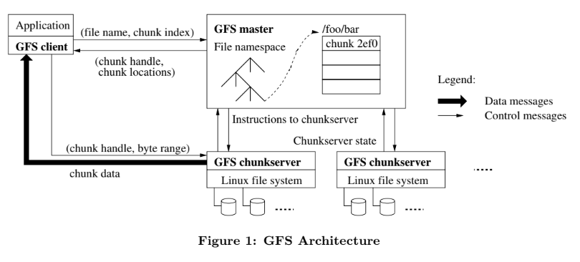
Single Master:

Slide 7
Cont.
First, using the fixed chunk-size, the client translates the file name and byte offset specified by the application into a chunk-index within the file. Then, it sends the master a request containing the file name and chunk index. The master replies with the corresponding chunk handle and locations of the replicas. The client caches this information using the file name and chunk-index as the key.

Slide 8
Chunk Size:
64MB
Large chunk size can cause internal fragmentation but it is avoided by lazy space allocation. Only allocate space of requested size. Client can cache the information to avoid sending request to master again
Hotspot occurs in batch queueing system.

Slide 9
Meta Data:
Three main components: the file and chunk namespace, the mapping from file to chunks, and the location of each chunk replica.
Master does not store meta data persistently
When again power on, it asks each chunk server for their available chunks and will store their locations

Slide 10
Chunk Location:
The master does not keep chunk's location details all the time. When it starts for next time, it asks each individual chunk-server about their available chunks and store their location in a table.

Slide 11
Operation Log:
Maintains all transactions/operations performed in a group
Place multiple copies of log on different remote clients
Roll back to come again to the consistent state
Create checkpoint to create snapshot of current all operations in a separate thread and flush the log to save time (Compact BTree)
Improves availability
Helps in automatic recovery/troubleshooting

Slide 12
Guarantee by GFS:
Atomicity
Locking mechanism
Same data of all replicas (consistent view)
If changes are applied, same result will be available on all replicas
If changes are not available -> roll back and check log file and apply all the stored sequence of operations again
Handles stale copies -> if old copy (replica which is not updated currently) is read, it will be refreshed on next read
Performs check-summing for data integrity & corruption
Master and chunk-server handshakes to check for failed server regularly
If all replicas corrupted before validation, errors are notified to corresponding applications

Slide 13
Implication for Application:
Appends instead of overwrites
Checkpointing
Self validating records
Handling concurrent appends which causes redundancy
Filtering duplicates
Google has also provided code for handling checksuming which applications under google can use

Slide 14
System interaction:
Mutation -> modification in file by overwriting or appending
leases -> locks to ensure synchronization
Master assigns chunk lease to one of the replica which defines mutation order
Lease management: Lease timeout is 1 minute but can take more time from master if more mutations are required. Master can revoke/stop lease from a replica if file is renamed
If master loses, it assigns lease to another replica
Consistent order is maintained by following order defined by primary (having lease assigned by master server)
Client sends request to master, and it reply by sending the replica having lease (primary). Client sends data to all replicas.
Each replica store data temporarily and tells the primary node that they successfully receive the data. Primary will assign a unique number to each operation, and they will be applied from lowest to highest id and details of sequence will be shared with other secondary replicas. If some error occurs in any of the node, whole process will be repeated.

Slide 15
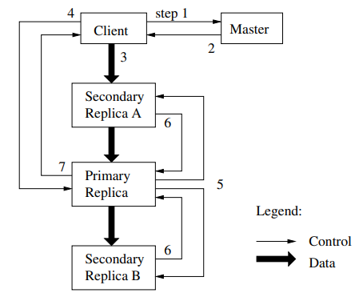

Slide 16
Data flow:
Decoupling control and data flow:
Data flow is how much data is sent. Maximum chunk size is 64MB and if data is more to send, it will be fragmented
Control flow determine in which manner communication will be occur. How much bandwidth will be utilized.
For efficient use of network, send all the data to only one nearest replica which forward the data to its nearest neighbors
Full bandwidth of the channel will be utilized.
Each chunk-server will receive data and send already received data to minimize delays.
Transfer rate. 1MB in 80 milliseconds
This is like sending a photo album to friends in a very short time.

Slide 17
Atomic record append:
Appending data at the same time will result in inconsistent result.
This operation ensures that append operation will be atomic (all vs none)
GFS not guarantees exact copy of data in all replicas
Portion of file where data written is successfully acknowledged, will be considered as "defined".
The client sends the data to all the copies of the last part of the file.
It then asks the primary (the main server) if it's okay to add this data.
The primary checks if adding this data would make the file too big. If it would, it prepares for the next chunk and asks others to do the same.
If the data fits, the primary adds it and tells the others to do the same, then says "success" to the client.

Slide 18
Snapshot:
Copy of the meta is created instantly while copy of chunk server data is not created until it is not modified (Copy on write COW).
Master server revokes all the leases from chunk-servers before creating snapshot.
Clients asks for chunks and master finds chunk having lease holder and shared among snapshot, create a new copy and send its location
Revoke lease
log operation
duplicate metadata
shared chunks
handling write requests
local copy creation
normal write operation

Slide 19
Namespace management:
Snapshot takes long time and master server can go to long delay
GFS not maintains per directory data structure
Maps filenames to their corresponding pathnames
Aliases are not supported (like hard & soft links in Unix)
Each file or directory has a read-write lock
Locks ensures proper synchronization
File creation requires a read-lock (multiple files can be created simultaneously
Locks are assigned lazily (only when needed)
Locks are revoked when not in use
Deadlocks are prevented by acquiring locks in consistent order

Slide 20
Replica placement:
Spread across multiple machines and racks (set of machines closely connected i.e., data centers)
Increase availability
Tradeoff for write traffic

Slide 21
Creation, re-replication, rebalancing:
When master creates a chunk, it decides where to place the initial replicas based on several factors
having more disk space and which will equalize disk utilization
Limits number of chunks creation on each chunk-server
Re-replication (increased number of replicas) when users required number of chunks more than available
Prioritization is based on replicas having more missing chunks
Master server selects higher priority chunk
Master periodically re-balance the chunk server to perform load balancing to equalize disk utilization
Chunks are removed from chunk-server first where space is less

Slide 22
Garbage collection:
When chunk is deleted, its memory is not reclaimed but file name of corresponding chunk is renamed with time stamp and set to hidden. Garbage collector regularly checks the free resource, it finds those hidden files and delete them, and chunk server sends HeartBeat message to master node which further delete that chunk entry and its corresponding metadata from table. It saves resources but produces delay.
Provides data recovery for accidental deletion for configured timeline. Can degrade performance for tight storage requirements.
User can specify the period after which regular garbage collector is invoked. They can also specify in which directory replication is not required and, they can define policy which can immediately free space.

Slide 23
Stale replica detection:
Stale replica (old copies) are detected by assigning each replica a version number. When a new operation is applied, version number is increased to make nodes UpToDate. When master node assigns lease, it also determine version number of each replica. If an old version is detected, it is deleted via regular garbage collection. This helps to place replica in consistent and UpToDate state. Master also sends request chunk with its version number and client application keep verifies this version number to get UpToDate information.

Slide 24
Fast recovery:
Both the master and the chunk-server are designed to restore their state and restart within seconds, regardless of how they terminated.
There is no distinction between normal and abnormal termination; servers can be routinely shut down by killing the process.

Slide 25
Chunk Replication:
Each chunk is replicated on multiple chunk-servers on different racks to ensure fault tolerance.
Users can specify different replication levels for different parts of the file namespace (default is three).

Slide 26
Master Replication:
The master state is replicated for reliability, including its operation log and checkpoints, which are replicated on multiple machines.
A mutation to the state is considered committed only after its log record has been flushed to disk locally and on all master replicas. "Shadow" masters provide read-only access to the file system even when the primary master is down, lagging slightly behind the primary. Shadow masters enhance read availability for files that are not actively mutated or for applications that can tolerate slightly stale results.

Slide 27
Data Integrity:
GFS ensures data integrity by employing checksums to detect corruption of stored data. Each chunk-server breaks a chunk into 64 KB blocks, with each block having a corresponding 32-bit checksum. These checksums are kept in memory and stored persistently with logging, separate from user data.
Verification on read
Propagation control -> dirty replica must not exceed to other chunk-servers
idle period verification
What if checksum is not properly calculated (other replica will be rejected and later deleted by garbage collector by master server)

Slide 28
Diagnostic tools:
GFS utilizes extensive and detailed diagnostic logging for problem isolation, debugging, and performance analysis.
Servers in GFS generate logs that record significant events (e.g., chunk-servers going up and down) and all RPC (Remote Procedure Call) requests and replies.
Diagnostic logs contain information about events and all RPC interactions, excluding file data being read or written.
These logs can be freely deleted without affecting the correctness of the system, but efforts are made to retain them as long as space permits. The performance impact of logging is minimal and justified by the benefits gained from diagnostic information.

Slide 29
Conclusion:
The Google File System demonstrates the qualities essential for supporting large-scale data processing workloads on commodity hardware. While some design decisions are specific to our unique setting, many may apply to data processing tasks of a similar magnitude and cost consciousness.
We started by reexamining traditional file system assumptions in light of our current and anticipated application workloads and technological environment. Our observations have led to radically different points in the design space.
We treat component failures as the norm rather than the exception, optimize for huge files that are mostly appended to (perhaps concurrently) and then read (usually sequentially), and both extend and relax the standard file system interface to improve the overall system.

Slide 30
Thank You

