Slide 1
Simulation
Aoun-Haider
FA21-BSE-133@cuilahore.edu.pk

Slide 2
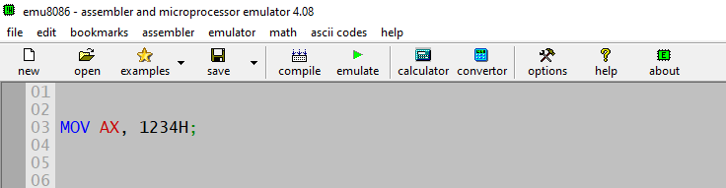
Mov instruction:
It is used to move data from one register to other

Slide 3
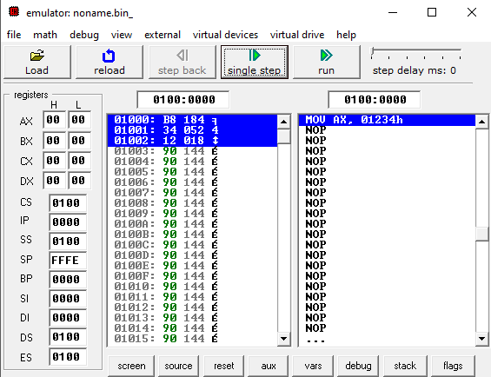
Emulating instruction:
Logical address
CS:IP

Slide 4
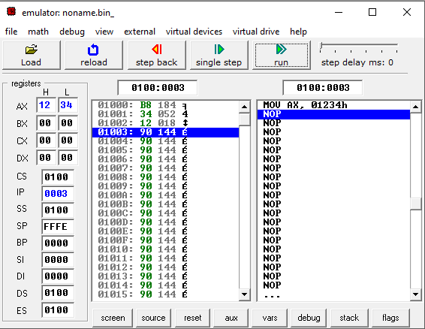
After executing instruction:

Slide 5
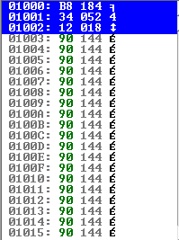
Binary representation:
1st column is the logical base address of each instruction
2nd column is hexadecimal representation of each chunk of
Code
3rd column is its value and last one is ascii symbol
So, the original code is:
MOV AX, 1234H
Hexadecimal representation:
B8 34 12
Decimal representation:
184 052 018
Binary representation:
10111000 00110100 00010010

Slide 6
Physical address in Code Segment:
CS = 0100
IP = 0003
Logical address is 20bit.
Physical address = Segment base address: offset
CS:IP
CS*10 + IP
0100*10 + 0003
1003

Slide 7
Other method:
Algorithm:
1- Start with CS
2- insert 0 as the least significant digit
3- Add IP
Example:
CS = 1980H IP = 78FEH
1980
19800
78FE
210FE
So, 210FE is the physical address!!

Slide 8
Quiz:
If CS=24F6H and IP=634AH,
Determine:
a) The logical address
b) The offset address
c) The physical address
d) The lower range of the code segment
e) The upper range of the code segment

Slide 9
Solution:
24F6:634A
634A
24F60 + 634A = 2B2AA
24F6:0000
24F6:FFFF

Slide 10
Addressing in data segment:
The area of memory allocated strictly for data is called data segment.
Data segment contains variables containing single values and arrays of values, where code segment only contain program instructions.
Logical Address in Data Segment is represented by using segment address in DS register and Offset Address in BX, SI or DI registers.
DS:BX
DS:SI
DS:DI
At any time three locations in the data segment are pointed with DS:BX, DS:SI and DS:DI respectively.

Slide 11
Quiz
If DS=7FA2H and the offset is 438EH, determine:
The physical address
The lower range of the data segment
The upper range of the data segment
Show the logical address

Slide 12
Solution:
The Physical address is; 7FA20+438E = 83DAE
The lower range: 7FA20+0000= 7FA20
The upper range: 7FA20+FFFF = 8FA1F
The logical address is; 7FA2:438E

Slide 13
Logical address vs Physical address:
Logical address and physical address are two different concepts related to memory management in computer systems.
Logical address: A logical address is a virtual address that is used by a program or process running on a computer system. It is generated by the CPU (Central Processing Unit) as part of the memory addressing mechanism. A logical address represents a location in the virtual address space of a process, and it is typically defined as an unsigned integer.
Physical address: A physical address, on the other hand, refers to an actual location in the physical memory (RAM) of a computer system. It represents a unique location where data is stored in the physical memory chips.
The key difference between logical and physical addresses is that a logical address is generated by the CPU and used by a process as part of its memory addressing, while a physical address corresponds to an actual physical location in the physical memory.
To translate a logical address to a physical address, a computer system uses a memory management unit (MMU) or a similar hardware component. The MMU maps logical addresses to physical addresses by translating them through a process known as memory address translation. This allows the operating system to manage and control how processes access memory, including features such as virtual memory, memory protection, and memory sharing.

Slide 14
Accessing values from address:
MOV AX,35F3H ;load 35F3H into AX
MOV [1500],AX ; copy contents of AX to offset 1500H
Square brace is used to access specific address.
‘h’ at the end of values represents hexadecimal format.
Assembly language is case insensitive.

Slide 15
Auxiliary flag:
Blue – upper nibble
Brown- lower nibble
Red - carry
It is set to true if result of lower significant nibble fall towards upper significant nibble.
This helps to check whether carry exist from one nibble to other or not.
For example, if we add two numbers 00001111 & 00000001
00001111
+00000001
------------------
00010000
------------------
In this case, auxiliary flag set to true.
If we add 00001111 and 00001111, resulting 00011110. No carry from lower nibble to upper nibble exist and auxiliary flag sets to zero.

Slide 16
Parity flag:
Parity helps us to check whether number is even or odd or number of bits are even or odd. If least significant bit is 1, number is odd other wise even.
Parity flag sets to true when number is even (LSB is zero) and false in opposite case.

Slide 17
Digital vs microcomputers:
The main difference between a digital computer and a microcomputer lies in their size, complexity, and processing capabilities.
Size: Digital computers are typically larger and more complex, often consisting of multiple cabinets or racks containing various components such as processors, memory modules, storage devices, and input/output (I/O) devices. They are usually designed for heavy-duty computing tasks and are commonly found in data centers or large-scale computing environments.
On the other hand, microcomputers, also known as personal computers (PCs), are smaller in size and are designed for individual use. They typically consist of a single unit that integrates a processor, memory, storage, and I/O devices into a single enclosure, making them more compact and portable. Microcomputers are commonly used for general-purpose computing tasks, such as office productivity, gaming, and entertainment.

Slide 18
Cont.
Complexity: Digital computers are generally more complex in terms of their architecture, design, and capabilities. They may have multiple processors, large amounts of memory, and high-speed I/O interfaces, and are capable of handling massive amounts of data and complex computations. Digital computers are often used in scientific research, engineering, and other specialized applications that require high computing power and advanced capabilities.
Microcomputers, on the other hand, are typically less complex, with a single processor, moderate amounts of memory, and standard I/O interfaces. They are designed for more general-purpose computing tasks and may not have the same level of processing power or advanced features as digital computers.

Slide 19
Cont.
Processing Capabilities: Digital computers are generally designed for high-performance computing and can handle complex computations, large datasets, and high-speed data processing. They are typically optimized for specific tasks, such as scientific simulations, weather modeling, or big data analytics, and may require specialized software and hardware configurations.
Microcomputers, on the other hand, are designed for more general-purpose computing tasks and are typically used for everyday computing needs, such as word processing, web browsing, multimedia playback, and basic gaming. While microcomputers have become increasingly powerful over the years, they may not have the same level of processing capabilities or scalability as digital computers.
In summary, the main differences between digital computers and microcomputers lie in their size, complexity, and processing capabilities. Digital computers are larger, more complex, and optimized for high-performance computing tasks, while microcomputers are smaller, less complex, and designed for general-purpose computing tasks for individual use.

Slide 20
Register spilling:
If our program contains more amount of data (variables) then number of registers, then remaining will be stored in ram temporarily and accessed only when required dynamically.
Register spilling can impact the performance of a program, as accessing data from main memory is typically slower than accessing data from registers. Therefore, compiler optimizations often attempt to minimize register spilling by carefully managing the usage of registers and minimizing the need to store data in memory. Techniques such as register allocation, register renaming, and instruction scheduling are commonly used to optimize register usage and minimize register spills, with the goal of improving program performance by reducing memory access overheads.

Slide 21
External vs internal commands:
In the context of computer operating systems, external and internal commands refer to different types of commands that can be executed by a command-line interface or a shell.
External commands: External commands are standalone programs or executable files that are stored in separate files on disk and are loaded into memory when they are executed. These commands are typically provided by the operating system or third-party software, and they are invoked from the command line by typing their names followed by any arguments or options. Once executed, the external command performs a specific task or operation and returns the result to the user.

Slide 22
Cont.
Example: In the Windows command prompt (CMD), commands such as "dir" (to list directory contents), "copy" (to copy files), and "ping" (to test network connectivity) are external commands. These commands are stored as separate executable files on the disk, and when they are executed, they are loaded into memory and perform their respective tasks.
Internal commands: Internal commands, also known as built-in commands, are commands that are part of the command-line interpreter or shell itself, and they are executed directly by the command-line interpreter without the need to load separate executable files. These commands are typically smaller in size and are designed to perform basic operations or provide utility functions.

Slide 23
Cont.
Example: In the Windows command prompt (CMD), commands such as "cd" (to change the current directory), "echo" (to display text), and "type" (to display the contents of a file) are internal commands. These commands are part of the CMD interpreter itself, and they are executed directly by the CMD interpreter without the need to load separate external executable files.
The key difference between external and internal commands is that external commands are standalone programs stored in separate executable files, while internal commands are built-in functions of the command-line interpreter or shell itself. External commands provide more complex functionality and are typically provided by the operating system or third-party software, while internal commands provide basic operations and utility functions directly within the command-line interface or shell.

Slide 24
NEG
;Negation example
MOV AX, 1004h
NEG AX
What will be the value of AX in 1st and 2nd iteration??

Slide 25
Solution:
1st iteration: AX = 1004, AH = 10, AL = 04
Convert each digit to 4 bit and represent in binary and take 2’s complement:
1 = 0001, 0 = 0000, 0 = 0000, 4 = 0100
One’s complement: 1110 1111 1111 1011
2’s complement: 1110 1111 1111 1100
Now again convert to hexadecimal
EFFC
2nd iteration: AX = EFFC, AH = EF, AL = FC

