Slide 1
Edit Distance
Michael T. Goodrich
University of California, Irvine
Most slides adapted from slides by Dan Jurafsky, Stanford University

Slide 2
How similar are two strings?
Spell correction
The user typed “graffe”
Which is closest?
graf
graft
grail
giraffe
Computational Biology
Align two sequences of nucleotides
Resulting alignment:
AGGCTATCACCTGACCTCCAGGCCGATGCCC
TAGCTATCACGACCGCGGTCGATTTGCCCGAC
-AGGCTATCACCTGACCTCCAGGCCGA--TGCCC---
TAG-CTATCAC--GACCGC--GGTCGATTTGCCCGAC
Also for Machine Translation, Information Extraction, Speech Recognition

Slide 3
Edit Distance
The minimum edit distance between two strings
Is the minimum number of editing operations
Insertion
Deletion
Substitution
Needed to transform one into the other
Matches are not included in the count.

Slide 4
Edit Distance
Example: transform vintner to writers
vintner replace v with w → wintner
wintner insert r after w → wrintner
wrintner match i → wrintner
wrintner delete n → writner
writner match t → writner
writner delete n → writer
writer match e → writer
writer match r → writer
writer insert s → writers

Slide 5

Minimum Edit Distance
Two strings and their alignment:

Slide 6
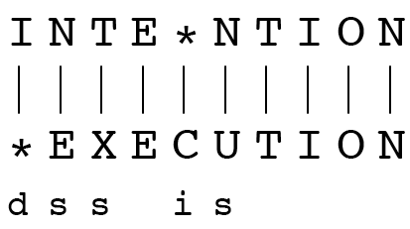
Minimum Edit Distance
If each operation has cost of 1
Distance between these is 5
If substitutions cost 2 (Levenshtein)
Distance between them is 8

Slide 7
Alignment in Computational Biology
Given a sequence of bases
An alignment:
Given two sequences, align each letter to a letter or gap
AGGCTATCACCTGACCTCCAGGCCGATGCCC
TAGCTATCACGACCGCGGTCGATTTGCCCGAC
-AGGCTATCACCTGACCTCCAGGCCGA--TGCCC---
TAG-CTATCAC--GACCGC--GGTCGATTTGCCCGAC

Slide 8
Uses of Edit Distance in NLP
Evaluating Machine Translation and speech recognition
R Spokesman confirms senior government adviser was appointed
H Spokesman said the senior adviser was appointed
S I D I

Slide 9
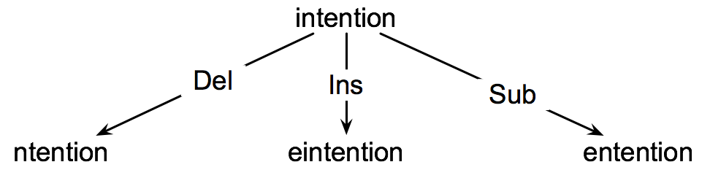
How to find the Min Edit Distance?
Searching for a path (sequence of edits) from the start string to the final string:
Initial state: the word we’re transforming
Operators: insert, delete, substitute
Goal state: the word we’re trying to get to
Path cost: what we want to minimize: the number of edits

Slide 10
Minimum Edit Distance as Search
But the space of all edit sequences is huge!
We can’t afford to navigate naïvely
Lots of distinct paths wind up at the same state.
We don’t have to keep track of all of them
Instead, we use dynamic programming, in a way very similar to the LCS problem…

Slide 11
Defining Edit Distance Parameters
For two strings
X of length n
Y of length m
We define D(i,j)
the edit distance between X[1..i] and Y[1..j]
i.e., the first i characters of X and the first j characters of Y
The edit distance between X and Y is thus D(n,m)

Slide 12
Dynamic Programming for Edit Distance
Dynamic programming: A tabular computation of D(n,m)
Solving problems by combining solutions to subproblems.
Bottom-up
We compute D(i,j) for small i,j
And compute larger D(i,j) based on previously computed smaller values
i.e., compute D(i,j) for all i (0 < i < n) and j (0 < j < m)
Notice that we can solve D(i,j) for all combination of lengths of prefixes of X and Y.

Slide 13
Defining Min Edit Distance (Levenshtein)
Initialization
D(i,0) = i
D(0,j) = j
Recurrence Relation:
For each i = 1…M
For each j = 1…N
D(i-1,j) + 1
D(i,j)= min D(i,j-1) + 1
D(i-1,j-1) + 2; if X(i) ≠ Y(j)
0; if X(i) = Y(j)
Termination:
D(N,M) is distance

Slide 14
The Edit Distance Table
Given two strings: INTENTION and EXECUTION, determine the minimum edit distance using dynamic programming.
 | # | E | X | E | C | U | T | I | O | N
# | 0 | 1 | 2 | 3 | 4 | 5 | 6 | 7 | 8 | 9
I | 1
N | 2
T | 3
E | 4
N | 5
T | 6
I | 7
O | 8
N | 9

Slide 15
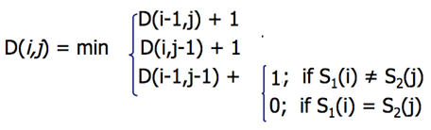
The Edit Distance Table
Given two strings: INTENTION and EXECUTION, determine the minimum edit distance using dynamic programming.
 | # | E | X | E | C | U | T | I | O | N
# | 0 | 1 | 2 | 3 | 4 | 5 | 6 | 7 | 8 | 9
I | 1
N | 2
T | 3
E | 4
N | 5
T | 6
I | 7
O | 8
N | 9

Slide 16
The Edit Distance Table
Given two strings: INTENTION and EXECUTION, determine the minimum edit distance using dynamic programming.
 | # | E | X | E | C | U | T | I | O | N
# | 0 | 1 | 2 | 3 | 4 | 5 | 6 | 7 | 8 | 9
I | 1
N | 2
T | 3
E | 4
N | 5
T | 6
I | 7
O | 8
N | 9

Slide 17
The Edit Distance Table
Given two strings: INTENTION and EXECUTION, determine the minimum edit distance using dynamic programming.
 | # | E | X | E | C | U | T | I | O | N
# | 0 | 1 | 2 | 3 | 4 | 5 | 6 | 7 | 8 | 9
I | 1 | 1 | 2 | 3 | 4 | 5 | 6 | 6 | 7 | 8
N | 2 | 2 | 2 | 3 | 4 | 5 | 6 | 7 | 7 | 7
T | 3 | 3 | 3 | 3 | 4 | 5 | 5 | 6 | 7 | 8
E | 4 | 3 | 4 | 3 | 4 | 5 | 6 | 6 | 7 | 8
N | 5 | 4 | 4 | 4 | 4 | 5 | 6 | 7 | 7 | 7
T | 6 | 5 | 5 | 5 | 5 | 5 | 5 | 6 | 7 | 8
I | 7 | 6 | 6 | 6 | 6 | 6 | 6 | 5 | 6 | 7
O | 8 | 7 | 7 | 7 | 7 | 7 | 7 | 6 | 5 | 6
N | 9 | 8 | 8 | 8 | 8 | 8 | 8 | 7 | 6 | 5

Slide 18
Computing alignments
Edit distance isn’t sufficient
We often need to align each character of the two strings to each other
We do this by keeping a “backtrace”
Every time we enter a cell, remember where we came from
When we reach the end,
Trace back the path from the upper right corner to read off the alignment

Slide 19
The Edit Distance Table
Given two strings: INTENTION and EXECUTION, determine the minimum edit distance using dynamic programming.
 | # | E | X | E | C | U | T | I | O | N
# | 0 | 1 | 2 | 3 | 4 | 5 | 6 | 7 | 8 | 9
I | 1 | 1 | 2 | 3 | 4 | 5 | 6 | 6 | 7 | 8
N | 2 | 2 | 2 | 3 | 4 | 5 | 6 | 7 | 7 | 7
T | 3 | 3 | 3 | 3 | 4 | 5 | 5 | 6 | 7 | 8
E | 4 | 3 | 4 | 3 | 4 | 5 | 6 | 6 | 7 | 8
N | 5 | 4 | 4 | 4 | 4 | 5 | 6 | 7 | 7 | 7
T | 6 | 5 | 5 | 5 | 5 | 5 | 5 | 6 | 7 | 8
I | 7 | 6 | 6 | 6 | 6 | 6 | 6 | 5 | 6 | 7
O | 8 | 7 | 7 | 7 | 7 | 7 | 7 | 6 | 5 | 6
N | 9 | 8 | 8 | 8 | 8 | 8 | 8 | 7 | 6 | 5

Slide 20
The Edit Distance Table
Given two strings: INTENTION and EXECUTION, determine the minimum edit distance using dynamic programming.
 | # | E | X | E | C | U | T | I | O | N
# | 0 | 1 | 2 | 3 | 4 | 5 | 6 | 7 | 8 | 9
I | 1 | 1 | 2 | 3 | 4 | 5 | 6 | 6 | 7 | 8
N | 2 | 2 | 2 | 3 | 4 | 5 | 6 | 7 | 7 | 7
T | 3 | 3 | 3 | 3 | 4 | 5 | 5 | 6 | 7 | 8
E | 4 | 3 | 4 | 3 | 4 | 5 | 6 | 6 | 7 | 8
N | 5 | 4 | 4 | 4 | 4 | 5 | 6 | 7 | 7 | 7
T | 6 | 5 | 5 | 5 | 5 | 5 | 5 | 6 | 7 | 8
I | 7 | 6 | 6 | 6 | 6 | 6 | 6 | 5 | 6 | 7
O | 8 | 7 | 7 | 7 | 7 | 7 | 7 | 6 | 5 | 6
N | 9 | 8 | 8 | 8 | 8 | 8 | 8 | 7 | 6 | 5

Slide 21
Adding Backtrace to Minimum Edit Distance
Base conditions: Termination:
D(i,0) = i D(0,j) = j D(N,M) is distance
Recurrence Relation:
For each i = 1…M
For each j = 1…N
D(i-1,j) + 1
D(i,j)= min D(i,j-1) + 1
D(i-1,j-1) + 2; if X(i) ≠ Y(j)
0; if X(i) = Y(j)
LEFT
ptr(i,j)= DOWN
DIAG
insertion
deletion
substitution
deletion
insertion
substitution

Slide 22
The Edit Distance Table
- | E | X | E | C | U | T | I | O | N
I | N | T | E | - | N | T | I | O | N
I | S | S |  | D | S
 | # | E | X | E | C | U | T | I | O | N
# | 0 | 1 | 2 | 3 | 4 | 5 | 6 | 7 | 8 | 9
I | 1 | 1 | 2 | 3 | 4 | 5 | 6 | 6 | 7 | 8
N | 2 | 2 | 2 | 3 | 4 | 5 | 6 | 7 | 7 | 7
T | 3 | 3 | 3 | 3 | 4 | 5 | 5 | 6 | 7 | 8
E | 4 | 3 | 4 | 3 | 4 | 5 | 6 | 6 | 7 | 8
N | 5 | 4 | 4 | 4 | 4 | 5 | 6 | 7 | 7 | 7
T | 6 | 5 | 5 | 5 | 5 | 5 | 5 | 6 | 7 | 8
I | 7 | 6 | 6 | 6 | 6 | 6 | 6 | 5 | 6 | 7
O | 8 | 7 | 7 | 7 | 7 | 7 | 7 | 6 | 5 | 6
N | 9 | 8 | 8 | 8 | 8 | 8 | 8 | 7 | 6 | 5

Slide 23
Performance
Time:
O(nm)
Space:
O(nm)
Can be improved to O(n+m) using Hirschberg’s algorithm
Backtrace:
O(n+m)

Slide 24
Types of Edit Distance Metrics
The Levenshtein distance allows deletion, insertion and substitution.
The Longest common subsequence (LCS) distance allows only insertion and deletion, not substitution.
The Hamming distance allows only substitution; hence, it only applies to strings of the same length.
The Damerau–Levenshtein distance allows insertion, deletion, substitution, and the transposition of two adjacent characters.
The Jaro distance allows only transposition.

Slide 25
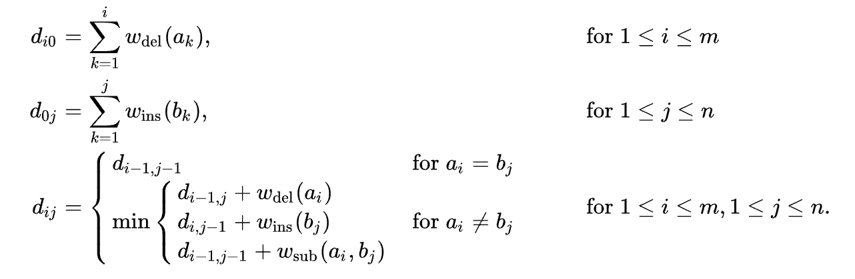
Common Algorithm
This doesn’t include transposition – how could we add this operation?
From https://en.wikipedia.org/wiki/Edit_distance

