Slide 1
CSC 301 – Design and Analysis of Algorithms
Instructor: Dr. M. Hasan Jamal
Lecture# 03(a): Sorting Algorithms

Slide 2
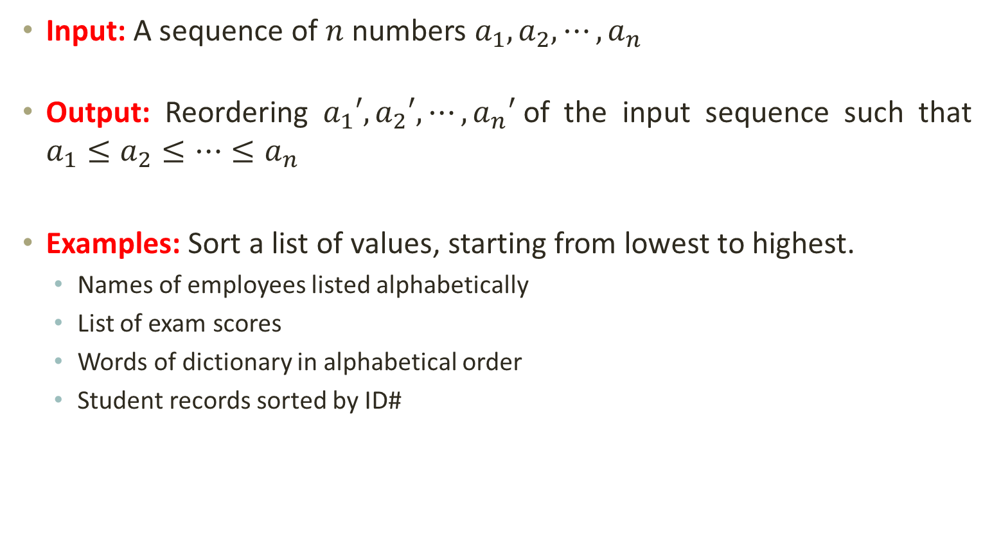
The Sorting Problem
Input: A sequence of $n$ numbers $a_{1},a_{2}, ⋯,a_{n}$
Output: Reordering $a_{1}′,a_{2}′, ⋯,a_{n}′$of the input sequence such that $a_{1}≤a_{2}≤⋯≤a_{n}$
Examples: Sort a list of values, starting from lowest to highest.
Names of employees listed alphabetically
List of exam scores
Words of dictionary in alphabetical order
Student records sorted by ID#

Slide 3
Why Study Sorting Algorithms?
One of the fundamental problems in computer science that can be solved in many ways:
there are many sorting algorithms
some are faster/slower than others
some use more/less memory than others
some work better with specific kinds of data ...
There are a variety of situations that we can encounter
Is the data randomly ordered?
Are all data values unique?
What is the range of data?
What is the total size of data to be sorted?
Need guaranteed performance?
To what extent is the data already sorted?
Various algorithms are better suited to some of these situations

Slide 4
Properties of Sorting Algorithms
In Place Sort: The amount of extra space required to sort the data is constant with the input size; i.e. no additional space is required.
Stable Sort: two equal (or repeating) elements appear in the same order in sorted output as they appear in the input unsorted array.
8
4₁
6
9
4₂
3
1
1
3
4₁
4₂
6
8
9

Slide 5
Types of Sorting Algorithms
Incremental comparison-based sorting: compares pairs of elements incrementally
Selection sort
Bubble sort
Insertion sort
Recursive comparison-based sorting: compares pairs of elements by using divide-and-conquer approach
Merge sort
Quick sort
Heap sort
Non-comparison based linear sorting: sorts data with comparing pair of elements
Count sort
Radix sort
Bucket sort

Slide 6
Selection Sort
Idea:
Find the smallest/largest element in the array and exchange it with the element in the first/last index of the array
Find the second smallest/largest element in the array and exchange it with the element in the second first/last index of the array
Continue until the array is sorted

Slide 7
Selection Sort
SELECTION-SORT(A)
n ← length[A]
for i ← 0 to n – 2
smallest ← i
for j ← i + 1 to n – 1
if A[ smallest ] > A[ j ]
smallest ← j
A[ i ] ↔ A[ smallest ]
Mark the first index to be storing the smallest element of the unsorted part of the array
Update the index storing the smallest element
Place the smallest element to its actual location

Slide 8
Selection Sort
SELECTION-SORT(A)
n ← length[A]
for i ← 0 to n – 2
smallest ← i
for j ← i + 1 to n – 1
if A[ smallest ] > A[ j ]
smallest ← j
A[ i ] ↔ A[ smallest ]
i
j
j
j
j
j
•
•
•
•
•
•
12
8
6
6
14
17
22
12
•
•
Smallest
Smallest

Slide 9
Selection Sort
SELECTION-SORT(A)
n ← length[A]
for i ← 0 to n – 2
smallest ← i
for j ← i + 1 to n – 1
if A[ smallest ] > A[ j ]
smallest ← j
A[ i ] ↔ A[ smallest ]
i
j
j
j
j
•
•
•
•
•
12
12
8
6
8
14
17
12
22
•
•
Smallest
Smallest

Slide 10
Selection Sort
SELECTION-SORT(A)
n ← length[A]
for i ← 0 to n – 2
smallest ← i
for j ← i + 1 to n – 1
if A[ smallest ] > A[ j ]
smallest ← j
A[ i ] ↔ A[ smallest ]
i
j
j
j
•
•
•
•
12
12
12
6
8
14
17
22
12
14
•
•
Smallest
Smallest

Slide 11
Selection Sort
SELECTION-SORT(A)
n ← length[A]
for i ← 0 to n – 2
smallest ← i
for j ← i + 1 to n – 1
if A[ smallest ] > A[ j ]
smallest ← j
A[ i ] ↔ A[ smallest ]
i
j
j
•
•
•
12
12
14
6
8
14
17
22
12
14
17
•
•
Smallest
Smallest

Slide 12
Selection Sort
SELECTION-SORT(A)
n ← length[A]
for i ← 0 to n – 2
smallest ← i
for j ← i + 1 to n – 1
if A[ smallest ] > A[ j ]
smallest ← j
A[ i ] ↔ A[ smallest ]
i
j
•
•
12
12
17
22
6
8
14
17
22
12
14
17
•
Smallest

Slide 13
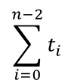
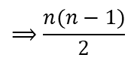
Selection Sort
SELECTION-SORT(A)
n ← length[A]
for i ← 0 to n – 2
smallest ← i
for j ← i + 1 to n – 1
if A[ smallest ] > A[ j ]
smallest ← j
A[ i ] ↔ A[ smallest ]
No. of Steps
1
n – 1
n – 1
No. of comparisons
$$\sum_{i=0}^{n−2}{t_{i}}$$
$$⟹\frac{n(n−1)}{2}$$
n – 1
No. of Exchanges
$T\left(n\right)=1+\left(n−1\right)+\left(n−1\right)+\frac{n(n−1)}{2}$+ $\frac{n(n−1)}{2}$+ $\frac{n(n−1)}{2}$ $+\left(n−1\right)$
t_{i} : # of times the inner for loop executes at iteration i

Slide 14
Selection Sort
Worst Case Time Complexity?
SELECTION-SORT(A)
n ← length[A]
for i ← 0 to n – 2
smallest ← i
for j ← i + 1 to n – 1
if A[ smallest ] > A[ j ]
smallest ← j
A[ i ] ↔ A[ smallest ]
O(n²)
Best Case Time Complexity?
O(n²)
Average Case Time Complexity?
O(n²)
$T\left(n\right)=1+\left(n−1\right)+\left(n−1\right)+\frac{n(n−1)}{2}$+ $\frac{n(n−1)}{2}$+ $\frac{n(n−1)}{2}$ $+\left(n−1\right)$
The efficiency of Selection Sort does not depend on the initial arrangement of the data.

Slide 15
Bubble Sort
Idea: Given a list of n elements, repeat the following steps n -1 times:
For each pair of adjacent numbers, if number on the left is greater than the number on the right, swap them.
“Bubble” the largest element to the end of the array using pair-wise comparisons and swapping.

Slide 16
Bubble Sort
BUBBLE-SORT(A)
n ← length[A]
for i ← 0 to n – 2
for j ← 0 to n – i – 2
if A[ j ] > A[ j+1 ]
A[ j ] ↔ A[ j+1 ]
Compare two adjacent elements
Exchange if the element on the left is greater than the element on the right

Slide 17
Bubble Sort
BUBBLE-SORT(A)
n ← length[A]
for i ← 0 to n – 2
for j ← 0 to n – i – 2
if A[ j ] > A[ j+1 ]
A[ j ] ↔ A[ j+1 ]
12
12
6
6
6
12
12
6
22
14
14
22
8
8
17
22
17
22
14
8
14
8
17
22
17
22

Slide 18
Bubble Sort
BUBBLE-SORT(A)
n ← length[A]
for i ← 0 to n – 2
for j ← 0 to n – i – 2
if A[ j ] > A[ j+1 ]
A[ j ] ↔ A[ j+1 ]
6
8
6
12
12
8
14
14
14
8
17
8
14
17
22

Slide 19
Bubble Sort
BUBBLE-SORT(A)
n ← length[A]
for i ← 0 to n – 2
for j ← 0 to n – i – 2
if A[ j ] > A[ j+1 ]
A[ j ] ↔ A[ j+1 ]
8
14
6
14
6
12
17
12
8
8
8
12
12
22

Slide 20
Bubble Sort
BUBBLE-SORT(A)
n ← length[A]
for i ← 0 to n – 2
for j ← 0 to n – i – 2
if A[ j ] > A[ j+1 ]
A[ j ] ↔ A[ j+1 ]
8
14
6
8
12
17
22
6
12

Slide 21
Bubble Sort
BUBBLE-SORT(A)
n ← length[A]
for i ← 0 to n – 2
for j ← 0 to n – i – 2
if A[ j ] > A[ j+1 ]
A[ j ] ↔ A[ j+1 ]
8
14
6
8
12
17
22
6

Slide 22
Bubble Sort
BUBBLE-SORT(A)
n ← length[A]
for i ← 0 to n – 2
for j ← 0 to n – i – 2
if A[ j ] > A[ j+1 ]
A[ j ] ↔ A[ j+1 ]
6
8
12
14
17
22
6

Slide 23
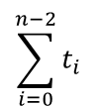
Bubble Sort
No. of Steps
BUBBLE-SORT(A)
n ← length[A]
for i ← 0 to n – 2
for j ← 0 to n – i – 2
if A[ j ] > A[ j+1 ]
A[ j ] ↔ A[ j+1 ]
1
n – 1
$$\sum_{i=0}^{n−2}{t_{i}}$$
$$⟹\frac{n(n−1)}{2}$$
No. of comparisons
No. of Exchanges
$T\left(n\right)=1+\left(n−1\right)+\frac{n(n−1)}{2}$+ $\frac{n(n−1)}{2}$+ $\frac{n(n−1)}{2}$
t_{i} : # of times the inner for loop executes at iteration i

Slide 24
Bubble Sort
Worst Case Time Complexity?
BUBBLE-SORT(A)
n ← length[A]
for i ← 0 to n – 2
for j ← 0 to n – i – 2
if A[ j ] > A[ j+1 ]
A[ j ] ↔ A[ j+1 ]
O(n²)
Best Case Time Complexity?
O(n²)
Average Case Time Complexity?
Can we optimize this code???
O(n²)
$T\left(n\right)=1+\left(n−1\right)+\frac{n(n−1)}{2}$+ $\frac{n(n−1)}{2}$+ $\frac{n(n−1)}{2}$
The efficiency of Bubble Sort does not depend on the initial arrangement of the data.

Slide 25
Bubble Sort (Optimized)
BUBBLE-SORT(A)
n ← length[A]
for i ← 0 to n – 2
swap ← 0;
for j ← 0 to n – i – 2
if A[ j ] > A[ j+1 ]
A[ j ] ↔ A[ j+1 ];
swap++;
if swap = = 0
break;
Best Case Time Complexity?
O(n)
Average and Worst Case Time Complexity?
O(n²)
$T\left(n\right)=1+\left(n−1\right)+\left(n−1\right)+\frac{n(n−1)}{2}$+ $\frac{n(n−1)}{2}$+ $\frac{n(n−1)}{2}\text{+} \frac{n(n−1)}{2}+\left(n−1\right)$
$$T\left(n\right)=1+1+1+\left(n−1\right)+\left(n−1\right)+0+0 +1$$
Notes:
The array is already sorted
Keep track of no. of swaps done in an iteration
Can finish early if no swapping occurs
t_{j} = 1 ➔ n – 1 comparisons in a single iteration

Slide 26
Insertion Sort
Idea: like sorting a hand of playing cards
Start with empty left hand and cards face down on the table.
Remove one card at a time from the table, and insert it into the correct position in the left hand.
compare it with each card already in the hand, from right to left
The cards held in the left hand are sorted
these cards were originally the top cards of the pile on the table
5
8
2
10
7

Slide 27
Insertion Sort
INSERTION-SORT(A)
n ← length[A]
for i ← 1 to n – 1
key ← A[ i ]
j ← i – 1
while ( j ≥ 0 && A[ j ] > key)
A[ j+1 ] ← A[ j ]
j ← j – 1
A[ j+1 ] ← key
Compare elements with the key
Move all elements larger than the key
Place key in its actual location

Slide 28
Insertion Sort
INSERTION-SORT(A)
n ← length[A]
for i ← 1 to n – 1
key ← A[ i ]
j ← i – 1
while ( j ≥ 0 && A[ j ] > key)
A[ j+1 ] ← A[ j ]
j ← j – 1
A[ j+1 ] ← key
i
•
Array index
0
1
2
3
4
5
6
7
Value
2.78
7.42
key = 7.42.
7.42
0.56
1.12
0.32
6.21
4.42
7.71
•
j

Slide 29
Insertion Sort
INSERTION-SORT(A)
n ← length[A]
for i ← 1 to n – 1
key ← A[ i ]
j ← i – 1
while ( j ≥ 0 && A[ j ] > key)
A[ j+1 ] ← A[ j ]
j ← j – 1
A[ j+1 ] ← key
i
•
Array index
0
1
2
3
4
5
6
7
0.56
0.56
key = 0.56.
Value
0.56
2.78
7.42
2.78
7.42
0.56
1.12
0.32
6.21
4.42
7.71
•
•
j
j

Slide 30
Insertion Sort
INSERTION-SORT(A)
n ← length[A]
for i ← 1 to n – 1
key ← A[ i ]
j ← i – 1
while ( j ≥ 0 && A[ j ] > key)
A[ j+1 ] ← A[ j ]
j ← j – 1
A[ j+1 ] ← key
i
•
Array index
0
1
2
3
4
5
6
7
Value
0.56
1.12
key = 1.12.
2.78
7.42
1.12
2.78
7.42
0.32
6.21
4.42
7.71
1.12
1.12
•
•
•
j
j
j

Slide 31
Insertion Sort
INSERTION-SORT(A)
n ← length[A]
for i ← 1 to n – 1
key ← A[ i ]
j ← i – 1
while ( j ≥ 0 && A[ j ] > key)
A[ j+1 ] ← A[ j ]
j ← j – 1
A[ j+1 ] ← key
i
•
Array index
0
1
2
3
4
5
6
7
0.32
0.32
7.42
key = 0.32.
0.32
0.56
0.32
Value
0.56
1.12
2.78
2.78
0.32
1.12
7.42
0.32
6.21
4.42
7.71
•
•
•
•
j
j
j
j

Slide 32
Insertion Sort
INSERTION-SORT(A)
n ← length[A]
for i ← 1 to n – 1
key ← A[ i ]
j ← i – 1
while ( j ≥ 0 && A[ j ] > key)
A[ j+1 ] ← A[ j ]
j ← j – 1
A[ j+1 ] ← key
i
•
Array index
0
1
2
3
4
5
6
7
Value
0.32
0.56
1.12
2.78
7.42
key = 6.21.
6.21
6.21
6.21
7.42
4.42
7.71
•
•
j
j

Slide 33
Insertion Sort
INSERTION-SORT(A)
n ← length[A]
for i ← 1 to n – 1
key ← A[ i ]
j ← i – 1
while ( j ≥ 0 && A[ j ] > key)
A[ j+1 ] ← A[ j ]
j ← j – 1
A[ j+1 ] ← key
i
•
Array index
0
1
2
3
4
5
6
7
4.42
key = 4.42.
4.42
4.42
Value
0.32
0.56
1.12
2.78
6.21
6.21
7.42
7.42
4.42
7.71
•
•
•
j
j
j

Slide 34
Insertion Sort
INSERTION-SORT(A)
n ← length[A]
for i ← 1 to n – 1
key ← A[ i ]
j ← i – 1
while ( j ≥ 0 && A[ j ] > key)
A[ j+1 ] ← A[ j ]
j ← j – 1
A[ j+1 ] ← key
i
•
Array index
0
1
2
3
4
5
6
7
4.42
key = 7.71.
4.42
4.42
Value
0.32
0.56
1.12
2.78
6.21
6.21
7.71
7.42
7.42
7.71
•
j

Slide 35
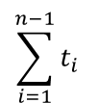
Insertion Sort
No. of Steps
INSERTION-SORT(A)
n ← length[A]
for i ← 1 to n – 1
key ← A[ i ]
j ← i – 1
while ( j ≥ 0 && A[ j ] > key)
A[ j+1 ] ← A[ j ]
j ← j – 1
A[ j+1 ] ← key
1
n – 1
n – 1
n – 1
No. of comparisons
$$\sum_{i=1}^{n−1}{t_{i}}$$
$$⟹\frac{n(n−1)}{2}$$
No. of Exchanges
n – 1
$T\left(n\right)=1+\left(n−1\right)+\left(n−1\right)+\frac{n(n−1)}{2}$+ $\frac{n(n−1)}{2}$+ $\frac{n(n−1)}{2}$ $+\left(n−1\right)$
t_{i} : # of times the inner for loop executes at iteration i

Slide 36
Insertion Sort
Worst Case Time Complexity?
INSERTION-SORT(A)
n ← length[A]
for i ← 1 to n – 1
key ← A[ i ]
j ← i – 1
while ( j ≥ 0 && A[ j ] > key)
A[ j+1 ] ← A[ j ]
j ← j – 1
A[ j+1 ] ← key
O(n²)
$T\left(n\right)=1+\left(n−1\right)+\left(n−1\right)+\frac{n(n−1)}{2}$+ $\frac{n(n−1)}{2}$+ $\frac{n(n−1)}{2}$ $+\left(n−1\right)$
Notes:
The array is in reverse sorted order
No. of comparisons and exchanges are n²/2

Slide 37
Insertion Sort
Worst Case Time Complexity?
INSERTION-SORT(A)
n ← length[A]
for i ← 1 to n – 1
key ← A[ i ]
j ← i – 1
while ( j ≥ 0 && A[ j ] > key)
A[ j+1 ] ← A[ j ]
j ← j – 1
A[ j+1 ] ← key
O(n²)
Best Case Time Complexity?
O(n)
$T\left(n\right)=1+\left(n−1\right)+\left(n−1\right)+\frac{n(n−1)}{2}$+ $\frac{n(n−1)}{2}$+ $\frac{n(n−1)}{2}$ $+\left(n−1\right)$
Notes:
The array is in sorted order
No. of comparisons are n
No. of exchanges are 0

Slide 38
Insertion Sort
Worst Case Time Complexity?
INSERTION-SORT(A)
n ← length[A]
for i ← 1 to n – 1
key ← A[ i ]
j ← i – 1
while ( j ≥ 0 && A[ j ] > key)
A[ j+1 ] ← A[ j ]
j ← j – 1
A[ j+1 ] ← key
O(n²)
Best Case Time Complexity?
O(n)
Average Case Time Complexity?
O(n²)
$T\left(n\right)=1+\left(n−1\right)+\left(n−1\right)+\frac{n(n−1)}{2}$+ $\frac{n(n−1)}{2}$+ $\frac{n(n−1)}{2}$ $+\left(n−1\right)$
Notes:
The array is in sorted order
No. of comparisons are n
No. of exchanges are 0

