Slide 1
Joins
Aoun-Haider
FA21-BSE-133@cuilahore.edu.pk

Slide 2
Types:
Left join/ left outer join
Right join/ right outer join
Full join/ full outer join
Inner join
Natural join
Semi-join
Equi-join
Theta join
Anti-join
Cross join
Self join

Slide 3
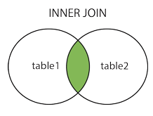
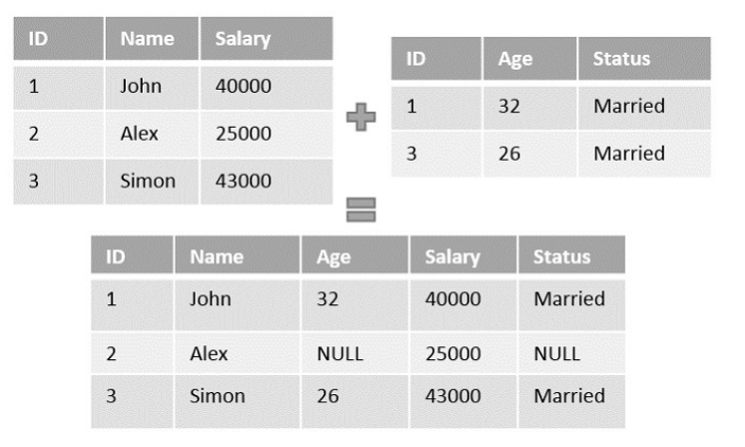
Inner Join:
Returns records that have matching values in both tables

Slide 4
Outer Join:
Unlike inner join the outer join may contain the records that doesn’t satisfy the join condition along with the records that satisfy it. There are three types of outer join namely −
Left Outer Join
Right Outer Join
Full Outer Join

Slide 5
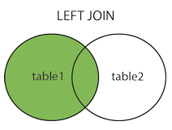
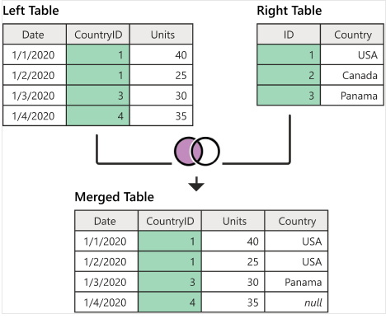
Left Join:
Fetches all the matched entries
And all left table entries whether
They match or not.

Slide 6
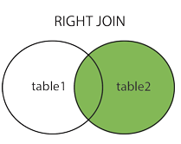
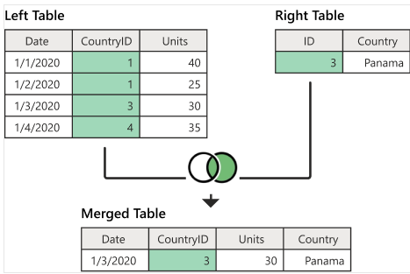
Right Join:
Fetches all the matched entries
And all right table entries whether
They match or not.

Slide 7
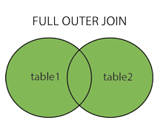
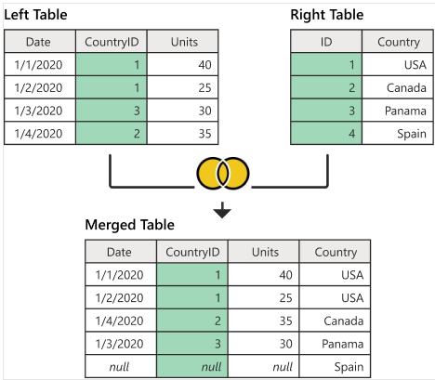
Full outer join:
Fetches all the matched entries
of both table. Non-matching entries
will be assigned null.

Slide 8
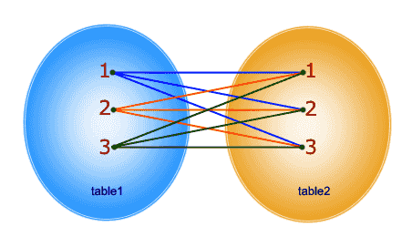
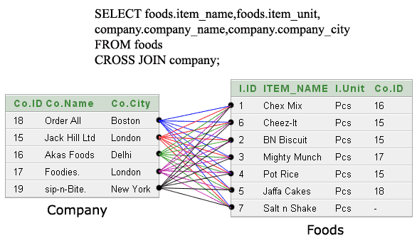
Cross Join:
Same as cartesian product of two tables.

Slide 9
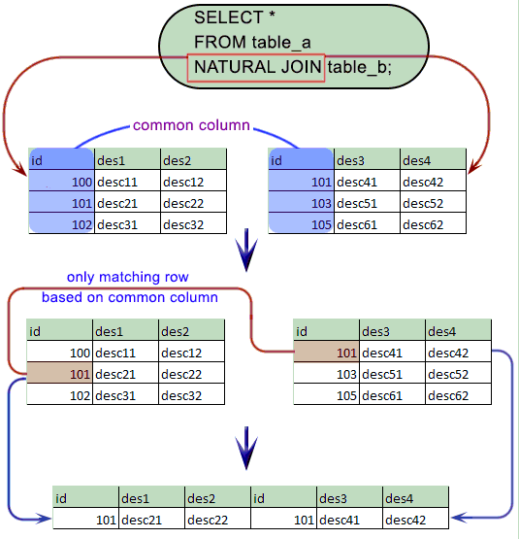
Natural Join:
Returns only matching rows of both tables.

Slide 10
Semi Join:
SELECT DISTINCT s.id
FROM students s
LEFT JOIN grades g ON g.student_id = s.id
WHERE g.student_id IS NOT NULL
Now the same with left semi-join:
SELECT s.id
FROM students s
WHERE EXISTS (SELECT 1 FROM grades g
WHERE g.student_id = s.id)

Slide 11
Cont.
Difference between regular join and semi-join is that it eliminates duplicate tuples and returns only 1st matching values. While regular join returns all the rows without taking care of duplicates.
In most cases, semi-join uses EXISTS, IN, NOT IN, DISTINCT clause to perform required operation.

Slide 12
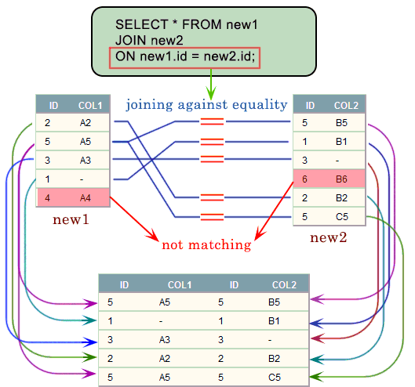
Equi join:
SQL EQUI JOIN performs a JOIN against equality
or matching column(s) values of the associated
tables. An equal sign (=) is used as comparison
operator in the where clause to refer equality.

Slide 13
Self Join:
A self join is a join in which a table is joined with itself (which is also called Unary relationships), especially when the table has a FOREIGN KEY which references its own PRIMARY KEY. To join a table itself means that each row of the table is combined with itself and with every other row of the table.
The self join can be viewed as a join of two copies of the same table. The table is not actually copied, but SQL performs the command as though it were.

Slide 14
Theta Join:
This type of join is commonly used in complex queries. If a join uses comparison operator other than equality operator, it is performing theta join operation.

Slide 15

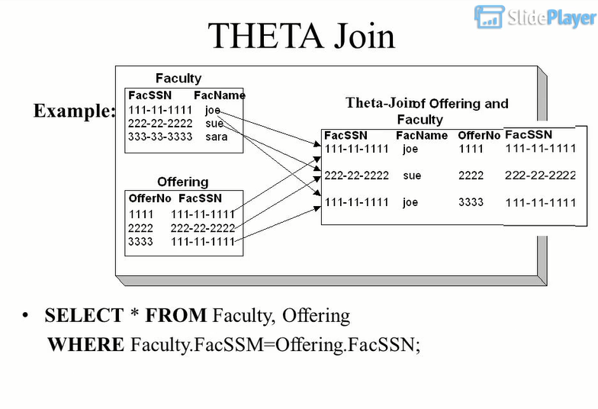

Slide 16
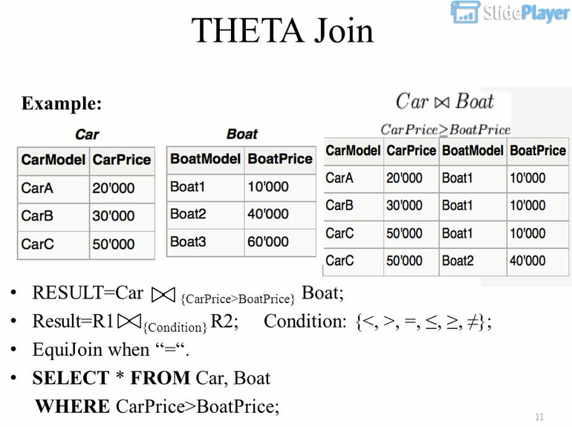

Slide 17
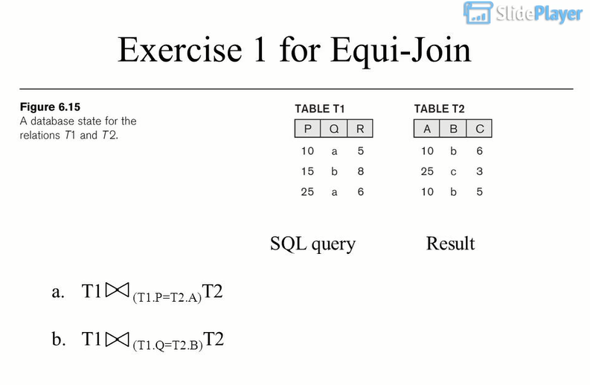

Slide 18
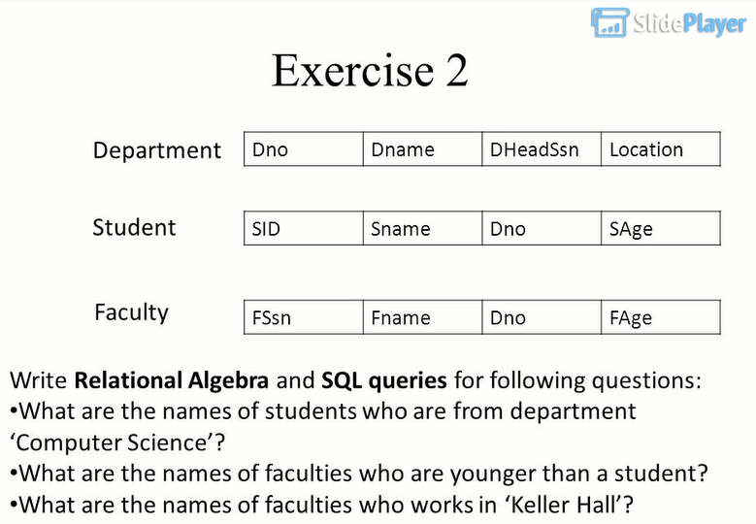


Slide 19
Anti-Join:
It is inverse of join. When you would like to keep all the records in the original table except those records that match the other table.
In the same way, left anti join will be inverse of left outer join.

