Slide 1
Introduction
CSC 322: Operating Systems Concept

Slide 2
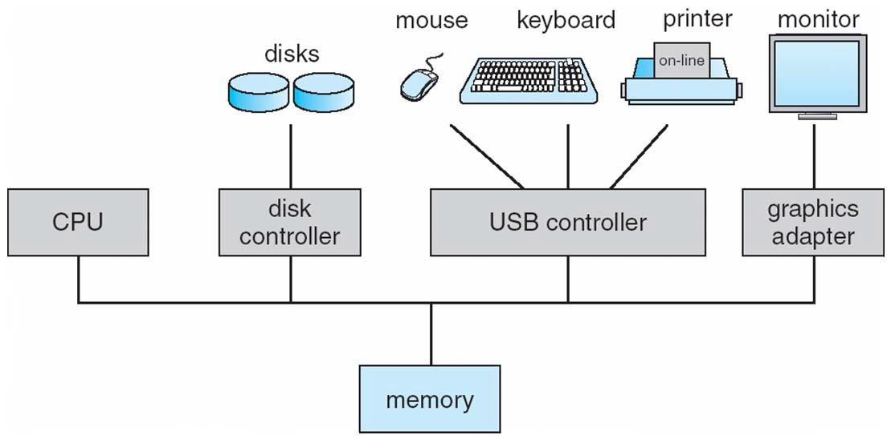
A Typical Computer from Hardware Point of View
One or more CPUs and device controllers connected through common bus
Notes:
A device controller is a part of a computer system that makes sense of the signals going to, and coming from the CPU. There are many device controllers in a computer system. Any device connected to the computer is connected by a plug and socket, and the socket is connected to a device controller.

Slide 3
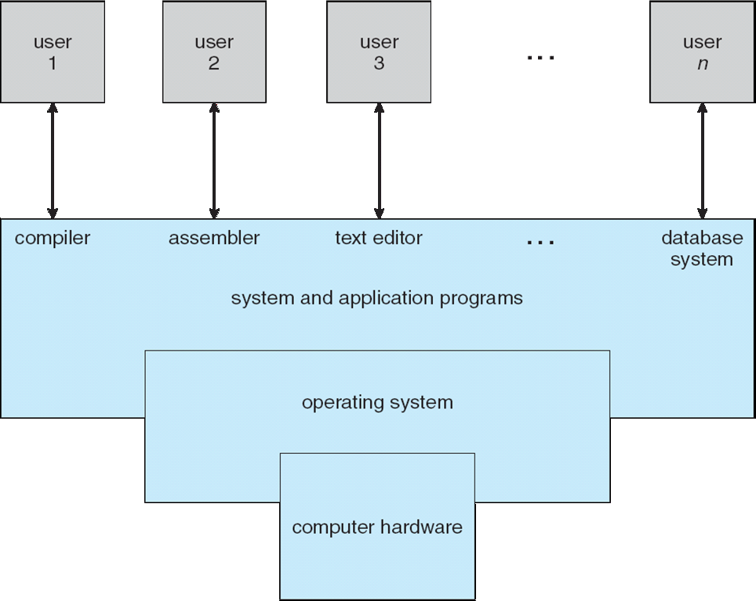
Computer System Components

Slide 4
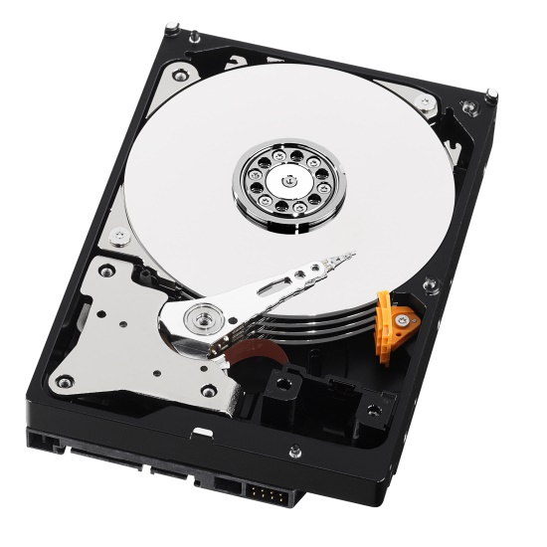
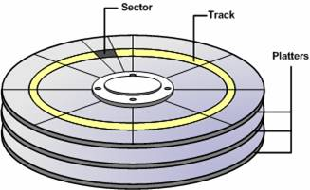
Example: Programming Hard Drive
Physical reality
Block oriented
Physical sector numbers
No protection among user systems
Data might be corrupted if machine crashes
Programming:
Loading values into special device registers
“I will save my lab1 solution on platter 5, track 8739, sector 3-4.”
Notes:
An operating system is a program that manages the computer hardware. It also provides a basis for application programs and acts as an intermediary
between a user of a computer and the computer hardware.

Slide 5
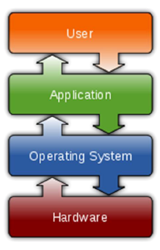
Computer System Components
Managing all these components requires a layer of software – the operating system

Slide 6
Example: Programming Hard Drive
Physical reality
Block oriented
Physical sector numbers
No protection among user systems
Data might be corrupted if machine crashes
Programming:
Loading values into special device registers
File system abstraction
Byte oriented
Named files
User protected from each other
Robust to machine failures
Programming:
open/read/write
“I will save my lab1 solution on platter 5, track 8739, sector 3-4.”
“My lab1 solution is in ~mhjamal/lab1/process.c.”
Notes:
An operating system is a program that manages the computer hardware. It also provides a basis for application programs and acts as an intermediary
between a user of a computer and the computer hardware.

Slide 7
Computer System Structure
Computer system can be divided into four components:
Hardware – provides basic computing resources
CPU, memory, I/O devices
Operating system
Controls and coordinates use of hardware among various applications and users
Application programs – define the ways in which the system resources are used to solve the computing problems of the users
Word processors, compilers, web browsers, database systems, video games
Users
People, machines, other computers

Slide 8
Computer Startup
Bootstrap program is loaded at power-up or reboot
Typically stored in ROM or EEPROM, generally known as firmware
Initializes all aspects of system
Locates and loads operating system kernel into memory and starts execution
Sometimes two-step process where boot block at fixed location loaded by ROM code, which loads bootstrap loader from disk
Common bootstrap loader, GRUB, allows selection of kernel from multiple disks, versions, kernel options
Kernel loads and system is then running

Slide 9
Computer Startup
ROM/BIOS contains firmware responsible to initiate the function of the computer.
This firmware
IPL (Initial Program Loader) is the first program which is executed whenever computer is turned ON.
ROM/BIOS is the first chip which is turned ON.
IPL checks the presence of the storage device.
Then to go to search OS on it.
If no OS then “No boot device available” message displayed by IPL.

Slide 10
Computer Startup
If storage device present then
IPL executes the boot strap routines (stored on the boot sector of HDD)
BOOT Sector is the first sector of the first track
Boot Strap Routines
Load the OS into the computer memory.
Finds the OS kernel on the HDD,
Load into memory and
Jumps to the initial address to begin the OS’s execution.

Slide 11
Brief History of Computer Systems
In the beginning 1 user/program at a time
Simple batch systems were 1st real OS
Spooling and buffering allowed jobs to be read ahead of time
Multiprogramming systems provided increased utilization (throughput)
Multiple runnable jobs loaded in memory
Overlap I/O with computation
Benefit from asynchronous I/O devices
1st instance where the OS must schedule resources
CPU scheduling
Memory management
Protection
Notes:
An operating system is a program that manages the computer hardware. It also provides a basis for application programs and acts as an intermediary
between a user of a computer and the computer hardware.

Slide 12
Brief History of Computer Systems
Timesharing (Multitasking) is a logical extension of multiprogramming
Optimize response time by frequent time-slicing multiple jobs
Each user feels he/she has the entire machine
Permits interactive work
More complex than the multiprogramming OS
In addition to CPU scheduling, memory management, protection
Virtual memory to allow part of the job to be in memory
File system (needed by interactive use)
Job communication, synchronization
Handling deadlock
Most systems today are timesharing (focus of this course)
Notes:
An operating system is a program that manages the computer hardware. It also provides a basis for application programs and acts as an intermediary
between a user of a computer and the computer hardware.

Slide 13
What is an Operating System?
“Code” that sits between:
Programs & hardware
Different programs
Different users
A program that acts as an intermediary between a computer user and the computer hardware
High level interface between user and machine
But what does it do/achieve?
Execute user programs and make solving user problems easier
Make the computer system convenient to use
Use the computer hardware in an efficient manner
Notes:
An operating system is a program that manages the computer hardware. It also provides a basis for application programs and acts as an intermediary
between a user of a computer and the computer hardware.

Slide 14
What is an Operating System?
Resource Manager
Extended (abstract) machine
Makes computers efficient and simple to use
Notes:
An operating system is a program that manages the computer hardware. It also provides a basis for application programs and acts as an intermediary
between a user of a computer and the computer hardware.

Slide 15
What is an Operating System?
Resource Manager
Allocation
Reclamation
Protection
Notes:
An operating system is a program that manages the computer hardware. It also provides a basis for application programs and acts as an intermediary
between a user of a computer and the computer hardware.

Slide 16
What is an Operating System?
Resource Manager
Allocation
Reclamation
Protection
Finite resources
Competing demands
Examples:
CPU
Memory
Disk
Network
Notes:
An operating system is a program that manages the computer hardware. It also provides a basis for application programs and acts as an intermediary
between a user of a computer and the computer hardware.

Slide 17
What is an Operating System?
Resource Manager
Allocation
Reclamation
Protection
“The OS giveth
The OS taketh away”
Implied at termination
Involuntary at run time
Cooperative (yield CPU)
Notes:
An operating system is a program that manages the computer hardware. It also provides a basis for application programs and acts as an intermediary
between a user of a computer and the computer hardware.

Slide 18
What is an Operating System?
Resource Manager
Allocation
Reclamation
Protection
“You can’t hurt me
I can’t hurt you”
Implies some degree of safety & security
Notes:
An operating system is a program that manages the computer hardware. It also provides a basis for application programs and acts as an intermediary
between a user of a computer and the computer hardware.

Slide 19
What is an Operating System?
Operating System as a resource manager
Allow multiple programs to run at the same time
Manage and protect memory, I/O devices, and other resources
Includes multiplexing (sharing) resources in two different ways:
In time
In space
Notes:
An operating system is a program that manages the computer hardware. It also provides a basis for application programs and acts as an intermediary
between a user of a computer and the computer hardware.

Slide 20
What is an Operating System?
Extended (abstract) machine
Much more ideal environment than the hardware
Ease of use
Fair (well-behaved)
Portable (back-compatible)
Reliable
Safe
Illusion of infinite, private resources
Single processor → many separate processors
Single memory → many separate, larger memories
Notes:
An operating system is a program that manages the computer hardware. It also provides a basis for application programs and acts as an intermediary
between a user of a computer and the computer hardware.

Slide 21
Separating Policy from Mechanism
A fundamental design principle in Computer Science
Mechanism – tool/implementation to achieve some effect
Policy – decisions on what effect should be achieved
Examples:
All users treated equally
All programs instances treated equally
Preferred users treated better
Separation leads to flexibility
Notes:
An operating system is a program that manages the computer hardware. It also provides a basis for application programs and acts as an intermediary
between a user of a computer and the computer hardware.

Slide 22
Is there a perfect OS?
Fairness
Efficiency
Portability
Interfaces
Security
Robustness
Conflicting goals
Fairness vs efficiency
Efficiency vs portability
…
Furthermore, …
Notes:
An operating system is a program that manages the computer hardware. It also provides a basis for application programs and acts as an intermediary
between a user of a computer and the computer hardware.

Slide 23
Hardware is evolving …
60’s – 70’s → Mainframes
Rise of IBM
70’s – 80’s → Minicomputers
Rise of Digital Equipment
80’s – 90’s → PCs
Rise of Intel, Microsoft
90’s – today → Handheld systems (smartphones)
Notes:
An operating system is a program that manages the computer hardware. It also provides a basis for application programs and acts as an intermediary
between a user of a computer and the computer hardware.

Slide 24
Computer Hardware Review: Processors
Instruction Set
Pentium cannot execute SPARC programs
ALU Arithmetic/Logic Unit
Instruction Register
address of the next instruction to be fetched
Stack Pointer
points to the top of the current stack in memory
General Registers
PSW Program Status Word
condition code bits, which are set by comparison instructions
Pipeline
Note: CPUs contain some registers inside to hold key variables and temporary results

Slide 25
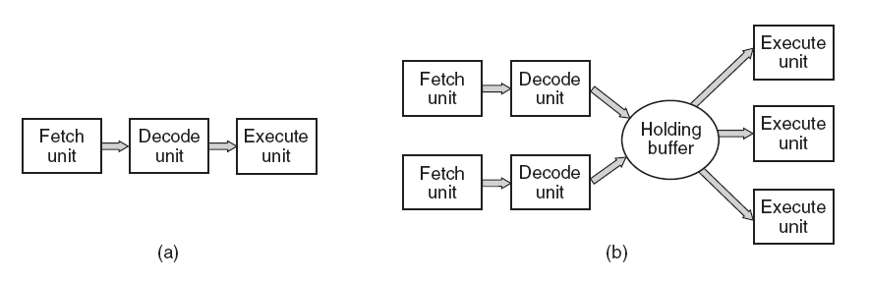
Computer Hardware Review: Processors
(a) A three-stage pipeline. (b) A superscalar CPU.

Slide 26
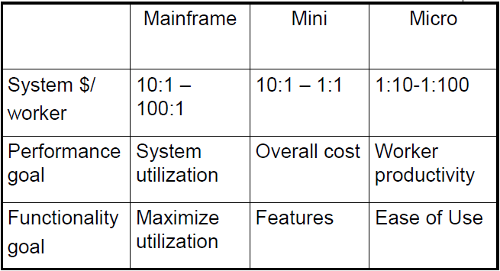
Historical Comparison
Notes:
An operating system is a program that manages the computer hardware. It also provides a basis for application programs and acts as an intermediary
between a user of a computer and the computer hardware.

Slide 27
Hardware is evolving …
New architectures
32-bit vs 64 bit
Multiprocessors
Multi-core
Notes:
An operating system is a program that manages the computer hardware. It also provides a basis for application programs and acts as an intermediary
between a user of a computer and the computer hardware.

Slide 28
May You Live in Interesting Times …
Processor speed doubles in 18 months
Number of cores per chip doubles in 24 months
Disks capacity doubles every 12 months
Performance/cost “sweet spot” constantly decaying
Notes:
An operating system is a program that manages the computer hardware. It also provides a basis for application programs and acts as an intermediary
between a user of a computer and the computer hardware.

Slide 29
Applications are also evolving
New applications
Computer games
Java
WWW (web servers)
Networked games
Peer-to-peer
Web 2.0 (Youtube, social network)
Mobile device applications
…
Notes:
An operating system is a program that manages the computer hardware. It also provides a basis for application programs and acts as an intermediary
between a user of a computer and the computer hardware.

Slide 30
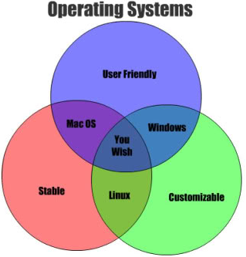
There is no magic in OS design
This is Engineering
Imperfection
Tradeoffs (perf/func)
Constraints
Hardware, cost, time, power
Optimizations
Nothing is permanent
High rate of change
Hardware
Applications
Cost/benefit analyses
One good news:
Inertia of a few design principles
Notes:
An operating system is a program that manages the computer hardware. It also provides a basis for application programs and acts as an intermediary
between a user of a computer and the computer hardware.

Slide 31
Storage Definitions and Notation Review
The basic unit of computer storage is the bit. A bit can contain one of two values, 0 and 1. All other storage in a computer is based on collections of bits. Given enough bits, it is amazing how many things a computer can represent: numbers, letters, images, movies, sounds, documents, and programs, to name a few. A byte is 8 bits, and on most computers it is the smallest convenient chunk of storage. For example, most computers don’t have an instruction to move a bit but do have one to move a byte. A less common term is word, which is a given computer architecture’s native unit of data. A word is made up of one or more bytes. For example, a computer that has 64-bit registers and 64-bit memory addressing typically has 64-bit (8-byte) words. A computer executes many operations in its native word size rather than a byte at a time.
Computer storage, along with most computer throughput, is generally measured and manipulated in bytes and collections of bytes.
A kilobyte, or KB, is 1,024 bytes
a megabyte, or MB, is 1,024² bytes
a gigabyte, or GB, is 1,024³ bytes
a terabyte, or TB, is 1,024⁴ bytes
a petabyte, or PB, is 1,024⁵ bytes
Computer manufacturers often round off these numbers and say that a megabyte is 1 million bytes and a gigabyte is 1 billion bytes. Networking measurements are an exception to this general rule; they are given in bits (because networks move data a bit at a time).

Slide 32
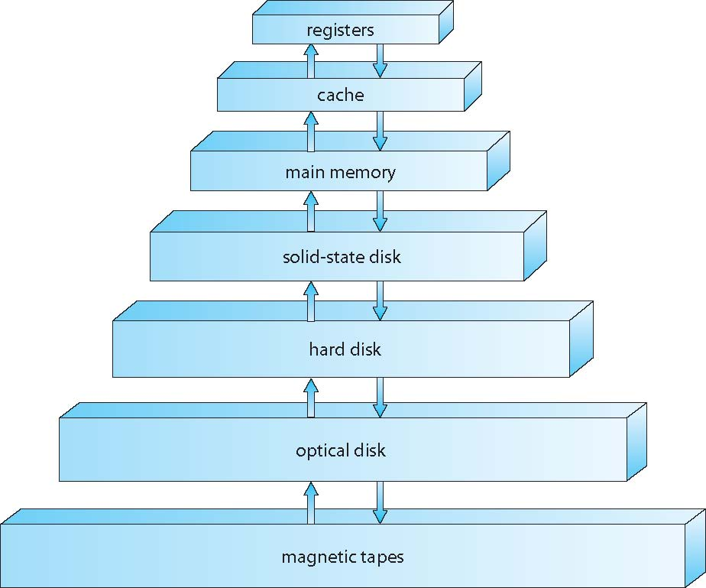
Storage Hierarchy
Storage systems organized in hierarchy
Speed
Cost
Volatility

Slide 33
Storage Structure
Main memory – only large storage media that the CPU can access directly
Random access
Typically volatile
Secondary storage – extension of main memory that provides large nonvolatile storage capacity
Hard disks – rigid metal or glass platters covered with magnetic recording material
Disk surface is logically divided into tracks, which are subdivided into sectors
The disk controller determines the logical interaction between the device and the computer
Solid-state disks – faster than hard disks, nonvolatile
Various technologies
Becoming more popular
Caching – copying information into faster storage system; main memory can be viewed as a cache for secondary storage
Device Driver for each device controller to manage I/O
Provides uniform interface between controller and kernel

Slide 34
Caching
Important principle, performed at many levels in a computer
in hardware, operating system, software
Information in use copied from slower to faster storage temporarily
Faster storage (cache) checked first to determine if information is there
If it is, information used directly from the cache (fast)
If not, data copied to cache and used there
Cache smaller than storage being cached
Cache management important design problem
Cache size and replacement policy

Slide 35
Performance of Various Levels of Storage

Slide 36
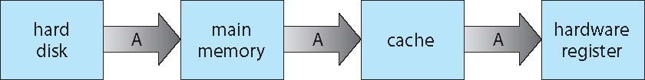
Migration of data “A” from Disk to Register
Multitasking environments must be careful to use most recent value, no matter where it is stored in the storage hierarchy
Multiprocessor environment must provide cache coherency in hardware such that all CPUs have the most recent value in their cache
Distributed environment situation even more complex
Several copies of a datum can exist
Various solutions covered in Chapter 17

Slide 37
I/O Subsystem
One purpose of OS is to hide peculiarities of hardware devices from the user
I/O subsystem responsible for
Memory management of I/O including buffering (storing data temporarily while it is being transferred), caching (storing parts of data in faster storage for performance), spooling (the overlapping of output of one job with input of other jobs)
General device-driver interface
Drivers for specific hardware devices

Slide 38
Protection and Security
Protection – any mechanism for controlling access of processes or users to resources defined by the OS
Security – defense of the system against internal and external attacks
Huge range, including denial-of-service, worms, viruses, identity theft, theft of service
Systems generally first distinguish among users, to determine who can do what
User identities (user IDs, security IDs) include name and associated number, one per user
User ID then associated with all files, processes of that user to determine access control
Group identifier (group ID) allows set of users to be defined and controls managed, then also associated with each process, file
Privilege escalation allows user to change to effective ID with more rights

Slide 39
Direct Memory Access Structure
Used for high-speed I/O devices able to transmit information at close to memory speeds
Device controller transfers blocks of data from buffer storage directly to main memory without CPU intervention
Only one interrupt is generated per block, rather than the one interrupt per byte

Slide 40
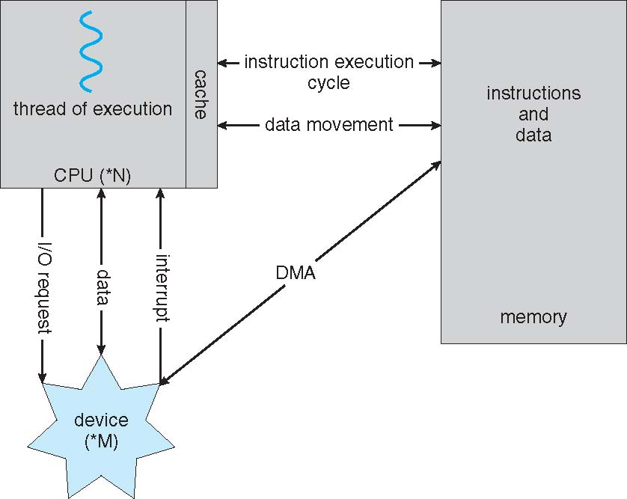
How a Modern Computer Works
A von Neumann architecture

Slide 41
Computer-System Architecture
Most systems contain a single general-purpose processor
Few systems contain special-purpose processors as well
Multiprocessors systems growing in use and importance
Also known as parallel systems, tightly-coupled systems
Advantages include:
Increased throughput- more work done in less time
Speed up ratio with N processor is not N
Overhead of keeping all component working correctly
Contention for shared resources
Economy of scale
Increased reliability – graceful degradation or fault tolerance
The ability of a system to maintain limited functionality even when a large portion of it has been destroyed or rendered inoperative

Slide 42
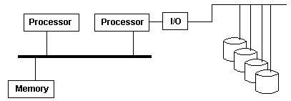
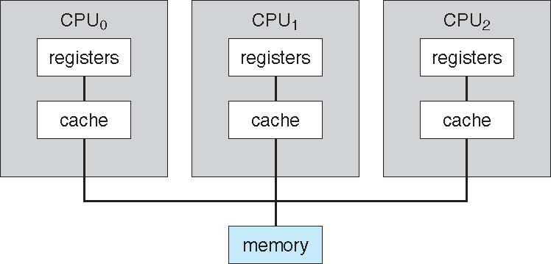
Computer-System Architecture
Multiprocessor systems are of two types:
Asymmetric Multiprocessing– each processor assigned a specific task
Master-slave relationship
The tasks are strictly divided by their types on processors
Typically, each processor has its own memory address space
These features make asymmetric multiprocessing difficult to implement.
Symmetric Multiprocessing (SMP)– each processor performs all tasks within the OS or they can do anything the others can.
All processor are peers
Contain own set of registers and private or local caches
Shared physical memory
Asymmetric multiprocessing; one processor doing all I/O
Symmetric multiprocessing

Slide 43
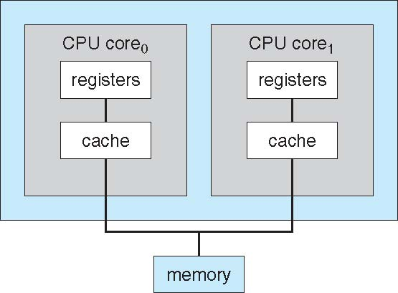
A Dual-Core Design
Cores- Multiprocessor chips
on-chip communication is faster
well suited for server (i.e., database, Web servers)
Multicore CPUs appear to the operating system as N standard processors
A dual-core design with two cores places on the same chip

Slide 44
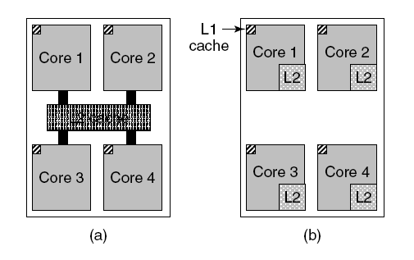
Multithreaded and Multicore Chips
(a) A quad-core chip with a shared L2 cache.
(b) A quad-core chip with separate L2 caches.

Slide 45
Clustered Systems
Another type of multiple-CPU system is clustered system
Usually sharing storage via a storage-area network (SAN)
Provides a high-availability service which survives failures
Asymmetric clustering; One machine in hot-standby mode while the other is running the applications
Symmetric clustering; multiple machines are running the applications as well as monitoring each other
Some clusters are for high-performance computing (HPC)
Applications must be written to use parallelization

Slide 46
Computing Environments - Traditional
Stand-alone general-purpose machines
But blurred as most systems interconnect with others (i.e., the Internet)
Network computers (thin clients) are like Web terminals
Mobile computers interconnect via wireless networks
Networking becoming ubiquitous – even home systems use firewalls to protect home computers from Internet attacks
Single User, single task OS (e.g., PDA and MS-DOS)
Single User, Multitasking OS (Microsoft's Windows and Apple's Mac OS)
Multiuser OS (Unix, VMS and mainframe operating systems)
Allows multiple users to use computer's resources simultaneously in a balanced manner, provided sufficient resources
Batch OS
No interaction of user with the computer directly. Job is prepared on an offline device like punch cards and submitted to the computer operator.

Slide 47
Computing Environments - Mobile
Mobile OS
Controls a mobile device and its design to supports wireless communication and mobile applications.
Has built-in support for mobile multimedia formats. Tablet PCs and smart phones run on mobile operating systems.
Allows new types of apps like augmented reality
Leaders are Apple iOS and Google Android

Slide 48
Computing Environments – Distributed
Distributed Computing
Collection of independent, possibly heterogeneous, systems networked together
Network is a communications path, TCP/IP most common
Local Area Network (LAN)
Wide Area Network (WAN)
Metropolitan Area Network (MAN)
Personal Area Network (PAN)
Distributed Operating System provides features between systems across network
Communication scheme allows systems to exchange messages
Computations are carried out on more than one machine
Illusion of a single system

Slide 49
Computing Environments – Client-Server
Client-Server Computing
Dumb terminals supplanted by smart PCs
Many systems now servers, responding to requests generated by clients
Compute-server system provides an interface to client to request services (i.e., database)
File-server system provides interface for clients to store and retrieve files

Slide 50
Computing Environments - Peer-to-Peer
Another model of distributed system
P2P does not distinguish clients and servers
Instead all nodes are considered peers
May each act as client, server or both
Node must join P2P network
Registers its service with central lookup service on network, or
Broadcast request for service and respond to requests for service via discovery protocol
Examples include Napster and Gnutella, Voice over IP (VoIP) such as Skype

Slide 51
Computing Environments - Virtualization
Allows operating systems to run applications within other OSes
Vast and growing industry
Emulation used when source CPU type different from target type (i.e. PowerPC to Intel x86)
Generally slowest method
When computer language not compiled to native code – Interpretation
Virtualization – OS natively compiled for CPU, running guest OSes also natively compiled
Consider VMware running WinXP guests, each running applications, all on native WinXP host OS
VMM (virtual machine Manager) provides virtualization services

Slide 52
Computing Environments - Virtualization
Use cases involve laptops and desktops running multiple OSes for exploration or compatibility
Apple laptop running Mac OS X host, Windows as a guest
Developing apps for multiple OSes without having multiple systems
QA testing applications without having multiple systems
Executing and managing compute environments within data centers
VMM can run natively, in which case they are also the host
There is no general-purpose host then (VMware ESX and Citrix XenServer)

Slide 53
Computing Environments – Cloud Computing
Delivers computing, storage, even apps as a service across a network
Logical extension of virtualization because it uses virtualization as the base for its functionality.
Amazon EC2 has thousands of servers, millions of virtual machines, petabytes of storage available across the Internet, pay based on usage
Many types
Public cloud – available via Internet to anyone willing to pay
Private cloud – run by a company for the company’s own use
Hybrid cloud – includes both public and private cloud components
Software as a Service (SaaS) – one or more applications available via the Internet (i.e., word processor)
Platform as a Service (PaaS) – software stack ready for application use via the Internet (i.e., a database server)
Infrastructure as a Service (IaaS) – servers or storage available over Internet (i.e., storage available for backup use)

Slide 54
Computing Environments – Cloud Computing
Cloud computing environments composed of traditional OSes, plus VMMs, plus cloud management tools
Internet connectivity requires security like firewalls
Load balancers spread traffic across multiple applications

Slide 55
Computing Environments – RTOS
Real-time embedded systems most prevalent form of computers
Vary considerable, special purpose, limited purpose OS, Real-Time OS (RTOS)
Used to control machinery, scientific instruments and industrial systems
Its use is expanding
Many other special computing environments as well
Some have OSes, some perform tasks without an OS
Very little user-interface capability, and no end-user utilities, since the system will be a "sealed box" when delivered for use (e. g., HDTV receiver and display)
Real-time OS has well-defined fixed time constraints
Processing must be done within constraint (must be quick)
Correct operation only if constraints met
Predictable response to events.

Slide 56
Open-Source Operating Systems
Operating systems made available in source-code format rather than just binary closed-source
Counter to the copy protection and Digital Rights Management (DRM) movement
Started by Free Software Foundation (FSF), which has “copyleft” GNU Public License (GPL)
Examples include GNU/Linux and BSD UNIX (including core of Mac OS X), and many more
Can use VMM like VMware Player (Free on Windows), Virtualbox (open source and free on many platforms - http://www.virtualbox.com)
Use to run guest operating systems for exploration

Slide 57
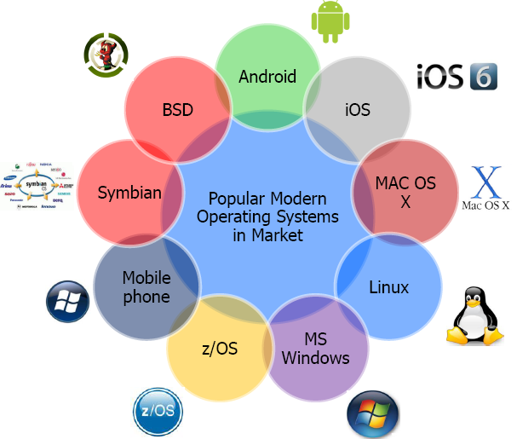
Available Operating Systems in the market
Notes:
Berkeley Software Distribution (BSD) is a Unix operating system derivative developed and distributed by the Computer Systems Research Group (CSRG) of the University of California, Berkeley, from 1977 to 1995.
Symbian was a mobile operating system (OS) and computing platform designed for smartphones.
z/OS is a 64-bit operating system for IBM mainframes, produced by IBM. It derives from and is the successor to OS/390, which in turn followed a string of MVS versions.

